Slide 1
Establishing Building Level Goals

Slide 2
How might your buildings set goals?
Fishbone analysis with intentional focus on district data point as the priority
Root cause analysis for the district goal and its connection to their building/work
Goal Writing Sheet
Priority Data Point
Quantitative and Qualitative Support
Root Cause Analysis
Current State → Desired State
SMART Goal

Slide 3
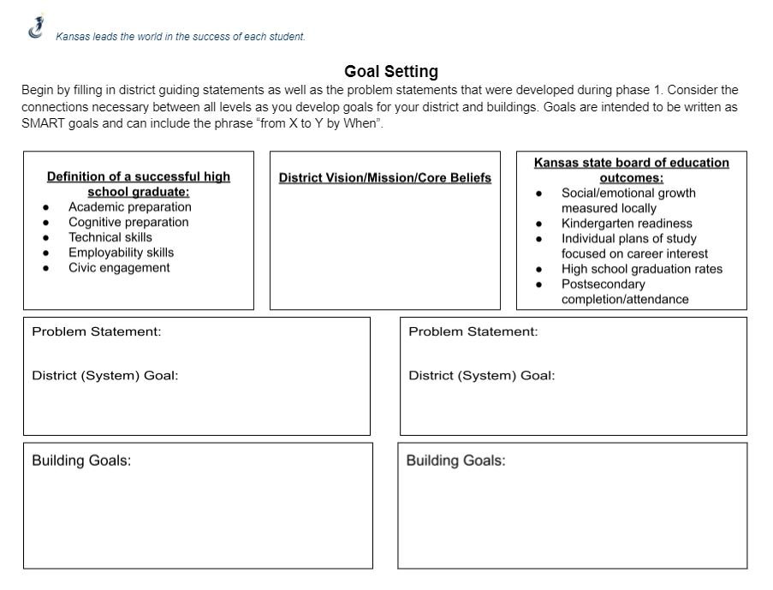
Notes:
This is just one way that you can organize your goals to show alignment between system and buildings.
Create the template that you need to successfully document and execute on your goals.

Slide 4
Supporting Buildings through the Goal Writing Process
Aligning ‘Up’
Building goals should align with the…
Building’s Mission, Vision, Values, Core Beliefs
Building Goals in KansaStar
District’s Goals
District’s Mission, Vision, Values, Core Beliefs
District Profile of a Graduate (if applicable)
Discuss
If your buildings meet all of their goals, would the district meet its goal?
Building-Level Goal Writing
Before defining future state, each building must determine their role in leveraging the district’s goals.
Once they know how they can help move the district goal forward, then they can determine what progress for them will need to look like (i.e. through their SMART Goal).
Remember, goals should always be based on data, and thus, they should always be measurable.
Notes:
Talk about yourdistrict strategic plan.
Be intentional about talking about 'other' goals that might exist within their system/building.

Slide 5
Examples
System - Post-Secondary Success
HS - # of internships
MS - # of career exploration
ES - % reading on grade level by grade 3
System - Academic Success (__% 3 & 4 on KAP)
Same District/Building OR
High School is struggling = Academic Goal pulled from System’s Elementary School is exceeding the goal = Focus on SEL to sustain and leverage cont. growth

Slide 6
Plan
Turnkey Planning-
What do you need to do with your buildings to help them create building goals aligned with your system-level goals?
Discussion for Existing Goals-
Ensuring Alignment- If your buildings meet all of their goals, would the district meet its goal?
What is your role in supporting the buildings efforts?
Are the goals SMART?
Are the goals benchmarks toward the future goal (desired state)? Or are the goals future state goals?
If your goal is future state, what are your benchmarks?
Do Building Goals address your gaps?
Notes:
If systems need to craft building goals, do what is on the left. If systems have building goals, they can discuss the questions on the right.

Slide 7
accreditation@ksde.org

