Slide 1
Drafting SMART Goals
Data Analysis → Setting Goals

Slide 2
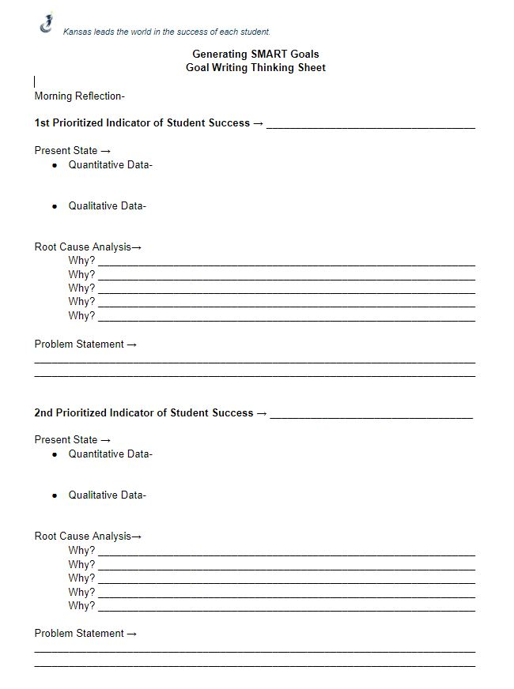
Review Work to Date
Snapshot-
Prioritized Data Point
Current State- Qualitative and Quantitative
Root Cause Analysis
Problem Statement
Why is this a problem for you?
What have you learned about your system since undergoing data analysis?

Slide 3
Defining Our Desired State

Slide 4
Notes:
Reorient to the State Board’s Vision - it is our Why.

Slide 5
{
Whole
Child
Notes:
This is our ‘portrait of a graduate’. You might have a district one that you work towards, or you might use this. Or, you might not have a ‘portrait of a graduate’ as part of their framework...but, you should always be thinking about this as part of their ‘outcome’ piece.

Slide 6
9 Dot Puzzle
Start the video and pause at :21 to attempt the 9 dot puzzle
After you have tried and discussed your efforts, resume the video.
When the video is done, discuss:
What unused space might exist?
What box/boundary have we unnecessarily imposed on our future state?
Notes:
Possible video for explore thinking outside the box. Stretch to create your desired state.

Slide 7
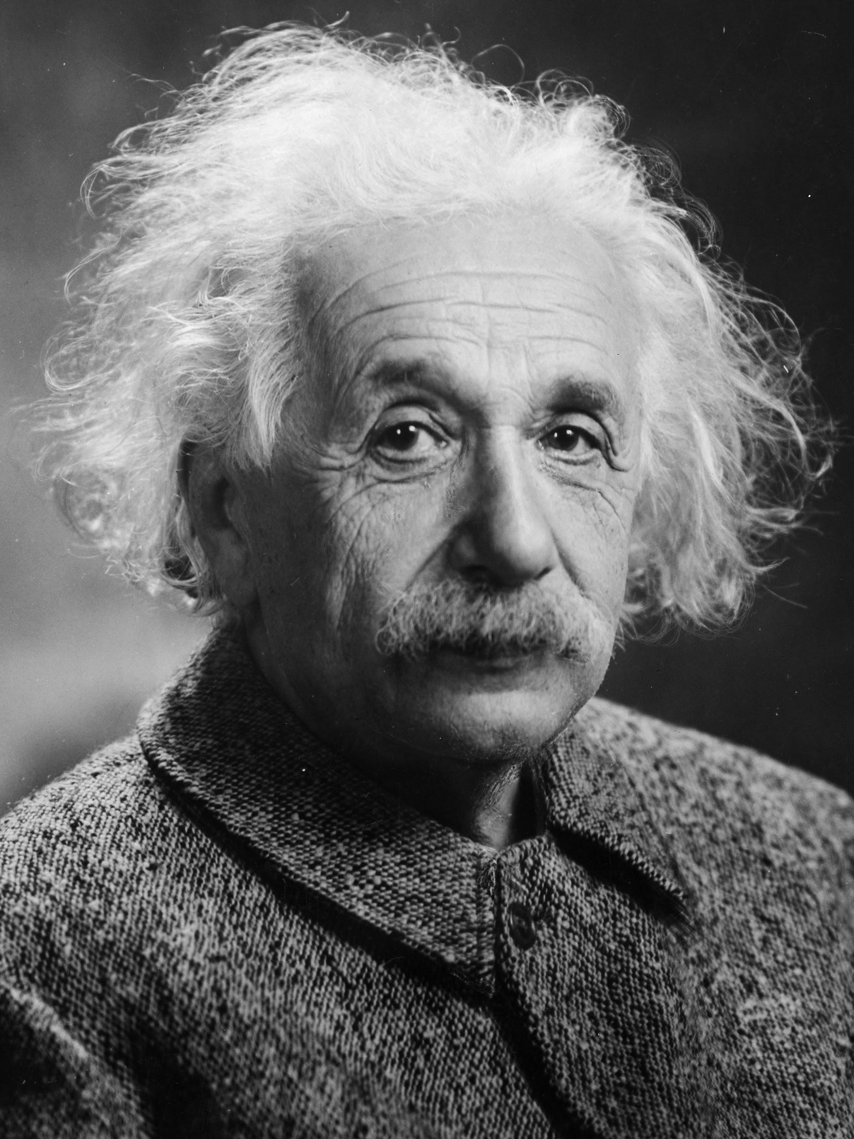
Define Your Future State
During phase 2 you will define a future state for each of your problem statements
“We can’t solve problems by using the same kind of thinking we used when we created them.”
Albert Einstein

Slide 8
Future State ≠ Wishful Thinking
Your future state balances need and realistic thinking to add up to positive transformation.
This must be challenging to be worthwhile, but it is only valuable if you can actually get there.

Slide 9
Team Discussion
Within your teams, discuss the future state you would like to achieve for each of your problem statements.
Document this future state on the goal organizer
Consider:
Is the future state attainable?
Is it challenging enough to be worthwhile?
Is it something that will drive us towards improvement?

Slide 10
Writing SMART Goals

Slide 11
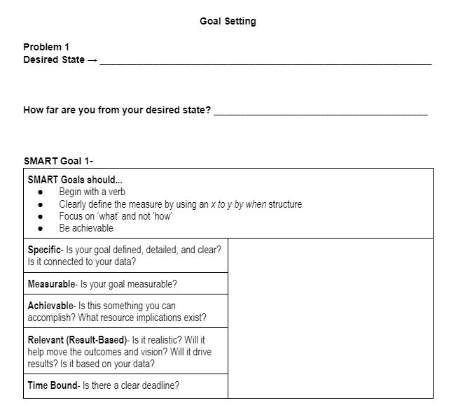
Draft SMART Goals
Define your desired/future state.
Answer- How far are you from your desired state?
Draft your goal. Goals should...
Begin with a verb
Clearly define the measure by using an x to y by when structure
Focus on ‘what’ and not ‘how’
Be achievable

Slide 12
Testing Your
SMART Goal
As you draft your Goals, you will want to test them against the following criteria:
Specific- Is your goal defined, detailed, and clear? Is it connected to your data?
Measurable- Is your goal measurable?
Achievable- Is this something you can accomplish? What resource implications exist?
Relevant (Results-Based)- Is it realistic? Will it help move the outcomes and vision? Will it drive results? Is it based on your data?
Time Bound- Is there a clear deadline?

Slide 13
Sample SMART Goal
By the 2023-2024 school year, 100% of sixth grade students (up from 70%) will meet typical growth identified by the MAP Assessment. At least 80% (up from 50%) of students will meet or exceed ‘proficient’ on the end of year MAP Assessment.
Specific | YES - Focused on mathematics achievement
Measurable | YES - Identified MAP assessment with x to y structure
Achievable | YES - Connects to work being done and tools already being used
Realistic (Result-Based) | YES - The percent gain is realistic in their time frame and tied to student achievement (results)
Time-Bound | YES - Clear deadline of 2023-2024

Slide 14
Draft SMART Goals for your District

Slide 15
Goal Writing Feedback
Notes:
KSDE

Slide 16
Ensuring Goal Alignment
Aligning ‘Up’-
District goals should align with the…
District’s Mission, Vision, Values, Core Beliefs
District Profile of a Graduate (if applicable)
State Definition of a Successful High School Graduate
State Board Outcomes
State Vision for Education
Questions to Consider-
Are there other things you need to consider that maybe you haven’t?
Will acting on this goal move you to your desired state?
When these goals are achieved, what will be the impact on the Kansans Can Vision of a successful high school graduate?
Notes:
Note-
Goals don’t have to hit each SBO & Def of Suc HS Grad
They will hit all of those in their day-to-day work
BUT, there will need to be a clear movement toward student achievement
Academics and ...

Slide 17
Reflection/Feedback on System Goal(s)
Discuss the following:
Why is this goal important (and more important than other possible goals)?
Will this goal lead to change? How do you know?
Is it clear enough to be accomplished?
Will this goal impact student success/improvement? How do you know?
Will this goal move the State Board Outcomes?

Slide 18
accreditation@ksde.org

