Slide 1
Senate Bill #109 Sec. 76
Safe and Secure Schools Unit

Slide 2
Initial Planning phase
Safe School Specialist break down requirements
Create Standards
Create Compliance criteria
Acceptable verbiage for educators
Internal review of standards and compliance criteria
Oct. 9th
Executive committee review of standards and compliance
criteria
Oct. 23rd

Slide 3
Initial Planning phase
Superintendents briefing
Nov. 14th
Final version to Deputy Commissioner to be reviewed and
approved by Board of Education
Nov. 20th
Approved by the Board of Education
Dec. 11th

Slide 4
Vetting Process
Internal
Executive Committee
Superintendents
Local Law Enforcement
County Emergency Management
School SRO’s/Police Depts.

Slide 5
Standards
1. Infrastructure Protection
2. Security Technology System
3. Interoperable Communication Matrix with Law Enforcement
and first responders
4. Communication network (outside of school)

Slide 6
Standards
5. Crisis Plan
The Crisis Plan is all‐hazard in nature addressing the four phases of emergency management (Mitigation, Preparedness, Response, and Recovery). The Crisis Plan is reviewed and updated on an annual basis. The Crisis Plan is developed by a school safety planning team, representative of essential school stakeholder’s, including local first responders. (see attached in guidance booklet)

Slide 7
Standards
6. Training and Exercises
7. Crisis Drill (4 –fire, 3-tornado (during tornado season) and 9-crisis drills)
8. Procedures for ensuring there is accountability for adopting and
implementing school safety and security plans in accordance with
standards adopted by BOE.
9. Firearm Safety Education Programs
K-5: Eddie Eagle gun safe program (NRA)
6-12: Hunters Education Program (KWPT)
Other evidence based programs

Slide 8
Training
Regional Workshops
Compliance to Standards
Creating, Maintaining and Implementing Crisis Plans
People rise or fall based on the level of their training. (Archilochus)
During a CRISIS (Emergency) one does not think or have anything but GROSS motor skills.

Slide 9
Every day is a “game day”
Mentally prepare for crisis’s
Physically prepare for crisis’s
Rural circumstances “Hold your own”

Slide 10
Mental Health
Key component in school safety.

Slide 11
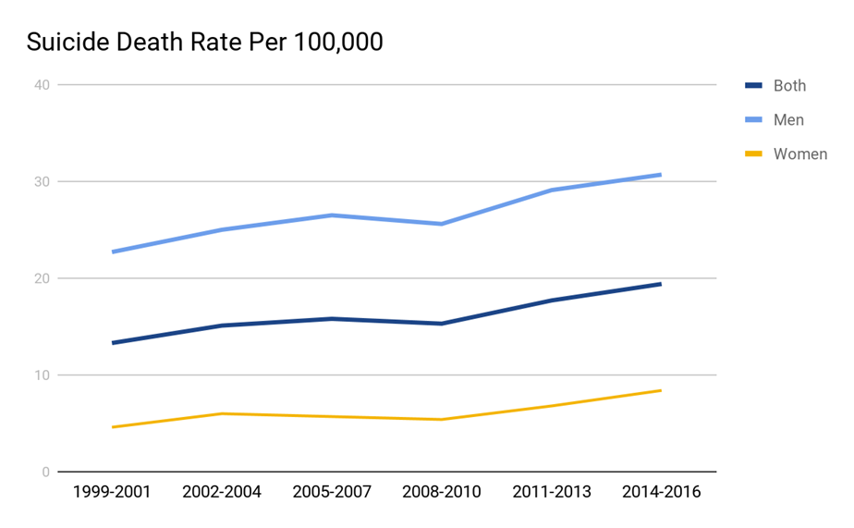
CDC report- Suicide Deaths across States
KS had the 5th largest increase in suicide deaths between 1999-2016 (45%)
54% of the suicide deaths investigated did not have a known mental health condition at the time of death
Other life stressors were contributing factors such as relationship problems, criminal/legal, housing loss or impending crisis

Slide 12
2018 Kansas Student-Reported Suicide Thoughts, Plans and Attempts

Slide 13
Suicide rate for Kansas
2nd leading cause of death for children ages 10-22 yrs old.

Slide 14
Cyberbullying
K.S.A. 72-8205
K.S.A. 72-8256….each school district shall adopt and implement a plan to address bullying while utilizing school property, in school vehicles, school sponsored events.
Cyberbullying in ANY FORM….bullying by use of an electronic communication devise through means including, but not limited to, e-mail, instant messaging, text messages, blogs, mobile phones, pager, online games and websites.

Slide 15
Chronic catastrophic mistakes
Parkland, FL, Feb. 2018
http://projects.sun-sentinel.com/2018/sfl-parkland-school-shooting-critical-moments/
NO Profile for an active shooter
Final Report of the Federal Commission on School Safety
https://www2.ed.gov/documents/school-safety/school-safety-report.pdf?utm_content=&utm_medium=email&utm_name=&utm_source=govdelivery&utm_term=

Slide 16
Common language
Use common language during crisis drills.
Approval of moving from active shooter to active assailant(s).
Rule of three (red flags)

Slide 17
Rules of 3
Red flag
Red flag
X
Tip of the spear…. CRISIS
Red flag
Red flag

Slide 18
Contact us:
Susan McMahan John Calvert
School Safety Specialist School Safety Specialist
(785) 296-4946 (785) 296-4946
smcmahan@ksde.org jcalvert@ksde.org
Safe and Secure Schools Unit
Mission Statement
To assist school districts by helping them build solid foundations of readiness, security and resiliency to withstand ALL-Hazards and anything man-made (intentional or unintentional).

