Slide 1
DLM training
2020

Slide 2
Objectives:
To understand the concept of Least Dangerous Assumption and the role it plays in Assessment Decisions
To understand the regulations around Alternate Assessments based on Alternate Academic Achievement Standards (AA-AAAS) and the 1% Threshold placed on the State
To understand who takes the Dynamic Learning Maps (DLM) Alternate Assessment
To understand what Kansas Data shows (risk factors/red flags)
.

Slide 3
Least Dangerous Assumption
Theory of Presuming Competence

Slide 4
Least Dangerous Assumption
Theory of Presuming Competence: Least Dangerous Assumption
“…in the absence of conclusive data, educational decisions ought to be based on assumptions which, if incorrect, will have the least dangerous effect on the likelihood that students will be able to function independently as adults. Furthermore, we should assume that poor performance is due to instructional inadequacy rather than to student deficits.”
– Anne Donnellan, 1984 as quoted by Cheryl Jorgensen, 2005
Notes:
If a student does not do well, the quality of the instruction should be questioned before the student’s ability to learn. When working with students with significant disabilities one should assume that they are competent and able to learn, because to do otherwise would result in harm (fewer educational opportunities, inferior literacy instruction, segregated education, and few choices as an adult)
Least Dangerous Assumption plays a role in least restrictive environment, assessment considerations, and assistive technology considerations
When we assume students with disabilities are not competent and able to learn from the general education curriculum, they often are not included in the general education classroom, people talk to them as if they are a much younger child, they are not supported to engage in social activities with same-age peers, and post-secondary education is geared toward lower-skilled jobs or workshops. Low expectations result in less focus on literacy or content learning. When we change our paradigm we promote student learning, inclusion, achievement, and quality of life now and in the future.

Slide 5
Least Dangerous Assumption
TIES Center: Tip #6 Using the Least Dangerous Assumption
in Educational Decisions

Slide 6
Kim
 | Scenario One | Scenario Two
Assumptions | She isn’t smart, sub-average intelligence and ability to learn | Treat her as smart, distrust validity of test results due to lack of communication and movement difficulties
Educational setting | Functional academics, speak in language more appropriate for younger child, functional skills, with other students with significant disabilities | Variety of methods to teach her to read, talk to her like any other teenager, enrolled in general academic classes, natural opportunities to teach functional skills
Communication support | Vocabulary and supports correspond to assessment of intellectual disabilities | Communication system includes words and concepts relating to current events, love, relationships, and her future
Friendships and dreams | Interactions with other students with disabilities, plan for moving into a group home and attend day program | Encourage friendships, participate in activities with classmates, postsecondary education addressed

Slide 7
Kim cont’d
 | Scenario One | Scenario Two
Brain scan results | IQ of 100 | IQ of 40
Has any harm been done? | Lost opportunity to teach her things she could have learned, missed social connections, missed high school experiences, low self-esteem, fewer possibilities for future career or post secondary education | Most say nothing has been lost, her education program offered her opportunities to develop life-long interest, to make friends, to be part of the social life of the school, to be part of the community after graduation, learned and generalized functional skills within the natural context of the day.
Modified from Cheryl Jorgensen article The Least Dangerous Assumption A Challenge to Create a New Paradigm

Slide 8
Least Dangerous assumption- points to ponder
Do all people have different talents and skills?
Is intelligence measured accurately and reliably enough to base students’ educational programs and future goals on test results?
Do children learn best when they feel valued, when people hold high expectations for them, and when they are taught and supported well?

Slide 9
3 Principles of the least dangerous assumption
If you are going to fail, fail because you believed in the student not because you placed an artificial limit on the student.
https://www.youtube.com/watch?v=1rIwA7C-vc8
Notes:
https://www.youtube.com/watch?v=1rIwA7C-vc8
If you are going to fail, fail because you believed in the student not because you placed an artificial limit on the student.
As educators we need to promote: presumption of competence and potential, have a growth mindset, and believe in the power of “YET”

Slide 10
The least dangerous assumption is to have high expectations for all students.
What if we assume students CAN learn, so we give them every opportunity, and it turns out the CAN”T?
What if we assume students CAN”T learn, so we don’t give them every opportunity, and it turns out they CAN?
VS

Slide 11
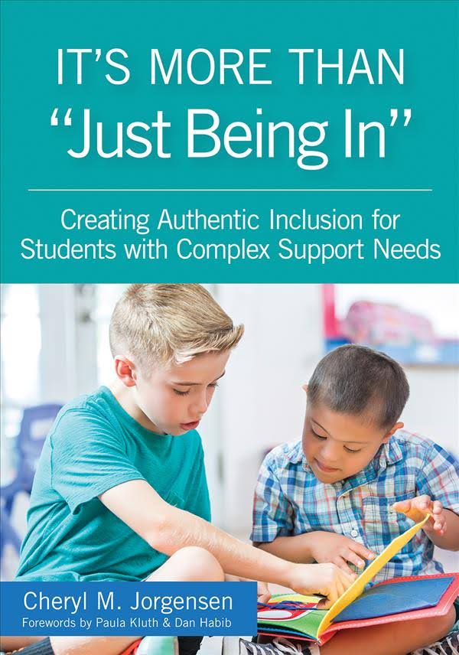
Flawed assumptions
Intelligence is something that can be reliably measured.
Students with intellectual disabilities cannot learn general education academic content……so there’s no benefit to being in general education classes.
The choice between a student being in general education or getting their needs met is an either/or situation.
Jorgenson, C.M.(2018). “It’s More Than ‘Just Being In’: Creating Authentic Inclusion for Students with Complex Support Needs.”

Slide 12
Improving Student Outcomes
Presuming
Competence
Least
Dangerous
Assumption
High
Expectations
Notes:
“The Case for Presuming Competence in Students with Significant Disabilities” describes three elements that work together to improve outcomes for all students, especially those with more complex needs.
Presuming competence means we assume that students are capable, and that we need to work to find ways to allow their capabilities to emerge.
High expectations means we don’t settle for the status quo when it comes to our students’ learning; instead we are intentional about setting ambitious yet reasonable goals for our students to work toward
Least dangerous assumption means making decisions about student learning that will ultimately cause the least harm to their ability to function independently as an adult.
Presuming competence is nothing less than a Hippocratic oath for educators. “First, do no harm” Douglas Biklen

Slide 13
Questions to Ponder
Notes:
WHO: Students with significant intellectual disabilities
WHAT: Meaningful access to academics, high expectations
WHEN: Lesson planning, instruction, IEP goals, assessment
WHERE: Least restrictive environment*
WHY: Least dangerous assumption
HOW: Focus on balance, and share responsibility

Slide 14
Alternate Assessment based on Alternate Academic Achievement Standards
1% Threshold
Notes:
When we talk about the Alternate Assessment we are referring to the Dynamic Learning Maps (DLM) The DLM is only intended for those students with a most significant disability. These are the students that are going to continue to need supports as adults. Many of these students are identified very young. Some are also untestable using standard IQ tests.

Slide 15
Every Student Succeeds Act (ESSA) - Enacted in 2016
Revision of the Elementary & Secondary Education Act of 1965
34 CFR 200.6 – Inclusion for all students
1.0 percent threshold is on the State
Not prohibit an LEA from assessing more than 1.0 percent of its assessed students in any subject for which assessments are administered under § 200.2(a)(1) with an alternate assessment aligned with alternate academic achievement standards.)
Require LEA must submit information justifying the need of the LEA to assess more than 1.0 percent of its assessed students in any such subject with an alternate assessment (Due to assessments being waived for the 2019-2020 school year, there will not be alternate assessment justifications this year)
Provide appropriate oversight , as determined by the State, of an LEA that is required to submit information to the State; and
Make the information submitted by an LEA publicly available, provided that such information does not reveal personally identifiable information about an individual student. http://www.ksde.org/Default.aspx?tabid=567
Notes:
34 CFR 200.6 Inclusion for all students indicates that a state must include students with disabilities in all assessments with appropriate accommodations. It permits students with the most significant cognitive disabilities to take an alternate assessment based on alternate academic achievement standards.
The 1.0 is a State threshold,
Justifications and assurances are required by all districts that test over 1.0% of their students using an alternate assessment or the Dynamic Learning Maps.
KSDE must provide oversight of districts. Oversite will include sharing red flag data with districts, DLM test observations. and technical assistance provided to districts identified due to percentage of students taking the DLM, trends in the percentage of students taking the DLM over 3 years, and red flag data.

Slide 16
1.0% Threshold Waiver

Slide 17
History
Kansas has consistently tested just over 1.0 percent of our students on the Alternate Assessment based on Alternate Academic Achievement Standards (AA-AAAS).
June 2019 – KSDE received an letter from the DOE requiring Kansas to submit a plan for coming into compliance with the 1.0 threshold. Plan was submitted July 24, 2019
KSDE submitted an AA-AAAS 1% threshold waiver request on August 22, 2019 – waiver was approved January 2, 2020
KSDE submitted an AA-AAAS 1% threshold waiver extension on June 2, 2020 – waiver extension was approved on August, 7, 2020
Notes:
2018-2019 ELA and math 1.15%, science 1.07% The Department of Education uses common rounding.

Slide 18
Requirements of the waiver extension
States must
Test at least 95% of all students and 95% of children with disabilities
The State must verify that each LEA that the State anticipates will assess more than 1.0 percent of its assessed students in any subject using an AA-AAAS complete assurances
Followed the State’s participation guidelines
Address any disproportionality in the percentage of students in any subgroup taking an AA-AAAS (districts will be required to complete assurances in December if they tested over 1.0 percent of students in any subject during the 2018-2019 school year)
Show substantial progress - based on enrollment and testing completed during the fall test window and the beginning of the spring test window, there was a decrease of 75 students in reading, 72 students in math, and 17 students in science

Slide 19
Moving Forward
Implement a tiered system of support
Universal
Targeted Technical Assistance
Intensive Technical

Slide 20
Student Information Sheet
Notes:
The student Information Sheet is required for all students enrolled in the DLM for districts identified for Targeted TA and Intensive TA.
KSDE/TASN staff will also be doing on-site file reviews based on these Student Information Sheets for districts receiving Intensive TA.

Slide 21
Dynamic Learning Maps (DLM)
Participation Guidelines
Notes:
Before a team decides to consider moving a student to the alternate assessment the IEP team should assume the student can learn grade level academic content and they should discuss what accommodations a student might need to assist them in learning grade level content.

Slide 22
Who are students with the most significant cognitive disability?
https://youtu.be/bZl6cjLAgZE

Slide 23
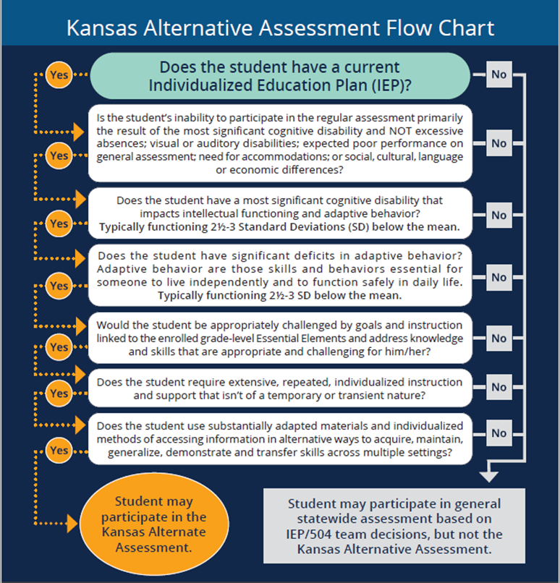
Kansas Alternate Assessment Flow Chart
The DLM is intended
for students with the
most significant
cognitive disability in the
state.

Slide 24
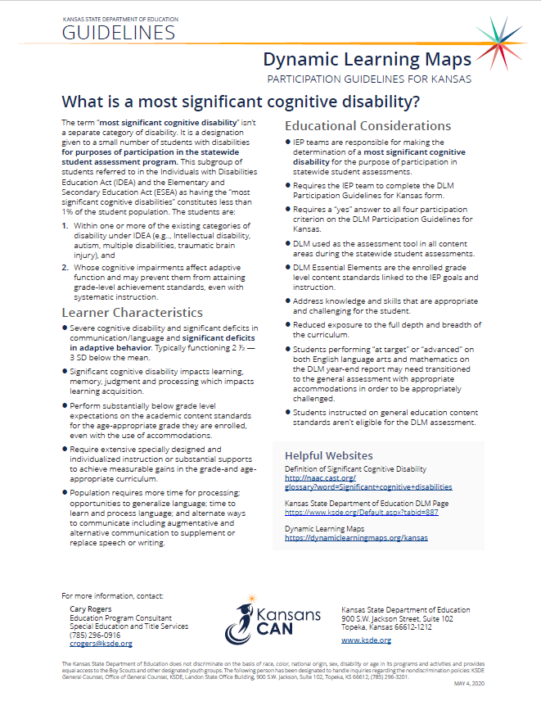
Dynamic Learning Maps Participation Guidelines for Kansas

Slide 25
Determination based on the student’s significant cognitive disability and not any of the following
A disability category or label
Poor attendance or extended absences
Native language/social/cultural or economic difference
Expected poor performance on the general education assessment
Academic and other services student receives
Educational environment or instructional setting
Percent of time receiving special education
English Language Learner (ELL) status
Low reading level/achievement level
Anticipated student’s disruptive behavior
Impact of student scores on accountability system
Administrator decision
Anticipated emotional duress
Need for accommodations (e.g., assistive technology/AAC) to participate in assessment process
Notes:
Team need to remember eligibility to participate in the DLM can not be determined based on any of these 14 reasons. This list is now at the top of the participation guidelines

Slide 26
Review of the eligibility criteria (continued)
The student has a most significant cognitive disability – review of student records indicate a disability or multiple disabilities that significantly impact intellectual functioning (typically functioning 2 ½ - 3 standard deviations below the mean)
Student must have a deficit in the student’s ability to plan, comprehend, and reason
While a student with only a specific learning disability, speech impairment, or emotional disturbance may have significant academic challenges, he or she has the intellectual potential to reach grade-level expectations. The description of specific learning disability, speech impairment, and emotional disturbance and the definition of significant cognitive disability present conflicting information.
Notes:
Significantly below the mean – 2.5-3 SD below the mean. A large number of students with a most significant cognitive disability are not able to achieve an IQ score due to being untestable.

Slide 27
Review of the eligibility criteria (continued)
The student has significant deficits in adaptive behavior – those skills and behaviors essential for someone to live independently and to function safely in daily life (typically functioning 2 ½-3 standard deviations below the mean)
Limit a student’s ability to apply social and practical skills such as personal care, social problem-solving skills, dressing and eating, using money, and other functional skills across life domains
It is unlikely to see these deficits in a student with a high incidence disability only, such as a specific learning disability, speech impairment, or emotional disturbance.
Notes:
2.5-3 SD below the mean If a student does not have significant deficits in adaptive behavior, they are not eligible to take the DLM.

Slide 28
Behavior: What’s the difference?
Maladaptive Behaviors
Adaptive Behaviors
(Life Skills)
A collection of skills people use to function in everyday life.
Examples:
Ritualistic behaviors
Self-injurious behaviors
Aggressive behaviors
Non-Attentive behaviors
Attention-seeking behaviors
Addictive behaviors
Behaviors which inhibit a person’s ability to adjust to different situations.
Examples:
Personal care skills
Independent living skills
Social skills
Communication
Self-direction
Slide Borrowed with permission from Arkansas Division of Elementary and Secondary Education
Notes:
The factors for students to be eligible to participate in the Alternate Assessment are two pronged. They must have a disability that significantly impacts intellectual functioning and an adaptive behavior deficit. The question then becomes, what is an adaptive behavior.
Adaptive behaviors are skills required to function in life, while maladaptive behaviors are actions which inhibit a person’s ability to adjust to different situations. The behaviors we are concerned with when determining participation in the alternate assessment are the adaptive behaviors. Can the student cook, manage a budget, do laundry?

Slide 29
Review of the eligibility criteria (continued)
The student is primarily being instructed or taught using the DLM Essential Elements as content standards – goals and instruction listed in the IEP for this student are linked to the enrolled grade level DLM Essential Elements and address knowledge and skills that are appropriate and challenging for this student.
Most likely requires teaching that includes hands-on materials, demonstrating concepts along with verbal directions, new tasks broken into small steps, prompting or shaping accurate performance, multiple opportunities and examples, and repeated student practice beyond disabled peers.
Usually perform significantly below grade-level proficiency (an elementary student may perform 3 or more grade levels below age appropriate peers, while a high school student may perform 7-9 grade levels below age appropriate peers.
Notes:
Not all students with ID or autism will meet this criteria.
If a 3rd grader is a beginning reader, they probably do not have a most significant cognitive disability. When considering the least dangerous assumption, one could say the student is capable of reading and learning and the student should continue to be exposed to the general education classroom and curriculum because to do otherwise would result in harm. Middle school and high school age students who are able to read with comprehension above the 3rd grade level probably do not have a most significant cognitive disability.
Risk factor data from the first contact survey shows
121 students reading with comprehension above the 3rd grade level,
297 students above the 2nd-3rd grade level, (13% read 2nd grade or above)
number of 3rd graders who were reading with comprehension up to the 1st grade level and even at the 1st-2nd grade level.
62 students who write paragraph length text without copying using writing. (2%)
64 students who multiply and divide using numerals with more than 80% accuracy. (2%)

Slide 30
Review of the eligibility criteria (continued)
The student requires extensive direct individualized instruction and substantial supports to achieve measurable gains in all grade-and age-appropriate curriculum.
a. Requires extensive, repeated, individualized instruction and support that is neither temporary nor limited to specific content areas.
b. Uses substantially adapted materials and individualized methods of accessing information in alternative ways to acquire, maintain, generalize, demonstrate and transfer skills across multiple settings.
IEP goals are both functional and academic in nature
Instruction appears very different from the instruction of their age-appropriate peers
Requires daily individualized instruction in every academic area that is on a substantially different level of rigor than peers with disabilities
Often requires an alternate curriculum, modified tasks, modified requirements, and frequent prompting that differs from his or her peers receiving special education services
Notes:
Students who spend more than 70% of their day in the general education classroom working on the general curriculum probably do not meet this criteria. Students need to have a most significant cognitive disability that affects all aspects of there life. All content areas and adaptive behavior.
2019-2020 67 students spending 80% or more of the day in regular education (2%)
10% of students taking the DLM in 2018-2019 performed in the advanced level on the ELA assessment
34% of students taking the DLM in 2018-2019 performed in at target on the ELA assessment
4% of students taking the DLM performed in the advanced level on the math assessment
12% of students taking the DLM performed at target on the math assessment
2% of students performed advanced on the science assessment
16% of students performed at target on the science assessment

Slide 31
Examples of students with a most significant cognitive disability.
https://youtu.be/wIkxLDUnWRA

Slide 32
My student no longer meets eligibility requirements for the DLM
IEP or IEP amendment must be done to remove the alternate assessment
Contact your district test coordinator to remove the student from the DLM and add the student to the KAP
We ask teams to take care of this in the fall before administering any DLM testlets if possible.
If a student has to be exited after beginning the DLM, that is fine. We want the right students taking the right test.
Discuss what accommodation the student needs in order to access grade level academic content.
Notes:
Requires prior written notice, does not require parent consent unless you are adding or removing a service or accommodation. If the student is going to need a new accommodation in order to take the general assessment it will require parental consent. Another thing to think about is if the IEP goals are aligned with the essential elements these should also be updated.

Slide 33
Rubric for determining student eligibility for the Kansas alternate assessment (DLM) for students with the most significant cognitive disabilities
Notes:
The Rubric for Determining Eligibility for the Kansas Alternate Assessment is another tool teams can use. This tool is very helpful when considering eligibility on those students that the team is struggling with answering the 4 questions from the participation guidelines. It provides more in-depth probing and questions to consider when determining if a student is appropriate for the alternate assessment.

Slide 34
Kansas Data

Slide 35
Statewide 1%
All Students -100 students
Students with Disabilities – 15 Students
Students with Significant Cognitive Disabilities - 3
Students with the Most Sig Cog Dis
1 student
Notes:
STATEWIDE - 1% - This includes all students in the state including students in residential facilities.
blue oval represents eligibility categories ID, Autism, MD, perhaps OHI.
red oval represents only those students with a most significant cognitive disability.
As you can see from this graphic there will be students with significant cognitive disabilities in the blue, students with ID or Autism, who will NOT meet the criteria for the alternate assessment.
Some districts won’t have any students who have the most significant cognitive disabilities.

Slide 36
LRE of Students Taking AA-AAAS 2018-2019
Notes:
6 students residential facility, 3 students homebound/hospital, 1 student parentally placed in private school all were less than 1% so they were left off the chart
The percentage of students that spend 40-79% of their day in the regular classroom and take an alternate assessment in Kansas is actually double the percentage identified in a study done this summer (24%).

Slide 37
Disability Categories Across All Tested Grades 2018-2019
Notes:
Kansas was very comparable to others states across the country when looking at the percentage of students in these three disability categories taking the alternate assessment.

Slide 38
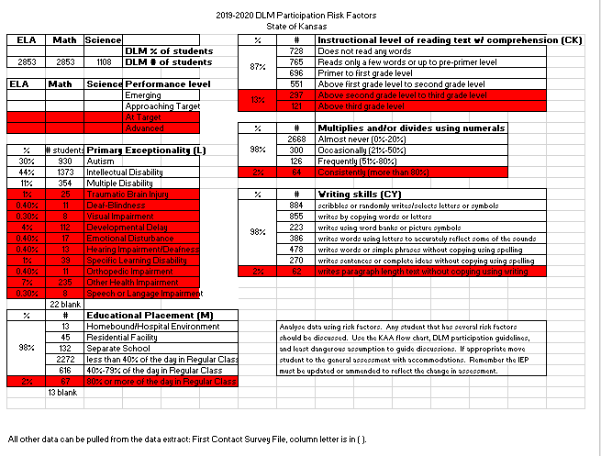
2019-2020 DLM Participation Risk Factor Data for Kansas
Notes:
The items shaded in red represent potential risk factors or red flags.

Slide 39
Resources

Slide 40
Resources
http://www.ksde.org/Default.aspx?tabid=887 (DLM page)
https://www.ksde.org/Default.aspx?tabid=407 (Assessment page)
https://dynamiclearningmaps.org/kansas
https://www.ksdetasn.org/
https://www.ksde.org/Teaching-Learning/Resources/Navigating-Change-Kansas-Guide-to-Learning-and-School-Safety-Operations
Navigating Change 2020 – Essential Elements Assessment Rubrics by grade band
Notes:
The resources created by KSDE will be located under supplemental resources on the DLM Kansas page.
KSDE DLM page –links to the DLM webinars and the recordings

Slide 41
Subscribe to KAA listserv
To sign up for KAA listserv, send this information: Subject line: KAA Listserv Body of message: Email address, First Name, Last Name, USD Number, USD Name, Send to this address: crogers@ksde.org

Slide 42
Contact Information
Cary Rogers Education Program Consultant Special Education and Title Services Team (785) 296-0916 crogers@ksde.org

