Slide 1
Kansas Blue Ribbon Bullying Task Force
Orion service center
may 28, 2019
Notes:
Good morning, thank you for the opportunity to share with you this morning

Slide 2
www.kctcdata.org
Notes:
How many of you have heard of the Kansas Communities That Care (KCTC) student survey
How many of you have used data from the website?
I would like to start with a video that provides some history of the survey, why it is important and how the data are used…

Slide 3
KCTC Survey Administration
Funded by Kansas Department for Aging and Disability Services, Behavioral Health Services
Based on prevention science from the University of Washington Social Development and Research Group
Available annually at no charge to all districts, public and private
Voluntary and anonymous
Available for paper & online administration
Target population is students in 6th, 8th, 10th, 12th grades
Notes:
To reiterate,
- The KCTC survey if funded by KDADS, Behavior Health Services and is offered annual at not cost to all schools in Kansas, both public and private .
- the survey was developed by Drs. Hawkins and Catalano from the University of Washington in the 1970s and is based on prevention science that focuses on reducing youth risk and promoting protective factors to buffer risk.
- The survey is voluntary and completely anonymous – there is no identifiable information collected on the survey and data are only reported at group level when there is a sample size of 20 or at least 25%.
State and county data are publicly available and district and building are password protected.
KCTC is the only consistent, standardized survey to provide annual, reliable LOCAL LEVEL data to schools and communities.

Slide 4
KCTC Participation 1995-2018
Notes:
This figure shows the participation rate from 1995- to present.
Highest participation was 99,167 in 2014
Does anyone know what happened here… (point to dip in 2015)

Slide 5
KCTC Participation 1995-2018
Notes:
2015 2016 2017 2018
37, 520 53,390 58,324 61,046
The drop was due to a change in legislation as the result of the passage of House Bill 2099 in 2015. This bill was passed to protect student data privacy. An unintended consequences was the inclusion of student surveys – I say it was unintended because KCTC does not collect any student specific identifiable information.
Schools have always notified parents of survey administration, but instead opting students out of survey participation, the legislative change required parents to opt their students in, which is a much different process and puts more burden on both schools and parents.
Schools were initially caught off guard by the change and weren’t prepared which is why we see such a large dip in 2015.
However, schools are learning to put the consent form in enrollment packets and as you can see, participation is bouncing back.

Slide 6
KCTC Participation
 | Overall Participation
School Year | # of USDs | # Private | # of Students
2013-2014 | 239 | 8 | 98,821
2014-2015 | 197 | 9 | 37,520
2015-2016 | 183 | 8 | 53,390
2016-2017 | 181 | 9 | 58,24
2017-2018 | 213 | 7 | 61,046
2018-2019 | 232 | 9 | >70,000
Notes:
The 2019 data will be coming out June 1st . Over 70,000 eligible students participated in the survey this year.
There were 232 school districts – in other words, 81% of all districts participated. In addition, 9 private schools participated
The KCTC also offers an optional four-question depression/suicide module – about 83% of participating districts also select to administer the optional mental health module which provides for the first time in Kansas, standardized local level mental health measure with state comparison!

Slide 7
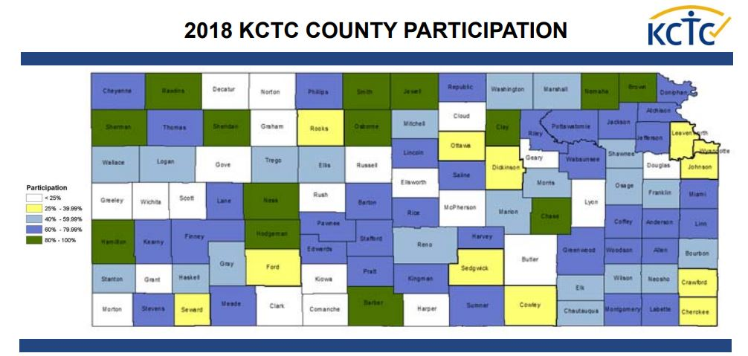
Notes:
This map shows partipation across the statea and you can see that it is well distribted.
Counties with 80% or higher participation are green, following by dark blue with 60% and so on. We anticipate the 2019 map to show even more counties with green and blue.

Slide 8
Notes:
When you click on the website, you will see the map of Kansas – you can select a county by clicking on it or you can select from a pull down menu at the top.
School Districts have a separate login on the top toolbar to login using their password to see building and district level data and comparisons

Slide 9
www.kctcdata.org
Notes:
When you click on a county or district, there are a number of buttons that show the four domains (school, community, peer/individual, and family). Any question related to these domains is contained within the button. Or you can select specific topic buttons related to substance use, or risk and protective factors.

Slide 10
Notes:
When you are on the website, you can compare county data to state data to see trends and to know if your values are higher or lower than the state average

Slide 11
State/County/District/Building Comparisons
Notes:
Similar, when a district or building login, you can compare building, to district, county, and state.

Slide 12
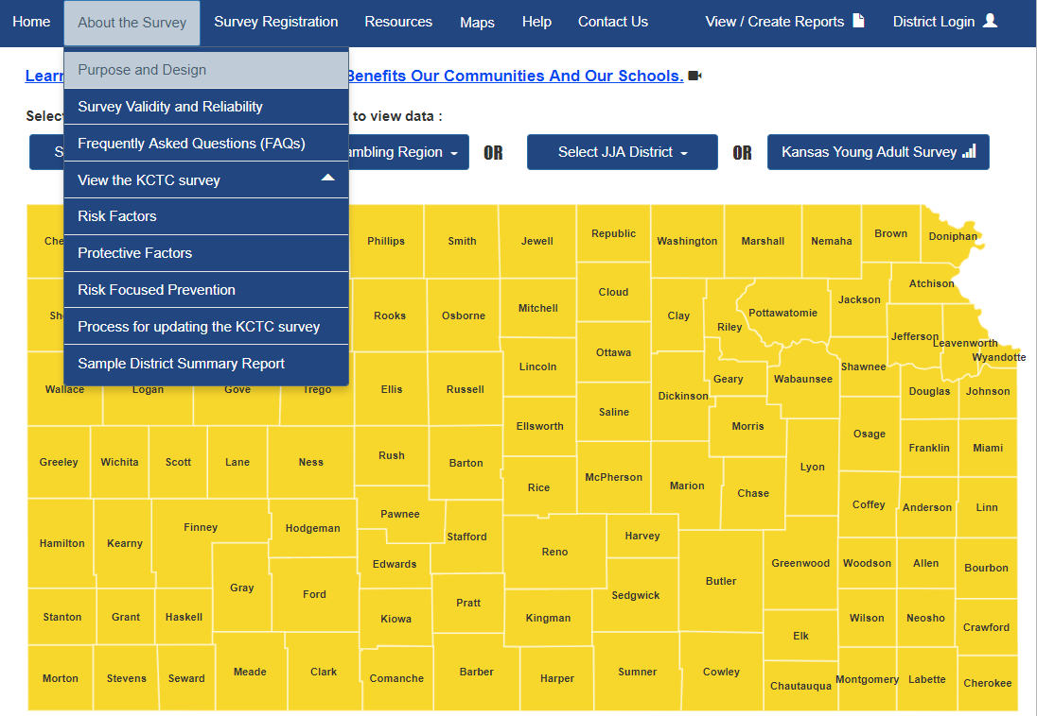
Notes:
The website also has valuable information and resources. For example on the “About the Survey” tab you can see the entire KCTC survey questions and format in both English and Spanish and you can also find information related to survey validity and reliability.
Survey registration forms and consent forms, fast facts, and other information are also found on the top toolbar.

Slide 13
Data Quality - Validity
Internal validity
Built in validity checks in the survey
Annually 3 - 5% deemed invalid
Content validity
Scales all show statistically significant relationships in the expected direction with outcome measures
External validity - representative data
Notes:
We are often asked about the validity and reliability of the survey.
There are several tests of INTERNAL validity built into the survey itself. Can identify response that are not honest of patterns that demosntrate lack of attention to the survey questions. Evidence of false reporting include:
-
Individual student surveys are identified and eliminated from the database if:
There is evidence is false reporting. One of the survey questions is “how honest were you in responding to the survey?” if a student reports that they were not honest at all, their survey is thrown out and not used.
Unrealistically frequent use of illicit drugs – for example if a student states that they have used 120 times in the past 30 days or have used all 4 drugs 40 or more times, their survey and all answers are not counted.
The survey asks about use of a fictitious drug. If any student reports using the drug, their survey data is not used.
CONTENT Risk and protective factor scales are correlated with problem behaviors in the expected direction such that risk factors are positively correlated with substance use and protective factors are negatively correlated with substance use.

Slide 14
Data Quality – Validity - Representativeness
Notes:
Comparing data from KSDE regarding grade enrollment (in red) with that percentage of students responding to the KCTC survey (in blue) and the Percentage of student surveyed with the Youth Risk Behavior Survey, or YRBS which is a statewide survey conducted every other year, you can see that the KCTC survey reflects that of the reported KSDE population well for each grade.

Slide 15
Data Quality - Validity
Notes:
Similarly for the distribution by gender – KCTC closely matches that of KSDE reported enrollment

Slide 16
Data Quality - Validity
Notes:
For race, this figure shows the percentage reported by race.
While KCTC shows a larger percentage of students identifying as white, this is likely a reflection of differences in the way race is asked or grouped by agency.
For example, KSDE reports Hispanic as a race whereas KCTC only has a Hispanic option under ethnicity question.
KSDE is parent-reported
KCTC self-reported

Slide 17
Data Quality - Validity
Notes:
And this shows, when looking at Hispanic as ethnicity, again, the KCTC accurately represents the KSDE reported percentage of students

Slide 18
Data Quality - Validity
Notes:
Finally, when looking at the distribution of students based on population density, looking at Kansas Department of Health and Environment density categories and the American Community Survey classification of counties, KCTC shows a slightly higher percentage of rural students than urban students, but is does a very nice job of representing the categories and reflecting the true population of students.

Slide 19
www.kctcdata.org
Notes:
Data on bullying can be found under the Problem Behaviors tab…

Slide 20
KCTC Bullying Questions
During this school year, how often have you seen someone being bullied?
During this school year, how often have you been bullied at school?
During the past 12 months, have you ever been electronically bullied? (Include being bullied through e-mail, chat rooms, instant messaging, websites, or texting).
During the past year, how often did you miss school because you felt unsafe, uncomfortable or nervous at school or on your way to or form school?
During the past school year, how often have you had your property stolen or deliberately damaged, such as your car, clothing, or books?
If you saw bullying at school, what would you do?
What do adults do at school when they see bullying?
Notes:
The survey asks for student responses to 7 questions related to bulling. These questions were Added to the survey in 2008
- How often have you seen someone being bulled
- How often have YOU been bullied at school
- Have you ever been electronically bullied? - Gives examples so students understand what that means
- Did you miss schools because you felt unsafe or nervous at school or on your way to or from school
- How you had property stolen or deliberately damaged?
- If you saw bullying at school what would you do?
- What do adults do at school when they see bullying?
With the exception of electronic bullying, the survey does not define bullying. While people may define it differently, the survey is measuring what the students perceive as bullying through their eyes and through their experiences.

Slide 21
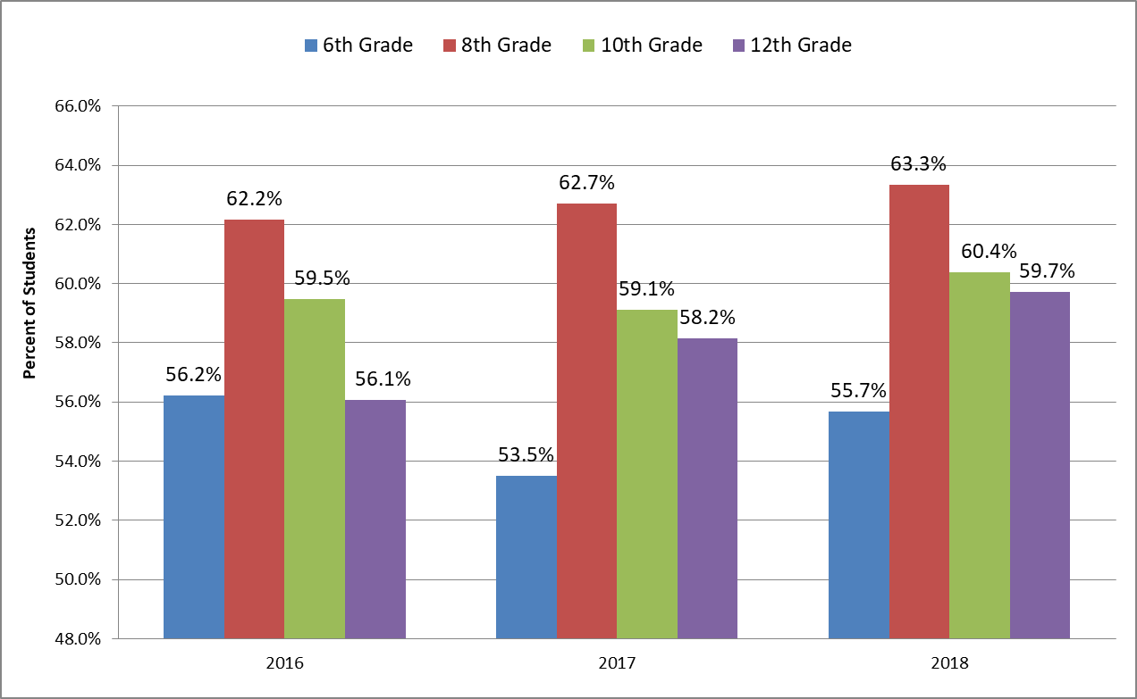
During this school year, how often have you seen someone being bullied?

Slide 22
During this school year, how often have you been bullied?

Slide 23
Electronic Bullying, Property Damage, Feeling Anxious or Unsafe

Slide 24
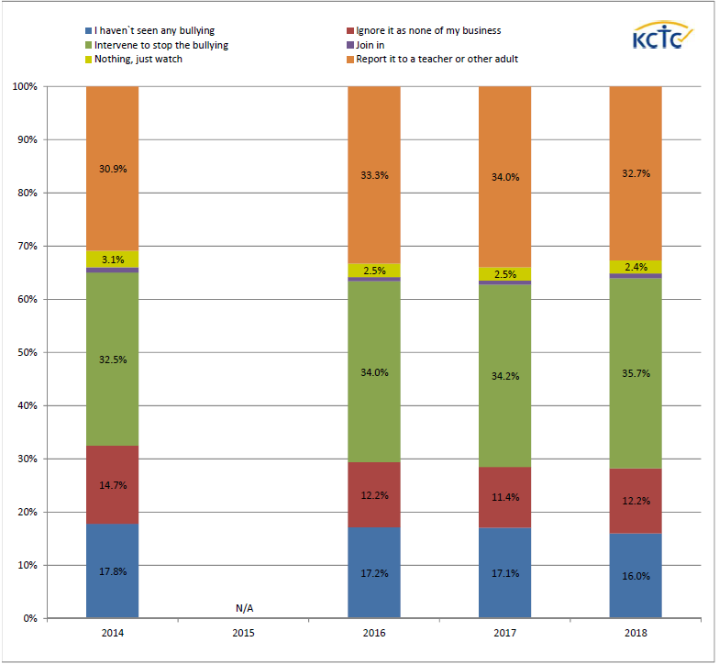
If you saw bullying at school, what would you do?

Slide 25
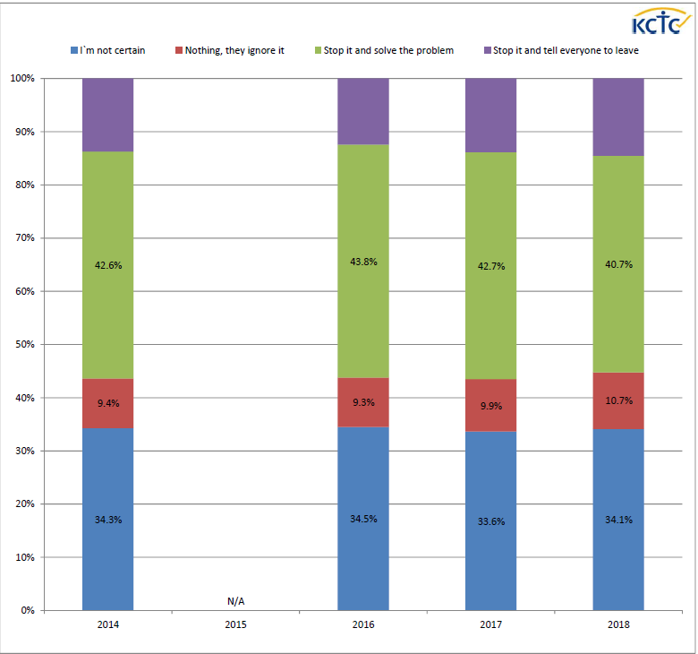
What do adults do at school when they see bullying?

Slide 26
Data-Based Decision Making
Magnitude
The number of people affected
Trend
How the data are changing over time
Impact
The depth of the problem(s)
Relative Ratio
How the data compares to state or national values
Notes:
Now that we know what the data are – what do we do with this information ?
What should we take into consideration to determine
Greenbush:
Explain that there are various criteria to consider in selecting which problem(s) to address. You will want to make sure you have data collected that allows you to examine the following criteria:
Magnitude – Which problem seems to be the largest?
Trend – Is the problem getting worse over time or is it getting better over time?
Impact –How severe is the problem?
Relative Ratio – How does the community’s problem compare to surrounding communities or the state?
Risk-focused prevention is based on a simple premise: To prevent a problem from happening, we need to identify the factors that increase the risk of that problem developing and then Data from the KCTC Youth Survey can be used to help school and community prevention planners identify current levels of problem behaviors and the precursors (risk and protective factors) to those behaviors. By focusing prevention efforts on identified precursors, prevention planners can implement specific types of interventions that have been effective in either reducing the identified risk(s) or enhancing the identified protection(s) and evaluate their effectiveness.
To help make essential decisions, schools and communities should consider the following:
Look for
• for levels of drug use or bullying which are increasing or unacceptably high and consider the Magnitude or the number of youth affected.
How do I decide if a number is unacceptable?
• Compare your data with county, statewide, and national data - differences of 5% between local and other data are probably significant. • Look at the your data over time, the trend - rates which have been steadily increasing are probably significant. •Determine the values held within your community - is it acceptable in your community for 75% of high school students to believe that it is easy to obtain alcohol (for example).
Also look at how the data compares to state or national values – is it higher or lower?
How do I decide which intervention(s) to employ?
• Programs should be selected based on the risk factors that are high in your school or community and the protective factors which are low. • Programs should be age appropriate and employed prior to the onset of the problem behavior.

Slide 27
Connections
ACES
Family
Attachment
Social Emotional Learning
Substance Use
Depression
Suicide
Notes:
Some of the things we are starting to do more now with the scope of KCTC data is look at connections between variables.
For example, we know that ACES and family attachment in early childhood are associated with substance use later in life. Similarly, research has shown the connection between depression and substance use. While we know these connections, it is good to be able to understand the data as it pertains to OUR students in Kansas.

Slide 28
Notes:
Second to family conflict, the strongest correlate of youth depression with KCTC data was being bullied at school.
This figure shows in blue the percentage of students that reported depression and in orange those that did not.
Along the bottom is the frequency in which they reported being bullied in school during the past year. – With the range being ‘never’, ‘sometimes’ ‘regularly’, and ‘every day’.
You would hope that the percentage of students reported being bullied would go down as reported frequency increased, which is what you see with the orange line for student who did not also report depression. 81% reported they had not been bullied in school during the past year, and the percentage decreases with frequ4ncy.
Notice the opposite trajectory with the students that DID report depression. Fewer reported never being bullied and over half reported being bullied ‘every day’
There is a huge 63 percentage point difference between student who reported depression and ‘never’ being bullied and those who did not report depression and ‘ever’ being bulled.
While we cannot say that being bullied CAUSES depression, or vice-versa, we CAN say that there is a positive correlation between the two. As one increases, the other also increase,
Three is some research that suggests that both victims and bullies are at highest risk for depression.

Slide 29
Kansas Vision for Education, KSDE
Notes:
Another area related to the topic today and the idea of making Connections between the data is that of Social Emotional Learning which is a focus of KSDE and schools as it relates to the new accreditation process.
Schools are using KCTC data to measure Social emotional earning and growth.
As you look a the 4 rubrics you can see that SEL is part of every single evidence-based practiced .
And as you look at what is collected with the KCTC data you see how nicely it aligns.

Slide 30
www.kctcdata.org
Notes:
The four KCTC domains – school, community, peer/individual an family look very much like that in the relationship rubric and contain data critical for student engagement and school climate.

Slide 31
KCTC Social Emotional Learning Report
Notes:
With the information, we created a report that aligned to the KSDE SEL standards for
Character development
Personal development
Social development
And a school climate scale.
This fall we will be sharing tailored District SEL reports with participating districts at no cost for the third year.
District will be able to compare each standard with their baseline values, monitoring trends if they are improving based on their targeted data and strategies implemented.
They will be also be able to compare their percentages to that of the state average.

Slide 32
District and Community Reports
School Districts
At a Glance Report
District Short Report
Depression/Suicide Report
Social Emotional Learning Report
Community Coalitions
KPCCI KCTC Community Report
County Behavioral Health Report
Notes:
In addition to the Social Emotional Learning report, participating schools receive an at a glance infographic, a district short report focusing on reported substance use and bullying, a and a depression/suicide report, if participation.
Community coalitions that are focusing on youth substance use and suicide prevention also use the KCTC data and receive county reports for planning and monitoring progress toward their objectives.

Slide 33
TASN MTSS Example
Notes:
MTSS trainers also work with the KCTC data to provide districts with instructional strategies to improve areas of identified need based on the data.
**** More here based on conversation with Christina Mann

Slide 34
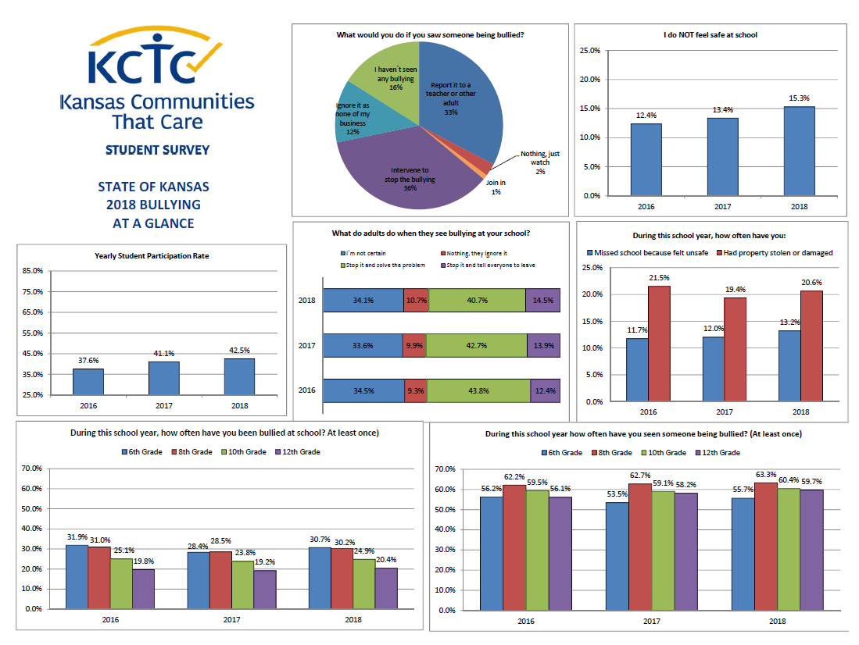
Notes:
I brought with me a state ‘at a glance’ report based on KCTC bullying data.
Participating districts receive a similar tailored district glance report based on common KCTC measure which makes it easy to review data needs and trends.

Slide 35
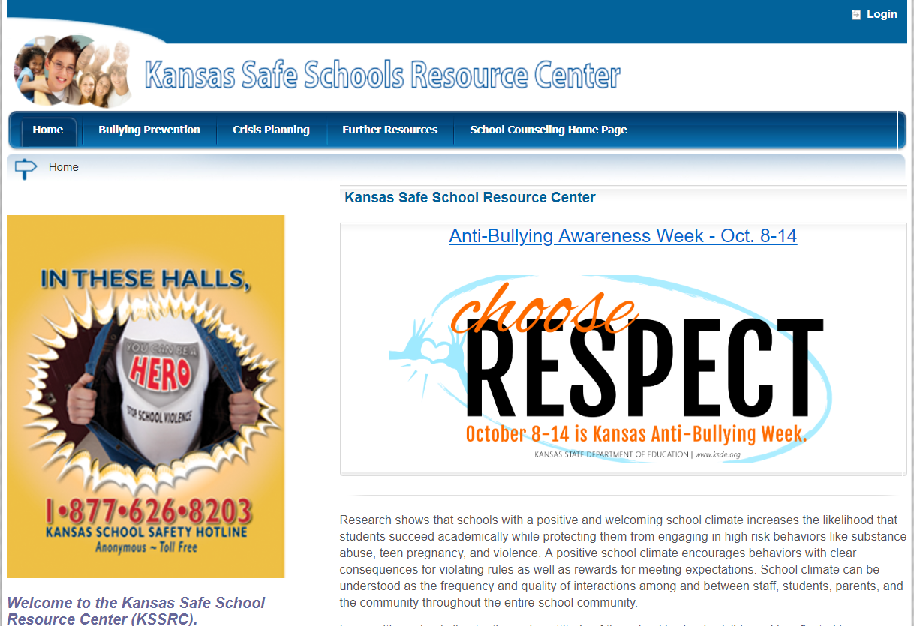
Kansas State Department of Education
Notes:
There are many resources available for bullying prevention including those on the KSDE website.

Slide 36
Recommendations
Encourage local level surveillance of student bullying behavior through KCTC Student Survey participation.
Maintain parent consent while removing burden of opt-in paperwork. Change legislation to opt-out consent for student participation.
Encourage use of data for local-level bullying prevention planning and monitoring to support outcomes.
Increase awareness by sharing local data with community stakeholders.
Notes:
With respect, we would like to issue the following recommendations to the task force:
First, schools should be encouraged to administer the KCTC student survey to gather data on student bullying perception and behavior.
Second, reduce the burden of data collection of anonymous surveys, while still maintaining parent choice, by working to change legislation to for opt-out instead of opt-in consent.
Three, encourage USE of data for local level bullying prevention planning and monitoring to support outcomes..
-- It is not enough just to collect the data, but we need to USE the data to guide decision making.
Finally, we need to increase awareness of the issue and concern, as well as progress and success, but SHARING data with stakeholders.

Slide 37
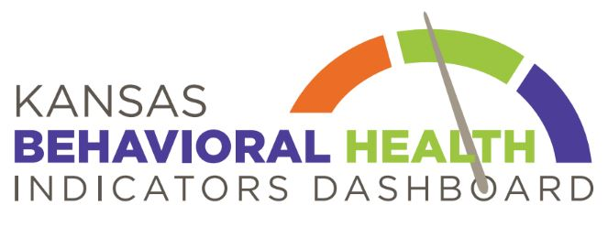
Nancy White
KCTC Survey Coordinator
Greenbush - The Southeast Kansas Education Service Center
Nancy.white@Greebush.org
620-724-6281
Notes:
Thank you for the opportunity to share this information and recommendation with the task force.
Are there are any questions?

