Slide 1
Kansas Leads the World in the Success of Each Student.
Kansas Teacher Fellows 2016

Slide 2


Slide 3

A NEW Vision for Kansas….
Kansas leads the world in the success of each student..
Notes:
Based on the feedback received across the state, the board has adopted as its new vision for education “Kansas leads the world in the success of each student.”
We intend to challenge the status quo, move away from placing emphasis on a single test score and focus more on helping each student identify and achieve their career aspirations.
Teachers, administrators and support staff already are doing great work preparing Kansas’ students for success, and this new vision stands to unite our efforts across the state. You will hear us say we need to rethink how our schools are asked to operate. From a state perspective, we will look at every requirement to determine if and how we are supporting or impeding our schools’ abilities to address the needs of each child.

Slide 4
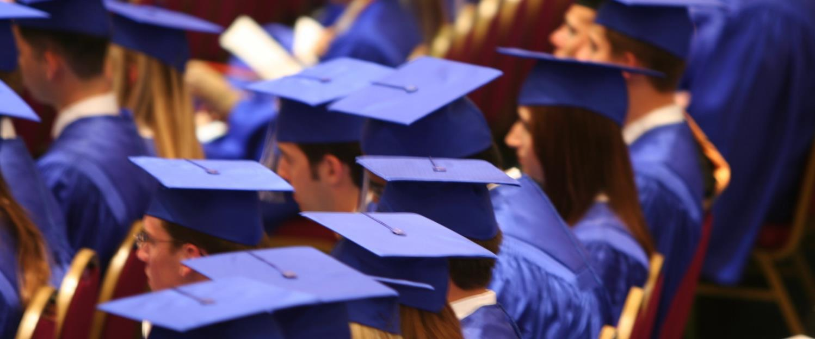
Defining Success
A Successful Kansas High School Graduate has the
Academic preparation,
Cognitive preparation,
Technical skills,
Employability skills and
Civic engagement
to be successful in postsecondary education, in the attainment of an industry recognized certification or in the workforce, without the need for remediation.
Notes:
The board has defined a “successful high school graduate” as having the academic preparation, cognitive preparation, technical skills, employability skills and civic engagement needed to be successful in postsecondary education, in the attainment of an industry recognized certification or in the workforce, without the need for remediation.

Slide 5

Creating a Vision for Kansas – State Outcomes
Kindergarten Readiness
Individual Plans of Study Focused on Career Interests
High School Graduation Rates
Postsecondary Completion/Attendance
Social/Emotional Growth Measured Locally
KANSAS STATE DEPARTMENT OF EDUCATION | www.ksde.org
Notes:
In order to measure our progress towards achieving the boards vision for education, the board has identified the following outcomes to be measured:
High School Graduation Rates
Post Secondary Completion/Attendance
Remedial Rate of Students Attending Post-Secondary
Kindergarten Readiness
Individual Plan of Study Focused on Career Interest
Social/Emotional Growth Measured Locally
Education Commissioner Randy Watson and members of the State Board of Education will meet with business, education and state leaders to build agreement on how we will work together to achieve this vision for Kansas education.
Kansas schools are already doing tremendous work to address the needs of individual students, but in order to achieve this new vision we cannot expect schools to go it alone. This requires a unified effort with businesses, communities, parents, higher education, and elected officials working with educators to help provide the supports and experiences Kansas students need for their future success.

Slide 6
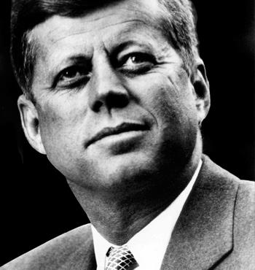
Creating a Vision for Kansas
“We choose to go to the moon in this decade and do the other things, not because they are easy, but because they are hard, because that goal will serve to organize and measure the best of our energies and skills, because that challenge is one that we are willing to accept, one we are unwilling to postpone, and one which we intend to win.”
- John F. Kennedy
Notes:
This new vision for Kansas education is our own moonshot. And just as President Kennedy said 50 years ago, we choose to do this not because it’s easy, but because it’s hard, because the goal will serve to organize and measure the best of our energies and skills, because the challenge is one that we are willing to accept, one we are unwilling to postpone, and one which we intend to win.

Slide 7

Notes:
We liken this phase of our education vision initiative to Project Mercury, which as you know was the United States' first man-in-space program. Project Mercury was charged with three specific goals:
- To orbit a manned spacecraft around Earth
- To investigate man's ability to function in space
- To recover both man and spacecraft safely
In our “Mercury” phase of the vision implementation, our goals are to
Identify the outcomes that will measure our success towards achieving the vision.
Define what the outcomes mean.
Identify how we intend to measure these outcomes.
This is what we will focus on today.

Slide 8
Achieving the Vision through Measurable Outcomes

Slide 9
Measurable Outcomes
Kindergarten Readiness
Individual Plans of Study Focused on Career Interests
High School Graduation Rates
Postsecondary Completion/Attendance
Social/Emotional Growth Measured Locally
Notes:
The Kansas State Board of Education has identified five outcomes that will be used to measure our progress towards achieving the vision that Kansas leads the world in the success of each student:
Kindergarten readiness
High school graduation rates
Individual Plans of Study based on career interests
Postsecondary attendance/completion
Social/emotional growth measured locally

Slide 10
Measurable Outcomes
Kindergarten Readiness
Individual Plans of Study Focused on Career Interests
High School Graduation Rates
Postsecondary Completion/Attendance
Social/Emotional Growth Measured Locally

Slide 11
Kindergarten Readiness
What
Early childhood experiences, birth to kindergarten entry, that ensure health and physical well-being and the development of cognitive, communication and social-emotional skills necessary for school success and have a direct influence on future success.
KANSAS STATE DEPARTMENT OF EDUCATION | www.ksde.org

Slide 13
Kindergarten Readiness Key Points
Measuring kindergarten readiness provides a snapshot of where children are upon entry to kindergarten.
Kindergarten readiness measurement will include at least language/literacy, math, and social emotional well-being areas of development.
Families and caregivers will be engaged in gathering information about their child’s development and early childhood experiences prior to kindergarten
The agency has assembled a work group comprised of school and early childhood stakeholders.
KANSAS STATE DEPARTMENT OF EDUCATION | www.ksde.org
Notes:
If you remember nothing else, please remember this: Screening for kindergarten readiness WON’T be used to keep a child from entering kindergarten, and it WON’T measure a teacher’s abilities, parenting skills, or programs. It will measure a kindergartener’s development in motor, literacy/ language, math and social-emotional,
A kindergarten readiness screener will provide educators with data to help determine where extra resources and supports should be delivered to students. It will be used to provide information to families, teachers and administrators about how many kindergarten students are developing at a rate that is appropriate for their age and where supports need to be provided if they aren’t developing at the same rates. This information will support data-driven decision making by school, district and state policy makers who can consider targeted ways to increase readiness.
Kindergarten readiness measurement will include at least language/literacy, math, and social emotional well-being areas of development.
Families and caregivers will be engaged in gathering information about their child’s development and early childhood experiences prior to kindergarten.
The agency has assembled a work group comprised of school and early childhood stakeholders.

Slide 14
Kindergarten Readiness Workgroup
Lori Adams, Teacher Licensure & Accreditation, KSDE
Amy Blosser, Early Childhood Director, Children’s Cabinet
Barbara Dayal, Part B, KSDE
Julie Ewing, English Learners & Title III, KSDE
Emily Fleming, Kindergarten Teacher Leader, KCK Public Schools
Beth Fultz, Career Standards and Assessments, KSDE
Kelly Jorgensen, Part C, KDHE
Tracie Kalic, Migrant Education GOSOSY Director
Kim Kennedy, Head Start Collaboration Office, DCF
Debbie Matthews, Dynamic Learning Maps, KSDE
Tammy Mitchell, Kindergarten Readiness & School Improvement, KSDE
Tony Moss, Assessment Data, KSDE
Chelie Nelson, Kansas MTSS
Janet Newton, Parents as Teachers, KSDE
Vera Stroup-Rentier, Early Childhood, KSDE, Chair
Alisha Walker, Elementary Special Education, Turner Public Schools
KANSAS STATE DEPARTMENT OF EDUCATION | www.ksde.org

Slide 15

Why Kindergarten Readiness?
Understand effectiveness of prior experiences
Inform most effective instruction
An important metric for communities – reflects system of care and early learning
Information about multiple aspects of a child’s learning and development
Critical for data driven decision making

Slide 16
Current Considerations
Selection of final commercial tool or development of a Kansas tool
Used during regular classroom activities
Based on families’ & teachers’ observations of children’s skills and abilities
Measures multiple domains and aligns with Kansas standards.
Can measure progress at multiple checkpoints throughout the year.
Aligns with tools already used in early childhood settings.
KANSAS STATE DEPARTMENT OF EDUCATION | www.ksde.org
Notes:
The Kindergarten Readiness Workgroup will use the following criteria to select or develop a tool to help measure the student’s readiness prior to entering kindergarten.
This tool may be used as a pilot during 2016-2017, must be used by 2017-2018.

Slide 17
Current Considerations cont.
Inter-rater reliability and validity to ensure fidelity.
Range of online and in-person training and supports available to teachers.
Appropriate for use with any developmentally appropriate curriculum.
Available in English and Spanish and culturally & linguistically appropriate.
Selection of final commercial tool or development of a Kansas tool
KANSAS STATE DEPARTMENT OF EDUCATION | www.ksde.org
Notes:
Based on what you know and what you are currently doing, what are your next steps?
What questions do you have as a district that you need answered?
What would this look like in your school?
What ideas do you have for implementing?

Slide 18
For More Information on
Kindergarten Readiness Contact:
Tammy Mitchell
Assistant Director
Early Childhood, Special Education and Title Services
(785) 296-7929
tmitchell@ksde.org

Slide 19
Measurable Outcomes
Kindergarten Readiness
Individual Plans of Study
High School Graduation Rates
Postsecondary Completion/Attendance
Social/Emotional Growth Measured Locally
KANSAS STATE DEPARTMENT OF EDUCATION | www.ksde.org
Notes:
The Kansas State Board of Education has identified five outcomes that will be used to measure our progress towards achieving the vision that Kansas leads the world in the success of each student:
Kindergarten readiness
High school graduation rates
Individual Plans of Study based on career interests
Postsecondary attendance/completion
Social/emotional growth measured locally
This is the one that keeps the commissioner up at night, because it will be amazing if done well or if it becomes a rote checklist it's going to crash and burn.
Key is to do for every student.

Slide 20
Individual Plans of Study
What
An Individual Plan of Study provides for a flexible career focus and an education plan that is clearly defined, rigorous and relevant in order to help students make a more informed decision about their path forward after high school graduation.
KANSAS STATE DEPARTMENT OF EDUCATION | www.ksde.org
Notes:
An IPS can help all Kansas students obtain a suitable vision of their path toward college and career readiness.

Slide 22
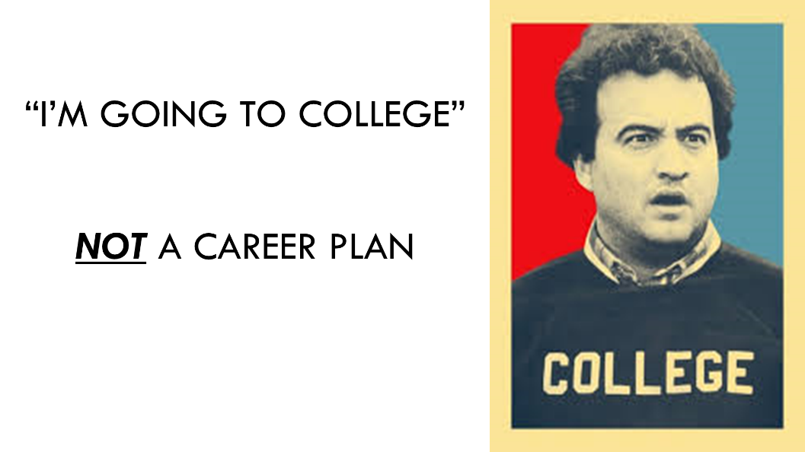
Why IPS?
KANSAS STATE DEPARTMENT OF EDUCATION | www.ksde.org
Notes:
When asked "what are your career plans?" most high schoolers will respond with "I'm going to college". College is not a career plan although some have tried to make college a career (Bluto).
Students and families need to move past thinking first of college and then a career. Students need to be encouraged to identify possible career interests and THEN think about the most efficient, relevant educational path (which may or may not involve "college") to enter into those careers.
Students need to know the 4 year university path is not the only ticket to the life they want to lead.
through an IPS, students and families can be educated on the different paths available to them, avoiding the "I'll figure it out as I go" approach to post-secondary life that befalls many of our students currently.

Slide 23
Why IPS?
Help students make informed decisions about career pursuits, minimizing the risk of lost time and lost money at a postsecondary institution.
Help students obtain a suitable vision of their path toward college and career readiness
Address the gap between the percentage of students enrolling and the percentage of students earning credit during their first year of enrollment in 2- and 4-year postsecondary institutions
KANSAS STATE DEPARTMENT OF EDUCATION | www.ksde.org
Notes:
Early planning for postsecondary pursuits increases the likelihood of the student being successful.
Beginning in middle school, schools should work with students and the students’ parents to develop individual plans of study focused on career interests. These are dynamic documents that should be reviewed with the student and parents twice a year and updated as needed. IPS is not intended to lock a student into a career path, but rather to help students explore areas of interest to better determine career interests and aptitude. Each IPS will include results of a series of career interest inventories, coursework aligned with the student’s educational and career goals, a general postsecondary plan and a comprehensive personal portfolio
An IPS can help address the gap between the percentage of students enrolling at postsecondary schools and the percentage of students completing a credential from two- and four-year postsecondary institutions.
Students must be exposed to a wide variety of career opportunities in order to find the area that best fulfills their passion and leverages their skill set.
An Individual Plan of Study provides for a flexible career focus and an education plan that is clearly defined, rigorous and relevant in order to help students make a more informed decision about their path forward after high school graduation.
An IPS can provide exploration of all forms of postsecondary education; help a student and their family members plan a more cost-effective education pathway, including dual-credit courses; and allow a student to select courses based upon his or her career interest.
An IPS isn’t a checklist. Developing and implementing an IPS is an ongoing process that should be reviewed and updated with the students and families at least twice per year.

Slide 24
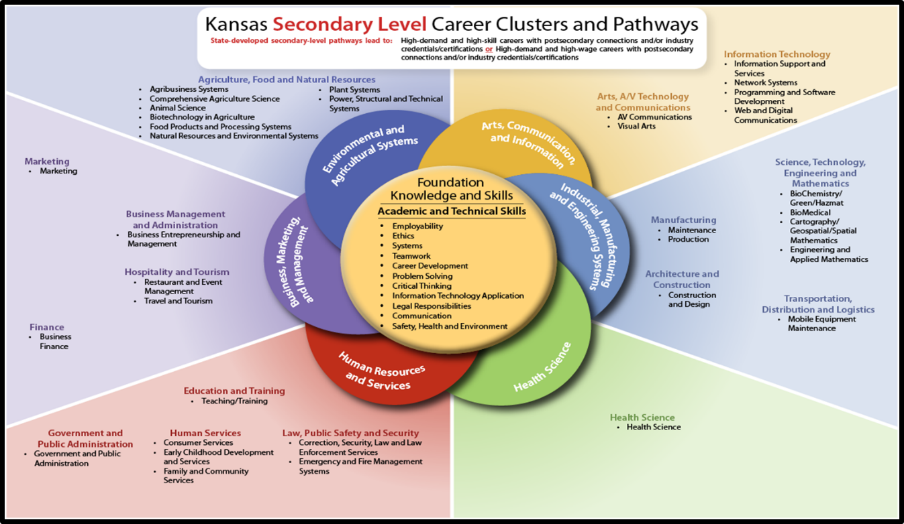
Notes:
Career Exploration
This isn’t about tracking students into careers or expecting them to select a career pathway while in HS,
It’s about students having a variety of life and career experiences while in HS to help them make better informed decisions
A K-12 approach to career education:
Elementary School: Career Exposure based on 6 Career FIELDS (Half-circles - Business, Marketing and Management; Environmental and Agricultural Systems; Arts, Communication and Information; Industrial, Manufacturing and Engineering Systems; Health Sciences; and Human Resources and Services.)
Middle School: Identify Career Interests aligned with 16 Career CLUSTERS (Colored Titles - Marketing; Finance; Business Management and Admin; Hospitality and Tourism; Agriculture, Food and Natural Resources; Arts, A/V Technology and Communications; Information Technology; Manufacturing; Architecture and Construction; Science, Technology, Engineering and Math; Transportation, Distribution and Logistics; Education and Training; Govt and Public Administration; Human Services; Law, Public Safety and Security.)
High School: Career Exploration through the 35 Career Pathways (Bulleted)

Slide 25
State Minimum IPS Components
8th – 12th Course builder function with course selections based on career interests
A general post-secondary plan (military, apprenticeship, 2-yr., 4-yr)
Portable electronic portfolio
A graduated series of strength finders & career interest inventories
KANSAS STATE DEPARTMENT OF EDUCATION | www.ksde.org
Notes:
State Minimum Components of an Individual Plan of Study :
1. A graduated series of strength finders & career interest inventories to help students identify preference toward career clusters:
Component 1 asks schools to use a graduated series of strength finders and interest inventories over time to help students identify their strengths, interests.
These results can help students guide their career exploration.
Middle Grades: Identifying Talents, Interests, Strengths and Learning Styles
High School: Career-focused Surveys and Ability Profilers
Postsecondary Options: Related careers
2. 8th – 12th Course builder function with course selections based on career interests
This component asks schools to use methods of course planning that align with cluster possibilities based on interest inventories and strength finders, and graduation tracking.
3. A general post-secondary plan (military, apprenticeship, 2-yr., 4-yr)
This component asks schools to take the secondary planning and extend it over the two years following high school graduation. This sample of a form also includes Post-Secondary and Career readiness activities at each grade level as well as testing opportunities at each grade level.
4. Portable electronic portfolio
The portfolio can house test scores, job shadowing Information, Internship information, classes taken, work samples, extra curricular activities like theatre, sports, science fair, choir, band and CTSO’s and a resume.

Slide 26
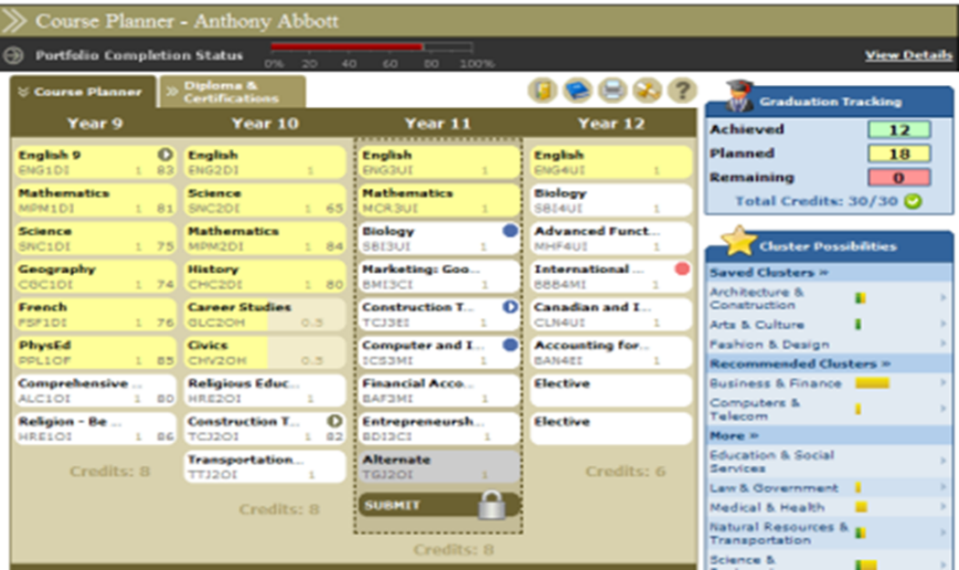
Sample System
KANSAS STATE DEPARTMENT OF EDUCATION | www.ksde.org
Notes:
This model comes from a vendor; however, a school can choose to capture this information however they see fit. You can see this model shows a four-year course planner, credits towards graduation, and alignment towards clusters.

Slide 27
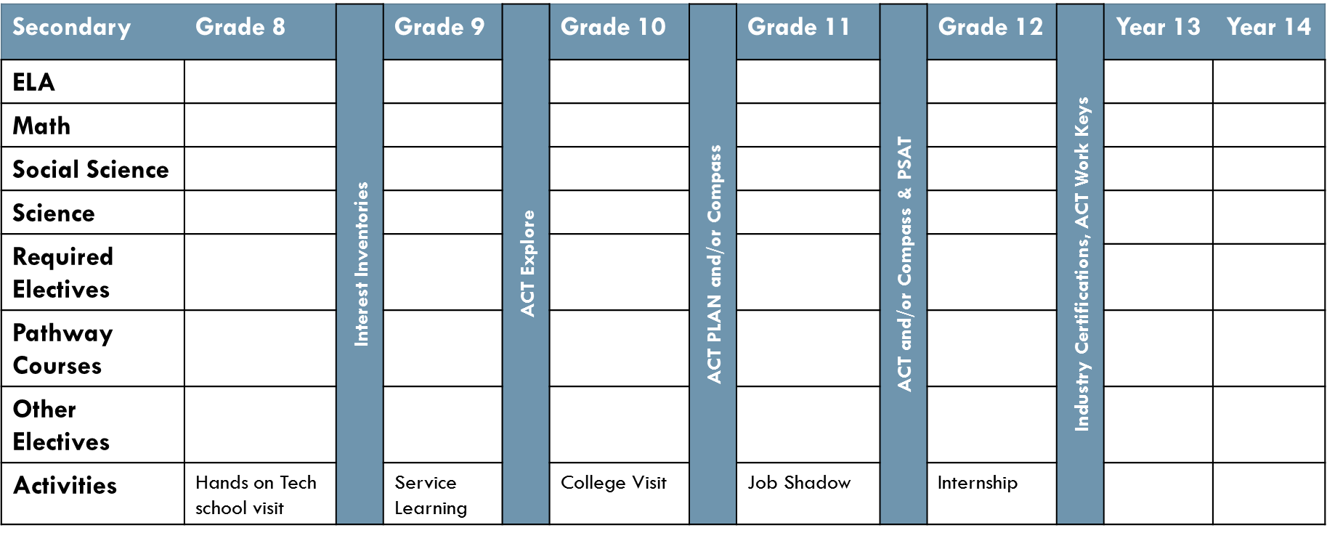
Sample System
KANSAS STATE DEPARTMENT OF EDUCATION | www.ksde.org
Notes:
This example shows secondary planning and how it extends over the two years following high school graduation. This sample of a form also includes Post-Secondary and Career readiness activities at each grade level as well as testing opportunities at each grade level.
KSDE is currently developing a State-Preferred IPS vendor list from which schools can select a vendor that best meets their needs.
Vendors will be required to meet minimum component requirements in order to ensure the product sold is of high quality.
Vendors will be required to meet specific, per-student subscription cost limitations
Schools who switch from a non-preferred vendor to a preferred vendor will be able to apply for a grant from KSDE/KBOR to offset start up costs.

Slide 28
Advising Models
Hybrid
Counselor Centered
Career Advisor System
Career Advocate
Notes:
In Ks., research indicates there are four advising models utilized in schools:
1) Counselor centered- the school counselor is responsible for implementation of the advising model and is the primary contact for students and families.
2) Career advisor system- this model utilizes staff members as advisors for students and families; the counselor acts as the model coordinator training staff and offering secondary support.
3) Career advocate- this model utilizes trained advocates that serve students and families in the advising process in addition to the school counseling program.
4) Hybrid approach
Determine what model works best for your schools.
In conjunction with principals & counselors, KSDE is developing sample career exploration activities at each grade level (6 – 12) and training for career advising.

Slide 29
Timeline
March 2016
June 2016
IPS state-preferred vendor list released
July 1, 2016 – Fall semester 2017
Perkins reserve funds available to schools for vendor start-up costs
IPS vendor RFP released
April 2016 – August 2017
Professional development focused on IPS software systems and IPS process
Notes:
March 2016 – RFP released
June 2016 – IPS state preferred vendor list released
July 1, 2016 through Fall semester 2017 – KSDE makes Perkins reserve funds available for start-up costs to middle and high schools wishing to contract with a state-preferred IPS vendor (eligible only if school is not currently under contract with a state-preferred vendor). Start-up costs will be available for middle and high schools prior to the 16-17 school year and the 17-18 school year.
April 2016 to August 2017 – Professional development focused on both IPS software systems and the IPS process (career advising)
By the 2017-2018 school year, every middle school and high school in Kansas will have an IPS product and process in place.
DISCUSSION
What questions do you have as a district that you need answered?
What would this look like in your school?
What ideas do you have for implementing?

Slide 30
For More Information on
Individual Plans of Study Contact:
Jay Scott
Assistant Director – Career & Technical Education
Career, Standards, & Assessment Services
(785) 296-4351
jscott@ksde.org

Slide 31
Measurable Outcomes
Kindergarten Readiness
Individual Plans of Study Focused on Career Interests
High School Graduation Rates
Postsecondary Completion/Attendance
Social/Emotional Growth Measured Locally
KANSAS STATE DEPARTMENT OF EDUCATION | www.ksde.org
Notes:
The Kansas State Board of Education has identified five outcomes that will be used to measure our progress towards achieving the vision that Kansas leads the world in the success of each student:
Kindergarten readiness
High school graduation rates
Individual Plans of Study based on career interests
Postsecondary attendance/completion
Social/emotional growth measured locally

Slide 32
High School Graduation Rates
What
Kansas’ 2014-2015 overall graduation rate was 85.7 percent.
Individuals without a high school degree qualify for only 17 percent of all jobs – primarily sales and office support, food and personal service and blue-collar jobs.
KANSAS STATE DEPARTMENT OF EDUCATION | www.ksde.org
Notes:
Kansas’ 2014-15 public school graduation rate was 85.7 percent. While this is above the national average, it isn’t enough.
We need to make sure every student graduates with the skills needed to be successful as they enter college or the workforce.
In order to meet the projected education requirements for our future workforce, it is imperative to increase the percent of students earning at least a high school diploma. To put it into perspective, according to the Georgetown Center on Education and the Workforce, individuals without a high school degree qualify for only 17 percent of all jobs – primarily sales and office support, food and personal service and blue-collar jobs.

Slide 34
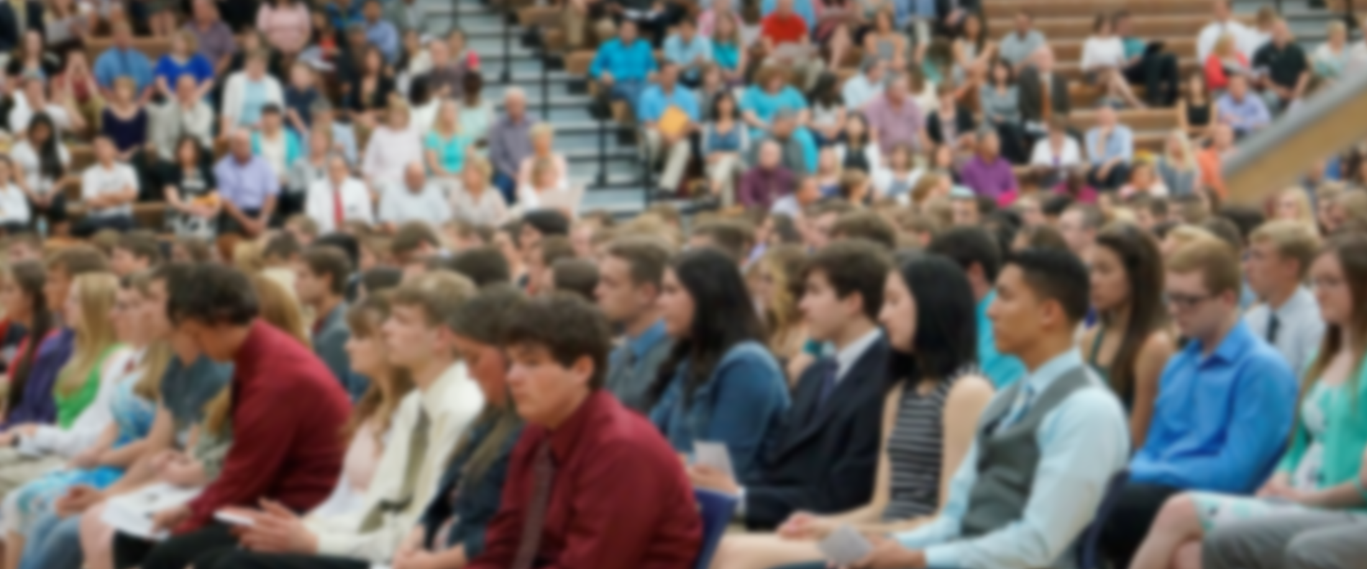
High School Graduation Goal
100%
Notes:
As a state, our ultimate goal is to graduate 100% of our students…but not just graduate 100%...graduate 100% with the skills needed to pursue and achieve their desired postsecondary goals.
It’s important to understand how graduation rates are calculated in Kansas.

Slide 35
High School Graduation Rates
Four-Year Adjusted Cohort
# of students who graduate in four years
with a regular high school diploma
# of students who entered high school
four years earlier (adjusting for transfers
in and out).
Notes:
Four-Year Adjusted Cohort
The number of students who graduate in four years with a regular high school diploma divided by the number of students who entered high school four years earlier (adjusting for transfers in and out).
In 2010, Kansas began using the four-year adjusted cohort graduation rate to calculate graduation rates. Previously, the Kansas graduation rate was calculated by dividing the number of graduates by the sum of the graduates plus dropouts for years one through four of high school. The four-year adjusted cohort graduation method actually provides a more accurate measurement of graduation rates because it tracks the movement of individual students.
The cohort begins with the incoming first-time ninth graders in a given year at a school or district. This cohort is continually adjusted: students who transfer into the school or district are added to the cohort, while students who transfer out of the school or district are removed from the cohort. It is important to note that students who drop out are not removed from a cohort. The cohort at the end of the four-yr time frame is called the “adjusted cohort” for the school or district, and the graduation rate for this cohort is defined as the percentage of students in the adjusted cohort who received a regular high school diploma.

Slide 36
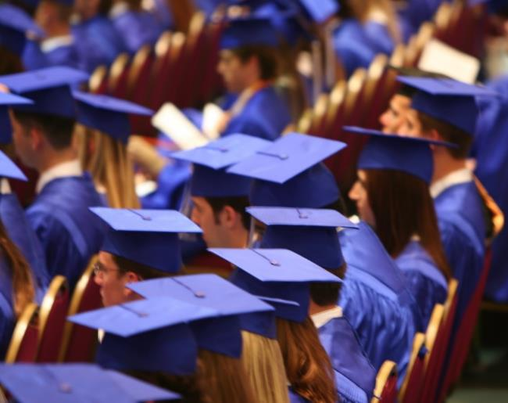
Understanding 4-Yr Cohort Graduation Rates
Students must graduate in four years.
Students must receive a regular high school diploma.
Students can only transfer out of the cohort with certain EXIT codes.
KANSAS STATE DEPARTMENT OF EDUCATION | www.ksde.org
Notes:
Key things to remember about the four-year cohort:
Students must graduate in four years
Students must receive a regular high school diploma
Students can only transfer out of the cohort with certain exit codes.
So let’s talk about what each of these requirements mean…

Slide 37


Students Must Graduate in Four Years
Student must receive diploma by
Oct 1 in the year they graduate.
Student who takes longer than four years to graduate is counted as a non-graduate in the four-year adjusted cohort graduation rate.
KANSAS STATE DEPARTMENT OF EDUCATION | www.ksde.org
Notes:
In order to be included in the four-year adjusted cohort graduation rate, a student must receive their diploma by Oct 1 (in the year they graduate).
Any student who takes longer than four years to graduate will be counted as a non-graduate in the four-year adjusted cohort graduation rate:
` There is an exception for students with disabilities who met the district graduation requirements for a regular high school diploma, but are remaining in school to receive transitional services deemed necessary by the IEP team
Use EXIT code 22 for students meeting this criteria so that they count as a graduate in the calculation

Slide 38
Students Must Receive Regular H.S. Diploma
A standard high school diploma awarded to students in a state that is fully aligned with the state’s academic content standards
Does not include a GED credential, certificate of attendance, or any alternative award.
Students who leave high school to attend an unaccredited private school or homeschool will count as non-graduates
KANSAS STATE DEPARTMENT OF EDUCATION | www.ksde.org
Notes:
A regular high school diploma means the standard high school diploma awarded to students in a state that is fully aligned with the state’s academic content standards
and
Does NOT include a GED credential, certificate of attendance, or any alternative award.
Students who leave high school to attend an unaccredited private school or homeschool will count as non-graduates because these schools are not required to be fully aligned with the state’s academic content standards.

Slide 39
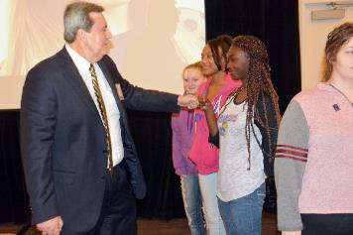
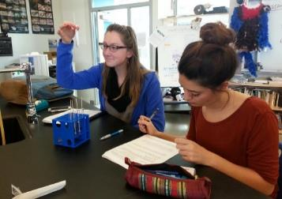
Students Can Only Transfer out of the Cohort with Certain EXIT Codes
Transfer to a public school in Kansas
Transfer to a public school in another state
Transfer to an accredited private school
Transfer to a juvenile correctional facility where educational services are provided
Moved to another country
Student death
Notes:
A student can transfer out of the cohort for the following reasons:
Transfer to a public school in Kansas
Transfer to a public school in another state
Transfer to an accredited private school
Transfer to a juvenile correctional facility where educational services are provided
Moved to another country
Student death
All other EXIT codes (except graduation) will count the student as a non-graduate.

Slide 40
High School Graduation Rates
fIVE-Year Adjusted Cohort
# of students who graduate in five years
with a regular high school diploma
# of students who entered high school
five years earlier (adjusting for transfers
in and out).
Notes:
Five-Year Adjusted Cohort
The number of students who graduate in five years with a regular high school diploma divided by the number of students who entered high school five years earlier (adjusting for transfers in and out).
NOTE: The five-year rate is a continuation of the prior year’s four-year rate. We have followed the cohort of students for an additional year.

Slide 41

Dropout Graduation Summary Report (DGSR)
The DGSR provides all schools and districts an opportunity to review and certify their dropout and graduation data are correct before submitting the report to KSDE.
The DGSR houses historical data as well and is a great resource for districts and schools to use to understand why some students didn’t graduate.
KANSAS STATE DEPARTMENT OF EDUCATION | www.ksde.org
Notes:
The Dropout Graduation Summary Report (DGSR) is a KSDE authenticated web application
Individuals who do not have access to KSDE authenticated web applications need to register: https://online.ksde.org/authentication/login.aspx
There are detailed instructions in the Kansas Graduation and Dropout Information Handbook

Slide 42
Questions to Ask
What are our known barriers to graduation?
What supports do we offer?
What supports do we need to offer?
Who are our potential partners?
What does the data tell us about our dropouts and non-graduates?
KANSAS STATE DEPARTMENT OF EDUCATION | www.ksde.org
Notes:
So in order to get to 100%, we have to understand the landscape of our own districts.
What are the barriers to graduation we see?
What supports do we offer?
DISCUSSION
What questions do you have as a district that you need answered?
What does your data tell you?
What would this look like in your school?
What ideas do you have for implementing?
What supports do we need to offer?
Who are our potential partners?

Slide 43
For More Information on
Improving Graduation Rate Contact:
Jessica Noble
Education Program Consultant
Teacher Licensure and Accreditation
(785) 296-3163
jnoble@ksde.org

Slide 44
Measurable Outcomes
Kindergarten Readiness
Individual Plans of Study Focused on Career Interests
High School Graduation Rates
Postsecondary Completion/Attendance
Social/Emotional Growth Measured Locally
KANSAS STATE DEPARTMENT OF EDUCATION | www.ksde.org

Slide 45
Postsecondary Attendance/Completion
What
With the labor market constantly trending toward a higher set of skills, students will need to pursue higher levels of postsecondary education/training in order to remain competitive for jobs.
KANSAS STATE DEPARTMENT OF EDUCATION | www.ksde.org

Slide 47
Student Success
Kansas needs 71% of workers to have a post secondary certificate or degree
Approximately 36% need to be bachelor degrees or higher
Approximately 35% need to have a certificate or associate degree
KANSAS STATE DEPARTMENT OF EDUCATION | www.ksde.org
Notes:
According to research conducted by the Georgetown Center on Education and the Workforce, by the year 2020, 65% of the nation’s jobs will require some sort of postsecondary education. In Kansas, that number increases to 71%.
Not every career requires a four-year degree. Technical colleges, community colleges, the military, etc. all play a critical role in preparing student for the workforce.
Research shows that most new jobs or job openings will be “middle skill” jobs – those requiring a diploma, but less than a four-year degree.

Slide 48
Postsecondary Evidence
Notes:
2011 selected because 92% of Kansas students were proficient on KS Assessments for Reading and Math, yet the rates of enrollment/retention/remediation did not change. 2011 peak year of NCLB

Slide 49
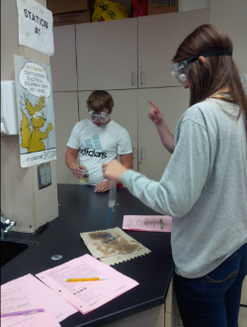
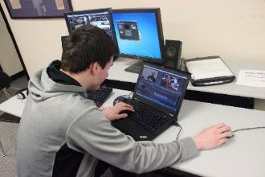
Possible Postsecondary Indicators – Meet One
Meet all four college and career indicators on the ACT
Earn an Industry Recognized Certification in high school or in the first semester post high school
Passing 4 Advanced Placement classes and scoring a "3" or higher on the AP exam for each course
Earn 12 college credit hours in high school or in the first semester post high school
Complete an IB course of study and score a "5" on the exit exam
Enlist in the military post high school and complete basic training
KANSAS STATE DEPARTMENT OF EDUCATION | www.ksde.org
Notes:
KSDE has assembled a postsecondary workgroup, which is currently working to develop indicators.
Current considerations include:
Meet all four college and career indicators on the ACT
Earn an Industry Recognized Certification in high school or in the first semester post high school
Passing 4 Advanced Placement classes and scoring a "3" or higher on the AP exam for each course
Earn 12 college credit hours in high school or in the first semester post high school
Complete an IB course of study and score a "5" on the exit exam
Enlist in the military post high school and complete basic training
DISCUSSION
What questions do you have as a district about these indicators that you need answered?
What would these indicators look like in your school?
What ideas do you have for postsecondary indicators?

Slide 50
For More Information on
Improving Post Secondary Completion Contact:
Scott Smith, PhD
Director
Career, Standards & Assessment Services
785-296-4639
sesmith@ksde.org

Slide 51
Measurable Outcomes
Kindergarten Readiness
Individual Plans of Study Focused on Career Interests
High School Graduation Rates
Postsecondary Completion/Attendance
Social/Emotional Growth Measured Locally
KANSAS STATE DEPARTMENT OF EDUCATION | www.ksde.org
Notes:
The Kansas State Board of Education has identified five outcomes that will be used to measure our progress towards achieving the vision that Kansas leads the world in the success of each student:
Kindergarten readiness
High school graduation rates
Individual Plans of Study based on career interests
Postsecondary attendance/completion
Social/emotional growth measured locally

Slide 52
Social/Emotional Growth Measured Locally
What
Social/emotional learning is the process through which students and adults acquire the knowledge, attitudes and skills necessary to:
Understand and manage emotions
Set and achieve positive goals
Feel and show empathy for others
Establish and maintain positive relationships
Make responsible decisions
KANSAS STATE DEPARTMENT OF EDUCATION | www.ksde.org
Notes:
Social/emotional learning is the process through which students and adults acquire the knowledge, attitudes and skills necessary to:
Understand and manage emotions
Set and achieve positive goals
Feel and show empathy for others
Establish and maintain positive relationships
Make responsible decisions

Slide 54
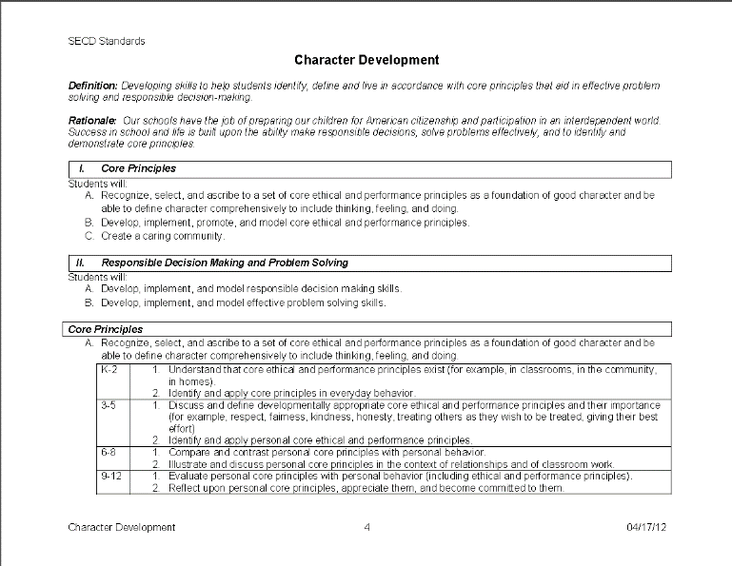
Standards
Kansas was the first state to adopt Social, Emotional and Character Development standards.
The standards were adopted in 2012
Access the standards here:
  http://www.ksde.org/Teaching-Learning
Notes:
Kansas was the first state to adopt Social, Emotional and Character Development standards.
The standards were adopted in 2012
Research shows schools that incorporate social, emotional and character development have more student engagement, decreased suspensions and improved academic scors.

Slide 55
Indicators
Attitude and behavior (perception data; KAN-DIS)
Attendance and program completion (KIDS data)
Bullying prevention (bullying data collected)
Character development (perception data)
School-based mental health (referral data)
Climate/student management (KAN-DIS)
Prevention data (prevention curriculum outcome data)
Volunteerism/service learning (number of students involved)
Notes:
So how do you measure social, emotional growth?
First of all, the Kansas State Board of Education believes this is something to be measured locally.
There are several indicators already in play. Chancers are good you’re already addressing many of these indicators:
Attitude and behavior (perception data; KAN-DIS)
Attendance and program completion (KIDS data)
Bullying prevention (bullying data collected)
Character development (perception data)
School-based mental health (referral data)
Volunteerism/service learning (number of students involved)
Climate/student management (KAN-DIS)
Prevention data (prevention curriculum outcome data)
DISCUSSION
What questions do you have as a district that you need answered?
What would this look like in your school?
What ideas do you have for implementing?

Slide 56
For More Information on
Improving Social/Emotional/Character Outcomes Contact:
Kent Reed
School Climate/Culture and Integration Specialist
Career Standards and Assessments
(785) 296-8109 kreed@ksde.org

Slide 57
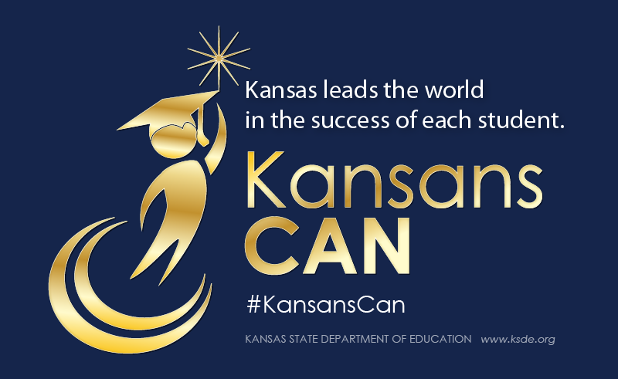
Notes:
Today’s students are the future workforce and future leaders of Kansas. Kansans Can achieve anything and, together, Kansans Can lead the world in the success of each student.

