Slide 1
Next Generation Science Standards and Implementation: A Look at How Districts are Changing
Shawnee Heights Usd 450’s journey into the next generation science standards

Slide 2
USD 450 Curriculum process

Slide 3
Curriculum Team Learning Phases
Review the work from last committee – 5E lesson plan and science learning through inquiry
Dive into the ngss – http://nextgenscience.org
Partnership with Patricia Lucido, ph.D, director and cofounder of Targeted Connections (www.targeted-connections.com)
Training on Engineering Design in the classroom
Training on content of NGSS

Slide 4
Nextgenscience.org
Background
Development
The why
implementation

Slide 6
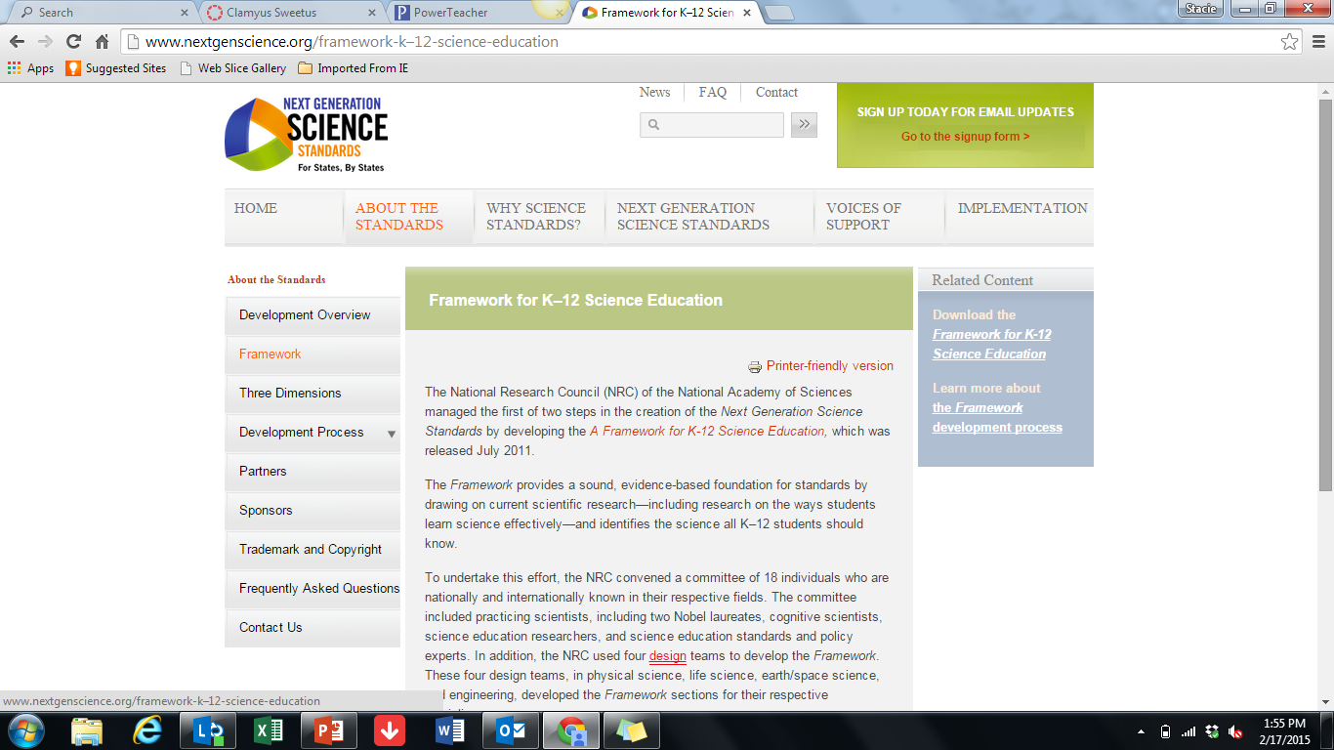

Slide 7
Three dimensions

Slide 10
All standards all students
Making the Next Generation Science Standards Accessible to All Students
economically disadvantaged students
students from major racial and ethnic groups
students with disabilities
students with limited English proficiency
Girls
students in alternative education programs
gifted and talented students

Slide 11
Engineering design
“Providing students a foundation in engineering design allows them to better engage in and aspire to solve the major societal and environmental challenges they will face in the decades ahead”
A. Defining and delimiting engineering
B. Designing solutions to engineering problems
C. Optimizing the design solution

Slide 12
Model Course Mapping in Middle and High School for the Next Generation Science Standards
A. Conceptual Progressions Model (6–8) and (9–12) (Course Map Model 1)
B. Science Domains Model (6–8) and (9–12) (Course Map Model 2)
C. Modified Science Domains Model (9–12) (Course Map Model 3)

Slide 13
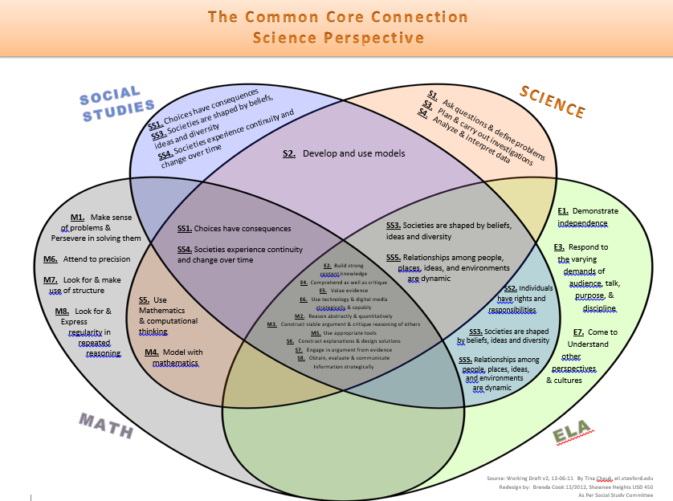

Slide 14
The standards
View the NGSS in Disciplinary Core Idea (DCI) Arrangements
Discipline core idea- Physical, Life, Earth, Engineering
View the NGSS in Topic Arrangements
Topic- interdependence, Reactions, forces
View and Search the NGSS performance expectations individually

Slide 15
Kindergarten Science Eight Essentials
What do plants and animals need to survive?
Basic needs
Use of environment
2. What natural resources we use every day?
3. What can I do to take care of our natural resources?
1. Impact of land, water and air
2. Reduce use of natural resources
3. Recognize local natural resources and conservations
4. How do pushes and pulls make things move in different ways?
5. How can I use tools or objects to change the speed of an object?
6. How does the sun effect my world?
1. Warmth
2. Light
7. How can I protect myself from the sun?
1. Build a structure for shelter
2. Clothing/sunscreen
8. How can I be safe in dangerous weather?
1. Local concerns
2. Using forecasting and watching weather

Slide 16
First Grade Science Essential Questions
How do animals grow and survive in the world?
Use body parts to see, hear, grasp, protect, feed, move
Young animals are like, but not exactly like, their parents
How do animals meet their needs?
How do animals parents help their babies live and grow?
How do animals use their senses to survive?
Do humans learn to solve problems by observing animals?
How do plants grow, live and survive in the world?
Plants use their parts to live and grow
Plants of the same type still have some differences ( e.g., slight difference from one sunflower plant to another)
How do plant parts help plants grow? What is the plant life cycle?
Do all plants have the same needs? Will plants keep growing if their environment changes?
Where does light come from and can I control it?
Objects can only be seen when illuminated (natural and/or man-made)
Materials conduct light differently
Can I create light? Can I make light do what I want it to do?
How can different materials effect how we use of light? Can I use light to communicate?

Slide 17
4. Where does sound come from and how can I create it?
1.Sound is created by vibration
What happens to objects when they make sounds?
Can I find different ways to use sound to communicate?
5. What are some objects in the sky and do they move?
1. Describe sun, moon and star patterns
2. Relate time of year to daylight hours
3. Why are days longer in summer and shorter in winter? (Connect to student)
4. Do objects in the sky have patterns?
6. How do I explore science in my life?
1. Observations, communicating, investigations, design models, research, design solutions, determine patterns
How can I find answers to questions? Can I always solve problems the same way?
What do I do when I can’t find an answer right away?
7. How do I use science in my life?
1. Inferring, creating, interpreting, exploring, applying science concepts
Do I use science every day? How do I know I’m using science?
Can science be part of PE and music? Can science make my world better?

Slide 18
Second Grade Science Essential Questions
Physical Science (Structure and Properties of Matter)
How can I describe and classify objects? 2PS1-1
color/texture/hardness/flexibility
How can temperature change objects? 2PS1-4
heating/cooling/reversible or irreversible change
construct an argument with evidence
Life Science (Interdependent Relationships in Ecosystems)
What do plants need to grow? 2LS2-1
investigation variables include sunlight and water
How do animals disperse seed and pollinate plants? 2LS2-2
create model
Why do plants and animals live in different habitats? 2LS4-1
observe plants and animals to compare diversity of life in different habitats
Earth and Space Science (Processes that Shape the Earth)
How does the Earth change quickly and slowly? 2-ESS1-1
volcanic explosions/earthquakes/erosion/maps
How can wind and water change the shape of the land? 2-ESS2-1
can be prevented by: dikes/windbreaks/shrubs/grass/trees
Engineering, Technology, and Applications of Science
What can I create to solve a problem? K-2-ETS1-2
use a sketch, drawing, or model to solve a problem, compare and test designs

Slide 19
Third Grade Science Essential Questions
1. How can I demonstrate how different objects move and interact with each other?
• Observe and record how one object interacts with another
• Moves objects by pushing, pulling, throwing, spinning, dropping and rolling; and describes the motion
• Predicts future motions
2. How do magnets and electricity interact?
• Solve design problems using magnets
• Electric Interactions
3. How do organisms survive in their ecosystem?
• Adaptation, Environmental changes
• Animal groupings in relation to survival
4. How can I use fossils to understand their past environment?
5. How does a life cycle affect the growth and change of plants and animals from birth to death?
• Compares basic needs of different organisms in their environment
• Compares plant and animal life cycles
6. How do plant and animal traits effect the survival of organisms?
• Inheritance and variation of traits
• Environmental influence
• Natural selection
7. How do weather and climate vary throughout the world?
• Analyze weather conditions
• Examine weather related hazards and solutions

Slide 20
Fourth Grade Science Essential Questions
1. How can I use evidence to explain the relationship between the speed and energy of objects?
• Sound, light, heat and electric currents
• Conservation of energy and energy transfer
2. How can I investigate how to convert energy from one form to another?
3. How does the amplitude and wavelength of waves affect how objects move?
• Describe how patterns are used to transfer information
• Link to reflection with eye
4. How do plant and animal internal and external structures help them function?
• Survival, Growth, Behavior, Reproduction
• Reflective function of the eye
5. How do animals use their senses to process and respond to information?
6. How do I use rock formations and fossils to explain changes in the landscape?
• Weathering observations
• Erosion observations
• Interpret data from maps
7. How can I reduce the impact of natural Earth processes on humans?
• Earthquakes, Floods, Tsunamis, Volcanic eruptions
8. How could I describe the link between natural resources and energy and fuels?
• Renewable and nonrenewable energy

Slide 21
Fifth Grade Science Essential Questions
1. How do the geosphere, biosphere, hydrosphere and/or atmosphere interact?
• Earth’s systems affect each other
• Water plays a role in Earth’s surface processes
• Humans have an impact on Earth’s systems
2. How can I defend that the gravitational force is exerted by Earth on objects is directed
towards the planet’s center?
3. How do I prove there are observable patterns for the sun and stars?
• Shadows, Brightness due to relative distance, Seasonal appearance of stars
4. How do I identify matter based on its structure and properties?
• Particles too small to be seen
• Properties could include color, hardness, reflectivity, electrical conductivity, thermal
conductivity, magnetic forces and solubility
5. How can I determine whether two or more substances create a new substance?
• Conservation of matter
6. How does energy flow through an ecosystem?
• Movement of matter among plants, animals, decomposers and the environment
• Plant growth occurs mainly from air and water
7. How can solve a problem utilizing design?
• Define and delimiting an engineering problem
• Develop possible solutions
• Optimize design solutions

Slide 22
Sixth Grade Science Essential Questions
1. How do organisms interact within their environment to obtain energy and matter?
• How can I use a food web model to demonstrate how energy is transferred among producers, consumers, and decomposers?
• Based on models and/or evidence, what factors cause constraints on the growth and reproduction of organisms in an ecosystem?
2. How does energy move through an ecosystem?
• What evidence can we observe that energy moves into and out of organisms through process of photosynthesis?
• How can I use a model to demonstrate that photosynthesis and cellular processes include the breaking down and rearrangement of molecules?
3. How can I explain the earth’s place in relation to our solar system, galaxy, and universe?
• How do I use an earth-sun-moon model to explain lunar phases, eclipses of the sun and moon, and seasonal changes?
• How can I use a model to demonstrate the apparent motion of the moon, stars, and sky?
• What is the role of gravity on the orbit and formation of planetary objects in the solar system?
4. Where does all the water from a big rain come from and where does it go?
• How do I model and explain the hydrological cycle?
• In what ways have weathering and erosion effected the earth’s surface over time?

Slide 23
6th grade continued
5. What factors influence our weather and climate?
• How do interactions of air masses result in changes in weather conditions?
• How do unequal heating and the rotation of the earth cause patterns of atmospheric and oceanic
circulation that determine regional climates?
6. How does Newton’s Third Law relate to two objects moving toward each other?
• How do I demonstrate Newton’s Third Law of Motion?
• How do I apply Newton’s Third Law to design a solution to a problem?
7. How can I solve a problem utilizing design?
• How do I define an engineering problem?
• How do I develop possible solutions?
• How do I improve design solutions?
We use the 5-E Learning Cycle to develop a deep understanding of the Essential Questions.
The 5-E model includes the following elements:
• Engage – Capture their interest, Explore – Use Investigations, Explain – Clarify concepts or correct misconceptions, Elaborate – Generalize concepts on a broader scale. Evaluate – Apply concepts.
✓ NGSS standards stress the use of the following strategies:
• Construct explanations of science phenomena using models.
• Use investigations to provide evidence for a scientific explanations or to apply scientific concepts.
• Use Engineering Design principles to: Define a problem; Develop solutions; and Improve designs.

Slide 24
Select Resources
Grade level | Kit Name | Implementation | Target Training | Notes
K | Forces and Motion | Spring 2015 | Trained on this STC 2014
K | Trees and Weather | Fall 2015 | August PD 2015
K | Animals 2x2 | Winter 2016 | Winter 2016
K | Materials and Motion | Spring 2016 | Spring 2016
1st | Plants | Spring 2016 | Spring 2016
1st | Air and Weather | Fall 2015 | August PD 2015
1st | Sound and Light | Winter 2016 | November 2015
2nd | Balance and Motion | Spring 2015 | Not needed
2nd | Pebbles, Silt and Sand | Fall 2015 | Aug. PD 2015 ½ day | Switch to NGSS
2nd | Solids and Liquids | Spring 2015 | Jan. PD 2015 | Drop Balance &…
2nd | Insects and Plants | Spring 2016 | Winter 2016
3rd | Water and Climate | Spring 2015 | Jan. 22, 2015 | NGSS Kit
3rd | Motion and Matter | Fall 2015 | August PD | NGSS Kit
3rd | Structures of Life | Spring 2016 | January 2016 | NGSS Kit
4th | Environments | Spring 2015 | January 2015 | Transition NGSS ‘16
4th | Soils, Rocks & Landforms | Fall 2015 | Aug. PD 2015
4th | Forces &Energy Transfer | Winter 2016 | Jan. PD 2016
5th | Living Systems | Spring 2015 | Feb. 5, 2015 | Transition NGSS ’16
5th | Earth & Sun Systems | Fall 2015 | Aug. PD 2015 | Wait for NGSS
5th | Mixtures & Solutions | Winter 2016 | Jan. PD 2016
6th | Weather & Water | Spring 2015 | Feb. 4, 2015
6th | Population & Ecosystem | Fall 2015 | Aug. PD 2015 | First ½
6th | Planetary Science | Winter 2016 | Jan. PD 2016 | Maybe Earth systems &..
Partnership with Nicole Riegel, Executive director of Systemic innovations (www.growstem.org)
Knew we wanted…
Hands-on
High engagement
Inquiry-based
Student-centered
NGSS Alignment
Went with Foss and STC
Purchase of literature sets to support and supplement

Slide 25
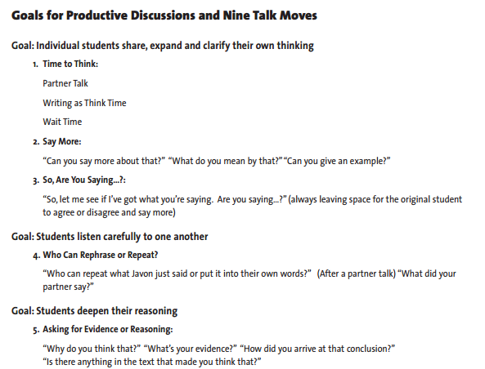
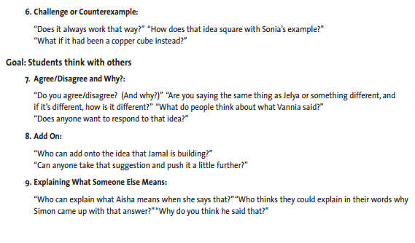
Increasing ELA in Science increases understanding
Continued commitment to science notebooking, reading within the content, and increasing speaking and listening opportunities

Slide 26
Middle school –high school conundrum
Previous
6th- Life Science
7th – Physical science
8th- earth science
9th- biology
Two more years of science (student choice)
All students were not getting all standards
Still want students to have choice
Qualified admissions/ncaa
Teacher licensure
Standards emphasize integration
Plenty of standards to cover!

Slide 27
Our solution!
6th, 7th, 8th- Integrated
9th – biology
10th – integrated science A (earth science emphasis) and integrated science b (physical science emphasis)
Students wanting advanced coursework can also enroll in Honors chemistry and will not have to take integrated science B
11th and 12th- Chemistry, Physics, zoology, anatomy and physiology, etc

Slide 28
it is not perfect!
Pros
All students all standards
Students still have choices
Cons
Physics
Working towards heart of NGSS- integration

Slide 29
Seventh Grade Essential Questions
How do cell parts become the building-blocks of multicellular organisms?
What are the genetic advantages of sexual reproduction over asexual reproduction?
What factors affect the strength of electric, magnetic, and gravitational forces?
What are the characteristic properties of waves and how are those properties used?
How do the various forms of electromagnetic radiation affect life on Earth?
What is the effect of thermal energy on states of matter?
How does the atomic structure of an atom determine its properties, and how are those properties organized on the Periodic Table
How do I demonstrate the relationship between atoms, elements, and compounds?
Note: Embedded within each question are scientific methods and engineering practices.

Slide 30
Eighth Grade Science Essential Questions
How do human activities effect Earth’s resources, climate, biosphere and natural habitats?
How do human dependence on Earth’s resources change the planet?
How do people model and predict the effects of human activities on Earth’s climate?
How do scientists work to gather, analyze, validate and communicate their work?
How do engineers identify a need, develop solutions, test and communication results and plan for redesign?
How is energy transferred within a system?
How does mapping Earth’s geologic history predict future events?
How do people reconstruct and date events in Earth’s planetary history?
How have societies used engineering to manage natural hazards and prepare for future occurrences?
How does Earth’s natural processes change/shape the surface of the earth?
How do tectonic processes create/destroy Earth’s crust?
How do adaptation and inheritance of traits ensure/influence the survival of a species?
What evidence shows the different species are related?-embryologic similarities?
How does genetic variation among organisms affect survival and reproduction?
Why do individuals of the same species vary in how they look, function, and behave
What factors effect an ecosystem’s overall health?
How do biotic/abiotic factors cause potential changes to ecosystems and their biodiversity?

Slide 31
HIGH SCHOOL BIOLOGY ESSENTIAL QUESTIONS
From Molecules to Organisms: Structures and Processes (LS1)
“How do organisms live and grow?”
Structure and Function
Growth and Development of Organisms
Organization for Matter and Energy Flow in Organisms
Ecosystems: Interactions, Energy, and Dynamics (LS2)
“How and why do organisms interact with their environment, and what are the effects of these interactions?”
Heredity: Inheritance and Variation of Traits (LS3)
“How are characteristics of one generation passed to the next? How can individuals of the same species and even siblings have different characteristics?”
Biological Evolution: Unity and Diversity (LS4)
“What evidence shows that different species are related?”
Earth and human Activity (ESS3)
“How do Earth’s surface processes and human activities affect each other?”
Engineering (ETS1)
“How are science and engineering practices used to solve real world problems?”

Slide 32
HIGH SCHOOL INTEGRATED SCIENCE A AND B ESSENTIAL QUESTIONS
Earth’s Place in the Universe (ESS1)
“What is the Universe, and what is Earth’s place in it?”
Earth’s Systems (ESS2)
“How and why is Earth constantly changing?”
Earth and Human Activity (ESS3)
“How do Earth’s surface processes and human activities affect each other?”
Matter and Its Interactions (PS1)
“How can one explain and predict interactions between objects and within systems of objects?”
Motion and Stability: Forces and Interactions (PS2)
“How can one explain and predict interactions between objects and within systems of objects?”
Energy (PS3)
“How is energy transferred and conserved?”
Waves and their Applications in Technologies for Information transfer (PS4)
“How are waves used to transfer energy and send and store information?”
Engineering (ETS1)
“How are science and engineering practices used to solve real world problems?”

Slide 33
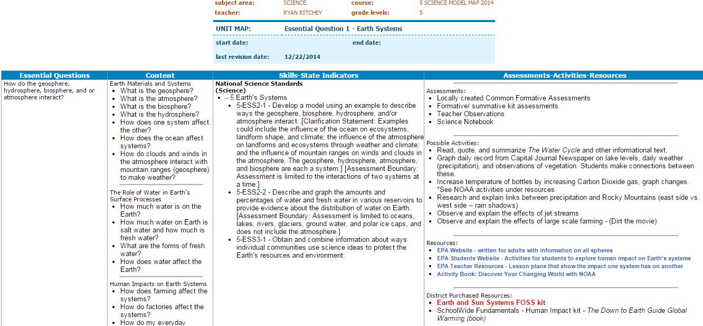
Creating Model Curriculum Maps

Slide 34
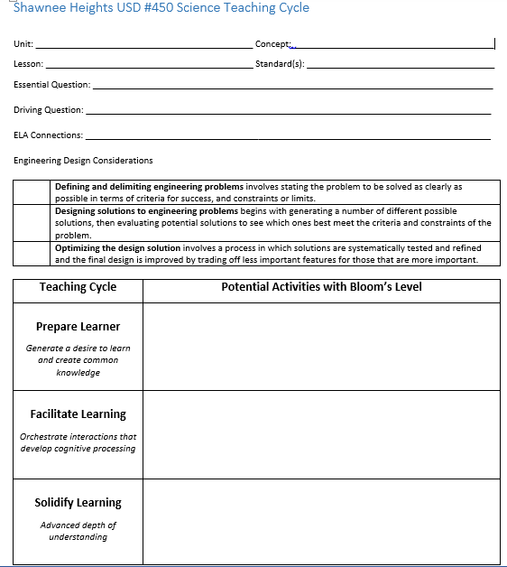
Developing Strong Lesson plans

Slide 35
Other resources
http://ambitiousscienceteaching.org/
http://inquiryproject.terc.edu/
http://ngss.nsta.org/
http://www.nextgenscience.org/resources
http://community.ksde.org/Default.aspx?tabid=5975

Slide 36
Contact information
Stacie Borjon- Shawnee Heights High School- borjons@usd450.net
Laura Hurla- Shawnee Heights Elementary School Instructional Coach- Hurlal@usd450.net

