Slide 1
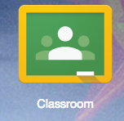
Google Classroom
Google Classroom, Doctopus, Goobric, Flubaroo
Framework and Assistive Educational Technologies

Slide 2
Amy Ramirez Spears
Anatomy & Health Science 3 (CTE)
Health Science College & Career Coordinator
Debate & STUCO Coach
Notes:
I’d like to share with you about Google Classroom and a few of its addons that I use to support my flipped classroom.

Slide 3
If educational technology is to:
*support & encourage learning
*challenge students
*prepare students for a globalized workforce
Google classroom works!
Notes:
Google apps and especially Google classroom provide a platform and means to create individually and collaboratively. Students can express their knowledge of content in new and engaging ways challenging their skills in a way that builds career and college skills.

Slide 4
Engaging
Relevant
Hands-on
Notes:
The following technology allows my class to do more engaging, hands-on projects in the classroom!
https://youtu.be/K26iyyQMp_g

Slide 5
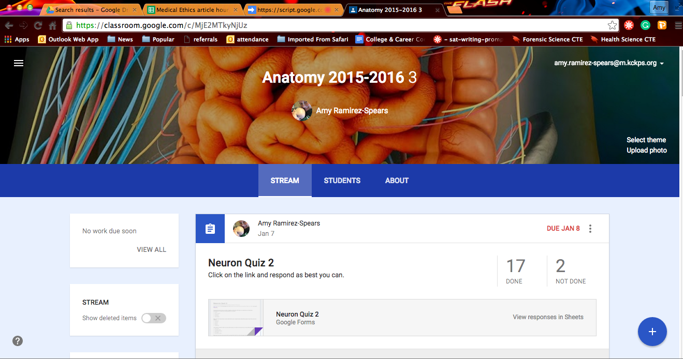
GAFE: Google Apps For Education
-An “office suite” with tools to help you share, communicate, plan, and collaborate.
-Participating members can work on projects synchronously and asynchronously.
Many AWESOME Apps!
-Drive, Calendar, Gmail, Sheets, Slides, Docs, Forms, Groups, and…CLASSROOM!
Notes:
We will start with the bad news first, you must have GAFE to use google classroom. Many local districts have GAFE, you need to talk to your administrator, teacher leader or tech department to find out if your district has it.
Here is where we start sharing the good news: Google classroom IS WORTH IT! Google classroom is a platform app that can provide a unique space to file share, track or grade students, manage projects, and collaborate.
Besides the above apps there are add-ons (free) that I will show.

Slide 6
Why Google Classroom?
Less paper!
Give instant and useful feedback!
Share resources!
Monitor learning with ease!
Reduce cheating!
Reduce grading time & effort!
Organize & track student submissions easily!
Create & manage small group collaboration!
Notes:
Why is Google classroom worth it? Less paper is used (go green!), You can give instant and useful feedback, you can share resources quickly (articles, video (flipped classroom), docs, spreadsheets, images, etc.), monitor learning, reduce cheating, reduce grading time, track students, and create and manage collaborative projects.
The list goes on and on. Today I am going to show you some of the ways I use it in the classroom to support and challenge my students.

Slide 7
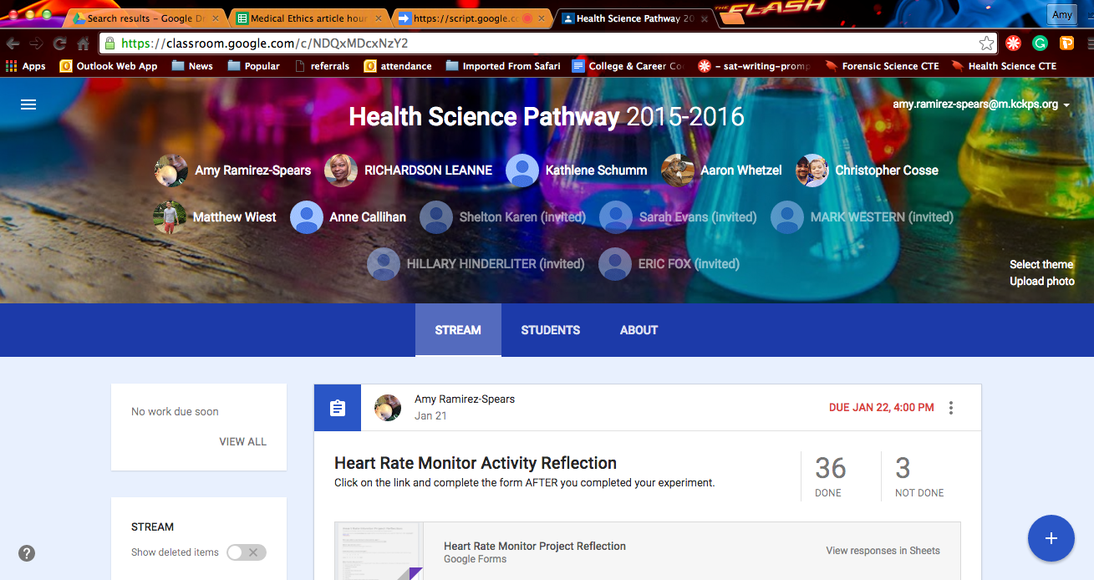
Google Classroom Platform
-Can be used by single or multiple teachers.
-Can be used for a class or a group.
-Especially useful in a flipped classroom.
Notes:
This is a classroom platform I created for our health science pathway. Here you can see the title of the class, the teachers who have accepted the invitation to use this classroom, the stream (activities), and one of our assignments. Here we post reflections and directions for projects we do as a pathway. It can be used by one teacher or multiple teachers.

Slide 8
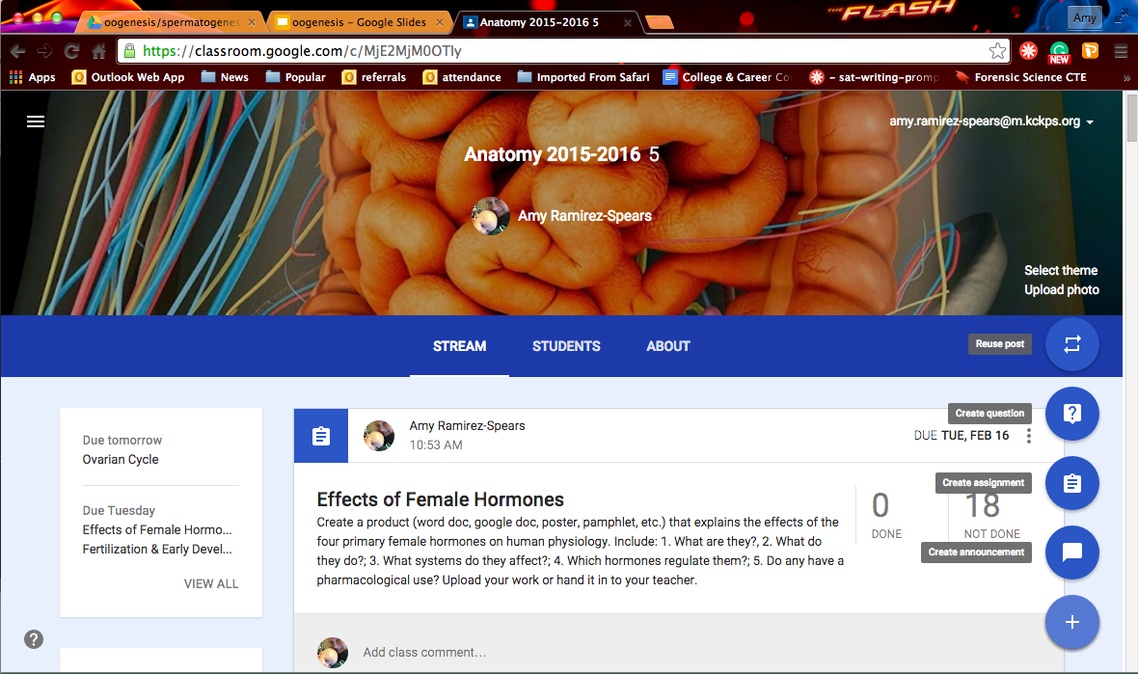
Create an assignment, a question, or an announcement.

Slide 9
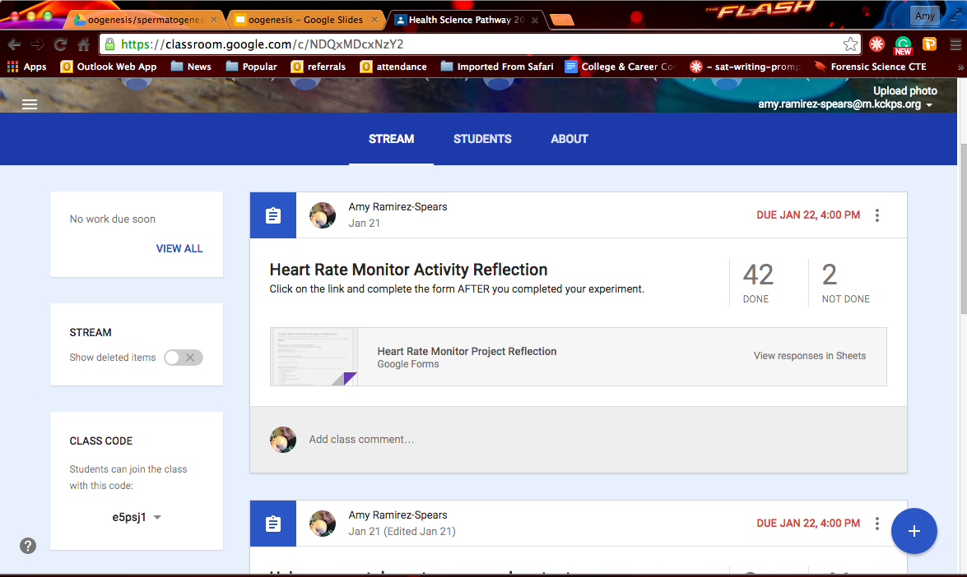
Google Forms Assignments
Notes:
Using google classroom you can create a quick quiz or reflection. Here we had students reporting on a project on mobile medicine. I created the google form

Slide 10
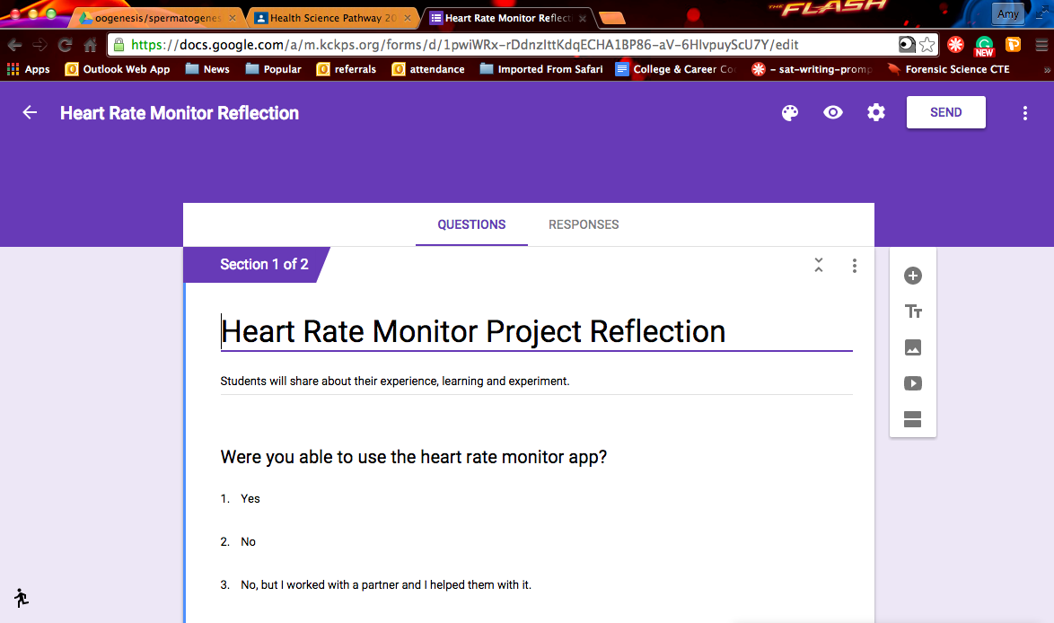
Create a Google Form
Notes:
Creating a google form is easy, it is a matter of typing in the questions and possible responses and choosing the type of questions you’d like to use. There are three major benefits to using google forms within google classroom
Organized data collection (every response recorded is linked to an account – you can track student by student responses.
Data collection is in real time.
Grading *can* be done automatically.

Slide 11
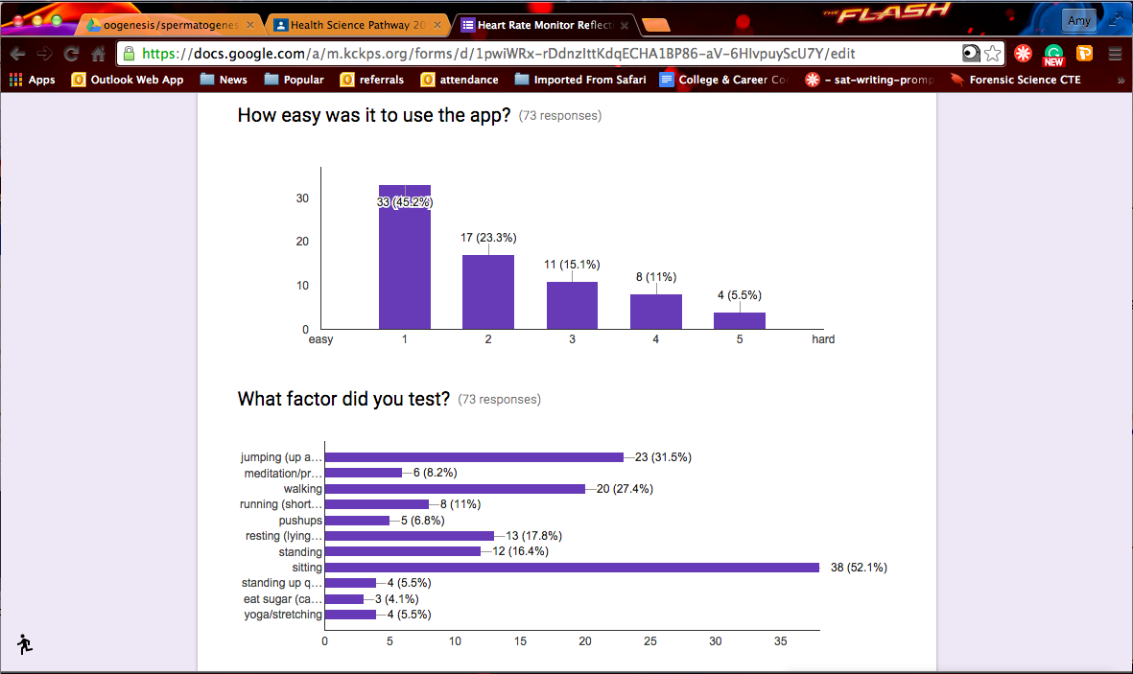
Google forms – data collection in real-time
Notes:
As your students complete and submit their google forms, you can view responses and track student understanding as a class. Yay Data!!!

Slide 12
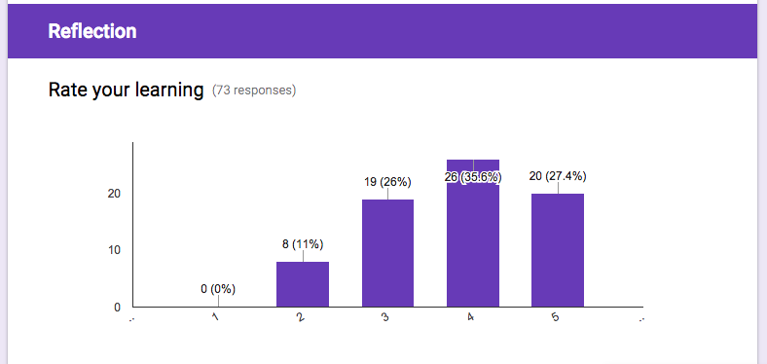
Students can practice metacognition skills.
Notes:
Tracking their own learning.

Slide 13
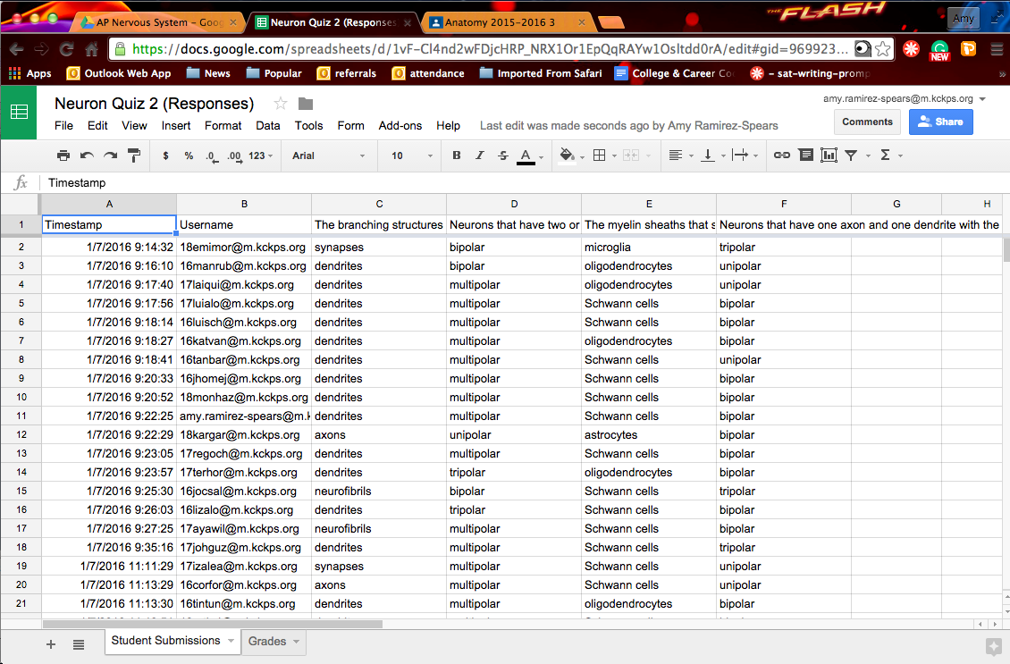
Google Forms collects data for you.
Notes:
Once your students have finished submitting their responses, google forms populates a spreadsheet for you to review. If you want to go a step further you can upload one of many add-on tools to assist with grading.

Slide 14
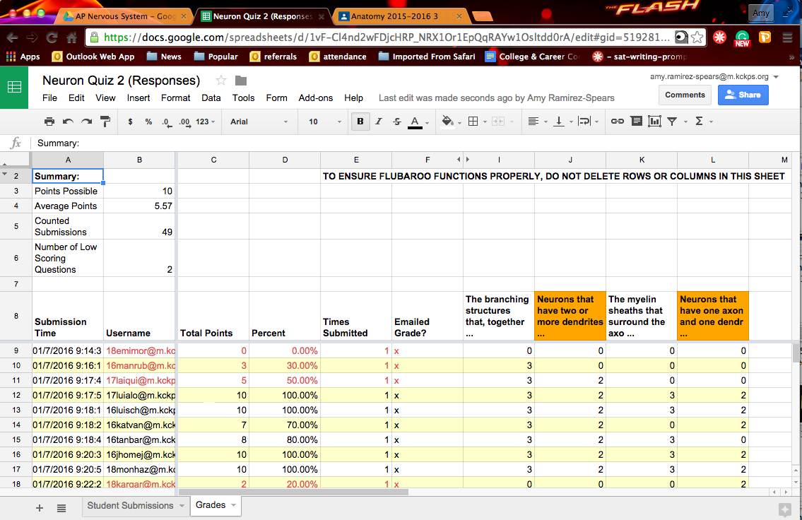
Flubaroo grades your assignments for you.
Notes:
Flubaroo is a free add-on tool in google sheets. It organizes your data for you and grades your assignments for you. You have to add it you’re your google app, initiate it and create a key. It will also email your students for you, if you choose to do so, their answers and grades – or just their grades.
Imagine this, for an effective formative assessment, you quickly put together a few questions on a google form, assign it in classroom, students take it and within minutes you grade it and send out the grades to the students. Imagine the differential – time saved on your part and instant response and reflection for the student.

Slide 15
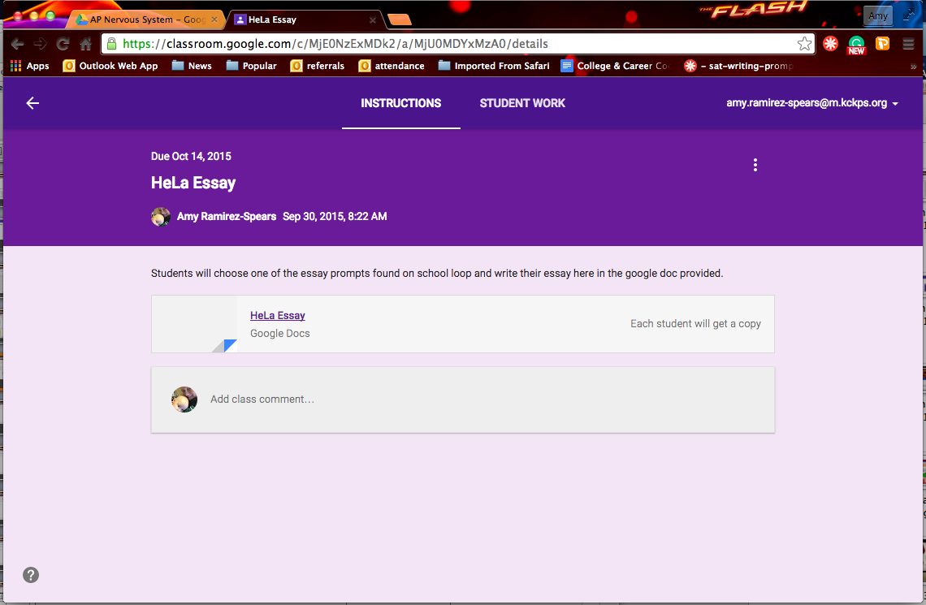
Google Classroom Essay Assignment
Notes:
Using Google classroom, you can assign an essay that will never get lost. Create and attach a google doc to a classroom assignment and make sure that it is set so that each student will get their own copy.

Slide 16
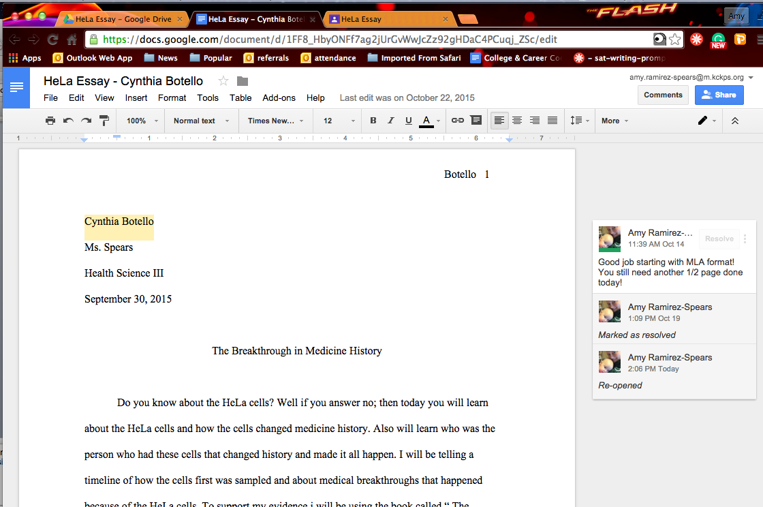
Manage the assignment & offer help as they work.
Work individually or collaboratively.
Notes:
As they work on their paper you can access it and offer assistance and direction. You can also monitor their work. You will know who is working on it and when they did. Using the revisions tool you can also look up what changes they made when and catch possible plagiarism early.
You can also create a doc with multiple students attached to it and they can work on the assignment as a group.
This is great, but what about grading. I still have to grade ALL of these papers! Using a Google Chrome add-on you can also aid in grading and student reflection. Doctopus.

Slide 17
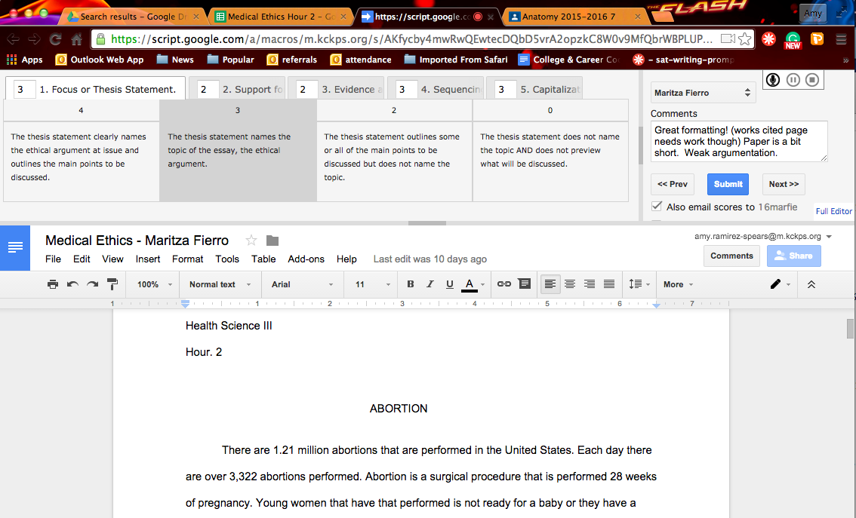
Doctopus is a way to grade and offer meaningful feedback.
Notes:
Doctopus – once you’ve installed the Chrome add-on and set it up is an incredible grading tool that increases your effectiveness.

Slide 18
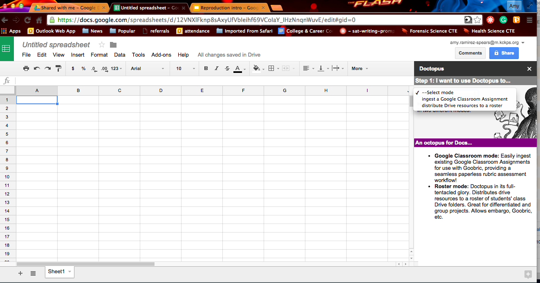
Setting up Doctopus involves the creation of a spreadsheet and a rubric.
Notes:
There is a little bit of set up, but don’t worry there are plenty of tutorials online. Doctopus is found in the add-ons tab. It also requires the pairing of a Chrome add-on called Goobric.

Slide 19
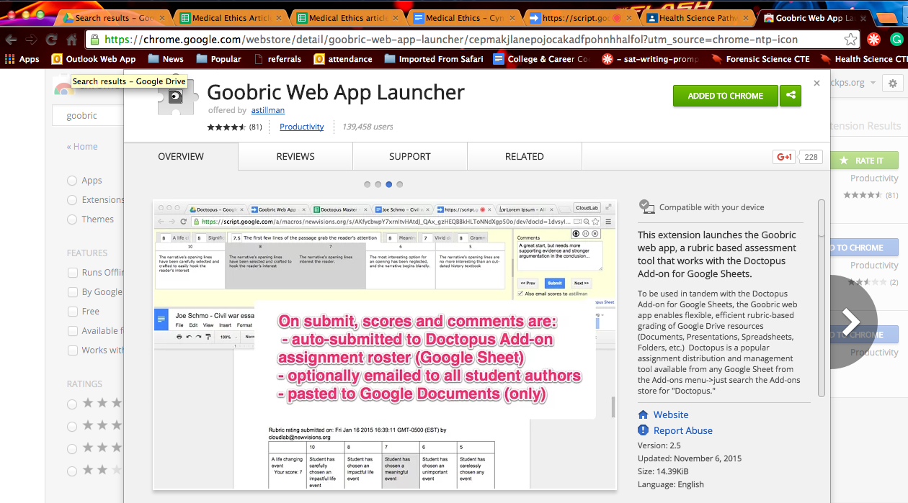
Doctopus & Goobric work together for the best result.
You can find Goobric in the Google web store. Follow instructions to install. You must have it installed before you can attach a Goobric to your Doctopus spreadsheet.
Notes:
Goobric is a Google Chrome add-on much like doctopus (within sheets).

Slide 20
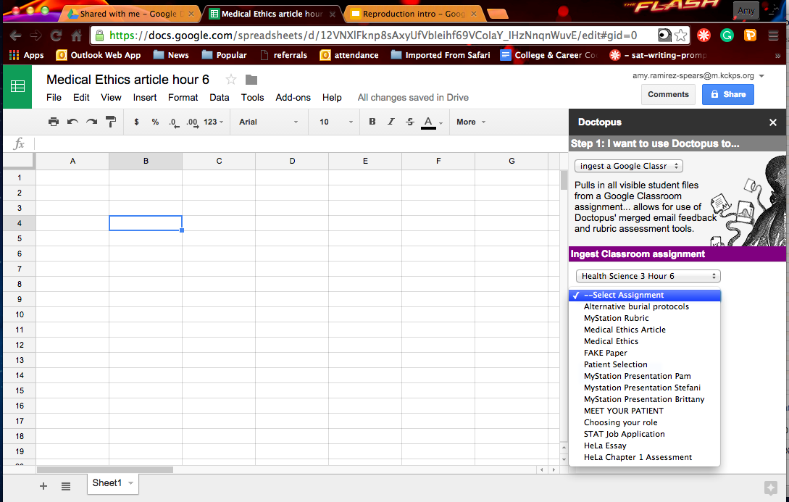
Once set up…
Doctopus allows you to select the class and assignment.
Notes:
Once you’ve added Doctopus & Goobric….
Organization – track one class/one assignment at a time.

Slide 21
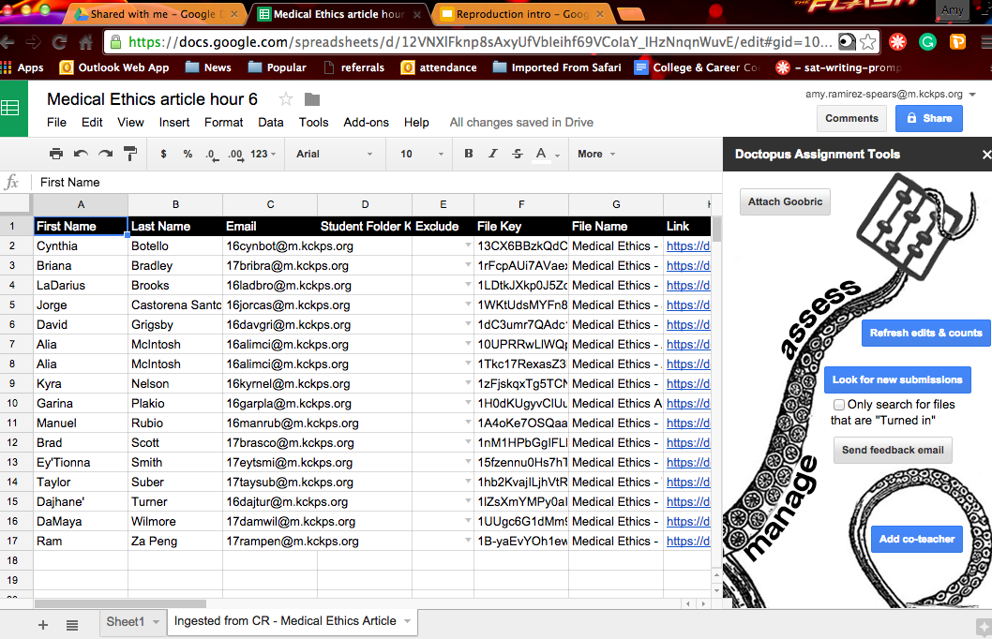
Student data is automatically populated. Attach Goobric.
Notes:
No messy data entry – you can manipulate your data as you wish.

Slide 22
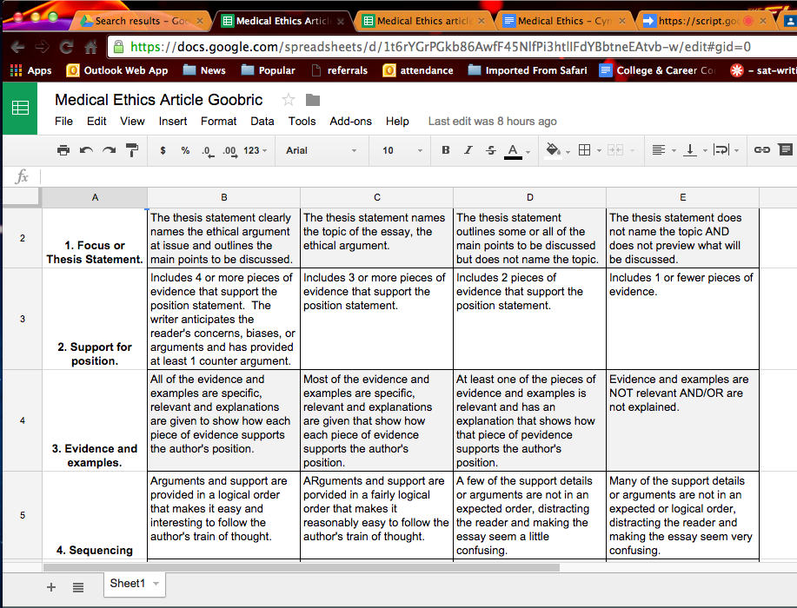
Notes:
Here is a basic Goobric. It is a simple Google spreadsheet. Goobric is a Google Chrome extension. It is easy to find if you google chrome apps. ENTIRELY CUSTOMIZABLE!!!
IT IS JUST A RUBRIC!!! HOW AWESOME IS THAT!?
You have to make this ahead of time.

Slide 23
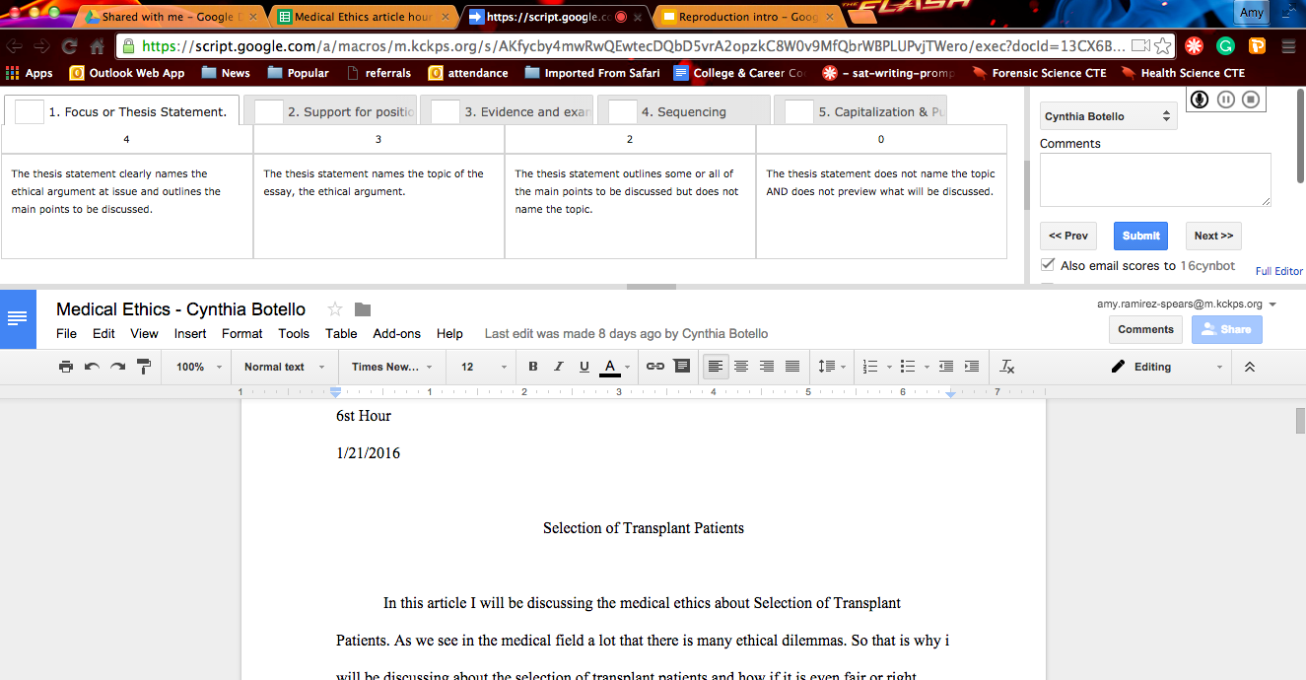
Google Classroom, Doctopus, and Goobric in ACTION!
Notes:
I can’t say enough good things about these three Google apps and add-ons. AMY – REVIEW EACH BUTTON AND STEP.

Slide 24
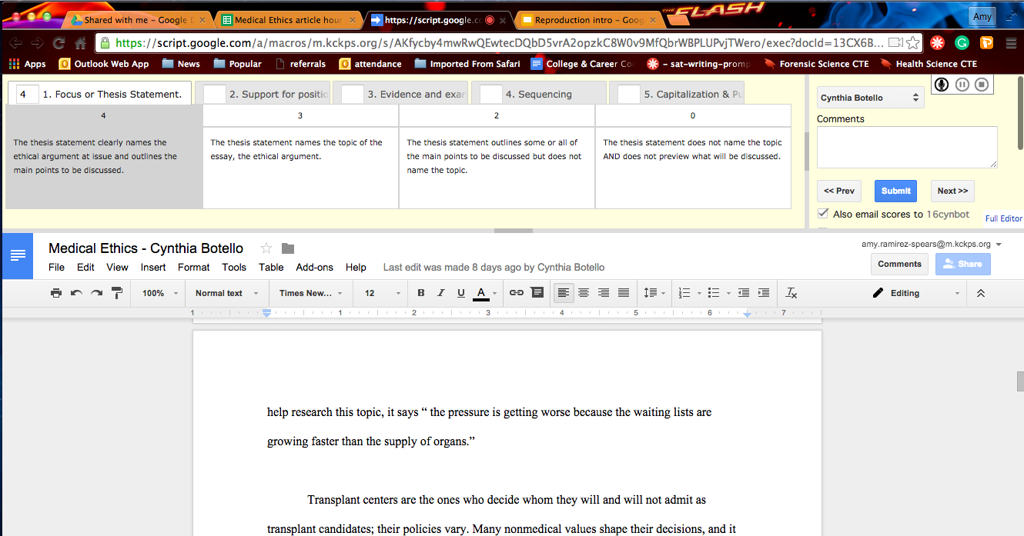
Google Classroom is effective, challenging and will aid in preparing our students for a future globally integrated technological workforce.
Google Classroom
-Effective
-Engaging
-Collaborative

Slide 25
Notes:
Thank you!

