Slide 1
Planning for Success: The Kansas Individual Plan of Study Program
KEEN Conference February 18, 2016
Notes:
Introductions and ask the audience for demographic information

Slide 2
Career Ready
The labor market is increasingly requiring higher levels of education for employment
By 2020, 71% of jobs in Kansas will require a post-secondary credential (certification through an advanced degree)**
Currently, just over half of working-age Kansans have a post-secondary credential
Most job openings will be for “middle skill” jobs (requiring more than a diploma but less than a four-year degree)
**Georgetown Public Policy Institute

Slide 3
Creating a Vision for Kansas
State Level Outcomes will drive our Vision!
High School Graduation Rates
Post Secondary Completion/ Attendance
Kindergarten Readiness
Individual Plan of Study Focused on Career Interest
Social/Emotional Growth Measured Locally
Notes:
Among the outcomes being considered by the state board are:
High School Graduation Rates
Post Secondary Completion/Attendance
Remedial Rate of Students Attending Post-Secondary
Kindergarten Readiness
Individual Plan of Study Focused on Career Interest
Social/Emotional Growth Measured Locally
Education Commissioner Randy Watson and members of the State Board of Education will meet with business, education and state leaders to build agreement on how we will work together to achieve this vision for Kansas education.
Kansas schools are already doing tremendous work to address the needs of individual students, but in order to achieve this new vision we cannot expect schools to go it alone. This requires a unified effort with businesses, communities, parents, higher education, and elected officials working with educators to help provide the supports and experiences Kansas students need for their future success.

Slide 4
Individual Plan of Study for Every Student Beginning In The Middle Grades
New Student Success Outcome
If done well, will lead to higher student engagement and more informed post-secondary decisions by students and families
Part of new accreditation model

Slide 5
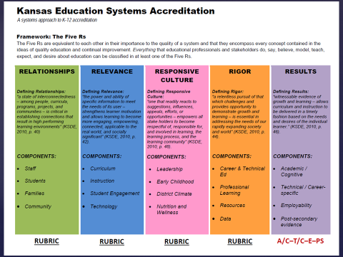
Accreditation
Notes:
Discuss the IPS ties into the five R’s

Slide 6
Planning for Success
An individual plan of study, at a minimum, contains:
Strength finders & career interest inventories to help students identify preference toward career clusters
8th – 12th Course builder function with course selections based on career interests
A general post-secondary plan (military, apprenticeship, 2-yr., 4-yr.)
Portable electronic portfolio

Slide 8
Elementary School
Career Exposure based on 6 Career FIELDS

Slide 9
Middle School
Identify Career Interests aligned with
16 Career CLUSTERS

Slide 10
High School
Career Exploration through Career Pathways

Slide 11
An Essential Component Of An Effective Individual Plan Of Study: Interest Inventory Progression
Identifying Talents, Interests, Strengths and Learning Styles
Middle Grades
Career-focused Surveys and Ability Profilers
High School Grades
Related Careers
Post-Secondary Options

Slide 12
How can teachers use IPS information?
What resources do you have right now to provide insight to your students’ career interests?
How would knowing your students’ career interests help you to make your content more relevant?

Slide 13
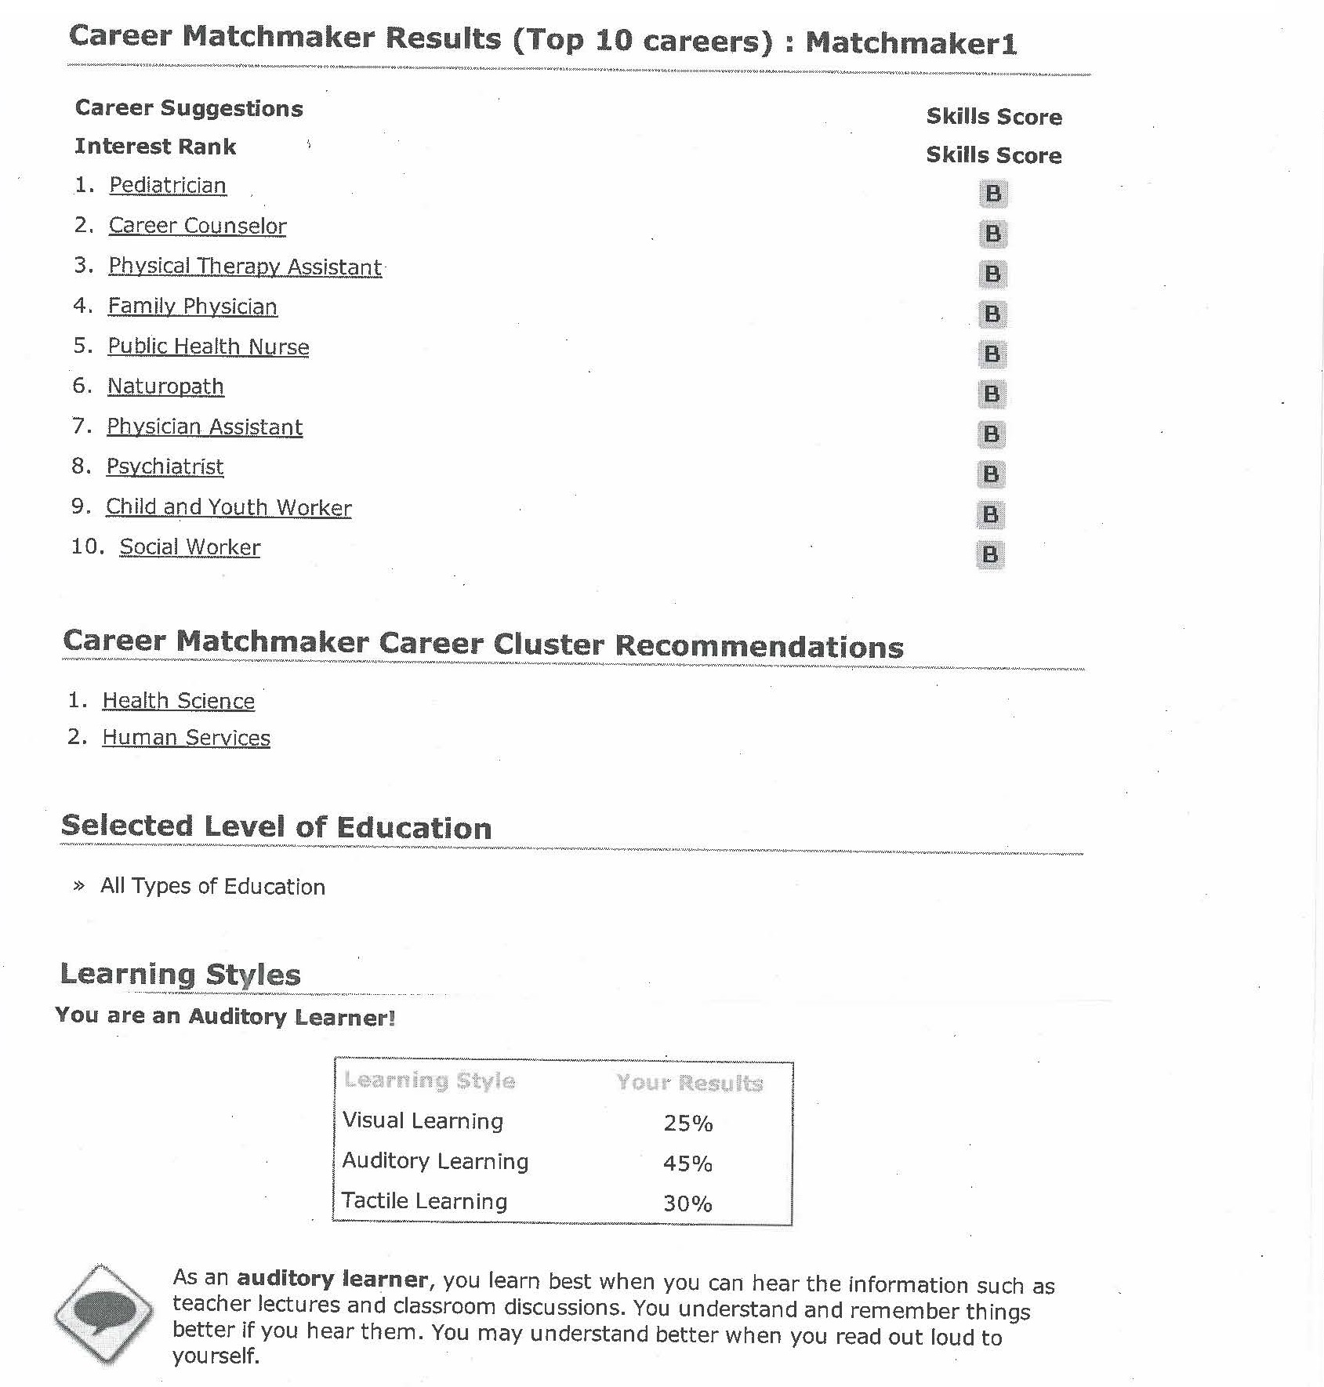
Student’s Career Interest and Learning Styles Report
Notes:
The individual plan of study can inform students, parents, administrators, counselors and teachers regarding the student’s career interests, aligned career clusters and learning styles.

Slide 14
Learning Styles Reporting By Class
Learning Style | Total | Male | Female | Detail
Tactile Learning | 7 | 2 | 5 | View
Auditory Learning | 6 | 1 | 5 | View
Auditory-Tactile Learning | 3 | 3 | 0 | View
Multi-Method Learning | 2 | 1 | 1 | View
Visual-Auditory Learning | 2 | 0 | 2 | View
Primary Auditory Learning with Secondary Visual Learning | 1 | 0 | 1 | View
Primary Auditory Learning with Secondary Tactile Learning | 1 | 1 | 0 | View
Primary Tactile Learning with Secondary Auditory Learning | 1 | 1 | 0 | View
Notes:
The individual plan of study can provide a summary of learning styles by class in order to support differentiation in the classroom

Slide 15
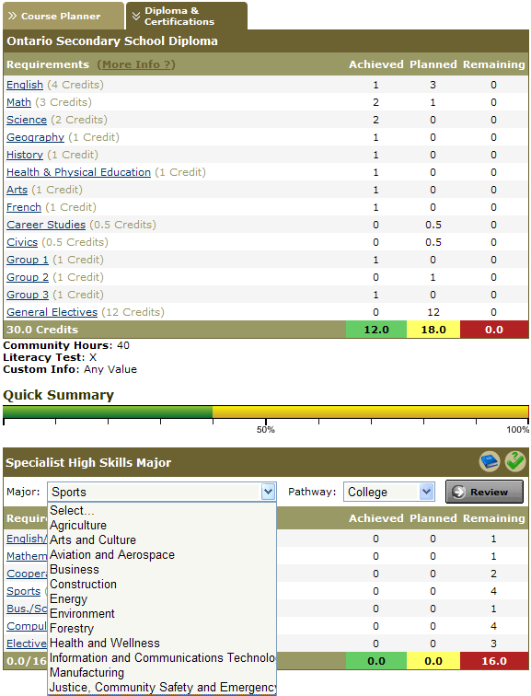
Essential Components
Essential Components Of An Effective Individual Plan Of Study:
Course Mapping and Credit Evaluation
Notes:
The Credit Evaluation shows exactly how many credits in each category are required for graduation.
The Credit Evaluation component allows teachers, counselors, administrators, parents and students to clearly delineate exactly which graduation credits are still required.
The Credit shows the student’s progress toward pathway completion
The Course mapping shows a summary of total credits needed, lays credits out for students to clearly see exactly what he or she is enrolling in, and past course grades.,
The Course Mapping cluster possibilities shows the Clusters the student has chosen
The course planner shows the courses the student has taken and is planning to take.
The course mapping Recommended clusters shows the clusters that the interest inventories identified as appropriate for this student
Having all of this information in one place can help students, parents and school staff clearly identify progress, gaps and alignment of course work to career goals.

Slide 16
Individual Plan of Study- Education
Core Classes
Education Level |  | Grade | English (ELA) | Math | Science | S. Studies | CTE or Pathway Courses | Other Courses
Interest Inventory Administered and Plan of Study Initiated for all Learners
Middle School | 8 |  | Language Arts | Algebra 1 | Earth Science | American History | Career and Life Planning (.5) Intro to Human Services (.5) | Elective Elective
TRANSITION YEAR: Interest Inventory Administered and Plan of Study Reviewed for all Learners/ Tests: ACT Explore given during 9th grade
High School | 9 |  | Freshman English | Geometry | Biology | World Geography | Human Growth and Development (.5) Family Studies (.5) | PE and Health Elective
Interest Inventory Administered and Plan of Study Reviewed for all learners/ Career Exposure Activity related to Pathway/ Tests: ACT Plan given during 10th grade
High School | 10 |  | Sophomore English | Algebra II | Chemistry | World History | Teaching as a Career (1) | Consumer Ed. (.5) Speech (.5) Elective
Interest Inventory Administered and Plan of Study Reviewed for all learners/ College visit related to Pathway/ Tests: ACT Recommended and Compass considered at the end of 11th grade
High School | 11 |  | Junior English | Pre-calculus | Physics | US History | Teaching Observation (1) | Personal Finance(.5) Business Com.(.5)
Notes:
Let’s look at an individual plan of study:
Grade Level
Core course selections
Accelerated math
Pathway Courses

Slide 17
Individual Plan of Study- Education
Educ. Level | Grade | English (ELA) | Math |  | Science |  | S. Studies |  | CTE or Pathway Courses |  | Other Courses
Interest Inventory Administered and Plan of Study Reviewed for all learners/ Job Shadow related to Pathway/ Tests: ACT Recommended and Compass considered at the beginning of 12th grade
High School | 12 (9 hours college credit) | Senior English |  | College Credit College Algebra (MA 110) |  | College Credit General Biology (GB 100) |  | US Government (.5)/ Economics (.5) |  | Teaching Internship (1) |  | Elective and/or (College Credit) Introduction to Psychology (PY 100)
TRANSITION YEAR
Post-Secondary (Emporia State University) | Freshman Year Semester 1 (15 hours) | Composition I (EG101)- 3 hours |  |  |  | Field and Lab Bio ( GB303)- 3 hours |  | Modern World Civ. (HI102)- 3 hours |  | Public Speaking (SP 101)- 3 hours |  | Developmental Psychology (PY211)- 3 hours
 | Freshman Year Semester 2 (14 hours plus 2 hours articulated credit) | Composition II (EG102)- 3 hours |  | Personal Finance (BU241)- 3 Hrs. |  | Our Physical World (PS115)- 3 Hours |  | Basic Music (MU 124)- 2 hours |  | *Intro. to Teaching (EL/ED 220) 2 hrs. Articulated Credit |  | Using Children’s Lit in the Elem. Class. (EL230)- 3 hrs.
Notes:
This student has the opportunity to earn college credit by planning ahead for his or her senior year.
This student has earned college credit by completing a pathway and articulating credit.
This student has planned for the first two years of college prior to leaving high school.

Slide 18
Essential Components Of An Effective Individual Plan Of Study: Portfolio

Slide 19
IPS Process
3 Models currently being utilized in Kansas schools:
1. Counselor-centered
2. Career Advisor system – all staff
3. Career Advocates
In conjunction with principals & counselors, KSDE is developing sample career exploration activities at each grade level (6 – 12) and training for career advising.

Slide 20
Planning for Success: The Kansas Individual Plan of Study Program
KEEN Conference February 18, 2016

