Slide 1
Visual Arts A Pathway Introduction
October 18, 2011

Slide 2
Presenters:
Joyce Huser
Gayla Randel
KSDE Fine Arts Program Consultant
National Board Certified Teacher - NBCT
19 years classroom experience
MS in Visual Arts Education
BA Philosophy, Theology, Minor in Art
KSDE Family and Consumer Sciences Program Consultant
20 yrs classroom experience
AAFCS Certified in Family and Consumer Sciences - CFCS
MS Adult, Continuing and Occupational Education
BS Vocational Home Economics

Slide 3
Agenda
Introduction of Presenters
The need for Visual Arts
High Demand—High Wage—High Skill
The need for art in occupational training
FACS/Art/Graphic Design Connection
Career Cluster Pathway Design
Design Sheet and Competencies
Pathway Requirements and KSDE Polices
Pathway Application (CPPSA)
Articulation Agreements
Advisory Committees
Professional Learning Experience/Portfolios
Question and Answers

Slide 4
Need for Visual Arts

Slide 5
Occupations in the Visual Arts (source. www.onetonline.org)
High Wage (>$13.25/hr), High Demand (>14%), High Skill (> high school diploma) Occupations
Growth:
Graphic Designers--$20.92/hr 124,800
Interior Designers--$22.25/hr 35,900
Commercial Designers--$27.99/hr 17,600
(Textile Designers)
Secondary Teachers--$53,200* 596,000
FCS Teachers--$65,000* 552,000
(* denotes teacher age which is over 50 yrs.)

Slide 6
The Art connection
Knowing the basics about drawing and illustration are vital to developing a stable foundation in any art-based career. (For example, knowing the elements of line, shape, form, and space and how they work together to result in a balanced, cohesive final product is important to successful design.)
These courses provide the knowledge and abilities needed in developing and recognizing successful results and identifying and solving design problems as they arise.
Intro to Drawing (30005) and Principles of Illustration (30101)are courses that will provide this foundation.

Slide 7
The FACS, ART, Graphic Design Connection
FACS—Family and Consumer Sciences —4-D design
Trained in interior design and apparel design industry related skills.
Understands how design elements and principles affect humans with regard to personal expression and impact on relationships and family function.
Graphic Design—2-D design
Trained in application of design elements and principles to share information that is pleasing and catches the eye through images and words.
Art– Foundational skills
Trained in developing the artistic eye
Trained in setting foundational knowledge of design elements which can then be used in many applications (including drawings/illustrations).

Slide 8
Career Cluster Introduction
Arts, AV Technology and Communications

Slide 9
Perkins Requirements (to qualify for additional funding)
Occupational focus must be High Demand career—14% increase in need or high volume of positions expected; High Wage--$13.25 or higher an hour ($26,000 per year); High Skill —Technical or advanced degree required
Approved pathway application
Qualified teacher
Course sequence of 3 credits or more offered
Articulation agreement in place
Advisory committee meets occupational tie (3 member min) who meet twice a year.
Plan of study includes grades 8-13

Slide 10
Arts, AV Technology and Communications Cluster
Visual Arts
AV Communications
(2-D and 4-D design)
Interior Design
Textile Design
Graphic Design
Exhibit or Set Design
Note: Animation and 3-D design is in Web and Digital Communication
Videography
Broadcasting
Digital new media
Social media
Journalistic writing
Digital story telling

Slide 11
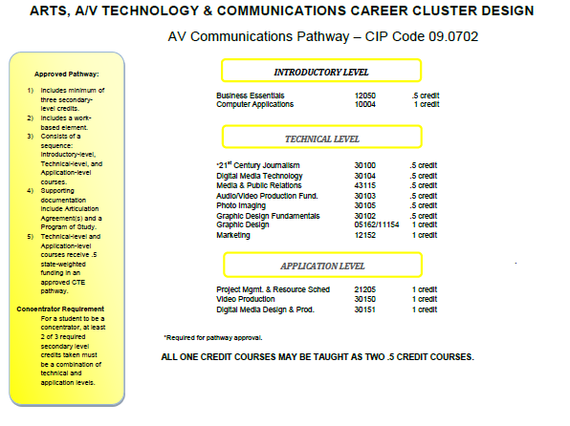
AV Communications

Slide 12
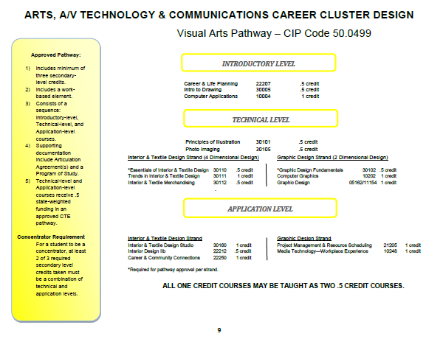
Visual Arts (two strands)
NOTE: It is Strand Specific (pick one). This will determine assessment later on.

Slide 13
Competencies and Profile Sheets

Slide 14
Course Competencies
Required of CTE Credit
Required for CTE and Fine Arts Credit
Industry determines the skills future workforce employees need.
Skills are addressed through competencies organized by class.
All course competencies must be taught in a course.
Competencies can be added, but none removed.
Everything in left column plus….
Must be taught by a Highly Qualified Fully Certified teacher licensed in Visual Art Education.
(QPA Requirement: “One unit of fine arts--music, art, dance, theater, forensics--or other similar studies selected by local board of education.”)

Slide 15
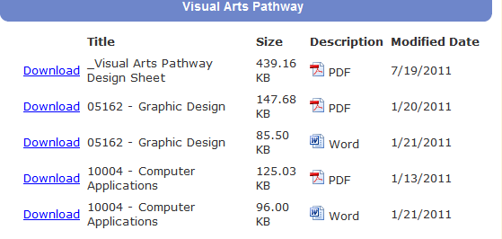
Arts, AV Tech and Communication Webpage (sample—Source: www.ksde.org (CTE—Arts, AV Tech and Communication Cluster Link )
Pathway Name
KCCMS Code/State Course Title
File format

Slide 16
Competency Profile— Part 1 of 3
Identifying information
Title/Description
Learner Information
Box
Directions and
Rating Scale

Slide 17
Competency Profile— Part 2 of 3
Competency and rating columns.
Essential competencies that all courses must include (incomplete list).

Slide 18
Competency Profile— Part 3 of 3
Technical competencies (Course specific)

Slide 19
KSDE-CTE Policies
Pathway Application

Slide 20
Pathway Application CPPSA—Career Pathways Program of Study Application
Have all courses in KCCMS so they will show up when completing your application.
Ask to be the data entry person OR find out who it is. This will be the person to complete the actual form.
Refer to the help documents available at www.ksde.org . Click on CTE (right menu) and then “CTE Forms and Documents” (left menu). You’ll find webinars/reference sheets, etc. on the process.
Submit completed application between Nov 15 and March 15 for following year. (Always working one year ahead.)

Slide 21
Pathway Requirements
Qualified teacher
Course sequence of 3 credits or more offered
Articulation agreement in place
Advisory committee meets occupational tie
Two meetings are held a year
Plan of study includes grades 8-13
(NOTE: Refer to the help documents available at www.ksde.org . Click on CTE (right menu) and then “CTE Forms and Documents”(left menu). You’ll find webinars/reference sheets, etc. on this webpage.)

Slide 22
KSDE-CTE Policies
Double Up

Slide 23
Policy changes for pathways(2011-2012)
Double ups are allowed (means two courses can be taught at the same time) if:
Courses are technical and/or application levels only
These courses are offered in the same classroom.
The total combined enrollment does not exceed 19 students per 1 teacher.
NESTING (more than two classes) is not allowed for funding, nor is independent study.

Slide 24
KSDE—CTE Policies
Professional Learning Experience

Slide 25
What it is and what it isn’t
OJT
Professional Learning Experience
Work-based only
One job common
Job may or may not be related to technical instruction.
May or may not allow for improvement
Work-based, community based or school based.
All aspects of the industry to be introduced, allows multiple experiences.
Builds on the technical skills of the student as determined by pathway sequence.
Learning goals and improvement plans are best practice.

Slide 26
Professional Learning Experience
A Professional Learning Experience is one that connects technical skills development to authentic industry-related experiences across all fields and pathways.
A Professional Learning Experience can be work-based (internship), community based (volunteer) or school based (within the school building).
A Professional Learning Experience is enhanced with a Career Technical Student Organization (FCCLA) experience (For example: STAR Events—resume building, projects/presentations build work skills, content applies knowledge.)
A Professional Learning Experience Toolkit has been developed to assist with the implementation of this experience.

Slide 27
Advisory Committee

Slide 28
Advisory committee Input: (Meetings, Minutes, Documentation)
Meetings are held as deemed necessary to address pathway decisions.
Membership must have a minimum of three (3) representatives from the pathway industry area.
Two advisory committee meetings are required.
Spring –in preparation for the year to come.
Fall—in response to issues.
(Can call additional meetings.)
(Brief minutes or topics of discussion and actions taken.)

Slide 29
Role of the Portfolio
For the Interior/Textile Design Strand

Slide 30
The portfolio is a working document, not a professional portfolio with best work.
The working portfolio is started at the intro level, with each course having a section or chapter.
The working portfolio is added to in each course as determined by the instructor.
The working portfolio serves as the reference book and/or textbook for the application level course

Slide 31
Example of use across courses….
Career Life Planning (intro)
Career and Community Connections (application)
Interest Survey results
Notes on writing resumes, letters of application, follow up notes
Personal resume, letters samples
Notes on how to interview successfully
Web resources
Retake interest survey to see if same results is found.
Refer to notes to apply for internships.
Refer to sample forms to adapt to create documents for internships
Refer to notes when interviewing for the internship.
Refer to the web recourses as needed

Slide 32
Next step…
Repeat the same process with each technical course.
Require the information you feel the student will need to have for a variety of experiences in the Career and Community Connections course in each section.
Grade as you see fit.
Keep the information at a minimum…this is not a way to keep everything students complete.
It can be hard copy, 3-ring binder or electronic portfolio format.
Won’t be sent in to KSDE, but kept locally to assist with the instruction of the Career and Community Connections course.

Slide 33
QUESTIONS?

Slide 34
Questions from the Field:
Why are only two art classes included in this career cluster?
The two courses included have a direct tie to the skills needed in the interior/textile design and graphic design strands. More about how they are connected are found on slides 6 & 7.
Where do I get the licensure for the courses?
The Teacher Licensure (TEAL) department at KSDE has a reference document that will share the licensure that can teach the course. This listing was prepared by CTE consultants with TEALS input and reflects the educational training. This may or may not agree with those allowances under VE2 programs. Please contact Gayla Randel with questions.
How can we teach all the essential knowledge and skills when they are too difficult for introduction students or there are too many to cover?
The essential knowledge and skills are to be taught in every course to build/enhance the 21st century skills of students, and all competencies are to be included. These can be taught simultaneously through the integration of a CTSO experience (such as FBLA or FCCLA) is considered best practice. Select the CTSO that best fits your subject area. Contact the state advisors (contact information available on the KSDE website) to learn more about CTSOs.
What about the courses I want to teach that are not listed on the pathway design sheet?
Only the courses on the pathway design sheet are recognized as part of the pathway. If a school wishes to offer courses locally, that is allowed, however they are not part of the pathway and are not included in the application nor any KSDE reporting. Files would be kept locally as deemed necessary. Note that only the technical and application level courses listed on the design sheet are funded. No locally offered courses are fundable.
Other information shared:
Courses in a pathway may be taught every other year to allow for larger class sizes and less teaching preps. Doubling up courses is also allowed (see slide 22 & 23 for additional information).

Slide 35
For more information:
Gayla Randel Education Program Consultant
grandel@ksde.org 785-296-4912
Joyce Huser
Education Program Consultant
Fine Arts
jhuser@ksde.org 785-296-4932

