Slide 1

Data + Reserve Funds= AAI Inclusion
Karmey Olson
Education Program Consultant
Kansas State Department of Education
NACTEI Conference
St. Louis, Missouri
May 13, 2010

Slide 2
All Aspects of an Industry
Integral part of Carl D. Perkins Career and Technical Education Act of 2006
Provision in this act calls for “………strong experience in and understanding of those aspects of industry the students are preparing to enter.”

Slide 3
The Perfect Labor Storm: Fact Book
Why Worker Shortages Won’t Go Away
Dr. Ira S. Wolfe
“The days of affording the costs of overstaffing to maintain full productivity, while continuing to pay for nonperformance have long gone.
We do not and will not have enough people to fill all the jobs that will be required to provide services and produce goods to a growing, aging and demanding population. And we don’t and won’t have enough people with the right skills to do all the jobs that exist, even today.”
Ira S.Wolfe [iwolfe@super-solutions.com]
Notes:
Show clip.

Slide 4

All Aspects of an Industry:
Integrating Academic and CTE
  Successful integration depends on having a rich context for applying academic skills and knowledge
  Covering “All Aspects” provides the rich context
  Analyzing and solving problems facing industry and the enterprises within it involves utilizing skills in reading, writing, math, science and social studies
Notes:
There are 4 reasons we need to include all aspects of an industry, whether it is from the teachers teaching the skills or the students plan of study.

Slide 5
EXAMPLE:
Critical Thinking on the Job
A patient is brought to the hospital with a severe thumb laceration. The attending physician verbally orders lidocaine 1% solution 2 mL as a local anesthetic. The health care professional picks up a vial labeled lidocaine 1% with epinephrine and draws up 2 mL. He then says,
“This is lidocaine 1 % solution 2 mL,” but neither mentions the epinephrine nor show the physician the label.
OOPS!
Notes:
Epinephrine, widely called adrenaline, is a hormone and neurotransmitter.^{[1]} When produced in the body it increases heart rate, contracts blood vessels and dilates air passages and participates in the fight-or-flight response of the sympathetic nervous system.^{[2]} It is a catecholamine, a monoamine produced only by the adrenal glands from the amino acids phenylalanine and tyrosine.

Slide 6
What Academic Understanding is Needed for the Situation?
  Reading?
  Math?
  Science ?

Slide 7
All Aspects of an Industry:
Empower Learners to Make Career and Life Choices
  Teaching “All Aspects” gives transferable skills
  How to plan and manage expands their opportunities
  Encourages entrepreneurial activities
Notes:
Long term employment with one company is getting more unlikely.
Fast changing technology also forces students to be prepared to undergo significant changes in their work over the course of their careers,
Data shows us that many workers who have lost jobs due to the economy and restructuring will develop their own businesses. By including all aspects of an industry in a training situation provides a basis for these entrepreneurial endeavors.

Slide 8
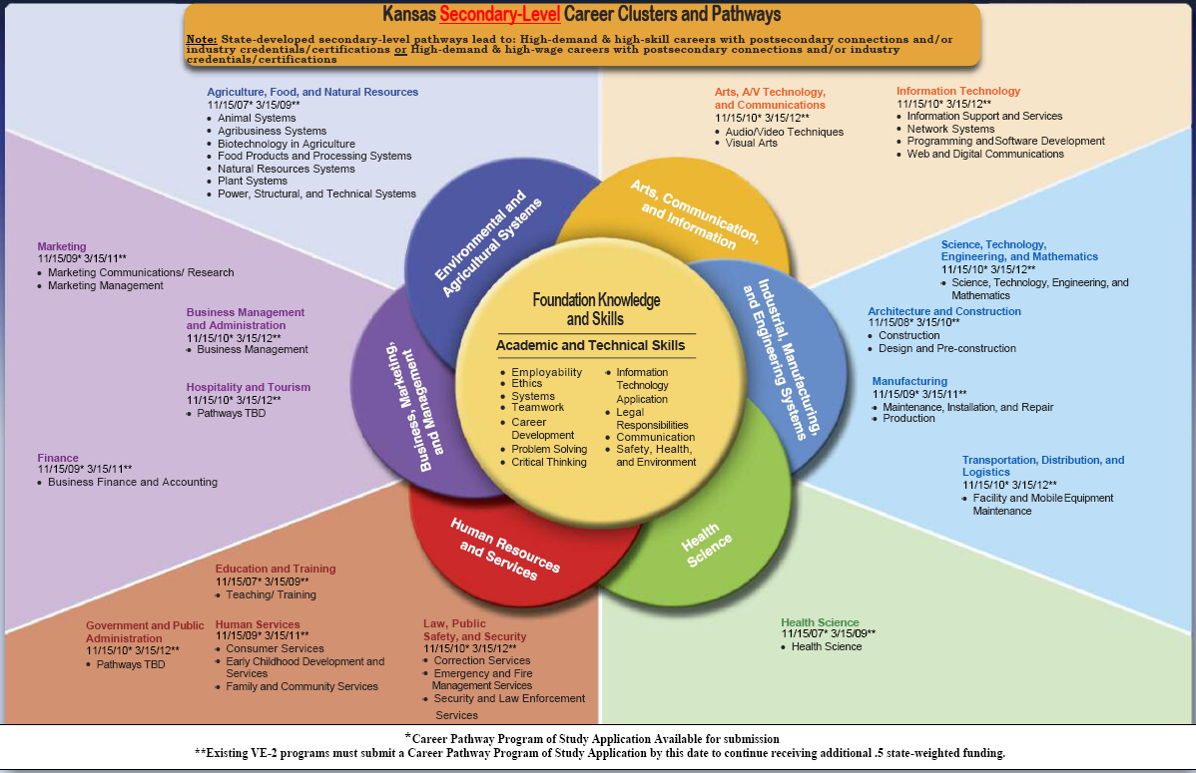
Career Clusters: Foundation Knowledge and Skills

Slide 9
Transferable Skills Across Clusters in Kansas
 | Pathway | Courses
1. | Food Products & Processing Systems | Food Safety/Food Science
 | Family and Consumer Services
2. | STEM | BioSciences
 | Biomedical
 | Biotechnology in Agriculture
3. | Marketing Management | Marketing the Restaurant/Hospitality Industry
 | Restaurant and Hospitality Management
4. | EMS and Fire Safety | Health Science II
 | Diagnostic/Therapeutic

Slide 10
All Aspects of an Industry:
Enabling Learners to Adapt to Technological Change
  Providing learners with broad skills in “All Aspects” along with academic skills enables them to understand and adapt to change when they leave school and throughout their careers
  Prepares a higher skilled worker to meet evolving needs of future employers
Notes:
Knowledge of a broader set of skills in the workplace will provide a better foundation for the learning needs of students and the evolving needs of their future employers.

Slide 11

Example of Technological Change
Welders
Standard Mig and Tig Welders used in most classrooms/shops/labs
Mig and Tig Welders produce:
  High quality welds
  All position welding capability
  Used on materials of various types and thicknesses
  Clean-up is fast since there is little to no slag and low spatter.

Slide 12
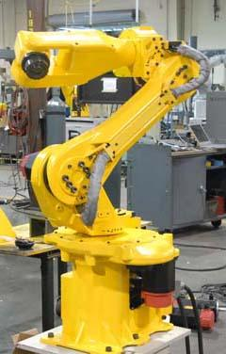
From Mig/Tig to Robotic Welders
Dexterity
Reliability
High speeds
Numerous applications and working environments
Compact, slim wrist and small footprint permit operation which allows it to work in tight places

Slide 13
All Aspects of an Industry:
Involving Learners in Economic Development
  All Aspects of an Industry practices provide for a demand of higher skilled workers

Slide 14
    If jobs prepare learners with only a few skills, they are left dependent upon too few jobs, which demand too few skills and provide too little income for a decent life
    In contrast, “All Aspects” provides learners with an understanding and experience in assorted aspects of an industry framework

Slide 15

A Learner Exposed to All Aspects of an Industry Will Learn How to…….
Connect traditional CTE skills to broader knowledge and competence associated with the context in which CTE skills are used

Slide 16
Kansas Reserve Competitive Funds
Five Identified Uses for the Funds:
1. Development of new and innovative clusters/pathways at the local level that support high-wage, high-skill and high-demand occupations inclusive of instructional strategies promoting integration of rigorous academics, all aspects of an industry, 21st Century Learner Skills and non-traditional participation
2. Participation in professional development opportunities that support career clusters/pathways implementation, academic integration, non-traditional participation and 21st Century Learner Skills
Notes:
Kansas has five identified uses of the Reserve Competitive Funds. Each identified use can and does support all aspects of an industry. The RCF focus on activities that will assist teachers in gaining skills needed to teach the all aspects of an industry respective of their areas of expertise.

Slide 17
3. Participation in an externship opportunity to enhance/improve all aspects of industry knowledge and skills integration for an approved cluster/pathway to include high-wage, high-skill, high-demand occupations and non-traditional students
4. Participation in a training opportunity to enhance instruction to become initially certified/licensed in a content area that is recognized for that career cluster/pathway
5. Development of an improvement plan to support increased performance levels of unmet core indicators which will provide a means for districts/consortiums to make data informed decisions for future career and technical education clusters/pathways.
Notes:
Identified Use 5 will support 2S1 – Technical Skill Attainment. The instructor may need to participate in a professional development opportunity, externship, receive initial training , etc. to be better prepared to teach students the appropriate skills needed in business and industry. Students may not be able to grasp how they are being taught to master the needed skills. Through these various opportunities available to an instructor, new methodologies may be learned thus improving classroom instruction of the skills. So a part of the improvement plan will be to obtain additional training for the instructor to develop new methods for teaching the skills needed in business and industry.

Slide 18
Key to Approval
Creative and Innovative approaches to the inclusion of All Aspects of An Industry through the use of…….
DATA!!!
Notes:
While writing the plan…DATA must be used.

Slide 19

DATA: WHAT IS USED?
LOCAL: Surveys of Students, Parents, and the Community
STATE: Census Data for Kansas, Kansas Department of Commerce
REGIONAL: Kansas Department of Labor and Kansas Department of Commerce
NATIONAL: Federal Bureau of Labor Statistics
TREND: Search the internet
CaTE: Perkins Performance Measures/CAR Summary
Kansas Career Pipeline: Identifies Student Interests
Notes:
As students actively engage in student interest inventories through the KCP, results will assist instructors in how their programs/clusters/pathways need to be improved, enhanced and/or modernized. As instructors review student interest inventories, curriculum revisions may need to be made to support the demand that is evident through student interest and new skills to support the career choices students make.

Slide 20

Where Is DATA Used?
1. Describe the data that makes your district an eligible recipient of this grant. (Use and cite data to support the chosen category.)
a. rural areas (http://www.dol.ks.gov);
b. areas with high percentages of career and technical education students; or,
c. areas with high numbers of career and technical education students.
2. Describe the overall proposed project. Cite data to support your narrative is required. (What are the proposed activities? What programs/clusters are involved?)
3. Describe the importance and/or need for this project. Cite data to support your narrative is required. (Why do you want to do this project? What is the potential impact of the project?)
Notes:
There are 5 statements in the RCF Grant application that make up the Proposal Narrative. Three of the five statements to be addressed require the use of data to complete their responses.
Statement 1 : Districts/Consortiums must address the 3 criteria outlined in the Perkins legislation to identify if they are an eligible recipient of the RCF. Census data and regional and state labor data are generally used to determine a districts eligibility.
Statement 2: Use data to describe the overall project. A district /consortium may be thinking of adding a Pathway in Law and Public Safety Cluster. Data may demonstrate for their region of the state high-wage, high-skill, high-demand occupations will increase by 20% in the next 10 years. Because of this data they are proposing the development of this pathway which some classes can be co-taught with Health Science Education courses. The district could use a local survey to show student interest in the pathway thus supporting the need for the overall project. Local businesses could be surveyed to identify business/industry partnerships and support as the pathway is developed and to ensure professional learning experiences for students.
Statement 3: Trend, Regional, State and National data can be used to demonstrate the impact of implementing the pathway.

Slide 21


When Considering All Aspects of an Industry……
There are common elements to any industry.
When including data the common aspects of any business and/or industry should be considered

Slide 22
Business Planning
Management
Technical and Production Skills
Health, Safety and Environment
8 Common Elements
Labor
Finance
Principals of Technology
Community Issues
Notes:
Key points for each of the 8 common elements that will help a grant writer to identify appropriate data:
Business Planning: Strategic Planning/Goals and Objectives
management: Organizaitonal Structure/Culture/ Mission Statement
Health, Safety and Environment: Regulatory Issues/Safe Workplace
Community Issues: Impact of the Company on the community and Impact of the community on the company
Principals of Technology: Technology in the workplace/ Continued professional Training
Technology/Production Skills: Team Player Skills/ Specific production Skills
Labor: Employees’ rights and responsibilities/ Role of labor organizations
Finance: capital acquisitions/Financial operations

Slide 23
Key Points to the 8 Common Elements
 | Elements | Key Points to Tie to Data
1. | Business Planning | Strategic Planning/Goals and Objectives
2. | Management | Organizational Structure/Culture/Mission Statement
3. | Health, Safety and Environment | Regulatory Issues/Safe Workplace
4. | Community Issues | Impact of company on the community and Impact of the community on the company
5. | Principals of Technology | Technology in the workplace/Continued Professional Development
6. | Technology/Production Skills | Team Player Skills/Specific Production Skills
7. | Labor | Employees’ rights and responsibilities/ Role of labor organizations
8. | Finance | Capital Acquisitions/Financial Operations
Notes:
Key points for each of the 8 common elements that will help a grant writer to identify appropriate data:
Business Planning: Strategic Planning/Goals and Objectives
management: Organizaitonal Structure/Culture/ Mission Statement
Health, Safety and Environment: Regulatory Issues/Safe Workplace
Community Issues: Impact of the Company on the community and Impact of the community on the company
Principals of Technology: Technology in the workplace/ Continued professional Training
Technology/Production Skills: Team Player Skills/ Specific production Skills
Labor: Employees’ rights and responsibilities/ Role of labor organizations
Finance: capital acquisitions/Financial operations

Slide 24
Where and How are the 8 Aspects Learned in CTE?
21st Century Employability
All Aspects of an Industry
8 Common Elements
Business Entrepreneurship
Occupational Skills
Notes:
Three common areas that support the 8 common elements. A grant writer should include measures that the district is currently participating in and how they will implement with these activities to demonstrate connectivity.

Slide 25
Business Entrepreneurship Knowledge and Skills
Learned through Practical Hands-On Applications:
Core Business functions – project planning/management, operations and design
Analyze customer needs, marketing and sales
Business system management, process improvement and quality assurance
Resources management- fiscal/accounting; time; materials
Health, safety, and environmental sustainability within design and operations
Managing human resources, culture, and ethical responsibility
Technologies of the industry
Notes:
Such as an externship for teachers who then by working closely with business and industry can establish professional experience opportunities for the students to gain practical hands-on applications.

Slide 26
Occupational Knowledge and Skills
Learned Best Through Post-secondary
Training and/or the Workplace
Specialized academic and technical
skills for expert role performance
Meta-skills for enduring expert performance within the industry
Notes:
Kansas Department of Education works very closely with the Kansas Board of Regents. KSDE looks to KBOR to provide the occupationally specific instruction while KSDE provide the basic knowledge and skills needed to for all careers.
Professional Work Experience opportunities provides students with the opportunity to explore various careers in each of the clusters/pathways.
Another reason for instructors to participate in activities that support learning/gaining skills needed from an all aspects vision of a career cluster.

Slide 27
21st Century Employability Knowledge and Skills
Learned Best Through an Integrated Curriculum with Practical Hands-On Training at the Worksite:
                Critical thinking and problem solving
                Creativity and Innovation
                Collaboration and Teamwork
                Communications – Oral and Written
                Information Literacy
                Information and Communication Technologies
                Leadership and Responsibility
                Adaptability
                Initiative/Productivity/Self-direction
                Global/Cultural awareness
                Rigorous academic skills
                Continuous lifelong learning
                Core academics (reading, writing, math, science)
Notes:
Kansas encourages CTE teachers to include an academic teacher, counselors, administrators, school board members and/or advisory committee member when participating in an activity that supports all aspects of an industry. It is believed that a larger view of the industry can produce a broader outlook when preparing lessons and even programs of study.

Slide 28
When Thinking about the 8 Common Elements……
Kansas Document:
“All Aspects of an Industry”
http://www.ksde.org/Default.aspx?tabid=1660

Slide 29
Additional All Aspects of An Industry Resources from Kansas
Kansas City Public Schools
1. All Aspects of an Industry Forms
http://www.nww.org/kckcontents.html
KU Medical Professional Work Experience Opportunities for Teachers
Health Science Education is the Cluster chosen by students in Kansas (KCP)
1. Learn occupations in the 5 pathways of Health Science Education
2. Learn all aspects from Doctors/Nurses and Researcher perspectives
3. Trainers assist teachers in development of lesson plans and training opportunities for students
#1
Notes:
This form was developed after an instructor participated in an externship activity. He determined that his students needed to see and understand all aspects of an industry as they participated in internships in the application level courses of his specific content area. He was so enthused about his externship that he has was asked by his administration to share with all CTE areas

Slide 30
Questions?

Slide 31

Contact Information:
Karmey Olson
785.296.2883 kolson@ksde.org

