Slide 1
National Assessment of Educational Progress Beth Fultz NAEP Consultant Kansas State Department of Education
Questions Tool and Constructed Response Items

Slide 2
NAEP QUESTIONS TOOL

Slide 3
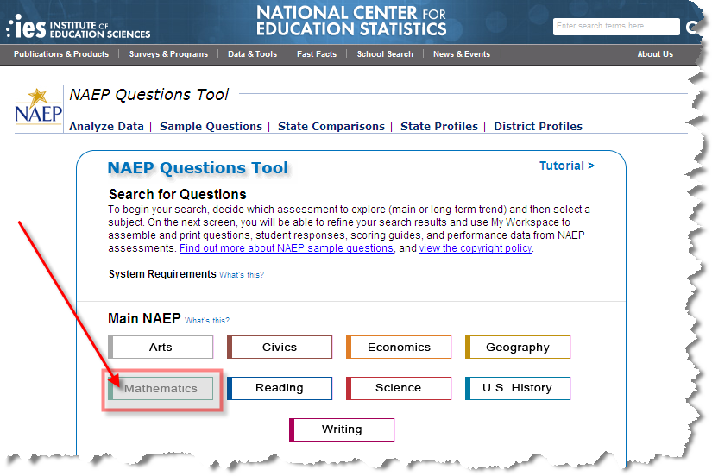
NAEP QUESTIONS TOOL

Slide 4
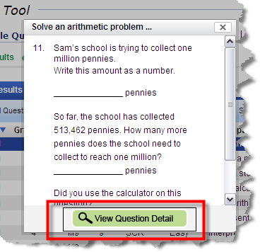
NAEP QUESTIONS TOOL

Slide 5
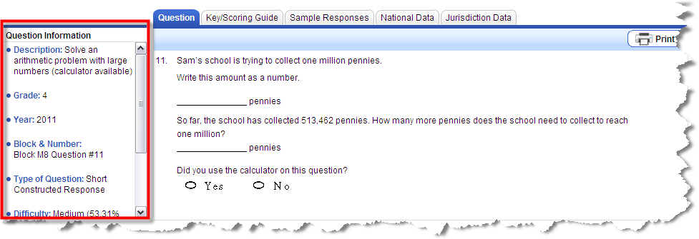
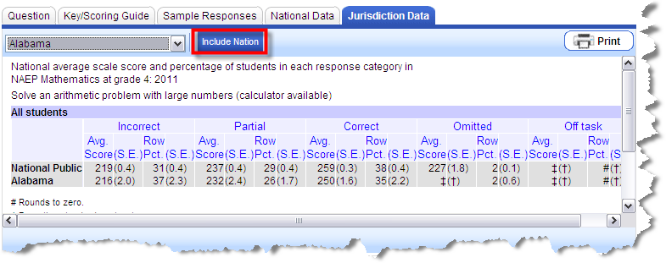
NAEP QUESTIONS TOOL

Slide 6
NAEP Reading
The NAEP reading assessment contains multiple-choice questions, as well as short and extended constructed-response questions.
Students spend approximately 50 to 60 percent of their assessment time providing written answers to constructed-response questions.

Slide 7
Item Type Distribution Reading

Slide 8
Reading Grade 4 Sample Question NAEP Reading Grade 4 Sample Question

Slide 9
NAEP Reading Grade 4 Question/Response
Scale Score Item 326: Use information to explain caused relations in a process – Integrate/Interpret

Slide 10
NAEP Reading Grade 4 Score Response
Difficult Item

Slide 11
NAEP Reading Grade 4 Question/Response
Scale Score Item 211: Recognize main purpose of informational text – Integrate/Interpret

Slide 12
NAEP Reading Grade 4 Score Response
Relatively
easier item

Slide 13
NAEP Grade 4 Teacher Questionnaire

Slide 14
NAEP Reading Grade 4 Teacher Question
Use of Cognitive Process:
Classroom Organization and Instruction

Slide 15
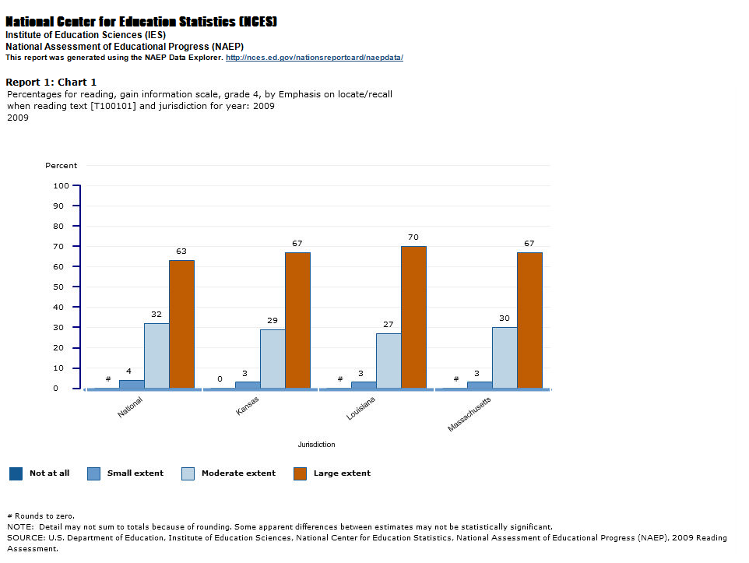
NAEP Reading Grade 4 Teacher Response
locate & recall

Slide 16
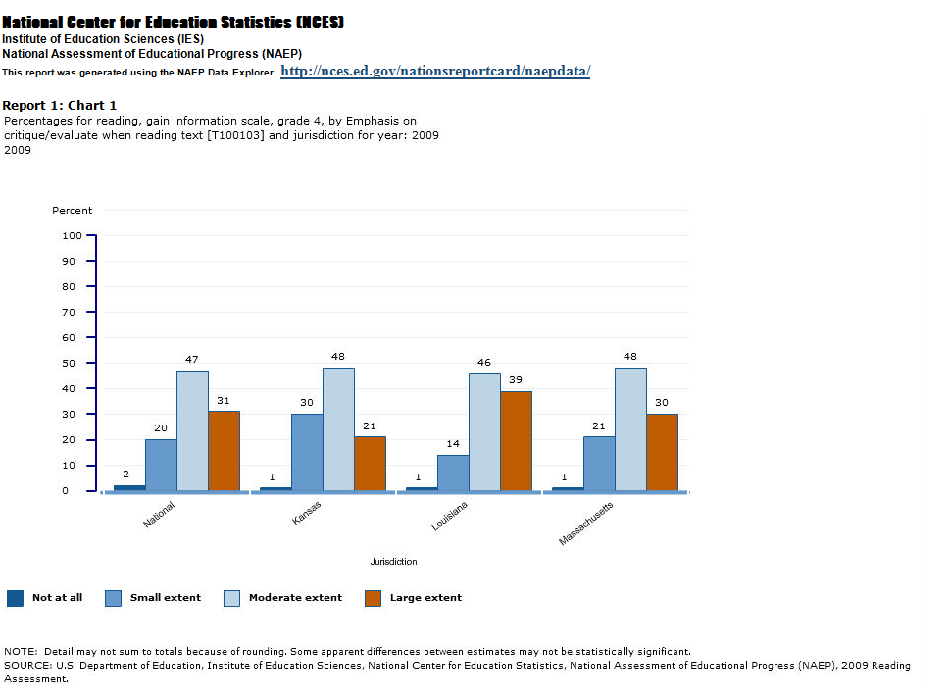
NAEP Reading Grade 4 Teacher Response
critique & evaluate

