Slide 1
Balanced Assessment Systems
Beth Fultz & Julie Ewing
January 20, 2023

Slide 2
Go to www.menti.com
Use the code 4645 3854
What do you think of when you hear Balanced Assessment System?

Slide 3
Balanced Assessment System
Formative Tools
Planned, instructionally-embedded, and ongoing
Minute by minute between teacher and student
Interim Assessments
Intentionally developed and administered at particular intervals of the school year
Can be aggregated at classroom or building level
Typically focuses on smaller number of standards
Summative Assessments
Provide evidence of learning and mastery of standards at end point in time
End of year
Comprehensive
Can be used as a snapshot within and across schools and districts
All based on Kansas Standards

Slide 4
Where do all my tests fit?
End of chapter test = interim
Teacher-created end-of-unit test = all three?
ACT = more like a screener
Fastbridge dyslexia screener = screeners are different
Notes:
Although we think of a balanced assessment system as consisting of formative, interim, and summative assessments, there are other types of assessments used in schools that do not fit the definitions neatly.
For example, you may use an end-of-chapter test from a text book to see what the students have learned from the chapter. Typically, we consider this an interim assessment.
Teachers also create their own end-of-unit tests. These could be considered summative, interim OR formative, depending on how they are used. If they are used to assign a grade for the unit, they are summative. If they are only used for the teacher to determine where students’ knowledge and skills are lacking so she can plan instruction, then they are formative. Any combination of that or aggregate analysis of the data makes them interim.
We also have tests that are screeners. Screeners are used to place students into programs. The various reading tests under Fastbridge are often used as screeners. However, once they are administered multiple times to measure progress, they act more like interim tests.
Finally, admissions tests could be considered summative – the end of high school – but, really, they are more like screeners to see if the student has the requisite knowledge and skill for college.

Slide 5
Exercise #1: What assessments do you give throughout the year?
Talk to your neighbors about the types of assessments you use. Try to use the three main categories plus “screener” as you do so.
Summative
Interim
Formative
Screener
Notes:
Now we will take a break so you can talk about what I have presented so far.
Talk to the people at your table about the types of tests you give the most frequently. What types are they? Why do you give them? Could you use more feedback from assessments or are you already giving too many?
What type of assessment are you giving most frequently?
How satisfied are you with the number of assessments you give? Explain.

Slide 6
Go to www.menti.com
Use the code 4645 3854
What summative assessment has the most value in your district?

Slide 7
Go to www.menti.com
Use the code 4645 3854
What interim assessment has the most value in your district?

Slide 8
Go to www.menti.com
Use the code 4645 3854
What formative assessment has the most value in your district?

Slide 9
Using Assessments in a Balanced Systems
Summative Questions:
How much of the standards did Johnny learn this year?
Overall, where were the strengths and weakness in my class?
Which schools in my district were most successful in meeting the standards?
Interim Questions:
Which standards has Maria mastered?
How much has Maria grown from October to January? Is that a lot?
If Maria took the summative test today, how would she likely perform?
Formative Questions:
Do my students understand what I just taught them?
Where are they struggling?
Once we understand the types of assessments, the next question is “how do we use them all appropriately?”
Notes:
Knowing what each type of assessment is is only the first step. The next question is which to use when? My recommendation is to first figure out what your question is. What information are you trying to collect? What do you want to know? When you can articulate your question, you can then figure out what type of assessment is most likely to answer it.
This slide shows some typical questions for each assessment type.
Summative tests can answer questions like:
How much of the standards did Johnny learn this year?
Overall, where were the strengths and weakness in my class?
Which schools in my district were most successful in meeting the standards?
Interim assessments can answer questions such as:
Which standards has Maria mastered?
How much has Maria grown from October to January? Is that a lot?
If Maria took the summative test today, how would she likely perform?
And formative assessments help teachers with more immediate questions to help in lesson planning like:
Do my students understand what I just taught them?
Where are they struggling?

Slide 10
Exercise #2 Summative Data
Talk to your neighbors and discuss how you currently use summative assessment data?
What data does a summative give?
What data doesn’t it give?

Slide 11
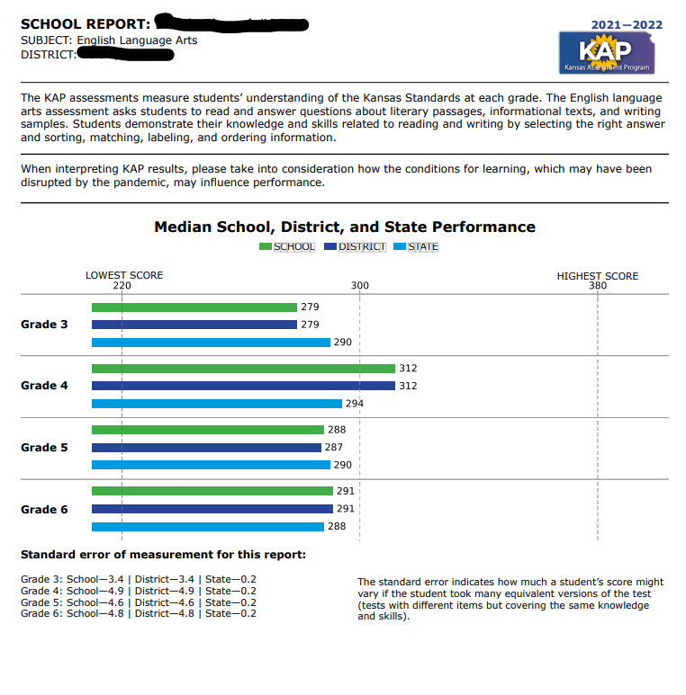
School Level Report- ELA State Assessment

Slide 12
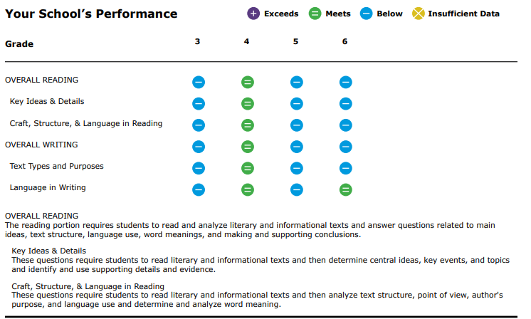
School Level Report- ELA State Assessment

Slide 13
Selecting the Best Interim Assessment
The first step is to determine why you want to give an interim assessment.
If you want to judge performance on the state content standards, you need to be sure the test is aligned to the state content standards.
If you want to see how your students match up to others, you want a test that is “normed.”
If you want to monitor the progress your student makes throughout the year, you want to give a test that tracks growth.
Second is to consider other features
Does it provide the needed accommodations for all my students?
How easy is it to use?
Notes:
Once you’ve decided you need an interim assessment, the next question is “which one?” Now, you may not have much of a choice if you’re a teacher and the district has already paid for a specific example, but you can at least choose between a district purchased assessment, the KS interims, and something you create yourself.
If your goal is to check on how well students have learned the standards, you need to make sure the test measures those standards. The KS interim is the best for that. Or you could write your own test.
If your goal is to see how your students match up to others, you will want an assessment that is normed. These are typically purchased by the district.
If your goal is to monitor the progress your student makes through the year, you want to give a test that tracks growth, which again is typically purchased.
If you’re someone who gets to decide which test to purchase, you’ll want to think about which of the first three questions are most important. Second, you’ll need to think about other features such as accommodations and ease of use.

Slide 14
Exercise #3
Share with your neighbors what interim assessments your district uses
What do you like about them?
What would you change?
What data does the interims give you?
Notes:
Now let’s take another break from this presentation to talk about what we’ve learned.
Think about questions you want to answer. What are the 2-3 most important questions you face during the school year? What type of assessment could help you answer these? Are you already using that test or do you need to select or design a new one?

Slide 15
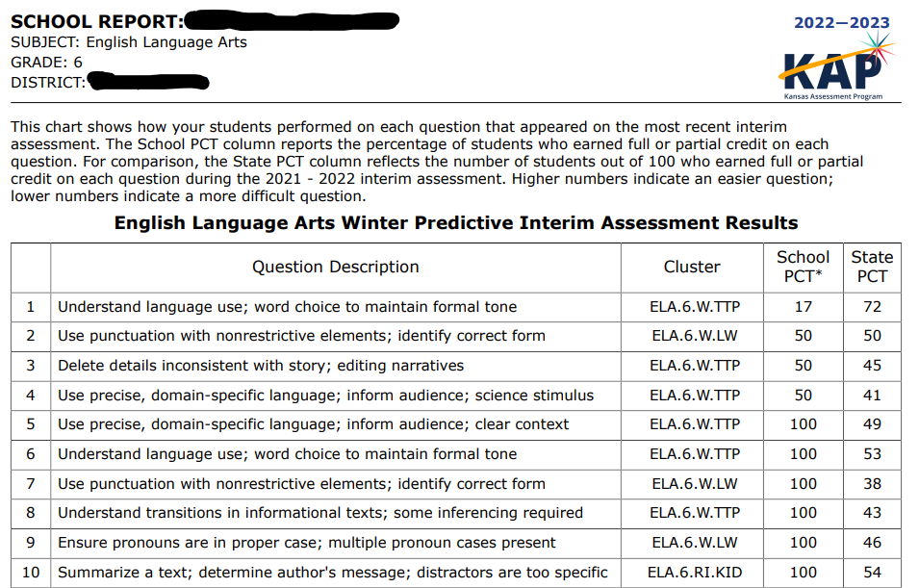
School Level Report- KS Interim

Slide 16
Selecting types of Formative Assessment
Some teachers have noted that formative assessment is simply part of good teaching.
There are many types of quick check-ins you can use to see how well a student is understanding material.
If you’re interested in seeing what your class took from your instruction that day, an exit interview question may be most appropriate
If you want to gauge understanding of a concept as you’re teaching it, whiteboards, red-yellow-green markers will be helpful.
If you’re focused on a single student or small group of students and trying to figure out what concepts they are not understanding, asking “what is wrong with this approach” questions or “pick the best explanation” may help.
Notes:
If you decide you really want to work more on formative assessment, these can be easy to implement. Many teachers call formative assessment “good teaching,”
There are many types of quick check-ins you can use to see how well a student is understanding material. If you’re interested in seeing what your class took from your instruction that day, an exit interview question may be most appropriate. If you want to gauge understanding of a concept as you’re teaching it, whiteboards, red-yellow-green markers will be helpful. If you’re focused on a single student or small group of students and trying to figure out what concepts they are not understanding, asking “what is wrong with this approach” questions or “pick the best explanation” may help.
There are many resources out there on formative techniques and your facilitator can help you find them.

Slide 17
Knowing when to use Interim vs Formative
Interim can identify standards that are mastered or problematic for an individual student and give you an overview of your classroom as a whole.
To really probe a misunderstanding or the depth of understanding, you need to use formative tools.
Notes:
Remember the grain size of information from the interim will be bigger than that from formative. Interim can identify standards that are mastered or problematic for an individual student and give you an overview of your classroom as a whole. However, it can only answer the “what” and not the “why.” To really probe a misunderstanding or the depth of understanding, you need to use formative tools.

Slide 18
Interpreting results
In a balanced assessment system, the common thread should be the content standards.
Summative only gives information relative to a category made up of multiple content standards. E.g., Reading Literary Texts
Interim could give you information about a group of standards or about individual items linked to standards.
The group may be the same as the summative or a smaller grain size
The individual item report will show which items they missed, and which distractor they chose
Formative is the smallest grain size and gives you more insight into student thinking, depth of understanding, lack of understanding, or misunderstanding.
Notes:
Finally, once we understand the difference amount assessments in a balanced assessment system and when to use each kind, we need to understand how to use the information from each of these.
In order to be able to move seamlessly across the three types of assessment and consider what the information from all three is telling you, all three assessments must be aligned to the content standards. We will talk about alignment in a separate video, but basically, all three assessments must measure the Kansas content standards and not anything outside of the standards.
For instance, KAP measures all of the standards in a grade and subject area. Depending on the level of emphasis, there may only be 1-2 items on a single standard, but it measures all of them and does not include any items that are not in the standards. However, summative assessments do not give you information at the standard level. Instead, the reports group standards into meaningful categories to give you information on how a student does on Reading Literary Texts separately from Reading Informational Texts, for example.
The KS interim assessments are also fully aligned to the KS content standards. Assessments developed by commercial vendors, such as NWEA MAP or Renaissance Start, will have some items that align to KS standards and others that do not. KS interims will give you information about individual items, while most commercial tests will give you different subcategory information. They will also tell you how many items a student got right and wrong.
Formative assessments typically focus on one standard or even a part of a standard. These are the tests that give the most insight about a student but with the fewest reference points.

Slide 19
Go to www.menti.com
Use the code 4645 3854
Where does your district need the most support concerning assessments?
Summative
Interim
Formative

Slide 20
Conclusion
A balanced assessment system is comprised of summative, interim, and formative assessments all working in conjunction to provide information about students’ knowledge and skills in various levels of detail.
To work well, a balanced assessment system needs to have all components fully aligned to the state content standards.
Many times, teachers learn more from their students from their own assessments.
Interim and summative assessments provide necessary information about performance relative to an external standard.
Criterion – performance levels
Normative – compared to other schools, districts, states, or the nation as a whole.
Notes:
In conclusion, a balanced assessment system is comprised of summative, interim, and formative assessments all working in conjunction to provide information about students’ knowledge and skills in various levels of detail.
To work well, a balanced assessment system needs to have all components fully aligned to the state content standards. Teachers need to understand what they can learn from each type of assessment and how to make the most of that data without overinterpreting it.
To do so, I recommend articulating your question first and then determining the best assessment to answer it.
Many times, teachers learn more from their students from their own assessments. Formative techniques can help with this.
However, although formative assessments are probably the most useful in the classroom, interim and summative assessments provide necessary information about performance relative to an external standard. We need to know how much of the grade-level content a student has learned, which is why the summative assessment has performance level. And sometimes we want to understand how our students’ achievement and growth compare to others, which we get through norm-referenced data.
It’s all about asking the right question at the right time and interpreting the data appropriately.

Slide 21
Resources
Understanding Assessment for ELA.pdf (ksde.org)
By Marianne Perie, Measurement in Practice, LLC

Slide 22
Beth Fultz
Director
Career, Standards & Assessment Services
785-296-2325
bfultz@ksde.org
Julie Ewing
Assessment Coordinator
Career, Standards and Assessment Services
785-296-4349
jewing@ksde.org

