Slide 1
Kansas Leads the World in the Success of Each Student.
Dr. Randy Watson, Kansas Commissioner of Education

Slide 2
A NEW Vision for Kansas ...
Kansas leads the world in the success of each student
KANSAS STATE DEPARTMENT OF EDUCATION | www.ksde.org

Slide 3
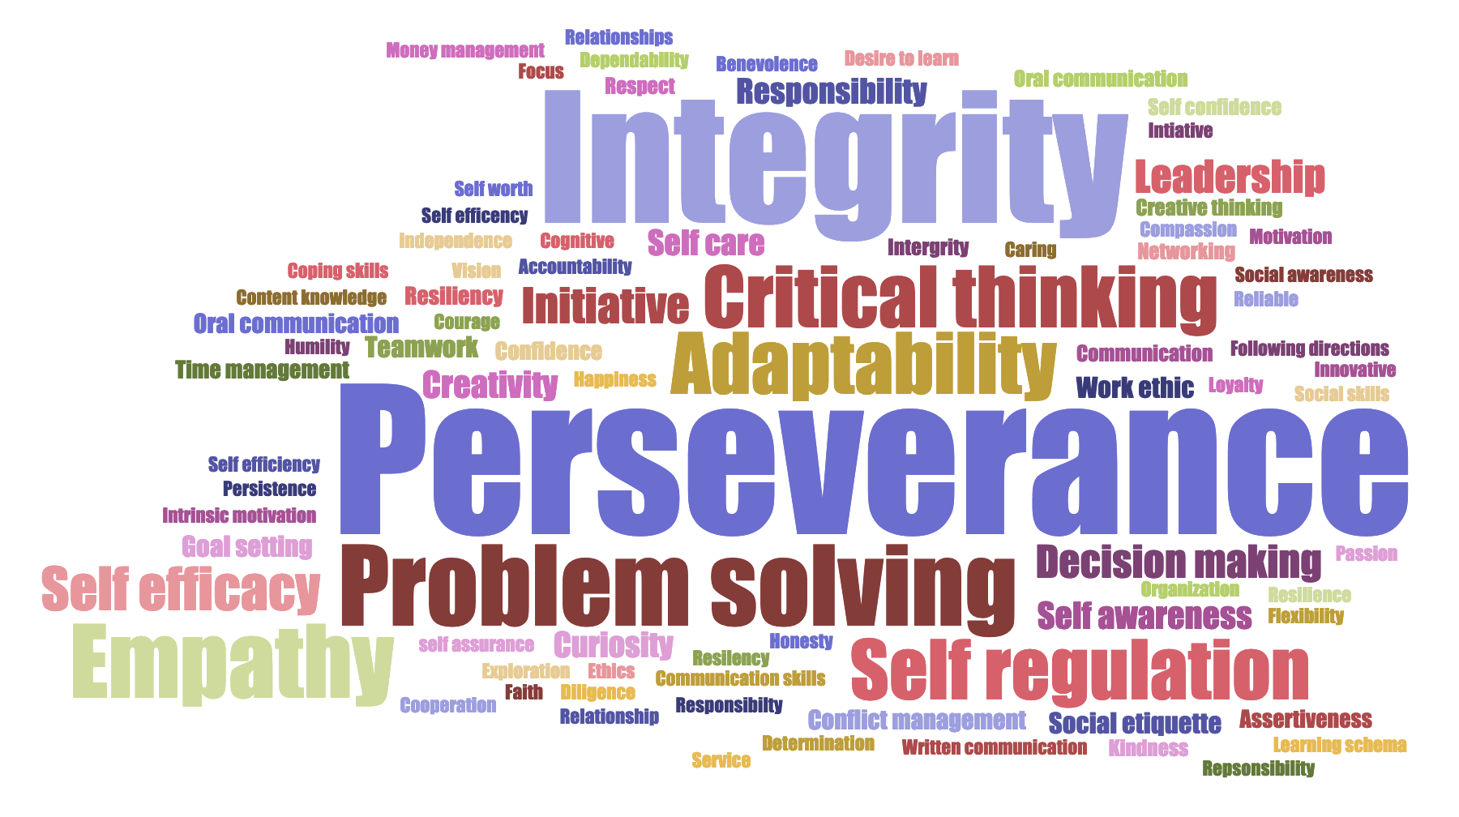
Kansans said…

Slide 4
How Does an IPS flow into Post Secondary Success?

Slide 5
Kansas School Redesign Principles
Student Success Skills | Family, Business, and Community Partnerships
There is an integrated approach to develop student social-emotional learning. | Partnerships are based on mutually beneficial relationships and collaboration.
Personalized Learning | Real World Application
Teachers support students to have choice over their time, place, pace and path. | Project-based learning, internships, and civic engagement makes learning relevant.

Slide 8
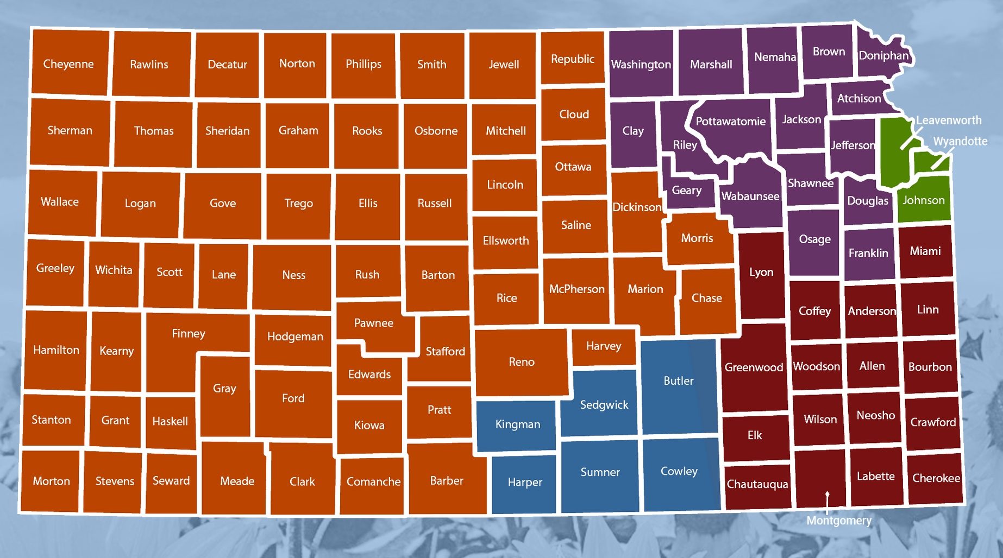
Health Care
Teaching
IT – Software developers
Business - Sales, managers, accountants
Energy - Lineman
Health Care
Teaching
IT – Software developers
Business - Sales, managers, accountants
Energy - Lineman
Health Care
Engineering
IT – Software developers
Business - Sales, managers, accountants
Truck Drivers
Health Care
Teaching
Ag
Business - Sales, managers, accountants
Machining
Health Care
Teaching
Ag
Business - Sales, managers, accountants
Energy - Lineman
Health Care
Teaching
Engineering
Business - Sales, managers, accountants
Aircraft machining
Health Care
Teaching
Engineering
Business - Sales, managers, accountants
Aircraft machining

Slide 9
Pathway Name | Count
Family, Community & Consumer Services | 236
Construction & Design | 230
Business Finance | 194
AV Communications | 187
Web & Digital Communications | 180
Comprehensive Agriculture Science Pathway | 170
Power, Structural, & Technical Systems | 170
Visual Arts Pathway | 133
Restaurant and Event Management | 131
Manufacturing | 116
Business Entrepreneurship and Management | 115
Marketing | 106
Health Science | 103
Teaching/Training | 103
Engineering & Applied Mathematics | 82
Early Childhood Development & Services | 77
Mobile Equipment Maintenance Pathway | 63
Programming & Software Development | 54
BioChemistry | 47
Plant Systems Pathway | 47
BioMedical | 46

Slide 10
Notes:
Today’s students are the future workforce and future leaders of Kansas. Kansans Can achieve anything and, together, Kansans Can lead the world in the success of each student.

