Slide 1
Navigating Change 2020
Dr. Randy Watson, Kansas Commissioner of Education

Slide 2
Shortened Quarantine Period After Exposure
NOTE:
The 14-day quarantine period after an exposure is still the best recommendation.
CDC is not changing the incubation period for COVID-19.
Guidance for a shortened quarantine period is aimed at increasing compliance
Shortened quarantine does NOT apply to residents of long-term care and assisted living facilities and does NOT apply to offender populations in prisons. These types of settings are high risk for outbreaks and house some of our most vulnerable populations.
Each county Local Health Officer has the ultimate decision on whether to adopt the shortened quarantine guidance.
Notes:
In the next day or so, CDC will release guidance on a shortened quarantine period for people that have been exposed to the SARS-CoV-2 virus (either because of their travel or after being exposed to a case). When they do, KDHE will adopt this with some slight modifications.
It is important to note that the 14 day quarantine after being exposed is still the gold standard. This alternative for a shortened quarantine period is NOT because the scientific literature is showing a shorter incubation period, which is the amount of time between when a person is exposed and when they develop disease. We still know that most people will develop disease within 14 days after exposure. This change is completely based on the fact that so many people are ignoring the 14 day quarantine period right now, or cases are not telling Public Health officials who their close contacts are because they don’t want people to have to quarantine. So, the shortened quarantine period is aimed at hopefully increasing compliance with quarantine, and getting more exposed people tested.
It’s also important to note that the shortened quarantine does NOT apply to residents of long-term care and assisted living facilities and does NOT apply to offender populations in prisons. These types of settings are high risk for outbreaks and house some of our most vulnerable populations so we want to continue to protect these populations as much as possible.
Finally, it’s important to note that each county Local Health Officer has the authority to adopt or not adopt this guidance.

Slide 3
Shortened Quarantine Period After Exposure
Shortened Quarantine Guidance
Quarantine with testing
After exposure, monitored daily (self monitoring or active monitoring by Public Health) for 7 days. Are only eligible for shortened quarantine if you have no symptoms.
On or after day 5, may get a PCR test (antigen and antibody tests are NOT allowed for this purpose) – if negative can be removed from quarantine after day seven (7).
Must remain asymptomatic (no symptoms)
Quarantine without testing
After exposure, monitored daily (self monitoring or active monitoring) daily for 10 days. Are only eligible for shortened quarantine if you have no symptoms.
After day 10 can be released from quarantine without a test.
Must remain asymptomatic (no symptoms)
All exposed people should self-monitor for fourteen (14) days from exposure and contact healthcare provider if symptoms develop. Disease can still develop through day 14.
Notes:
Quarantine with testing
After exposure, monitored daily (self monitoring or active monitoring by Public Health) for 7 days. Are only eligible for shortened quarantine if you have no symptoms.
After day 5, may get a PCR test – if negative can be removed from quarantine after day seven (7).
Must remain asymptomatic (no symptoms)
Quarantine without testing
After exposure, monitored daily (self monitoring or active monitoring) daily for 10 days. Are only eligible for shortened quarantine if you have no symptoms.
After day 10 can be released from quarantine without a test.
Must remain asymptomatic (no symptoms)

Slide 4
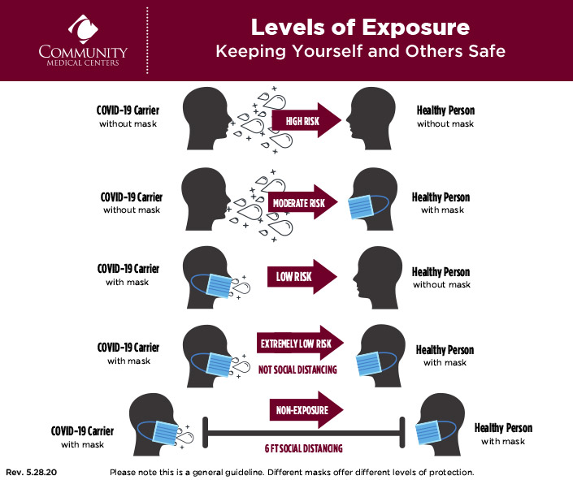

Slide 5
Partners who contribute to Navigating Change

Slide 6
Changes to Elementary Gating Criteria
As of November 23, 2020, in Kansas, 3.2% of cases have been among children ages 0-9 years (n=4,535 total cases). Kansas-specific data follows a general national trend which indicates that children ages 0-10 years make up a smaller proportion of the overall cases.¹ Evidence also suggests that children in this age group are less likely to transmit the virus if they are infected,² although there is some evidence that the secondary infection rate from children may be higher among their close household contacts.³
Notes:
1. Leeb RT, Price S, Sliwa S, et al. COVID-19 Trends Among School-Aged Children — United States, March 1–September 19, 2020. MMWR Morb Mortal Wkly Rep 2020;69:1410–1415.
2. Park YJ, Choe YJ, Park O, et al.; COVID-19 National Emergency Response Center, Epidemiology and Case Management Team. Contact tracing during coronavirus disease outbreak, South Korea, 2020. Emerg Infect Dis 2020;26.
3. Grijalva CG, Rolfes MA, Zhu Y, et al. Transmission of SARS-COV-2 Infections in Households — Tennessee and Wisconsin, April–September 2020. MMWR Morb Mortal Wkly Rep 2020;69:1631–1634.

Slide 7
Changes to Elementary Gating Criteria
Given what is currently known about infection rates in young children and secondary infections caused by young children, the Kansas Department of Health and Environment and the Kansas COVID Workgroup for KIDS recommend modifying the Navigating Change guidance to allow for elementary schools to remain in an In Person or Hybrid Learning Environment when county metrics recommend a Remote Only Learning Environment if school districts meet the following criteria:

Slide 8
Changes to Elementary Gating Criteria
Middle and High Schools should continue to follow Navigating Change guidelines as currently adopted.
As recommended in original Navigating Change Document, regardless of learning mode that is adopted by a district or building, students requiring in-person education based on individualized education plans or 504 plans as well as students failing or at risk of failing academically, or students experiencing disproportionate adverse social/emotional effects of remote schooling should be allowed to attend school in person. These groups should be small and in a cohort of no more than 10 students in each group; masking and physical distancing of 6 feet or more should be enforced. Students should remain in their cohort group for the duration of in person school. Buildings should follow local, state, and national guidance regarding congregation limits.

Slide 9
Changes to Elementary Gating Criteria
Students, teachers, and staff within the elementary buildings should wear a mask appropriately, in accordance to Navigating Change guidelines.
Students, teachers, and staff within the elementary buildings should wear a mask appropriately.
Elementary school children should be physically distanced at least 6 feet from each other for the majority of the day. Teachers and staff should also comply with physical distancing recommendations. If physical distance of 6 feet can’t be accomplished, schools may conduct a hybrid model of am/pm grouping or cohort in groups of no more than 5 students with each cohort remaining 6 feet apart for the majority of the day.
Each building used for Elementary instruction follow ventilation guidance in accordance to Navigating Change guidelines.
Each building used for Elementary instruction should sanitize and clean surfaces and restrooms in accordance to Navigating Change guidelines.

Slide 10
Changes to Elementary Gating Criteria
Students, teachers, and staff should continue regular hand hygiene as per Navigating Change.
Each school district may onboard point of care testing capacity to test any students, teachers and staff that become symptomatic with COVID-19 symptoms during the school day.
Buildings require appropriate staffing for classrooms, administrative offices, custodial staff, transportation, food service, and other programs that are vital to the district’s success. This also includes the ability to fill vacancies with licensed substitute staff when needed. If districts cannot maintain adequate staffing for a building, then that building should be closed until it is able to operate safely and effectively

Slide 11
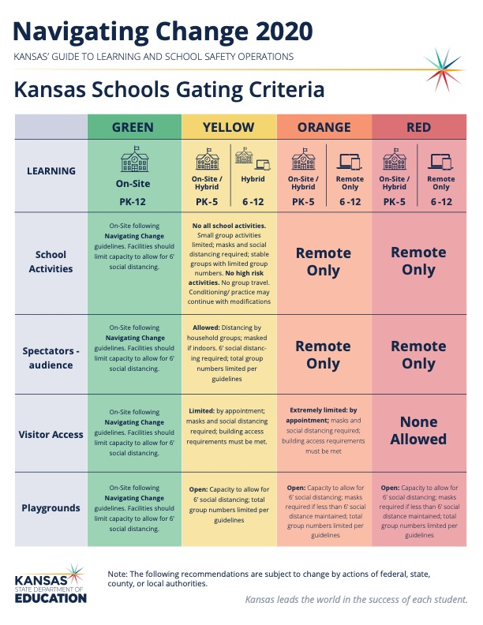

Slide 12
Proposal to the SBOE on the 1116 Hour Requirement
Schools requesting a waiver must schedule and use professional development hours between December 1, 2020 and April 30, 2021;
The State Board will waive the number of school hours equal to the number of hours used for said professional development up to 20 hours;
The time must be used for either staff development, staff collaboration, parent-teacher conferences, assistance to teachers and other staff in the planning and delivery of instruction during the pandemic, or any combination thereof.

Slide 13
Notes:
Today’s students are the future workforce and future leaders of Kansas. Kansans Can achieve anything and, together, Kansans Can lead the world in the success of each student.

Slide 14
Learning Environments
Understanding the need to be flexible during the 2020-21 school year, three different learning environments were defined.
On-Site
Used when community restrictions for COVID-19 are low.
Schools can operate at 100% capacity with precautions.
Social distancing should be practiced where feasible.
Group sizes and spectator events will meet local guidelines.
Hybrid
Used when community restrictions for COVID-19 are moderate.
Schools will operate at reduced capacity (50%) with students alternating between on-site and remote learning.
Social distancing should be enforced.
Group sizes will meet local guidelines (15)
Spectator events not allowed.
Remote
Used when community restrictions for COVID-19 are high.
School capacity restricted to essential staff and activities.
Social distancing should be strictly enforced.
Group sizes will meet local guidelines (10 or fewer).
Spectator events not allowed.

