Slide 1
Designing the
Rocket
Meeting 2- November/December 2021

Slide 2
Agenda
9:00-9:20 Welcome, Share-Out, Objectives
9:20-10:00 Create (Tentative) Goal Areas
10:20-10:30 BREAK
10:30-11:10 Redesign Principles
11:10-11:20 BREAK
11:20-12:00 Perfect Day
12:00-12:30 LUNCH
12:30-1:00 Research & GAITs
1:00-1:45 District Discussion
1:45-2:00 BREAK
2:00-2:45 Plan Time
2:45-3:00 Wrap Up

Slide 3
Links
Slides -

Slide 4
Kansas Vision for Redesign
Kansas leads the world in the success of each student
It’s what Kansans said they wanted. It’s what the job trends and our current K-12 outcomes are telling us.

Slide 5
Notes:
https://www.ksde.org/Portals/0/Communications/KC_School_Redesign/Kansans%20Can%20School%20Redesign%20Project%20Plan%20Year%20Timeline.pdf?ver=2020-09-24-144333-290

Slide 6
Objectives
01
Learn the Redesign Process
Experience Design Thinking
Empathize with your Students and Teachers
Create Goal Areas based on Data
02
Identify Strategies to Prototype (Principles)
Research and understand the 4 Redesign Principles (what, why, and how)
Compile list of possible Strategies
ID how many strategies to research for possible prototyping
03
Form Investigation Teams
Create Investigation teams based on Goal Areas
Establish Roles on Investigation Teams
04
Set Up School Visits
Goal Areas, Investigation Teams, and Capacity
In State, Out of State, and/or Virtual
Set up a Why and Goals before each visit
05
Communicate with Stakeholders
Why, Who, How, and When
Continue developing your plan
Over communicate

Slide 7
Designing the Rocket
FOCUS
LEVERAGE
ENGAGEMENT
ACCOUNTABILITY
Your Vision for Education
Learn the Redesign Process Research Goal Areas Engage Stakeholders & Communicate
-Design Thinking Challenge -Identify Goal Areas -Build a Purposeful
-Introduce 4DX -Develop Investigation Community
Teams -Mobilize Others -Research 4 Principles -Communication Plan
-Take Inventory -Business Plan
-Identify Strategies to Prototype
Notes:
Focus on the wildly important.
Act on lead measures.
Keep a compelling scoreboard.
Create a cadence of accountability.

Slide 8
TURNKEY PROCESS
Regional Training Team will experience workshop + modify turnkey materials to train the School redesign Teams in their service centers
RTT
School Redesign Team receives training from RTT and makes key decisions to modify expectations for their district and school context
SRT
School teams receive training from their School redesign team and engage staff through participation in investigation teams
FULL SCHOOL
Notes:
Two Things:
While you are at these trainings, we are giving you content and walking you through activities to assist you in engaging in design thinking to plan your school redesign. As you participate, you should always be thinking about what you will take back to your staff and how you will deliver it.
To assist you with planning your ‘turnkey’, we have a communication log that you were asked to create in the beginning of our time together. You are not obligated to use this, but it is highly encouraged. Use this communication log to help you plan, to track your progress, and to implement a system of accountability.

Slide 9
WHAT
Determine what is the essential learning for all.
WHY
Establish a clear purpose for the learning.
Turnkey Considerations
HOW
Determine the best time, place, and delivery model for the learning.

Slide 10
Check In with Coach
Discuss- How did you engage staff in…
Learning about the 4 Redesign Principles
Learning about Design Thinking
Empathizing with students
Creating HMW Questions
Notes:
Note- This is like an ‘accountability meeting’. Reporting on last time’s commitments, giving a status update based on data (i.e. checklist), and talking about what’s next...that’s discipline 4 ‘create a cadence of accountability’!

Slide 11
Reflection & Goal Areas
Redesign Principles: Deeper Dive
How can we use Design Thinking to Innovate?
How do we support Inquiry, Innovation, and Exploration?
Where are we now? Where are we going?
Turnkey Planning & Closing

Slide 12
BLENDING DESIGN THINKING & 4DX
EMPATHIZE
with our students and staff
TEST
models and strategies with students
DEFINE
their needs
Create a Cadence of Accountability
Iterations
PROTOTYPE
models and strategies
IDEATE
solutions to these needs
Focus on the Wildly Important (Goal Areas & Lag Measures)
Keep a Compelling Scoreboard
(Liang, Mitchell, & Scott, 2020)
Act on Lead Measures (Strategies)
Notes:
The four disciplines of execution…
Begin with Focusing on what is wildly important. As you define your goals based on your empathizing, you are engaging in the first discipline. You define your goal areas and you determine the piece of data that you ultimately intend to impact. We call this your lag measure because it lags behind the work. By executing on your strategies, by working to improve this goal area, you are ultimately wanting to move which piece of data? That is your lag measure. Lag measures can often align with the state board outcomes like graduation rate and post secondary effective rate.
As you begin to ideate, brainstorm, strategies that you prototype or plan out for implementation, you are preparing to ‘Act on your Lead Measures’. Those lead measures, or strategies, are what you lead you to results or movement closer to your lag measure.
Once you begin testing, you will want to keep a compelling scoreboard, meaning you have a way to track your progress or impact, and you also need to create a cadence of accountability where you can reflect on your progress and iterate or pivot as needed. Keeping a compelling scoreboard and creating a cadence of accountability represent disciplines 3 and 4 respectively. These disciplines challenge you to answer the question: Is what I am doing working? How do I know? Without scoreboards and accountability meetings, successful implementation falls flat.

Slide 13
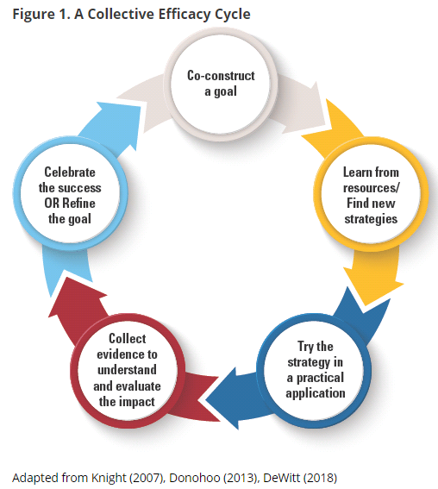
Grow Collective Efficacy
(Liang, Mitchell, & Scott, 2020)
Notes:
The graphic on the left walks through the steps necessary for growing collective efficacy in your organization. In order to grow and build collective efficacy, you must allow all staff an opportunity to co-construct the goal; learn from resources and investigate strategies; staff must have a chance to ‘try a strategy on’ while collecting evidence to understand impact; and lastly, staff must have a collective opportunity to celebrate and reflect.
If you compare that to the process used in Redesign of design thinking and the four disciplines of execution, you see that there is quite a significant alignment between them. In redesign, you use design thinking and 4dx to empathize with students and define your wildly important goals. You ideate and investigate strategies that become your lead measures. Your build prototypes the you test in small groups and while doing so, you create data scoreboards and you hold accountability meetings where ‘pivots’ or ‘adjustments’ are determined. And at the end of your test window, you reflect, celebrate and create a plan for scale or revise and begin again.
To put it simply, using the redesign process with fidelity and integrity will allow you to grow teacher collective efficacy. Let’s move on to learn a little bit more!
Donohoo, Jenni, and Steven Katz. “What Drives Collective Efficacy?” What Drives Collective Efficacy? - Educational Leadership, ASCD, July 2019, www.ascd.org/publications/educational-leadership/jul19/vol76/num09/What-Drives-Collective-Efficacy%C2%A2.aspx.
Liang, J. “Grace,” Mitchell, T., & Scott, J. (2020). Statewide School Redesign: Integrating Design Thinking and the Four Disciplines of Execution as a Continuous School Improvement Process. Journal of Case Studies in Educational Leadership, 1(13). Retrieved from https://journals.sagepub.com/doi/10.1177/1555458920975462

Slide 14
FOCUS
LEVERAGE
ENGAGEMENT
ACCOUNTABILITY
FOCUS
Focus on the Wildly Important
Identifies starting line, finish line, and deadline.
Narrows the gap
Think WHAT not HOW
Creates behavior change
Tests:
Aligned
Measureable now
Ownership
Performance based
Notes:
Discipline 1 support- https://www.franklincovey.com/the-4-disciplines/discipline-1-wildy-important/

Slide 15
Create WIGs
Wildly Important Goals
Using your ‘How Might We’ questions, begin establishing your Wildly Important Goals (WIGs).
It is recommended that you only have 2-4 WIGs.
Use this thinking sheet to help you go from a HMW to a WIG.

Slide 16
Introduce the Redesign Workbook
Preview the Redesign Workbook
Guidance & Sample
Fill In-
System Vision & Goals
School Vision
HMW
Goal Areas
Think about Lag Measure

Slide 17
VISION:
Foundations
Student Success Skills
Real World Applications
Personalized Learning
Family/Business/Community Engagement
How might we ...?
Goal Area:
Goal Area:
Goal Area:
Note-
It is recommended that you select 2-3 goal areas to intensely focus on in working to achieve your vision. Your goal areas should not be the Redesign Principles, but should connect back to the Principles through the execution of strategies. Also consider: what does your data tell you? What are your stakeholders telling you? What areas of need exist and need to be specifically addressed?
Lag Measure(s):
Lag Measure(s):
Lag Measure(s)
Strategies:
Strategies:
Strategies:
Goal Areas and Strategies
Notes:
The 4 Redesign Principles and the schools’ shared vision are foundational.
Schools, with the leadership of the SRT, will explore their student profiles, determine their HMW statements (or problems of practice). These could align with their KESA goal areas.
Schools do not need to have 4 goal areas, they could have fewer, depending on their student profiles.
The work of the investigation teams and the prototype results will inform the strategies that will be put in place. These strategies need to address the goal areas AND align to the 4 Redesign Principles.

Slide 18
Break

Slide 19
Reflection & Goal Areas
Redesign Principles: Deeper Dive
How can we use Design Thinking to Innovate?
How do we support Inquiry, Innovation, and Exploration?
Where are we now? Where are we going?
Turnkey Planning & Closing

Slide 20
Kansans Can School Redesign Principles
Student Success Skills | Family, Business, and Community Partnerships
There is an integrated approach to develop student social-emotional learning. | Partnerships are based on mutually beneficial relationships and collaboration.
Personalizing Learning | Real World Application
Personalized learning places the whole child at the center of instruction. It is informed by strong educator/student/family/community relationships to provide equity and choice in time, place, path, pace and demonstration of learning. | Project-based learning, internships, and civic engagement makes learning relevant.
Notes:
Read Elevator Speeches with the 4 Principles-https://www.ksde.org/LinkClick.aspx?fileticket=kfIj8dZVr94%3d&tabid=1509&portalid=0&mid=6018

Slide 21
Activity Options- 45 Minutes
Complete a Principle Gap Analysis
Complete this with an intentional focus on your Vision & Goal Area(s)
Rotations-
Personalized Learning Deep Dive (graphic)
Family Engagement Standards Review & Discussion
Explore Google Site
Optional Professional Learning Summary Sheet
Notes:
The Principle Gap Analysis is the recommended activity.
In Designing the Rocket Day 2, another 45 minutes will be spent exploring the principles. Any combination of what is on the slide will work. Flexibility around this portion of the day is allowed, so long as significant time is spent on the principles. Presenters can also generate their own exploration/investigation activities.

Slide 22
Break

Slide 23
Reflection & Goal Areas
Redesign Principles: Deeper Dive
How can we use Design Thinking to Innovate?
How do we support Inquiry, Innovation, and Exploration?
Where are we now? Where are we going?
Turnkey Planning & Closing

Slide 24
Tackling Hard Challenges
“You can’t solve hard problems without hard conversations.”
-Source Unknown
“We can’t solve problems by using the same kind of thinking we used when we created them.”
-Albert Einstein

Slide 25
9 Dot Puzzle
Start the video and pause at :21 to attempt the 9 dot puzzle
After you have tried and discussed your efforts, resume the video.
When the video is done, discuss:
What unused space might exist?
What box/boundary have we unnecessarily imposed on our work?

Slide 26
Introducing Ideate
IDEATE
3 min
Let’s Brainstorm ways to solve a HMW.
There are no limits!

Slide 27
Why Brainstorm?
IDEATE
Leverage the collective thinking of the group by engaging, listening and building upon ideas
Creates a distinct segment of time when you intentionally turn up the generative part of the brain and turn down the evaluative part
Can be used throughout the design process to come up with ideas and solutions

Slide 28
Notes:
Talking Points:
Be intentional about setting aside a period of time when your team will be in “brainstorm mode” – when the
sole goal is to come up with as many ideas as possible, and when judgment of those ideas will not come into
the discussion.
Invest energy into a short period of time, such as 15 or 30 minutes of high engagement.
Get in front of a whiteboard or around a table, but take an active posture of standing or sitting upright. Get
close together.
Write down clearly what you are brainstorming. Using a How-Might-We (HMW) question is a great way to
frame a brainstorm (e.g. HMW give each shopper a personal checkout experience?).
There are at least two ways to capture the ideas of a brainstorming:
Scribe: the scribe legibly and visually captures on the board ideas that team members call out.
It is very important to capture every idea, regardless of your own feelings about each idea.
2. All-in: Each person will write down each of his or her ideas as they come, and verbally share it with the
group. It is great to do this with post-it notes, so you can write your idea and then stick it on the board.
Follow and (nicely) enforce the brainstorming rules – they are intended to increase your creative output.

Slide 29
‘A Day in the Life’ our Prototype
PROTOTYPE
Mora M. - 12th Grade
Lacking confidence outside of her school
How Might We ensure Mora develops confidence?

Slide 30
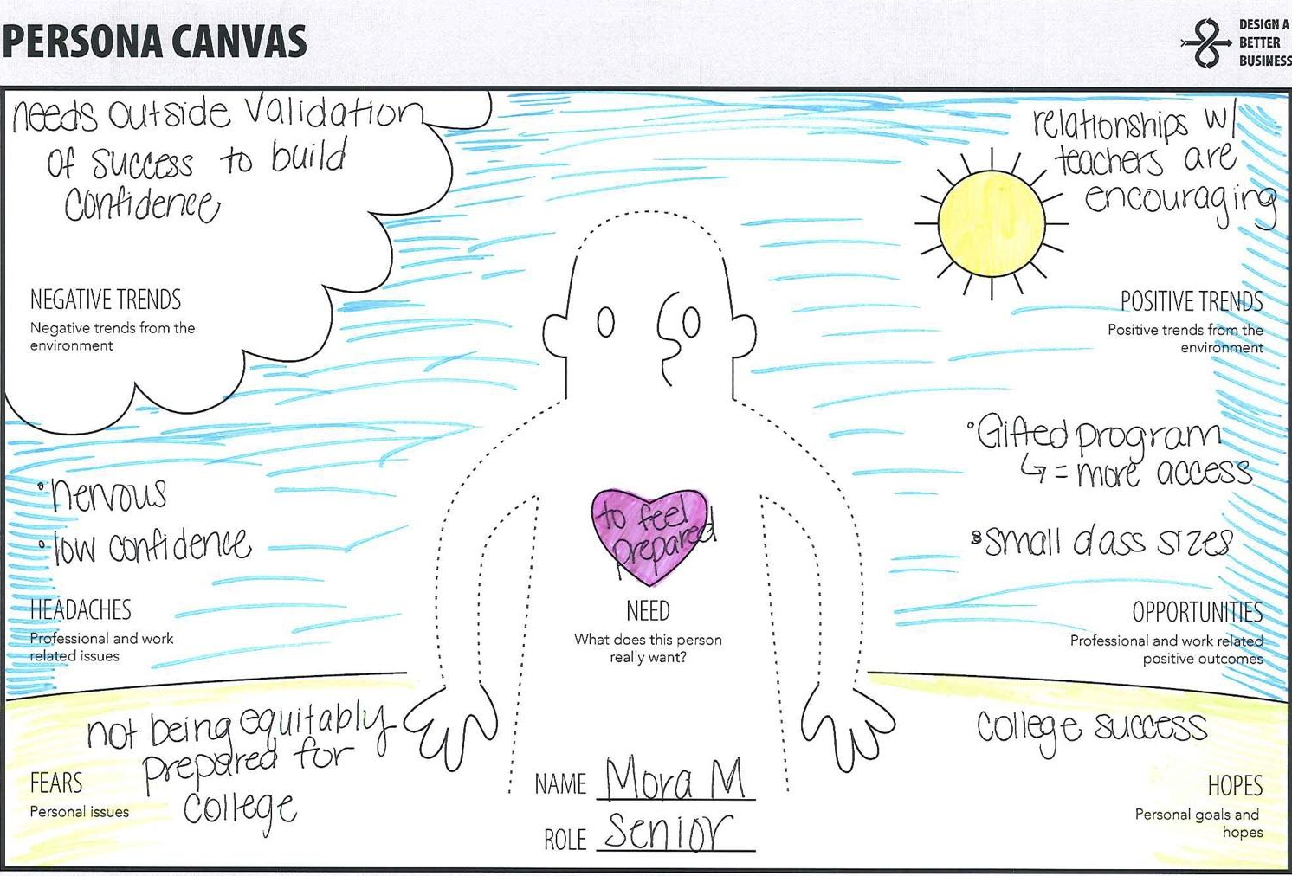

Slide 31
4 Principles of Redesign
PROTOTYPE
Student Success Skills | Community Partnerships
There is an integrated approach to develop student social-emotional growth | Partnerships are based on mutually beneficial relationships and collaboration
Personalized Learning | Real World Applications
Teachers support students to have choice over their time, place, pace and path | Project-based learning, internships, and civic engagement makes learning relevant
Mora M. - 12th Grade
Lacking confidence outside of her school
How Might We ensure Mora develops confidence?
Notes:
Needs: Identify and leverage a support system, Make school feel like home, Expose Mora to positive influences, Create more opportunities for self-reflection, Allow space for Mora to explore his creativity, Raise Mora’s self-esteem

Slide 32
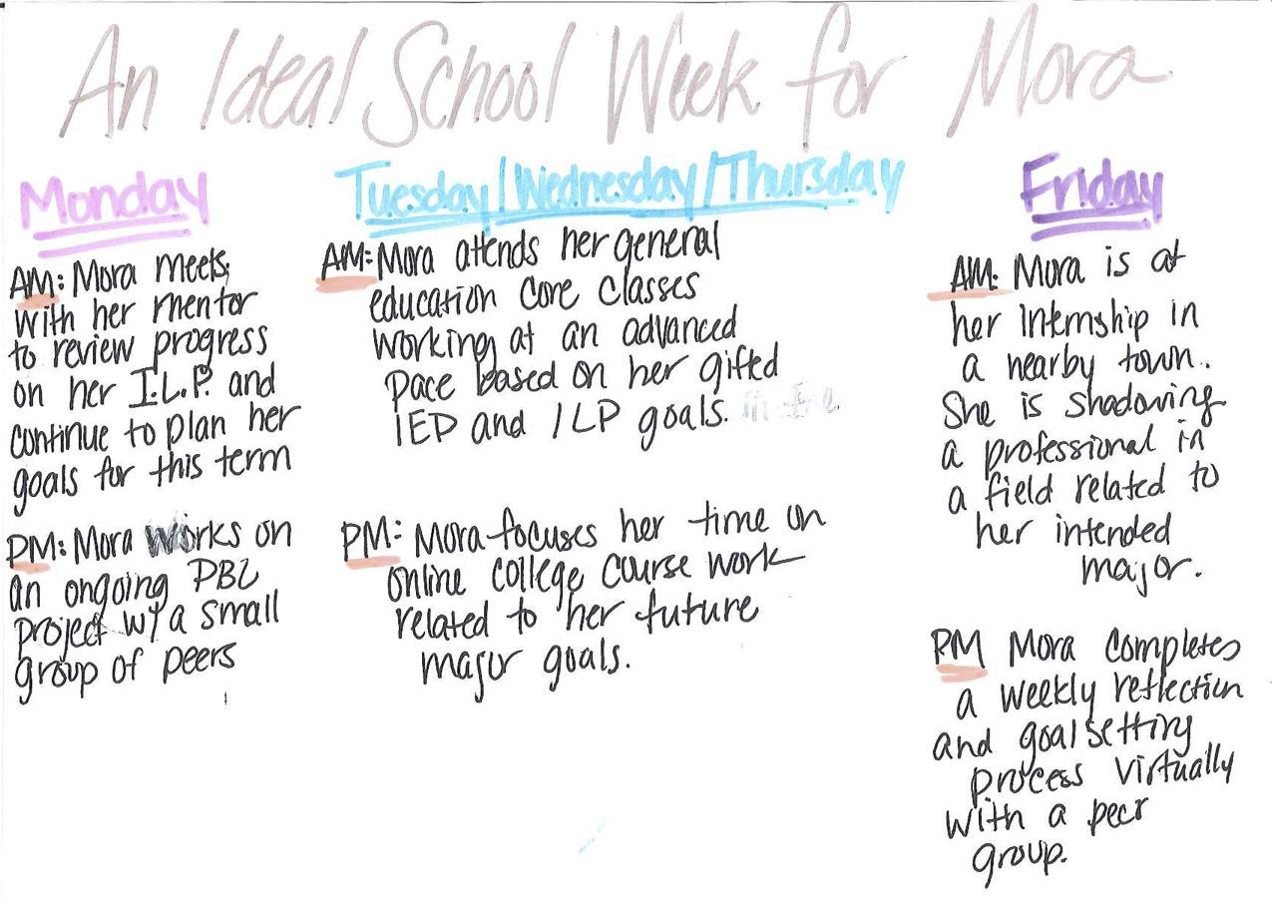

Slide 33
“Safe enough to try”
“Plan for change, not perfection”

Slide 34
Your Turn
PROTOTYPE
Based on what you have learned about your students needs and what you have in your palette, design a “Day in the Life”
Outline:
What your student will experience throughout their day
How does it meet the needs and trends you identified?
Identify how the 4 principles of School Redesign are expressed

Slide 35
Share with a Partner
PROTOTYPE
Share your prototype with a partner school

Slide 36
Strategies that you might be able to simply just go for it
We know all issues we will need to address
Known
Strategies to Prototype
Obstacles/ Issues to address
Unknown
We don’t know what issues there might be
Unknown
Known
Solutions
We don’t know if it will work
We know it will work
Notes:
Created by Jennifer Hanni at Greenbush

Slide 37
Quick Wins | Projects to Prototype
Safe Confidence Builders | Rethink and Repurpose
Low Impact High Impact
Low Effort High Effort
Notes:
Created by ESSDACK

Slide 38
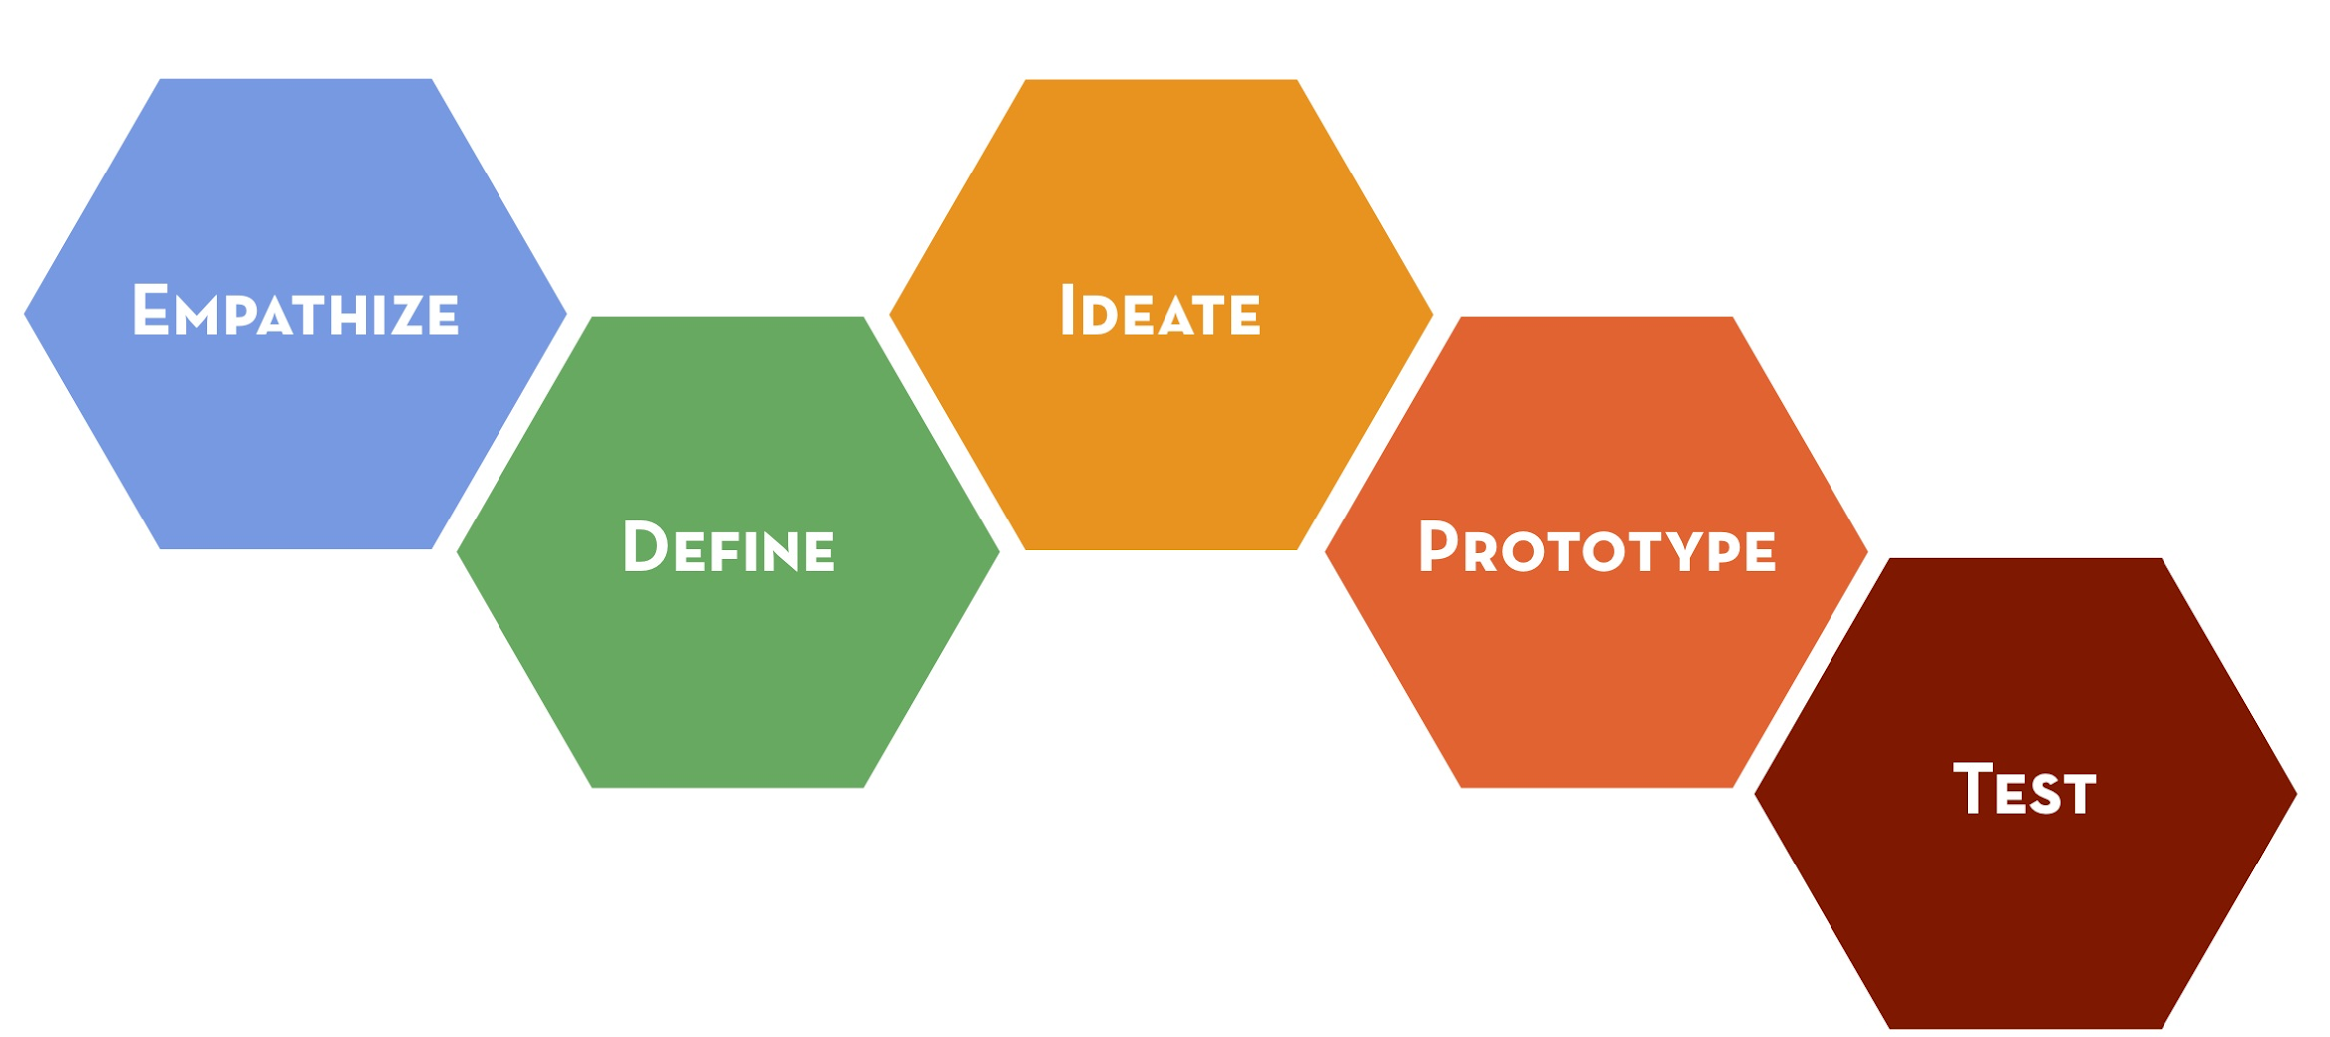
Design Thinking

Slide 39
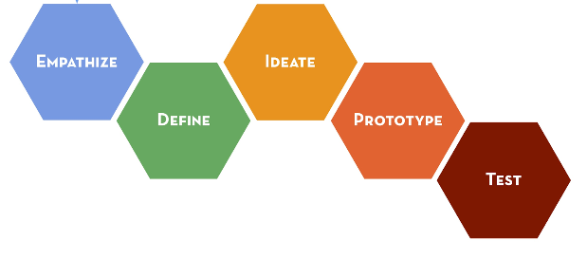
Design Thinking & School Redesign
Building the Rocket
Designing the Rocket

Slide 40
Lunch

Slide 41
Reflection & Goal Areas
Redesign Principles: Deeper Dive
How can we use Design Thinking to Innovate?
How do we support Inquiry, Innovation, and Exploration?
Where are we now? Where are we going?
Turnkey Planning & Closing

Slide 42
Leadership Focus- Principals
Ensure all actions are consistent with the school’s vision, mission, and values
Anticipate and address barriers and challenges
Begin using the Redesign Workbook to align your school’s vision, goals, and strategies with system expectations and State Board Outcomes.
Coach staff in prioritizing strategies that will leverage your goals and vision.
Serve as a conduit for communication between your teacher teams and your system leaders.
Evaluate resource implications for strategies so that implementation barriers can be addressed early.

Slide 43
Leadership Focus- Teachers
Psychological Safety- Relational Trust
Psychological Safety- Risk Taking
Benevolence- giving back to one another
Openness- sharing professional ideas
Honesty- telling the truth; refusing to spread untruths
Competence- collaborate to improve instructional practices
(Kaplan & Owings , 2013)
Utilize the mindset ‘safe enough to try’
Utilize the mindset of ‘failing forward’
Provide clarity around project ownership and responsibilities
Distribute authority to those closest to the decision
(Kim & Gonzalez-Black, 2016)

Slide 44
Conditions for a Learning Culture
Sh
Principals
Model Learning Leadership
Motivate Teachers
Support Inquiry, Innovation, and Exploration
Shared Leadership
Shared Leadership
-Shared Vision
-Psychological Safety
-Communication & Feedback
-Growth Mindset
Teachers
Collective Efficacy
Change Agents
Collegial Collaboration and Practices
Additional Stakeholders
Input in Goals and Strategies
Communicate about and Invest in the Work
Shared Leadership

Slide 45
Grow Collective Efficacy
(Liang, Mitchell, & Scott, 2020)
Notes:
The graphic on the left walks through the steps necessary for growing collective efficacy in your organization. In order to grow and build collective efficacy, you must allow all staff an opportunity to co-construct the goal; learn from resources and investigate strategies; staff must have a chance to ‘try a strategy on’ while collecting evidence to understand impact; and lastly, staff must have a collective opportunity to celebrate and reflect.
If you compare that to the process used in Redesign of design thinking and the four disciplines of execution, you see that there is quite a significant alignment between them. In redesign, you use design thinking and 4dx to empathize with students and define your wildly important goals. You ideate and investigate strategies that become your lead measures. Your build prototypes the you test in small groups and while doing so, you create data scoreboards and you hold accountability meetings where ‘pivots’ or ‘adjustments’ are determined. And at the end of your test window, you reflect, celebrate and create a plan for scale or revise and begin again.
To put it simply, using the redesign process with fidelity and integrity will allow you to grow teacher collective efficacy. Let’s move on to learn a little bit more!
Donohoo, Jenni, and Steven Katz. “What Drives Collective Efficacy?” What Drives Collective Efficacy? - Educational Leadership, ASCD, July 2019, www.ascd.org/publications/educational-leadership/jul19/vol76/num09/What-Drives-Collective-Efficacy%C2%A2.aspx.
Liang, J. “Grace,” Mitchell, T., & Scott, J. (2020). Statewide School Redesign: Integrating Design Thinking and the Four Disciplines of Execution as a Continuous School Improvement Process. Journal of Case Studies in Educational Leadership, 1(13). Retrieved from https://journals.sagepub.com/doi/10.1177/1555458920975462

Slide 46
What is a school-based investigation team?
Investigation Team Overview

Slide 47
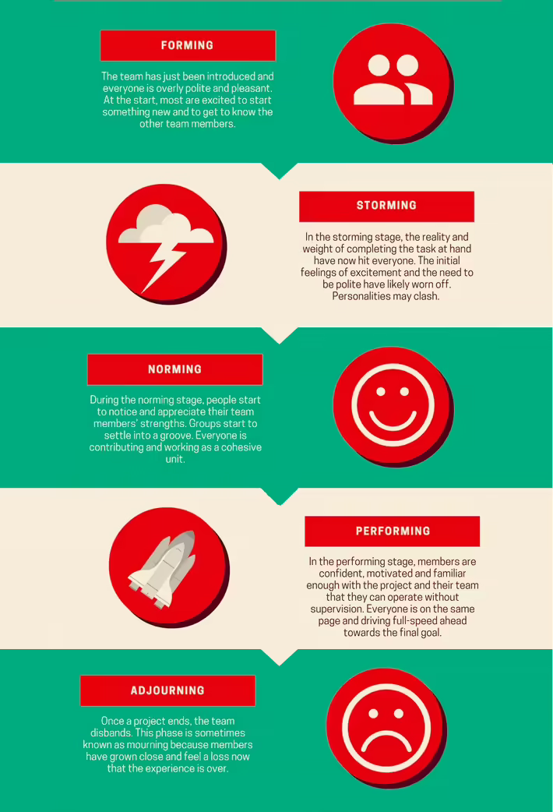
Team Development
As you form up your Goal Area Investigation Teams, be aware of the 5 phases every team works through:
Forming
Storming
Norming
Performing
Adjourning
Utilize Chapter 6 of ‘Playbook for Redesigning Schools for the 21st Century’ to learn how to evaluate your team and how to grow from a group to a team.
Notes:
Tuckman’s 5 stages of team development.
https://toggl.com/track/stages-of-team-development/#:~:text=In%201965%2C%20a%20psychologist%20named,have%20a%20knack%20for%20rhyming.

Slide 48
3 Types of Research
Traditional Research
Google Site, Website, Etc.
Observational Research
Site Visits
Leading to...
Action Research
Designing the Rocket
Building the Rocket

Slide 49
Site Visits & Connections
Research
Site Visits
KSDE Redesign Webpage- Videos Tab
Redesign Google Site- School Models Tab
EPIC Elementary
30 School Districts to Visit
Eminence, KY
Wilder, Idaho

Slide 50
Quality Strategies
Safe enough to try (Research Based) vs Evidenced Based
In Redesign, we encourage you to test strategies that are ‘Safe enough to try’. That means you have done research, looked closely at your stakeholders, data, and resources, and determined that testing this strategy would be ‘safe’ and possibly highly impactful.
That does not mean you can try anything. It means you try things that have been researched formally, or informally by your Goal Area Investigation Team, and demonstrate a potential for impact in your setting.
Evidence Based means that the strategy has been validated to be effective through numerous studies. You can learn more about evidence based practices by exploring ‘Wise Ways’, ‘What Works Clearinghouse’ or other academic research bases.

Slide 51
Reflection & Goal Areas
Redesign Principles: Deeper Dive
How can we use Design Thinking to Innovate?
How do we support Inquiry, Innovation, and Exploration?
Where are we now? Where are we going?
Turnkey Planning & Closing

Slide 52
Discussion with District Leaders
What is negotiable? What is not negotiable?
What is held tight? Loose?
How might central office support enable more school autonomy?
What would an efficient decentralized strategy look like?
What does a plan/timeline for scaling innovation mean to us?
Where might speed be useful? Why?
Who will determine the pace of roll-out?
Supporting Resource: “Look Both Ways” (Initial focus is on Q1 and Q2).

Slide 53
Break

Slide 54
Reflection & Goal Areas
Redesign Principles: Deeper Dive
How can we use Design Thinking to Innovate?
How do we support Inquiry, Innovation, and Exploration?
Where are we now? Where are we going?
Turnkey Planning & Closing

Slide 55
Turnkey & School Planning Time
Redesign Principles
Further Exploration
Design Thinking & 4DX
Goal Setting
Begin Workbook
Perfect Day
Goal Area Investigation Teams
Research, Visits, etc.
District Conversations
Establish Guardrails
Feedback & Communication
Communication Plan
Business/Community Engagement Plan
WHY
WHAT
Turnkey Considerations
HOW

Slide 56
Share your commitments between now and the next Training.
Each school will share out loud.
Notes:
Note- This is like an ‘accountability meeting’. Reporting on last time’s commitments, giving a status update based on data (i.e. checklist), and talking about what’s next...that’s discipline 4 ‘create a cadence of accountability’!

Slide 57
Upcoming Meeting Dates & Reminders
Designing the Rocket Day 3
Shore Up:
Goals
Lag Measures
Target Areas
System Alignment
Support for GAITs
Brainstorming
Research
Safe enough to try
Site-Visits

Slide 58
SURVEY
Please take the survey at the end of each training. Your feedback is incredibly valuable.

Slide 59
Follow us on Twitter
@KSDEredesign
#kstothemoon

