Slide 1
State Board of Education Gating Guidance for School Districts
Dr. Randy Watson, Kansas Commissioner of Education

Slide 3
Key Aspects of this Plan
Almost 1,000 Kansans – Teachers, Parents, Health Care Officials, Doctors, School Board Members, and many others gave of their time to provide the best guidance to schools, staff, students and families.
Local school districts and communities will take this guidance and make their own plan for their schools.
The guidance document enables families to maximize their learning options within their local school district.

Slide 4
Goals for all Stages
Have Strong Learning Environments
Keep Students and
Staff Safe
Academic rigor needs to be high and students need to be engaged on a daily basis.
Social-Emotional support and learning must be a high priority and a part of any plan.
Equity and Access is essential for families.
No environment can guarantee safety, but strong precautions can be taken to ensure the environment is as safe as possible.
Schools should enable families to maximize their learning options.

Slide 5
Learning Environments
Understanding the need to be flexible during the 2020-21 school year, three different learning environments were defined.
On-Site
Used when community restrictions for COVID-19 are low.
Schools can operate at 100% capacity with precautions.
Social distancing should be practiced where feasible.
Group sizes and spectator events will meet local guidelines.
Hybrid
Used when community restrictions for COVID-19 are moderate.
Schools will operate at reduced capacity (50%) with students alternating between on-site and remote learning.
Social distancing should be enforced.
Group sizes will meet local guidelines (15)
Spectator events not allowed.
Remote
Used when community restrictions for COVID-19 are high.
School capacity restricted to essential staff and activities.
Social distancing should be strictly enforced.
Group sizes will meet local guidelines (10 or fewer).
Spectator events not allowed.

Slide 6
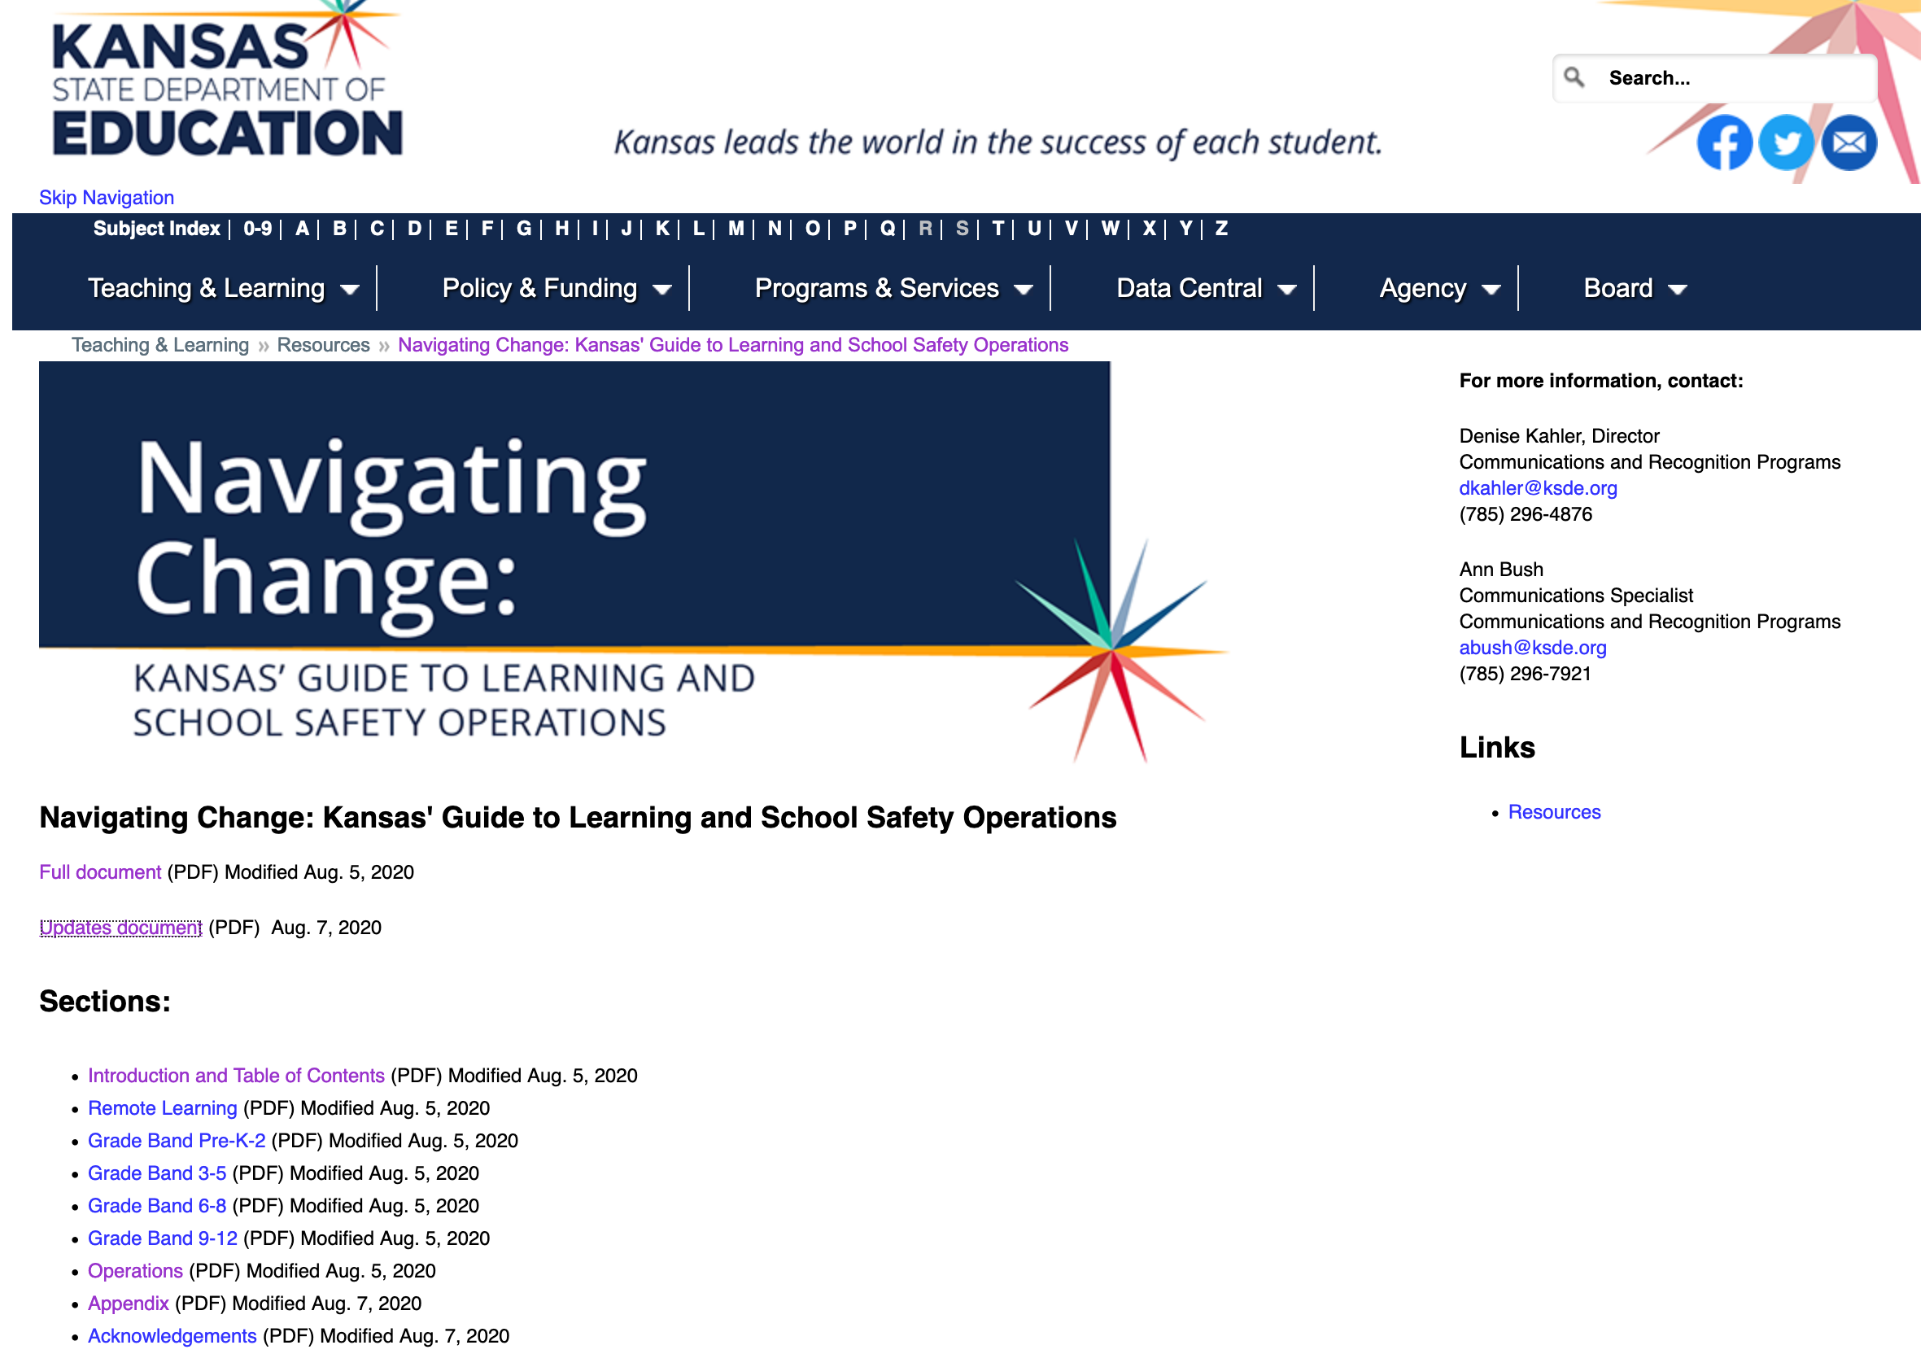

Slide 7
Navigating Change 2020 Oversight Committee Leads:
Cory Gibson, 262 Valley Center
Shannon Ralph, 231 Gardner-Edgerton
Implementation Team Leads:
(PreK-2) Rachel Meenen, 267 Renwick
(3-5) April Baugh, 443 Dodge City
(6-8) Keil Hileman, 232 De Soto
(9-12) Nathan McAlister, 345 Seaman
Operations Team Leads:
Frank Harwood, 232 De Soto
Ashley Goss, Deputy Secretary KDHE
Brad Neuenswander
Craig Neuenswander

Slide 8
Partners who contribute to Navigating Change

Slide 9
Kansas Schools Gating Criteria
Green
Yellow
Orange
Red
PK-12
PK-5
6-12
PK-5
6-12
PK-12
Learning
+
On-Site
On-Site**/
Hybrid
Hybrid
On-Site**/
Hybrid
Remote Only
Remote Only
School Activities
On-Site following Navigating Change guidelines. Facilities should limit capacity to allow for 6’ social distancing.
No all school activities. Small group activities limited; masks and social distancing required; stable groups with limited group numbers. No high risk activities. No group travel. Conditioning/ practice may continue with modifications
Remote Only
Remote Only
Spectators - audience
On-Site following Navigating Change guidelines. Facilities should limit capacity to allow for 6’ social distancing.
Allowed: Distancing by household groups; masked if indoors. 6’ social distancing required; total group numbers limited per guidelines
Remote Only
Remote Only
Visitor Access
On-Site following Navigating Change guidelines. Facilities should limit capacity to allow for 6’ social distancing.
Limited: by appointment; masks and social distancing required; building access requirements must be met
Extremely limited: by appointment; masks and social distancing required; building access requirements must be met
None Allowed
Playgrounds
On-Site following Navigating Change guidelines. Facilities should limit capacity to allow for 6’ social distancing.
Open: Capacity to allow for 6’ social distancing; total group numbers limited per guidelines
Open: Capacity to allow for 6’ social distancing; masks required if less than 6’ social distance maintained; total group numbers limited per guidelines
Closed
NOTE:
The following recommendations are subject to change by actions of federal, state, county, or local authorities.

Slide 10
Gating Criteria
 | Gating Criteria | Green | Yellow | Orange | Red
Building Gating Criteria* | Student Absenteeism based on building level Average Daily Attendance in 2019-20 (i.e. 95%) | <3.0% above baseline building level ADA | 3.0-5.9% above building level ADA | 6.0-9.9% above building level ADA | >10% above building level ADA
Community Gating Criteria | 2 week County percent positive case rate (% positive tests/all tests performed) | < 5% | 5.1-9.9% | 10-14.9% | > 15%
Community Gating Criteria ** | 2 week cumulative County incidence rate (# new cases/100K over prior 2 weeks) | 0-50 new cases | 51-100 new cases | 101-150 new cases | > 151 new cases
Community Gating Criteria | Trend in County incidence rate | Decreasing | Stable | Stable | Increasing
Community Gating Criteria | Local/referring hospital capacity | > 30% available capacity | 29.9-20% available capacity | 19.9-10% available capacity | < 10% available capacity
*increase of absenteeism rate should trigger conversation with local health officials regarding next steps.
**for example, 15 cases for 50,000 would equal 30 per 100K or another example 1 case for 4,000 would equal 25 per 100K

Slide 11
**Strategies to consider to promote full time onsite learning for Pre-K-5 students
Students should be grouped together in cohorts of less than15 students per group.
Safe but unused facilities within the district and community should be utilized to spread out students
Either have class sizes with < 15 students per class
OR have separate cohorts within classes of < 15 students per cohort with adequate physical distancing between cohorts and no mixing of groups other than the teacher
Middle and high school buildings should be utilized when those students are learning remotely
Sports and recreation facilities should be utilized when otherwise not in use
Outside areas should be utilized weather permitting
Schools should work with their community to utilize additional community locations to space out students for on-site education. This may include community buildings, churches, restaurants, etc.
Locations should be consistent between classes/cohorts
Nurses, special education teachers, administrators, and other staff should work in teams and be prepared to travel between sites as needed to provide services

Slide 12
Notes:
Today’s students are the future workforce and future leaders of Kansas. Kansans Can achieve anything and, together, Kansans Can lead the world in the success of each student.

