Slide 1
Project Managers

Slide 2
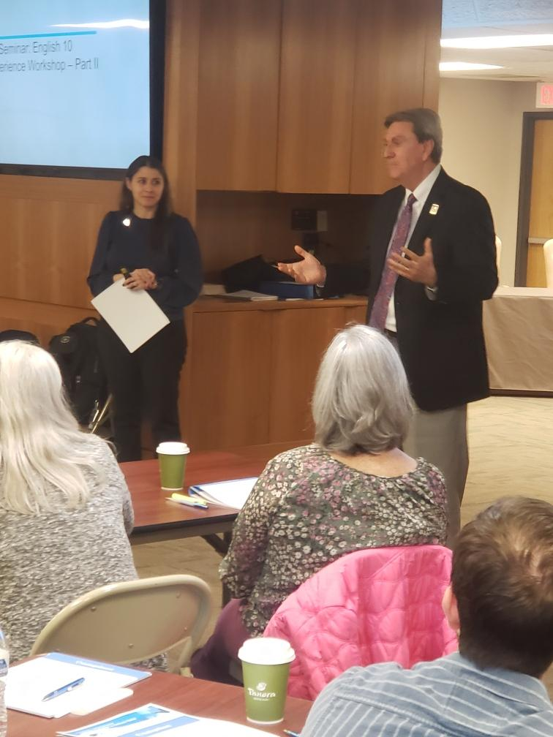
Come investigate further AP Seminar: English 10
January 23:
9:00-9:30 AM: REGISTER
12:00-12:30 PM: REGISTER
February 10, 9:00 AM-Noon: REGISTER
AP Seminar: English 10 Workshop Experience
In-person event: Instructional team
Orion
Topeka
Notes:
Fact Sheet

Slide 3
Why AP Seminar: English 10?
Current English 10 courses can be taught with the AP Seminar approach
Engages More
Students
Makes English 10
More Relevant
Offers Curriculum Flexibility for Teachers
Meets State
Standards
Gives more students the opportunity to fulfill a core course requirement while bolstering the foundational skills taught in AP Seminar, including evidence-based reading, writing, and speaking.
English 10: AP Seminar allows students to explore ideas and topics of their own interest. Students learn to work in teams to investigate real-world problems and present an argument for their proposed solution.
AP Seminar fits with current curriculum and allows for more flexibility to layer in cross-curricular content. Teachers continue to use the literary texts that are required and select literature-based stimuli for the performance tasks.
By adding literary analysis and narrative writing into the themes they choose for their AP Seminar course, teachers can fulfill their state’s English 10 standards.
Notes:
We believe that AP Seminar fits incredibly well as English 10 and here is why.

Slide 4
Why AP Seminar?
A project-based English class that equips students with soft skills needed for postsecondary success.
A foundational course, where students engage in academic conversations and analyze divergent perspectives through studying a wide range of texts.
READING
WRITING
LISTENING
SPEAKING
Students practice reading and analyzing:
Articles
Research studies
Foundational texts
Literary texts
Philosophical texts
Students learn to synthesize information from multiple sources and develop their own perspectives in written essays.
Students practice listening to and viewing:
Speeches
Broadcasts
Personal accounts
Artistic works
Performances
Students design and deliver oral and visual presentations, both individually and as part of a team.
Notes:
Similar to most English 10 courses, AP Seminar focuses on 4 main components.

Slide 5
AP Seminar Success in Grade 10
Percent of 10th Graders Achieving a Score of 3 or Higher
What the Data Shows
More than 8 out of 10
10th graders who took AP Seminar achieved a score of 3 or higher.
Schools were right to position it as a 10th grade course. 10th grade students are very successful in AP Seminar.
Seminar
86%
Seminar students in the 50th PSAT/NMSQT® percentile
72%
All Courses Other than Seminar
56%
World History: Modern*
51%
* Most popular AP course in Grade 10
Notes:
When we looked more closely at 10th graders in Seminar we found higher exam scores – these scores are roughly 30% higher than other common 10th grade courses
96% of 10th grade students who scored above the 75th percentile on their PSAT earned a 3 or higher on AP Seminar.
72% of 10th grade students who scored at the 50th percentile on their PSAT scored a 3 or higher on AP Seminar.

Slide 6
Next Steps to Offer AP Seminar: English 10
1
2
3
AP Seminar
Sign-up Form
Plan to Attend
Professional Learning
Implementation
Toolkit
Promote the course to students and parents: We have outreach templates that schools and districts can customize to share more information about the new course with students and parents.
AP Seminar Implementation Toolkit
Schools interested in offering AP Seminar: English 10 should have a school leader complete the free 2023-24 AP Seminar Sign Up Form. We encourage you to submit the form as soon as possible.
AP Summer Institute: Teachers must complete a one-time five-day workshop the summer prior to teaching the course. There will be two Kansas-specific (virtual, in-person) trainings offered at no cost.

Slide 7
Free Professional Learning for Kansas Educators
AP Summer Institute
What?
Fee waivers will be provided to all Kansas educators intending to elevate their current English course with AP Seminar: English 10 in the 2023-24 academic year. This is a $1,095.00 savings!
When?
Throughout the summer, from June-August.
Where?
An in-person session at Olathe Public Schools in June;
Multiple online offerings from June-August.
How?
The first step is to complete the 2023-24 AP Seminar Sign Up Form.
Registration information and fee waiver codes will be shared in March.

Slide 8
Community of Practice
The Writing Revolution
REGISTRATION
Bringing Words to Life
REGISTRATION
mentoring and implementation support Mondays, 4-6 PM
February 6 & 20
March 6 & 27
April 10 & 24
topics
sentence-level work
planning & prewriting
ongoing writing
revision
assessment
mentoring and implementation support Thursdays, 4-6 PM
February 9 & 23
March 9 & 30
April 13 & 27
topics
word selection & the explicit teach
transferring vocabulary into student lexicons
managing assessment & walls that teach
clarifying teaching of tier 3 words related to subject matter
Notes:
Describe business rules for using each – what are the non-negotiables in terms of design, etc.?
Describe logo usage – when to use KSDE, when to use Kansans Can, using dual logos, etc.

