Slide 1
Curriculum Leaders: April 16, 2021
Redesign Update
Notes:
Tammy

Slide 2
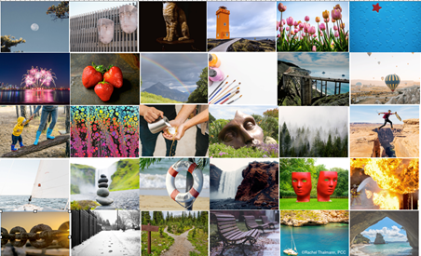
Designing for Next
Which image represents your 20-21 school year? Why?
Which represents how you want school for next year? Why?
How might you design learning experiences that students need to reach your vision for next school year?
Notes:
Tammy

Slide 3
“It’s so much easier to suggest solutions when you don’t know too much about the problem.”
Malcolm Forbes, American entrepreneur
Notes:
Jay
Design Thinking for School Leaders: Five Roles and Mindsets that Ignite Positive Change
http://www.ascd.org/publications/books/118022/chapters/An-ASCD-Study-Guide-for-Design-Thinking-for-School-Leaders@-Five-Roles-and-Mindsets-That-Ignite-Positive-Change.aspx

Slide 4
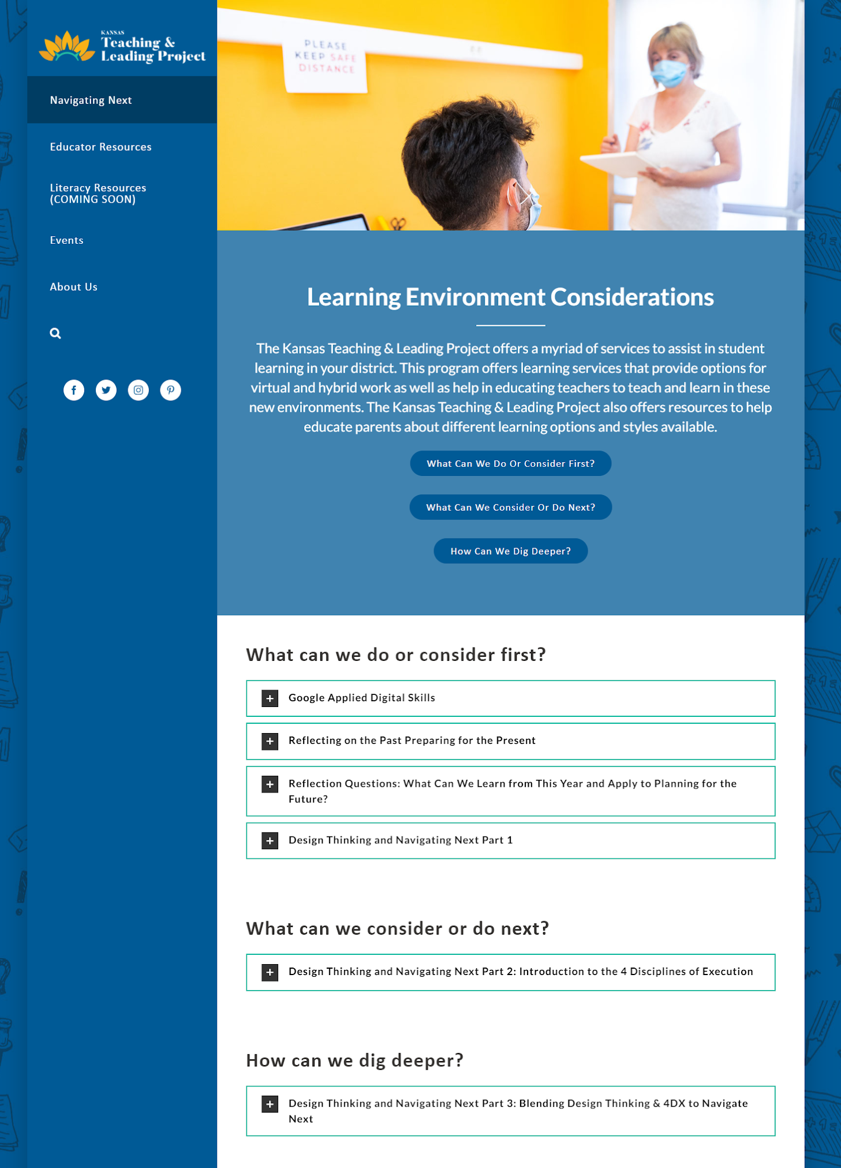
Training Opportunity
Design Thinking for Navigating Next: 3-Part Series Teaching and Leading Project Page- Learning Environment
Part 1- Design Thinking
Part 2- Utilizing 4 Disciplines of Execution with Design Thinking
Part 3- LIVE- Blending Design Thinking & 4DX to Navigating Next
April 20, 2021 from 9:00-10:00 a.m. (Zoom Registration)
Notes:
Jay
Which represents your 20-21 school year? Why?
Which represents how you want your school year next year? Why?
How might you design the learning experiences students need to reach your vision for next school year?

Slide 5
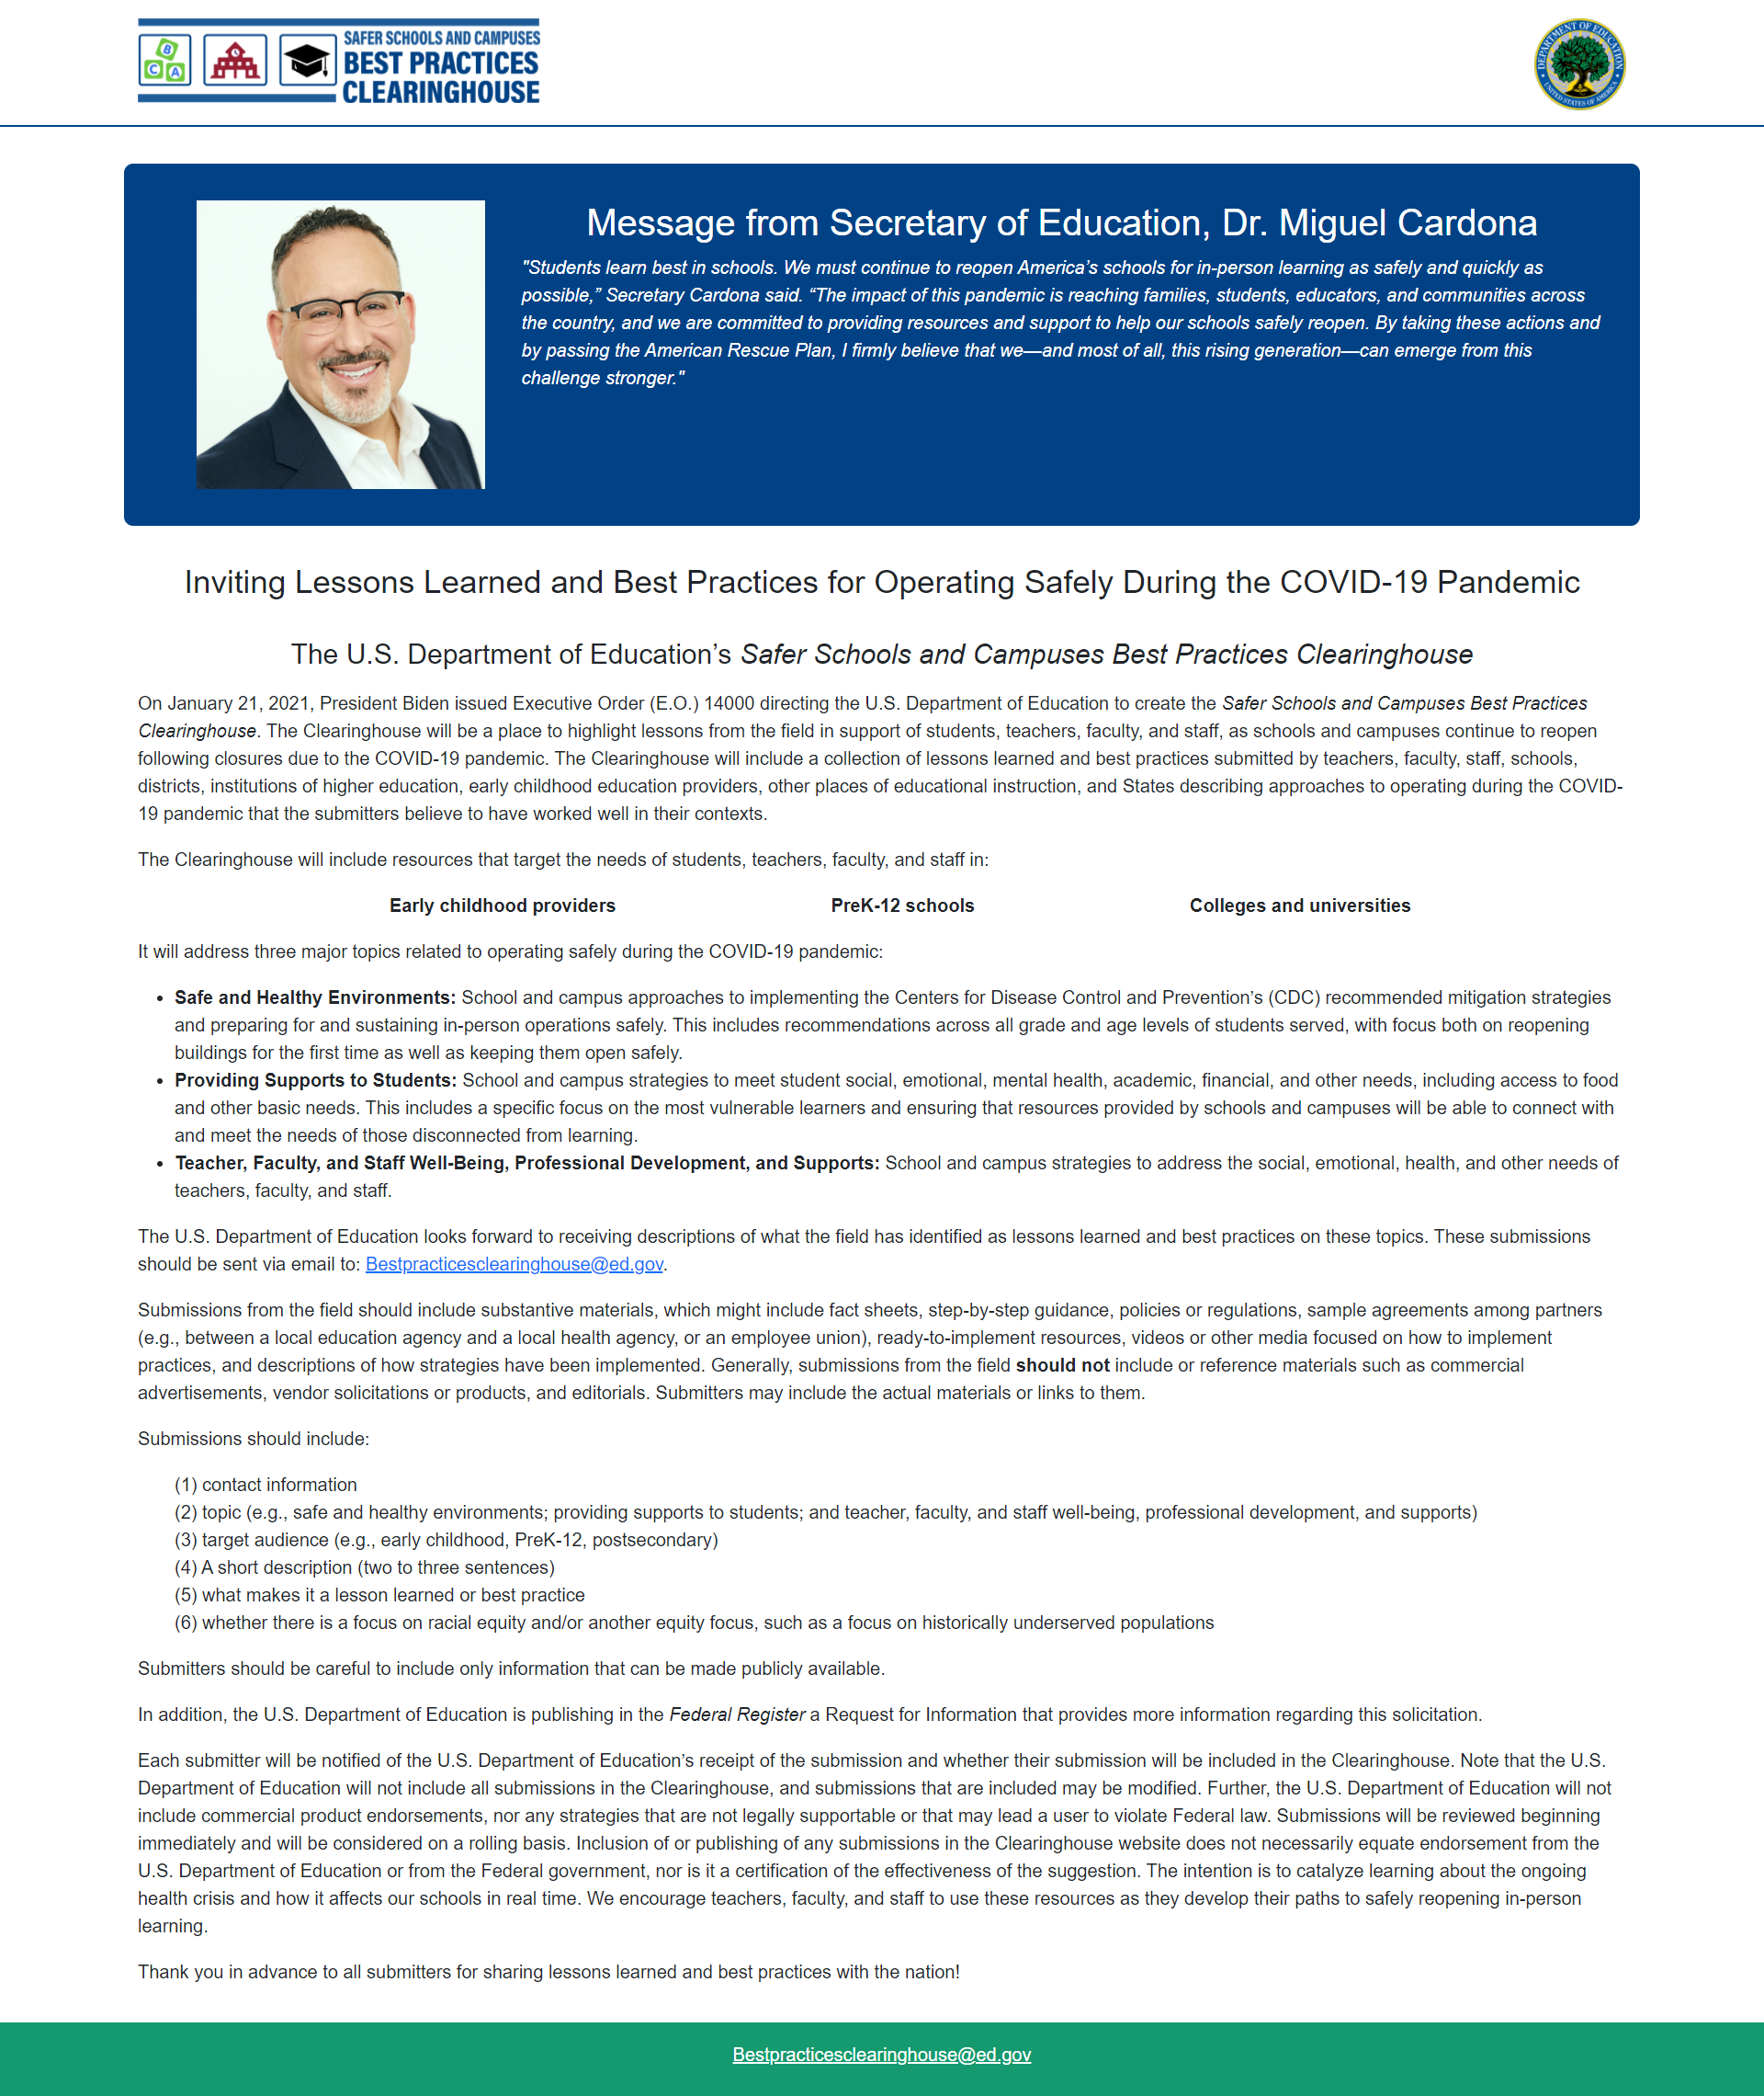
Opportunity
Tell your story:
Best Practice
Lesson Learned
Addressing:
Health & Safety
Supporting Students
Supporting Teachers
Submit
Independently
Through KSDE
Due April 30, 2021
Notes:
Sarah

Slide 6
Redesign April Newsletter
Receive our monthly newsletter by joining the Redesign Stakeholders listserv. Email Theresa Cote (tcote@ksde.org) to join.
Notes:
Sarah
https://drive.google.com/file/d/1Los5GXmt8bz86b0fhRLJ1miQTbdd33rS/view?usp=sharing
The Redesign Team puts out a monthly Redesign Newsletter. You can access the April newsletter by clicking on the link found on this slide. In this newsletter, you will find updates on various projects including our Design Thinking for Navigating Next training; updates on our new school culture survey; highlights from our PBL Student showcase; as well as cohort specific resources and updates.
Our newsletter is also shared via the monthly DLS Staff Update, and we provide monthly updates through Hot Topics as well. If you would like to stay up to date on Redesign information, you can join our Redesign Stakeholders listserv by emailing Theresa Cote and requesting to join. You can also review our webpage where we consistently make updates on events, resources, and ‘happenings’ in Redesign.

Slide 7
2021 Highlights
3 new schools have Launched
West Elementary, Goodland USD 352
Medicine Lodge Grade School, Barber County North USD 254
Medicine Lodge Jr/Sr High School, Barber County North USD 254
PBL Student Showcase
5 Schools
20 Videos
318 Unique Page Views
500 Page Visits
Culture Survey
5 Constructs [Preview the Questions & View Sample Report]
~2000 Responses to Date
~18 Schools to Date
Notes:
Sarah

Slide 8
Upcoming Highlights
Apollo 3
March 1 Informational Webinar
~30 Schools!
Applications Due May 31, 2021
Present to State Board on June 8, 2021
Application (word/pdf)
80% Vote
Board Letter of Support
Union Letter of Support
Collective Why & Culture Survey
New Leadership Bootcamp
July 27, 2021 from 9:00-3:30
Save the Date
Notes:
Sarah

Slide 9
KSDE Redesign Team - redesign@ksde.org
Jay Scott - jscott@ksde.org
Tammy Mitchell - tmitchell@ksde.org
Sarah Perryman - sperryman@ksde.org
Notes:
Sarah

