Slide 1
Accreditation & Design Monthly Update
March 7, 2023
Notes:
Jay

Slide 2
Agenda
Welcome
School/District Culture Survey
Q & A
Reminders:
Next Meeting/Final Meeting: April 11, 2023
What topics would you like to discuss in the future?
Notes:
Jay

Slide 3
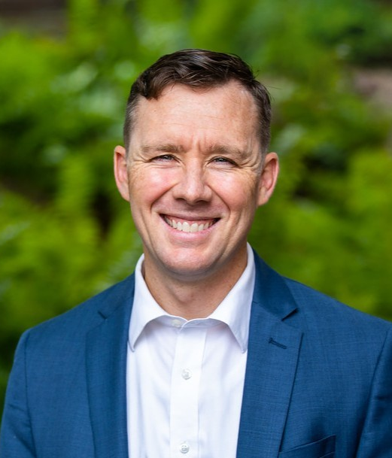
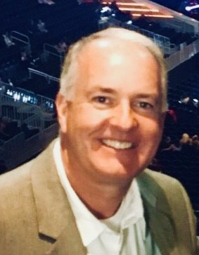
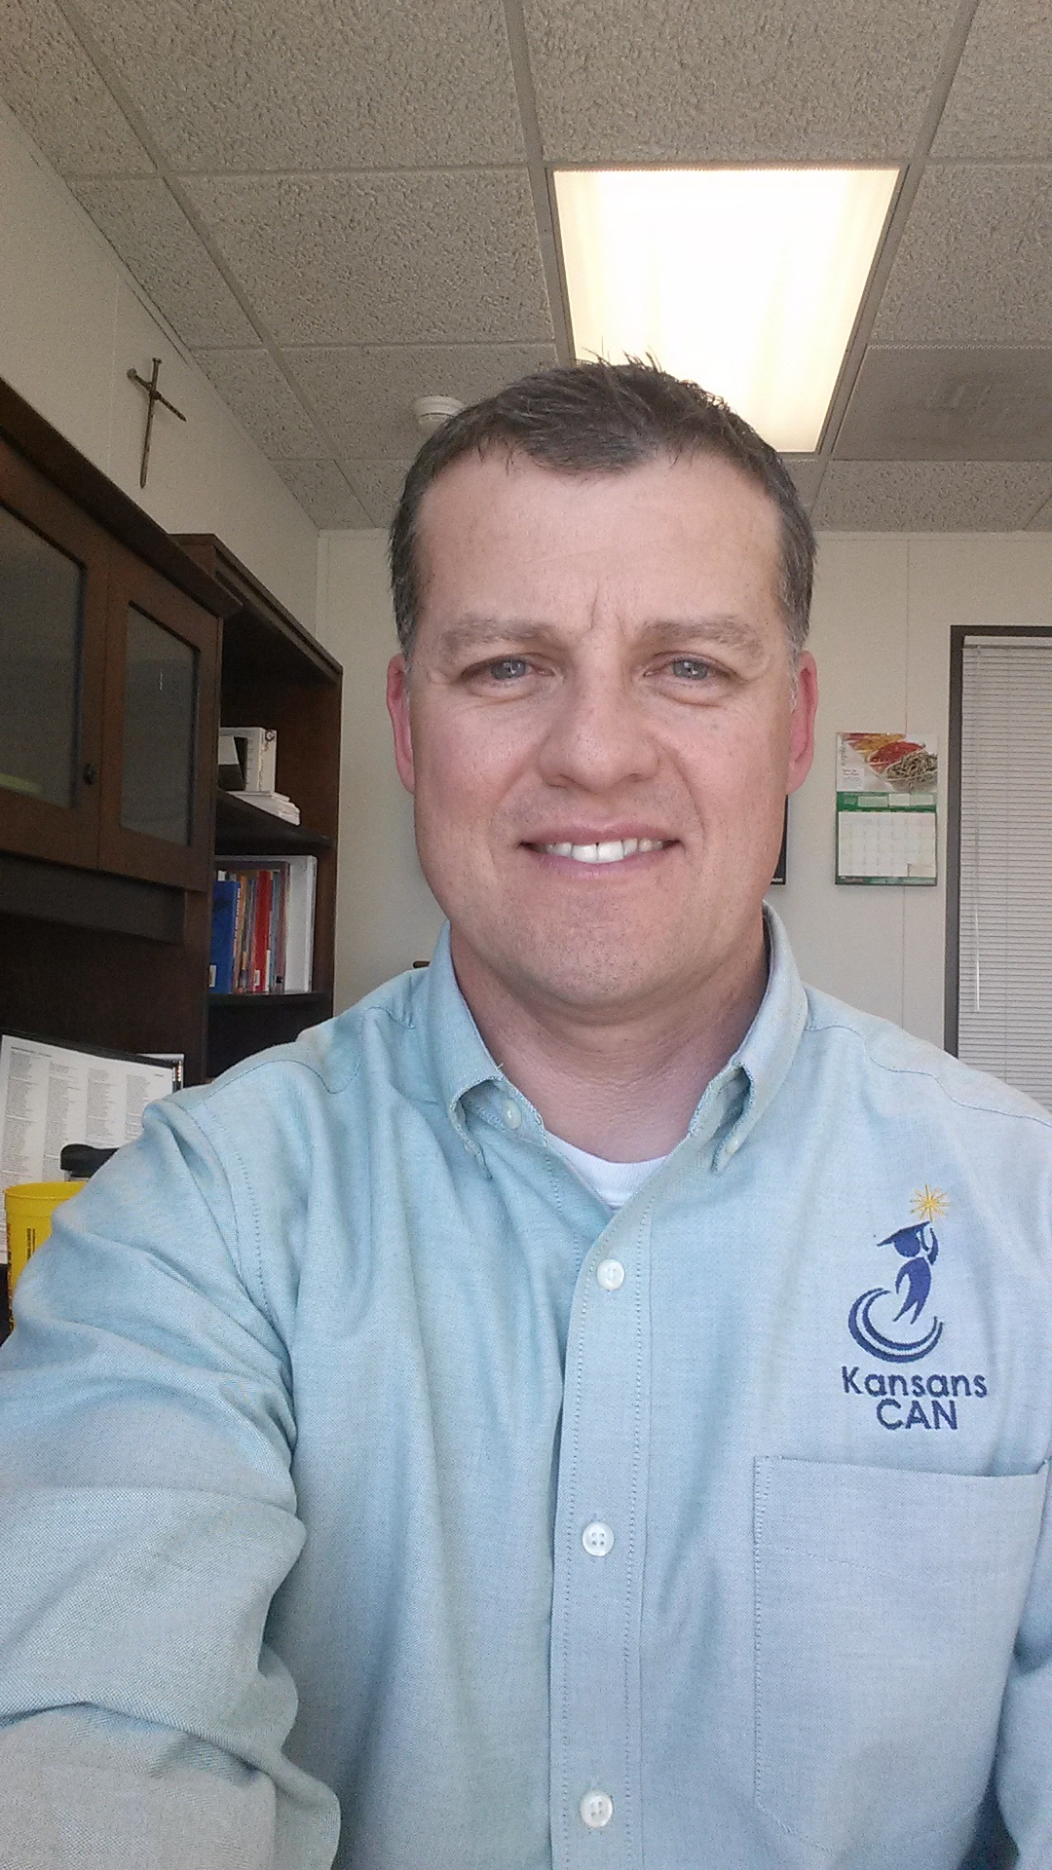
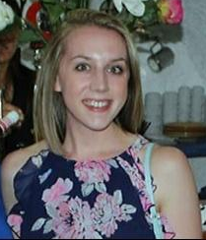
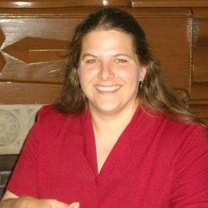
Accreditation & Design Team
TBD, Administrative Specialist
Jake Steel, Special Projects
Sarah Perryman, Coordinator
Catherine Chmidling, Assistant Director
Myron Melton, Assistant Director
Jay Scott, Director
Notes:
Jay

Slide 4
Accreditation & Design Team Mission
Within a system of accreditation and design, provide accountability along with support to move systems toward ensuring the success of each student.
Notes:
Jay

Slide 5
Why Change KESA?
Dissatisfaction with Current Student Outcomes, particularly Academics
Lack of Clarity, Consistency
Redundancy

Slide 6
Purpose of KESA
As a tool to support Kansas in leading the world in the success of each student, Kansas Education System Accreditation does the following:
Ensures that each K-12 system meets a minimum standard of quality for compliance and continuous improvement.
Evaluates each system’s student outcomes, both for a minimum standard and excellence in student success.

Slide 7
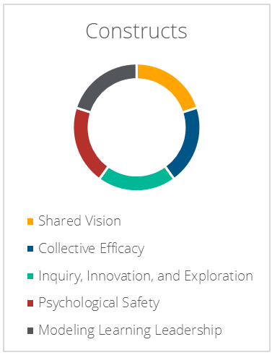
Culture Survey
What is it?
Who takes it?
How do you administer the survey?
How do I get/use my data?
Notes:
What is it?
Perception Survey
Who takes it?
All Certified Staff/Administrators
How do you administer the survey?
Via a Qualtrics Link (Preview Items)
How do I get my data?
Email accreditation@ksde.org

Slide 8
Misconceptions- Clearing the Air
Is the Culture Survey required?
NO!
It’s one tool you can use to gather staff perception on culture in your system/school.
Is the Culture Survey a needs assessment?
NO!
It’s one part of a comprehensive needs assessment, but it is not the whole thing.

Slide 9
What is it?
Perception Survey
Created by: KSDE Redesign Team & McRel
5 Evaluated Constructs: (Items)

Slide 10
Who takes the survey?
Recommended - Certified
Consider - Classified
Administrators
Certified Staff
Paraprofessionals
Teacher Aides
Food Service
Maintenance

Slide 11
How do you administer the survey?
Introduce the Survey to Staff
Purpose
Content
Location Selection
Email Sample
Establish a Window for Survey Completion
Share Link with Directions for Survey Completion
1-Take/User
Survey Link: https://ksde.sjc1.qualtrics.com/jfe/form/SV_ezlXTJs8s45QAmy
Notes:
Guidance -https://www.ksde.org/Portals/0/TLA/Accreditation/Culture%20Survey%20Guidance%202023.pdf?ver=2023-02-24-145039-217
DO NOT WRITE ON THE PDF ITEM VIEW; YOU MUST TAKE THE SURVEY VIA QUALTRICS
If you have staff who work at more than one building, our recommendation is that they complete the survey for the location in which they receive their annual evaluation. So if one building does that over another, choose that building; if the district does the evaluation, then they should answer as a district level user.

Slide 12
How do I get my data?
Options:
1 Aggregate Report (Sample)
District Level
All Building Level Responses
+
Building-Level (ELE/MS/HS)
Individual Buildings
Email accreditation@ksde.org
Expect a 3-5 Business Day Turn-Around
Sarah Perryman (sperryman@ksde.org)

Slide 13
How do I use my data?
Use Items Across Components to Validate Responses
Extrapolate Larger Themes
Buildings can use this to inform their Legislated Building Needs Assessment
Compare to Quantitative Data to Determine Trends & Goals
Data Analysis Action Steps
Notes:
Culture Toolkit - https://www.ksde.org/LinkClick.aspx?fileticket=EwDsNPsv5sM%3d&tabid=1509&portalid=0&mid=6016

Slide 14
Qualtrics Details
Is KSDE collecting and reviewing the culture survey data or is KSDE merely administering this as a local data collection tool and providing customized reports?
How do I found out the number of responses to know if all my staff have completed the survey?
Do I have to complete the survey on the same device and in the same browser?
Building level reports are only available for buildings that receive ten or more responses, correct?

Slide 15
Resources
Administration Guidance Fact Sheet
Item Preview
Introductory Slides for the Culture Survey
Frequently Asked Questions Sheet
Sample Email Template for Staff
Sample Report
Culture Toolkit

Slide 16
Q & A
Open Discussion
Notes:
Jay

Slide 17
General Reminders
Check KSDE Weekly for ADT Updates & News
Next Meeting = Final Meeting
April 11, 2023 from 9:00-9:45 (via zoom)
NO ‘year end wrap up’ in April
What would you like to talk about next time?
Notes:
Sarah

Slide 18
Accreditation and Design Team (785) 296-8012 accreditation@ksde.org
Notes:
Jay

