Slide 1
Kansas Leads the World in the Success of Each Student.
Dr. Randy Watson, Kansas Commissioner of Education

Slide 2
Vision for Kansas ...
Kansas leads the world in the success of each student
KANSAS STATE DEPARTMENT OF EDUCATION | www.ksde.org

Slide 3
Wage difference for education

Slide 4
Wage difference for education

Slide 5
Our Big Rocks…Our Overall Goal
100% of Students Graduate High School
100% of Students execute a Post Secondary Plan
45% attend a four year college
45% attend a two year college and/or have multiple certificates
5% are in apprentice programs
4% enlist in the military
1% attend 18-21 year old program

Slide 8
Severe workforce shortage
~3,600 across the region and state
Little awareness of severity of the problem or the available assets
Academic supply chain not equipped to meet demand
Curriculum is antiquated
Lack of connection between academia and their customers – those hiring their graduates
summary
findings

Slide 9
industry comments
Graduates are NOT workforce ready – lack real-world experience, soft skills
Curriculum is both antiquated and taught by teachers and professors lacking real world experience
Academia
struggle to build relationships their
customers – fail to leverage industry experts for curriculum development
Academia is not moving fast enough – agility is key!
Academia must train students differently – experiential learning is critical!
Industry is willing to partner with academia but will “go it alone” if necessary

Slide 10
EKC observations
The number one barrier to enterprise growth is the lack of well-qualified and well-suited talent
The industry comments apply across the entire educational spectrum
Real-world learning would help calibrate both student readiness and student interest – well-qualified and well-suited
Two different models are at odds:
Business – Agile, just in time, focus is on the customer, versus
Academia – Standardized, goal is to sustain over a large population

Slide 11
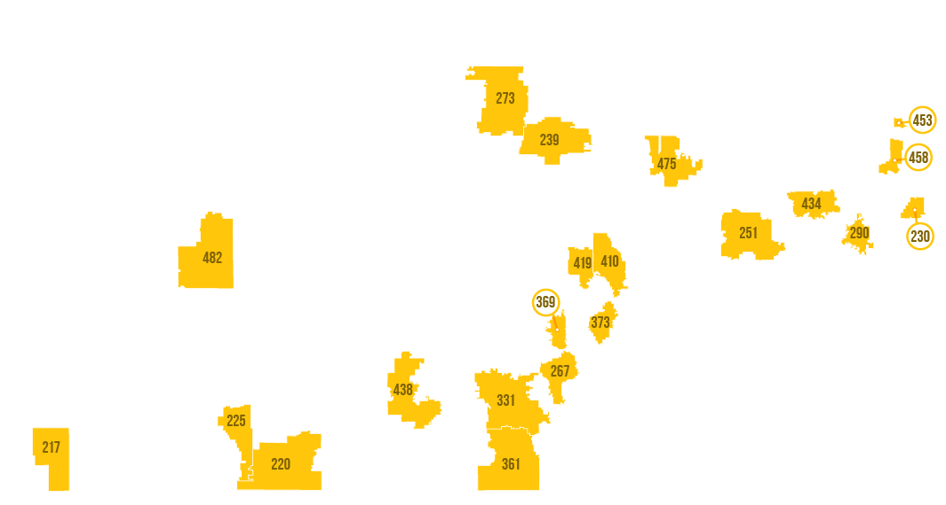
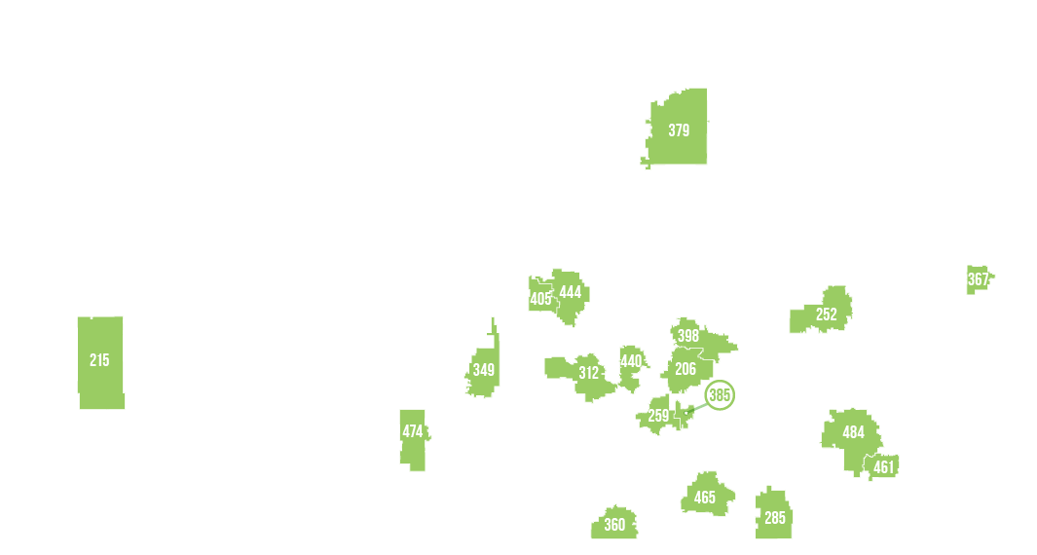
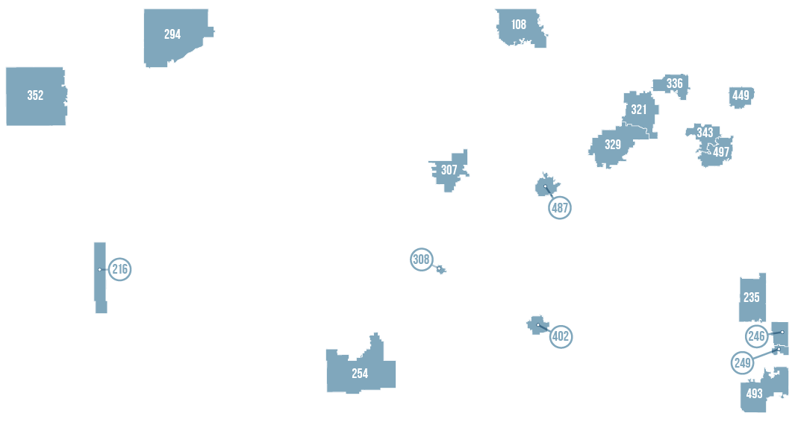

Slide 12
Base Aid for Student Excellence
School Year | BASE
2006-07 | 4,316
2007-08 | 4,374
2008-09 | 4,400
2009-10 | 4,012
2010-11 | 3,937
2012-13 | 3,838
2013-14 | 3,838
2014-15 | 3,852
2015-16 | 3,852
2016-17 | 3,852
2017-18 | 4,006
2018-19 | 4,165
School Year | BASE
2019-20 | 4,436*
2020-21 | 4,569*
2021-22 | 4,706*
2022-23 | 4,846*
*As appropriated by the legislature

Slide 13
Notes:
Today’s students are the future workforce and future leaders of Kansas. Kansans Can achieve anything and, together, Kansans Can lead the world in the success of each student.

