Slide 1
Kansas Leads the World in the Success of Each Student.
Dr. Randy Watson, Kansas Commissioner of Education

Slide 2
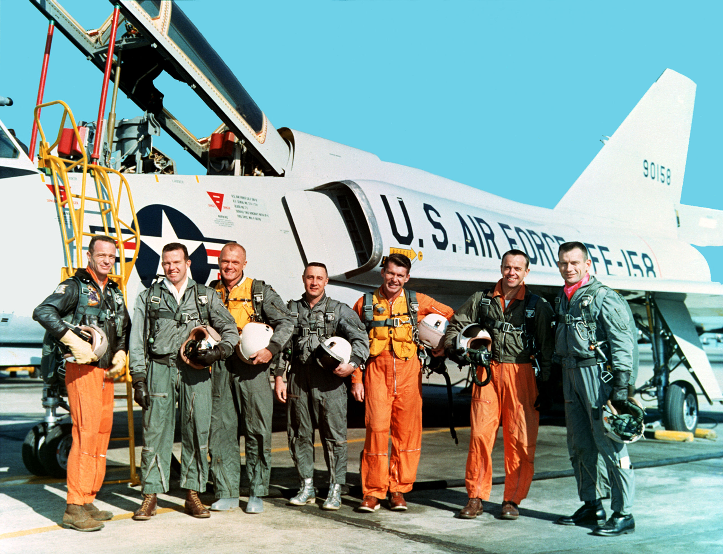

Slide 3
A NEW Vision for Kansas….
Kansas leads the world in the success of each student..
Notes:
Based on the feedback received across the state, the board has adopted as its new vision for education “Kansas leads the world in the success of each student.”
We intend to challenge the status quo, move away from placing emphasis on a single test score and focus more on helping each student identify and achieve their career aspirations.
Teachers, administrators and support staff already are doing great work preparing Kansas’ students for success, and this new vision stands to unite our efforts across the state. You will hear us say we need to rethink how our schools are asked to operate. From a state perspective, we will look at every requirement to determine if and how we are supporting or impeding our schools’ abilities to address the needs of each child.

Slide 5
How was the Vision Developed?
20 community tours with over 1,800 participants.
Participants broken into 287 focus groups of 5-6 individuals answering 3 questions.
What are the skills, attributes, and abilities of a successful 24-year-old Kansan?
What is K-12’s role in developing this successful Kansan, and how would we measure success?
What is higher education’s role in developing this successful Kansan, and how would we measure success?

Slide 6
How was the Vision Developed?
7 Business/Industry tours with more than 110 businesses.
Met with local Chambers of Commerce
Asked same three questions
Partnered with Kansas State University to analyze data.
Largest Qualitative Study completed.
Conducted a Reunion Tour in 10 regional locations to share results and to answer, “Did we hear you correctly?”

Slide 7
How was the Vision Developed?
Board held several retreats to analyze data and build a new Kansas Vision.
New Vision was launched in the fall of 2015 at the KSDE Annual Conference.
Attendee’s included over 1,000 Kansas educators.
Approximately 100 Business Professionals and Legislators

Slide 8
From the first set of focus group responses, what characteristics of success were most frequently cited?
Notes:
This result is a little surprising since about 66% of the respondents were educators, education administrators, or former educators—people who mostly teach, or used to teach, academic skills. Nevertheless, the soft skills—social-emotional, personality skills, or 21st century skills—they have lots of names—were cited 70% of the time.

Slide 9
The business and industry focal groups cited non-academic skills with greater frequency than the community groups:
Notes:
Recall that the community groups cited non-academic skills 70% of the time and academic skills 23% of the time. These frequencies are remarkably similar to those expressed by the community groups. If volume can be equated with importance, the business and industry groups are saying that the non-academic characteristics are more important than academic skills, including applied skills, and that non-academic skills are at least as important to them as to the community groups, maybe more so.
One cited experience as a characteristic of the ideally prepared 24 year old (the tiny yellow line).

Slide 10
A few take-home lessons
What is the role of K-12 education in achieving the future?
Re-designing the curriculum— around individualized goals, planning, instruction, and experience, around incorporating real-life problems and projects into the curriculum, and experiential learning—is heavily suggested.
New roles are suggested for school counselors—in deeper individual career planning, and perhaps in coordinating internships and work experiences with business and community organizations.
The large proportion of instrumental skill training that included some experiential training, e.g. internships; concrete, realistic practice, job shadowing, etc.—suggests much more integrated coordination with businesses and community organizations.
Notes:
There is a suggestion of a structure of social opportunities—opportunities for experience, particularly real-world experiences—that students need to practice applied skills, both practical and social.

Slide 11
What are community focus groups saying about measures?
How should K-12 measure indicators towards success?
Non-cognitive, social-emotional measures,
like conscientiousness and school climate,
are important, but how they can be measured isn’t clear.
Project and task performance, individual planning, curriculum designed for realistic experiences, internships and work experiences—are more important measures than traditional assessments.
Post high-school measures—credentials, employment, well-being—are also important measures of K-12 success.

Slide 12
What Kansans want from their schools
Changes need to be made to address school culture
New dynamic roles for counselor and social workers
Collaboration between schools and businesses
Reorganize schools around students, not the system
Community service needs to play a bigger role
Kansas children need quality preschool including all day kindergarten
Notes:
We also learned that Kansans believe
Every child needs access to quality preschool education
School culture needs to be addressed – we must value the student going to a two-year or certification program as much as a student attending a four-year institution.
Counselors need to be able to help students identify and explore career interests
Must be collaboration between schools and businesses to prepare students for postsecondary pursuits
Schools must be reorganized around the student, not the system to meet unique needs
Community service is an important part of preparing students for life after high school.

Slide 13
Harvard, Stanford and the Carnegie Foundation

Slide 14
Student Success
Kansas needs 71% of workers to have a post secondary certificate or degree.
Approximately 36% need to be bachelor degrees or higher
Approximately 35% need to have a certificate or associate degree

Slide 15
It’s How You Do It
32%
30%
20%
Long-term project taking a semester or more to complete
Internship or job where applied learning
Extremely involved in extracurricular activities and organizations
6%
Of All Graduates Experienced All Three
Copyright © 2016 Gallup, Inc. All rights reserved.

Slide 16
Lessons from Gallup Research
“Caring (not content) is King”
Mentors are needed
Excitement about the Future
Strengths, not Weaknesses
Long-term Projects
Project-based Learning
Work Experiences Connected to Learning (Intern, Apprentice, etc.)
Deep, Lasting Engagement
“Someone who encourages my development”
“Do what I do best every day”
Copyright © 2016 Gallup, Inc. All rights reserved.

Slide 17
Change is hard at first,
messy in the middle,
and gorgeous at the end. – Robin Sharma

Slide 18
Notes:
Today’s students are the future workforce and future leaders of Kansas. Kansans Can achieve anything and, together, Kansans Can lead the world in the success of each student.

