Slide 1
Kansas Leads the World in the Success of Each Student.
Dr. Randy Watson, Kansas Commissioner of Education

Slide 2
A NEW Vision for Kansas ...
Kansas leads the world in the success of each student
KANSAS STATE DEPARTMENT OF EDUCATION | www.ksde.org

Slide 3
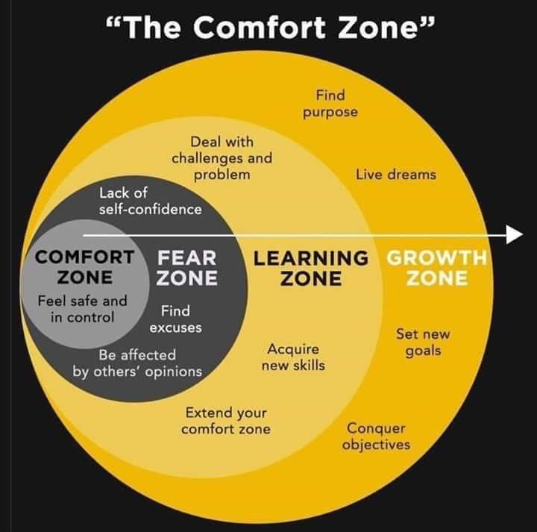
The Challenge of Change

Slide 4
Our Big Rocks…Our Overall Goal
100% of Students Graduate High School
100% of Students execute their Post Secondary Plan
45% attend a four year college
45% attend a two year college and/or have multiple certificates
5% are in apprentice programs
4% enlist in the military
1% attend 18-21 year old program

Slide 5
Stages of Development – What we look for
Birth – Age 4
Ages 5 - 9
Ages 10-16
Ages 17-20

Slide 6
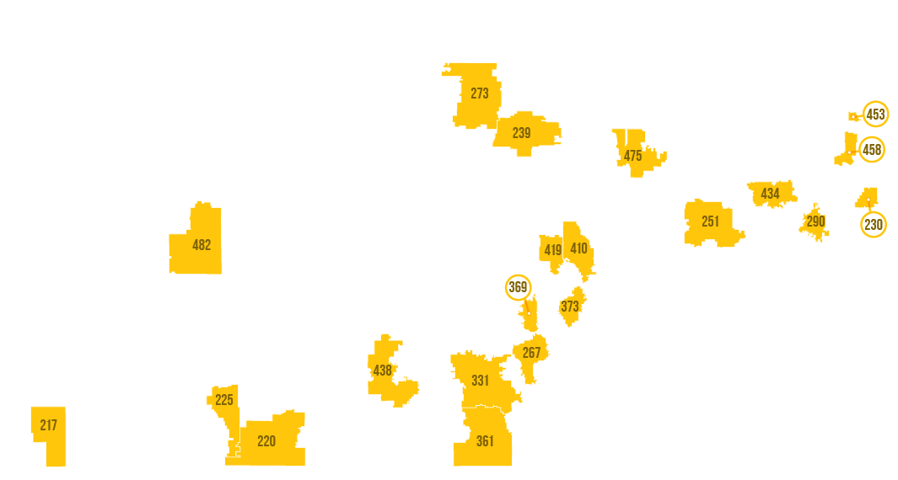
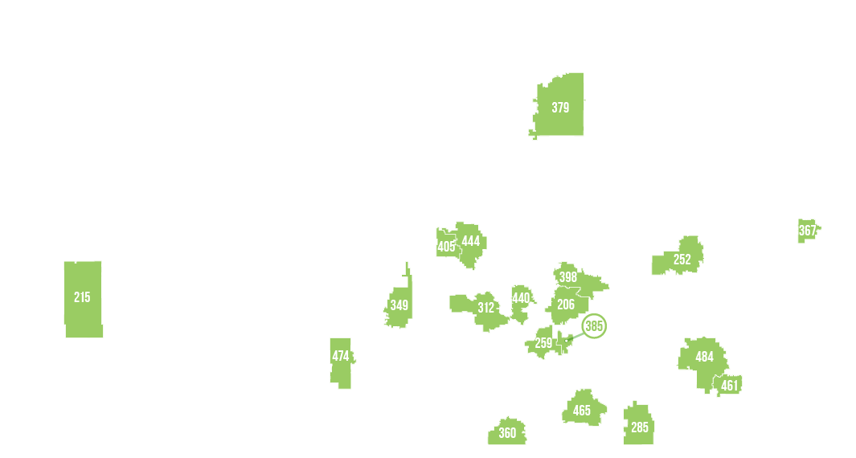
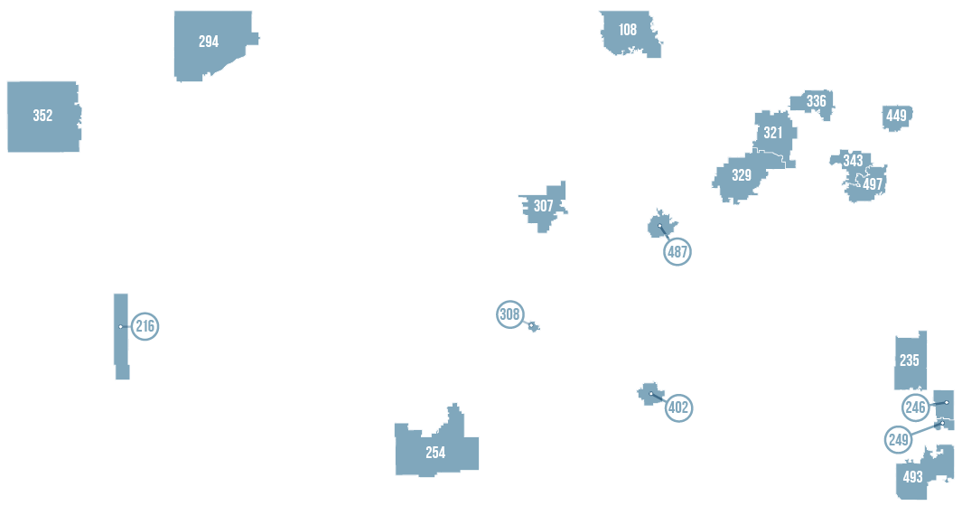

Slide 7
Kansas School Redesign Principles
Student Success Skills | Family, Business, and Community Partnerships
There is an integrated approach to develop student social-emotional learning. | Partnerships are based on mutually beneficial relationships and collaboration.
Personalized Learning | Real World Application
Teachers support students to have choice over their time, place, pace and path. | Project-based learning, internships, and civic engagement makes learning relevant.

Slide 8
Notes:
Today’s students are the future workforce and future leaders of Kansas. Kansans Can achieve anything and, together, Kansans Can lead the world in the success of each student.

