Slide 1
Apollo 3-
Mission Inception
June 15, 2021
9:00-10:00/3:00-4:00
https://www.youtube.com/watch?v=BXeOKhy1ltU
Notes:
9:00-9:10 1-6 Welcome & Apollo 3 Announcement
9:10-9:25 7-12 What is Redesign & Site Introduction
9:25-9:40 13-19 Time
9:40-9:55 20-26 Who?
9:55-10:00 27-32 Closing

Slide 2
Agenda
Congratulations
How will this support you in Navigating Next?
What is Kansans Can School Redesign?
How will you make time for Redesign?
Who are your teacher leaders?

Slide 3
Congratulations!
Notes:
https://www.youtube.com/watch?v=w5tWYmIOWGk
I wanted to share this with you all for two reasons; to congratulate you on taking the courageous step to Redesign and to give you a glimpse of where you’re headed!

Slide 4
Notes:
6 NEW Schools going through Regional Training
6 NEW Schools participating in Redesign through their district
3 schools finishing/rebooting their plan year
15 SCHOOLS!
Final cohort of Redesign before it is baked into KS Ed Systems Accreditation
Apollo 3 Plan year will be the best yet as we’ve taken all lessons learned and refined the content and pace leading to being launch ready.

Slide 5
Notes:
Shoutouts to all of our Apollo 3 schools as they join the other cohorts of Redesign in Kansas!

Slide 6
Why Redesign?
Notes:
To kick off our learning for today, we want to share this short video put together by Dr. Watson and Dr. Neuenswander over Apollo III and the impact Redesign can have on your school as we Navigate what comes Next.

Slide 7
What is Kansans Can School Redesign?
Notes:
To begin, we want to orient everyone to what we mean when we talk about engaging in Kansans Can Redesign.

Slide 8
Notes:
This is our balcony view timeline for the Redesign Plan Year. As you can see, the Plan Year is broken into 5 phases. We are completing that first phase today: Mission Inception. Take some time to review this timeline over the next few weeks. This is a great tool to share with stakeholders so that they can clearly see what they learn and when they will learn it. External stakeholders might also like seeing this so that they can feel ‘up to speed’ on what you are learning, doing, and planning to Redesign.
https://www.ksde.org/Portals/0/Communications/KC_School_Redesign/Kansans%20Can%20School%20Redesign%20Project%20Plan%20Year%20Timeline.pdf?ver=2020-09-24-144333-290

Slide 9
Kansans Can School Redesign Principles
Student Success Skills | Family, Business, and Community Partnerships
There is an integrated approach to develop student social-emotional learning. | Partnerships are based on mutually beneficial relationships and collaboration.
Personalizing Learning | Real World Application
Personalized learning places the whole child at the center of instruction. It is informed by strong educator/student/family/community relationships to provide equity and choice in time, place, path, pace and demonstration of learning. | Project-based learning, internships, and civic engagement makes learning relevant.
Notes:
In Redesign, we say there are 3 Key Elements:
Principles
Process
Conditions
To start, let’s review the 4 Redesign Principles. As you Redesign, you will want to make sure that you are accounting for these four things. READ THROUGH
Notice the cog in the center. As you Redesign, you will not be thinking of individual strategies for each principle. Rather, you should consider how one strong and robust strategy can tap into multiple principles. In the end, you will measured on how well you addressed each principle, not how many strategies you are planning to implement.

Slide 10
Redesign Process
DESIGN THINKING + 4DX
EMPATHIZE
with our students and staff
TEST
models and strategies with students
DEFINE
their needs
Create a Cadence of Accountability
Iterations
PROTOTYPE
models and strategies
IDEATE
solutions to these needs
Focus on the Wildly Important (Goal Areas & Lag Measures)
Keep a Compelling Scoreboard
(Liang, Mitchell, & Scott, 2020)
Act on Lead Measures (Strategies)
Notes:
The HOW of Redesign - process
Dream Home
Architect (DT) interviews you about what you like, don’t like, creating unique blueprint
Construction manager (4DX) sets timeline, benchmarks, monitors progress, holds people accountable
Hexagons are the Design Thinking steps, rectangles are the 4 Disciplines of Execution
Blending of the two models - unique to school improvement
Schools learn this process in the Plan Year and then continually replicate and cycle through in a perpetual loop

Slide 11
Conditions for a Learning Culture
Kools, M., Stoll, L., George, B., Steijn, B., Bekkers, V., & Goouëdard. (2020). The school as a learning organization: The concept and its measurement. European Journal of Education, 55, 25-42.
Sh
Principals
Model Learning Leadership
Motivate Teachers
Support Inquiry, Innovation, and Exploration
Shared Leadership
Shared Leadership
-Shared Vision
-Psychological Safety
-Communication & Feedback
-Growth Mindset
Teachers
Collective Efficacy
Change Agents
Collegial Collaboration and Practices
Additional Stakeholders
Input in Goals and Strategies
Communicate about and Invest in the Work
Shared Leadership
Notes:
Essential to the Redesign process is for school leaders to establish the conditions for the school’s culture to develop into a learning organization. Kools and Stoll (2016), in their work to redesign schools in Wales, UK, define learning organizations as schools that have “the capacity to change and adapt routinely to new environments and circumstances as its members, individually and together, learn their way to realizing their vision.” We believe this definition is extremely applicable to the current context in Kansas. A learning organization is built when the following constructs are intentionally developed:
Shared Vision
Inquiry, Innovation, and Exploration
Collective Efficacy
Modeling Learning Leadership
Psychological Safety
Learning from External Environments
The conditions of a learning organization (i.e. your culture) must be developed and supported.
In order for your organization to engage in continuous improvement, a Shared Leadership approach must be embedded in your organization. In Shared Leadership-and essential to Redesign-the organization must be flattened to allow for multiple voices to be included in the decision-making process. Shared Leadership also means embracing diverse perspectives and sharing the responsibility and accountability for vision, mission, and decisions of the organization. Thus, in order to have the right conditions for change, you must have in place a strong culture and shared leadership practices.
Your school should have completed the redesign school culture survey this past spring. If you, as the principal, have not yet requested your school’s report, please let us know.

Slide 12
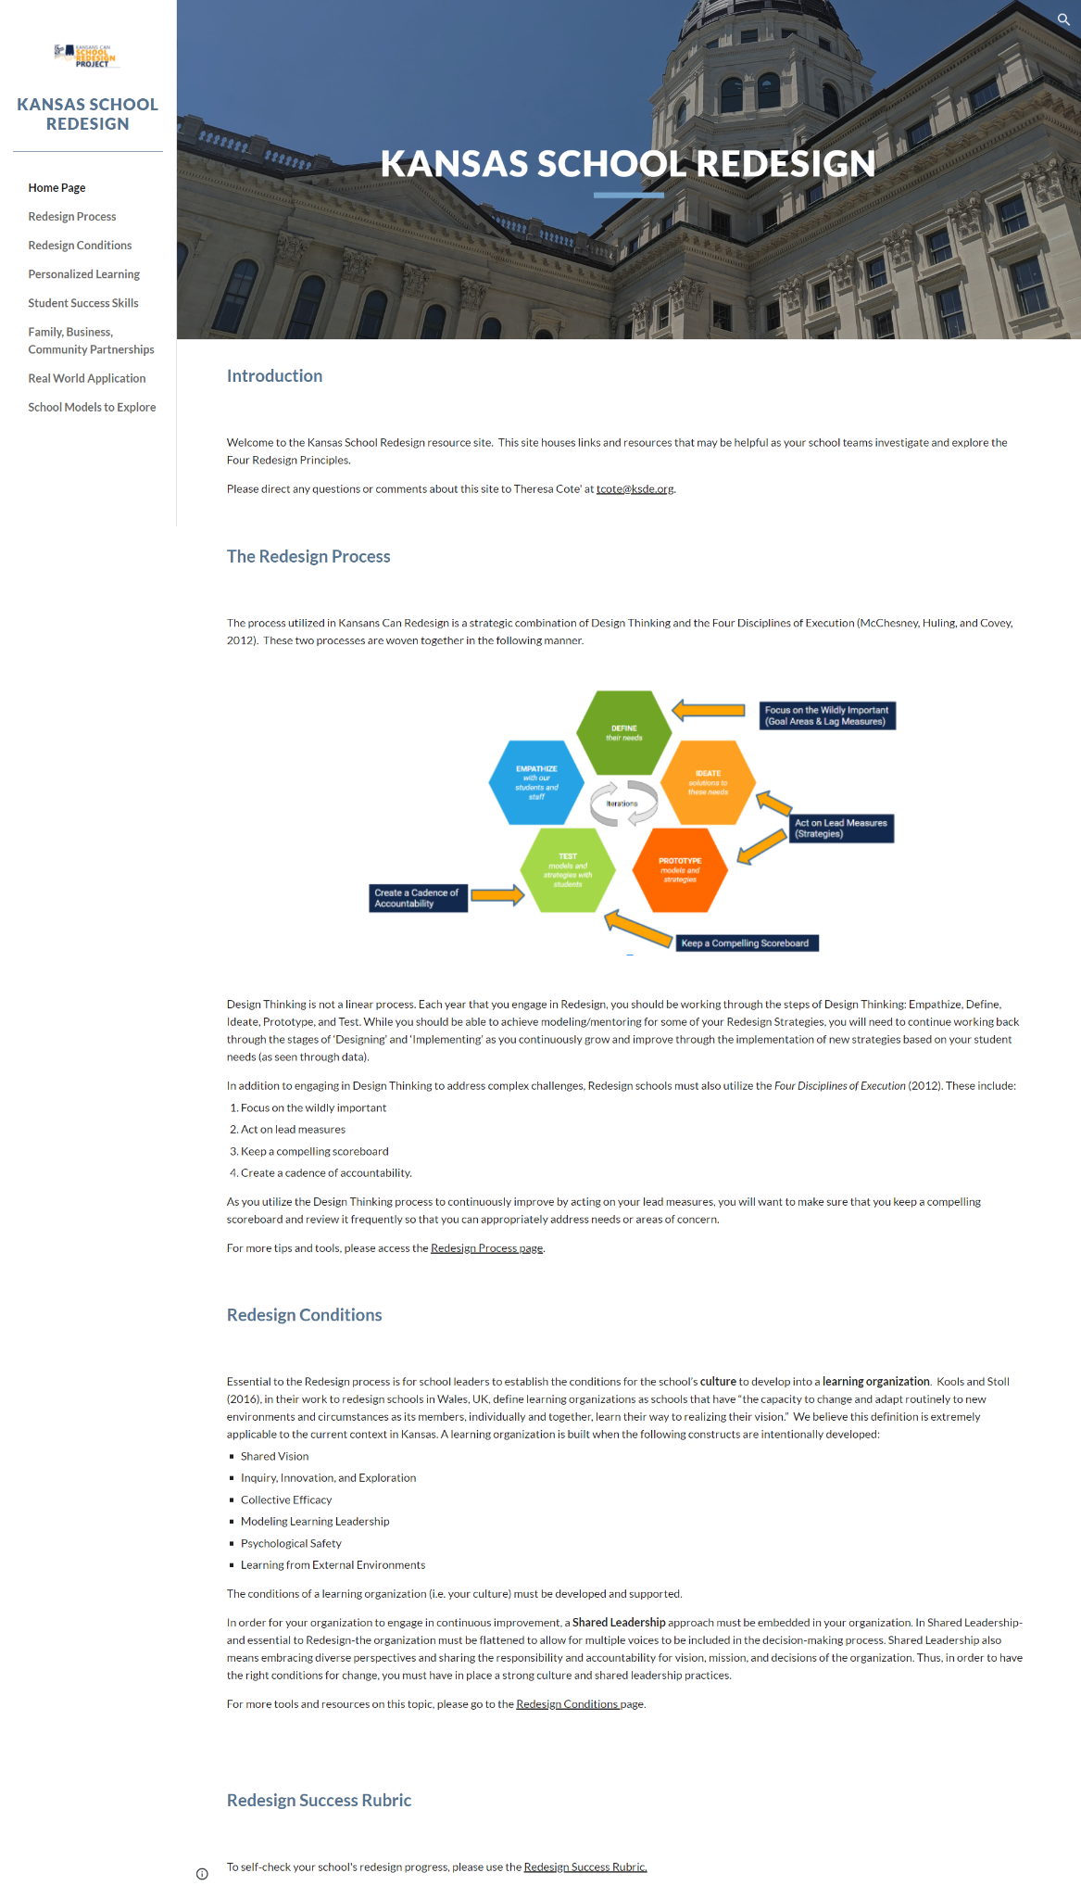
Homework- Explore
Learn more about Redesign by exploring our Google Site.
Notes:
Go to the home page - quick orientation.
Home Page
Menu
Great place to start.

Slide 13
How will you make time for Redesign?
Notes:
“It’s not one more thing on an already-full plate….Redesign IS the plate”

Slide 14
Time Commitment for School Redesign
80%
20%
Notes:
Ex. Google - 20% time, employees encouraged to take 1/5th of each week and spend time working on a passion project, collaboratively or individually. Once implemented 20% time became the driver of many innovations within Google including AdSense and Google Mail. to become the giant they are today.
It’s important to create and protect time for what’s important or the whirlwind will swallow up all the time. Ex. color-coded calendar for the week
How might that look for you? Blocking off 1 hour every day to focus.
How might that look in a school? Previous Redesign schools have Increased teacher collaboration time. SRT having a common planning time. Utilizing existing teacher collaboration or PLC time. Re-purposing existing staff meetings.
It will be important for the success of the Plan Year to build in and protect 20% time.

Slide 15
WHAT
Determine what is the essential learning for all.
WHY
Establish a clear purpose for the learning.
Turnkey Considerations
HOW
Determine the best time, place, and delivery model for the learning.
Notes:
Two Things:
While you are at these trainings, we are giving you content and walking you through activities to assist you in engaging in design thinking to plan your school redesign. As you participate, you should always be thinking about what you will take back to your staff and how you will deliver it.
To assist you with planning your ‘turnkey’, we have a communication log that you were asked to create in the beginning of our time together. You are not obligated to use this, but it is highly encouraged. Use this communication log to help you plan, to track your progress, and to implement a system of accountability.
It is not practical to think that you will simply repeat everything you did during the regional training with all staff. However, it is essential that as a school redesign team, you are intentional and plan what you will turnkey, why it is important, and how you will do it in such a way as to be meaningful for others.
Early lessons from redesign schools showed that when SRT’s waited to share until they had “everything figured out”, colleagues became anxious and suspicious about what they perceived as a lack of transparency.
It is not practical to think that you will simply repeat everything you did during the regional training with all staff. However, it is essential that as a school redesign team, you are intentional and plan what you will turnkey, why it is important, and how you will do it in such a way as to be meaningful for others.
Early lessons from redesign schools showed that when SRT’s waited to share until they had “everything figured out”, colleagues became anxious and suspicious about what they perceived as a lack of transparency.

Slide 16
Time Commitments - Plan Year
~10-11 workshops at each of the educational service centers, attended by the School Redesign Team
Time to Turnkey
Time for Teams to Meet (beginning in November)
Virtual Check Ins with your Coach
1 on-site visit (minimum) in the spring
Notes:
The Redesign Plan Year does ask a lot of schools! You will be asked to attend monthly meetings with your ESC or district. You will be expected to ‘turnkey’ (or take back and teach) your learning in these meetings. You will also work with your coach in between meetings to make sure you are on track and to receive TA if/when needed.

Slide 17
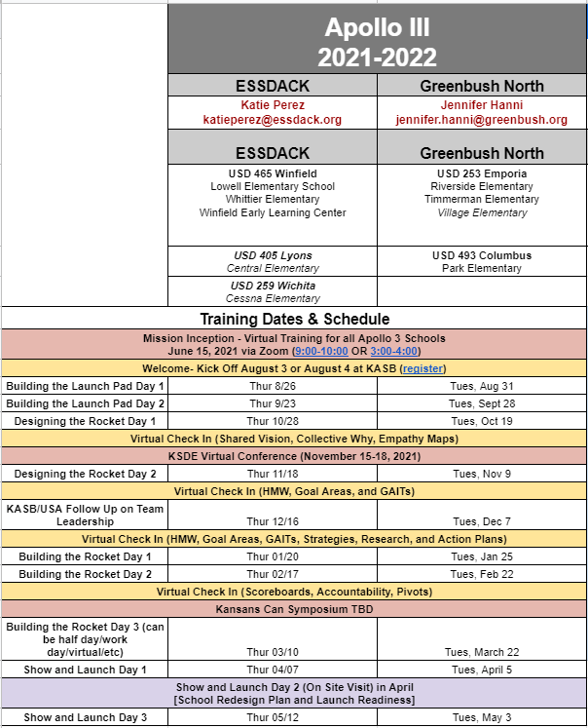
Calendar for the Plan Year
katieperez@essdack.org
jennifer.hanni@greenbush.org
Notes:
Here is the calendar for next year. Please note your ESC and their email. These dates should not change, but if there is a change, your ESC rep will let you know.
You can also view the calendar using the bit.ly provided.

Slide 18
Leadership and Apollo III Kick Off
When- August 3 OR 4, 2021
9:00-3:00
Where- Kansas Association of School Boards
1420 SW Arrowhead Road, Topeka, KS 66604
We will switch to a virtual option if necessary. That decision will be made by July 1, 2021.
Access- Register your team for the date that works best for you by completing this google form.
Notes:
We will be hosting our leadership kick off in August. This is a training for all of our schools in advance of kicking off your regional training.

Slide 19
Homework- Create
Create a 20% Calendar for how you will make time for Redesign during the 2021-2022 School Year.
Notes:
In advance of next year, please take some time to block off turnkey time, SRT time, so that you are not scrambling to find days/time next year during each turnkey planning time.

Slide 20
Who are your teacher leaders?
Notes:
For this section, we will talk about who are your teacher leaders? What are the characteristics of teachers who should be part of the school redesign team. This process provides ample opportunities for all teachers to practice and grow their leadership capacity, but who takes on the additional responsibility of the school redesign team matters.

Slide 21
Leadership Competencies
Notes:
The Pilot and/or Co-Pilot positions on the school redesign team are teacher leaders who will shepherd the process, with the support of the principal and the rest of the school redesign team. Some qualities to consider when selecting or electing the pilot/co-pilot are in this document of leadership competencies.
Pilots/Co-Pilots can:
Understand the principles of adult learning and know how to develop a collaborative culture of collective responsibility in the school. The teacher leaders use this knowledge to promote an environment of collegiality, trust and respect that focuses on continuous improvement.
Demonstrate that they are change agents. They embrace change both in and out of the classroom and exercise agency, making intentional decisions about their work.
Demonstrate a deep understanding of teaching and the learning processes and use this knowledge to advance the professional skills of colleagues by being a continuous learning and modeling reflective practice based on student results. The teacher leader works collaboratively with colleagues to ensure instructional practices are aligned

Slide 22
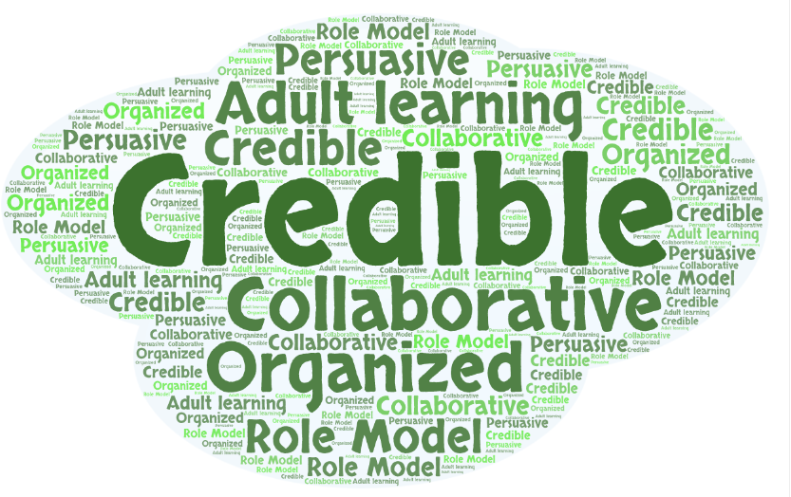
Qualities for Pilots/Co-Pilots
Notes:
● Have the capacity to persuade others
● Enjoy informal position and status
● Actively engage others in discussions
● Have credibility
● Earn and maintain status
● Are role models
● Are technical experts
● Are power people
● Can be cheerleaders
● Are the celebrities of the staff

Slide 23
Collective Efficacy- What & How?
→ Collective efficacy is the belief that you, and your team, have the ability and authority to make a difference and/or have an impact. Staff believe that they can produce meaningful learning experiences for students and that they can repair gaps in student learning. The belief in your own, or your groups’, potential.
Donahoo & Katz (2019)
Notes:
Are teachers…
Confident in their ability to motivate their students?
Skilled at producing meaningful student learning experiences?
Skilled in various methods of teaching?
Tenacious in that if a child doesn’t learn something new the first time, they will try another way?
Firm in the belief that every child can learn?
Confident to explore new instructional approaches to help underperforming students meet standards?
Donohoo, Jenni, and Steven Katz. “What Drives Collective Efficacy?” What Drives Collective Efficacy? - Educational Leadership, ASCD, July 2019, www.ascd.org/publications/educational-leadership/jul19/vol76/num09/What-Drives-Collective-Efficacy%C2%A2.aspx.
Elmore, D. R. F., Forman, M. L., & Stosich, E. L. (2010). Internal Coherence Survey. 7.
Kools, M., Stoll, L., George, B., Steijn, B., Bekkers, V., & Gouëdard, P. (2020). The school as a learning organisation: The concept and its measurement. European Journal of Education, 55(1), 24–42. https://doi.org/10.1111/ejed.12383

Slide 24
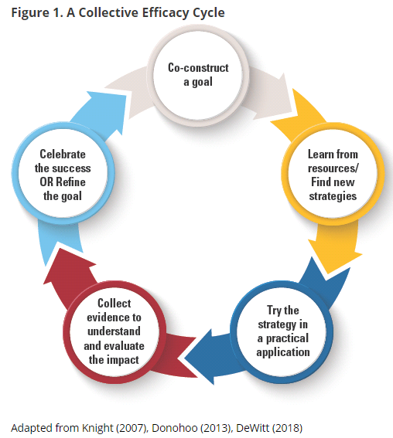
Grow Collective Efficacy
Notes:
The graphic walks through the steps necessary for growing collective efficacy in your organization. In order to grow and build collective efficacy, you must allow all staff an opportunity to co-construct the goal; learn from resources and investigate strategies; staff must have a chance to ‘try a strategy on’ while collecting evidence to understand impact; and lastly, staff must have a collective opportunity to celebrate and reflect.
If you compare that to the process used in Redesign of design thinking and the four disciplines of execution, you see that there is quite a significant alignment between them. In redesign, you use design thinking and 4dx to empathize with students and define your wildly important goals. You ideate and investigate strategies that become your lead measures. Your build prototypes the you test in small groups and while doing so, you create data scoreboards and you hold accountability meetings where ‘pivots’ or ‘adjustments’ are determined. And at the end of your test window, you reflect, celebrate and create a plan for scale or revise and begin again.
To put it simply, using the redesign process with fidelity and integrity will allow you to grow teacher collective efficacy. Let’s move on to learn a little bit more!
Donohoo, Jenni, and Steven Katz. “What Drives Collective Efficacy?” What Drives Collective Efficacy? - Educational Leadership, ASCD, July 2019, www.ascd.org/publications/educational-leadership/jul19/vol76/num09/What-Drives-Collective-Efficacy%C2%A2.aspx.

Slide 25
Redesign Principal Competencies
Engage all stakeholders to create and build a Shared Vision
Empower teachers to research, develop, and implement student-centered strategies
Establish, foster, and sustain a culture of learning
Differentiate leadership strategies to fit the situation
Set high expectations for continual learning
Notes:
Participate in professional learning to grow your practice
Actively participate in regional training (5)
Coach those you lead (4)
Provide opportunities for staff to participate in decision making (2)
Provide opportunities for students to participate in decision making (1)
Give staff responsibility to lead activities projects (2)
Ensure all actions are consistent with the school’s vision, mission, and values (5)
Anticipate and address barriers and challenges (4)
Celebrate big and small wins (3)

Slide 26
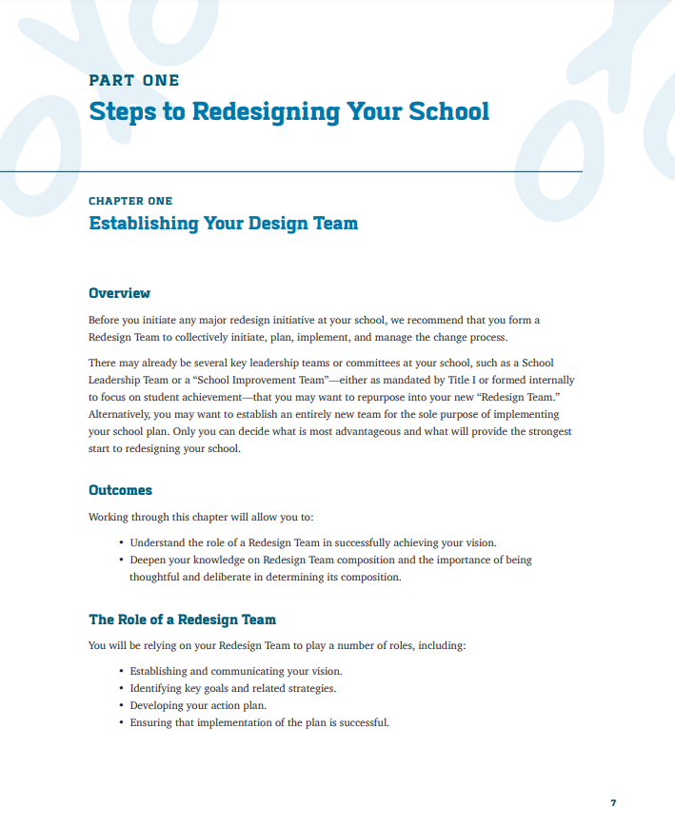
Homework- Establish
Establish your School Redesign Team.
Start by selecting your Pilot and Co-Pilot.
https://www.fourpointeducation.com/wp-content/uploads/2017/10/Playbook-for-Redesigning-Schools-for-the-21st-Century.pdf
Notes:
Best practices:
Candidates apply, then small group of staff interviews and selects OR all staff vote for pilot, co-pilot

Slide 27
Closing

Slide 28
Redesign Summer Work
Explore the Redesign Google Site
Create a 20% Calendar
Get Regional Training Dates on Calendar
Establish your Redesign Team

Slide 29
Recommended Reads
The New School Rules by Kim and Gonzalez-Black
Book Study Guide
Design Thinking for School Leaders by Gallagher and Thordarson
4 Disciplines of Execution by Covey, et. al.
Think Again by Adam Grant

Slide 30
KSDE Redesign Team - redesign@ksde.org
Jay Scott - jscott@ksde.org
Tammy Mitchell - tmitchell@ksde.org
Sarah Perryman - sperryman@ksde.org

