Slide 1
KSDE Kansas Dyslexia Initiatives
Curriculum Leaders/ Update (1.20.23)
Amy Bybee & Melissa Brunner, KSDE Teacher Leader Consultants: Early Literacy/ Dyslexia Team

Slide 2
Kansas Dyslexia Initiatives
With the goal of not missing any student-
Universal screening
KIDS accountability and SO66 report for educator training
MTSS that includes strong Tier 1 instruction using science of reading evidence base and supports all students who are identified as needing extra support
KSDE providing continual support as districts shift away from a balanced literacy approach to a structured literacy model of instruction

Slide 3
Universal Screening
Currently: Every student (K-12) is to be screened 3 times per year as required in the Dyslexia handbook which prescribes what subtest at each time of the year for each grade.
Considering: All students K-8 will be screened 3 times per year using a valid, reliable nationally-normed screener that includes the SBOE required sub-test assessments when determined by the technical manual for the screener and additionally as district determines. Any student moving into district should be screened within the first two weeks of attendance.
Notes:
The advantage is that you would be able to use the data for your screener without searching for a second screener and/ or changing the administration timeframe due to a KSDE requirement.

Slide 4
Spring scores would be uploaded to KIDS as they are now with the addition of 8th grade comprehension assessment
Phoneme segmentation (K)
Nonsense Word Reading (1st)
Oral Reading (2)
Comprehension (8)
Notes:
This is how it is NOW

Slide 5
We will continue to identify students at secondary level needing reading instruction/support
All 9th graders would be screened in the fall on timed comprehension measure (valid, reliable, nationally normed screener).
If student scores at or above benchmark (40th percentile) they can exit secondary screening (unless teacher or parent concern)
If student flags at some or high risk, score can be validated by methods below (and possibly others to be determined), and student can be exempt from further screening with:
PreACT (9th Grade) of 16 or above
ACT ELA 18 or above
Students who do not meet the above requirements and score at risk, should be given the CBM/ Oral Reading Fluency assessment with comprehension questions and diagnostics that would be useful in determining how to provide core support or reading intervention. They should continue progress monitoring and universal screening until they have scored at benchmark 40th percentile or above).
Notes:
Explain the importance of timed reading. While helping secondary schools focus their efforts on those students who are most in need of identification and assistance.

Slide 6
These are proposed changes that are being considered but are NOT finalized. We will provide additional information and details when any change is to be implemented.

Slide 7
Required Dyslexia Training
On SO66 there will be two responses required. One noting that all new teachers endorsed below have received the initial 6 hours of training and another that notes that those listed below have received the district determined required annual structured literacy training.
endorsed elementary education.
endorsed early childhood unified.
endorsed high incidence special education in teaching in grades K - 12.
endorsed English Language Arts grades 5 - 12.
endorsed as reading specialists.
endorsed as school psychologists.
and it is highly recommended that paraeducators receive the training.
Notes:
The training won’t be changing, just the clarification of the reporting. You can tell them that we are considering an update of the six hours of training.

Slide 8
To gain support for their structured literacy efforts- districts can identify their own professional learning or…
utilize KSDE Professional learning- in person
Tier 1 Support for Students in Middle/ Secondary: Dyslexia
Jan. 23, 2023 Keystone: Ozawkie, KS
Jan. 30, 2023 SW Plains: Sublette, KS
Feb. 6, 2023 NKESC: Oakley, KS
Feb. 27, 2023 Smoky Hill: Salina KS
March 6, 2023 Greenbush: Lawrence
More Dates TBD
Summer Academies 2023

Slide 9
or use KSDE Virtual Professional Learning
Previous PD that has been provided is being prepared for uploading to the KSDE Dyslexia Webpage (search KSDE Dyslexia) to allow access for all districts:
Suzanne Adlof’s Dyslexia/ Language Disorder Webinars
Shifting the Balance
Structured Literacy Walkthrough Tool
I’ve Screened…Now What?
Language to Literacy
90 Minute Literacy Block Party
Notes:
This won’t be up for a few weeks-

Slide 10
Pilot for 2nd Grade Assessment (optional)
Nothing new to report- but progressing…stay tuned.
Brief assessment (2, 30-minute computer administered sessions) used to inform classroom instruction (in development)
A “bridge” assessment between the instructional focus of early literacy instruction and the expectation of a comprehension assessment more typical of the 3rd grade assessment
Allow schools/ districts to see the effectiveness of core instruction in early grades
Allow schools to see if there are areas to focus on for the shift from learning to read- to reading to learn
Notes:
May take out depending on what Beth finds out due to timing

Slide 11
Literacy Advisory Council will meet later this month. This council will ask people to serve and rotate on and off…please consider saying “yes” if /when asked to serve!
The purpose is to assist KSDE with insight from the field.

Slide 12
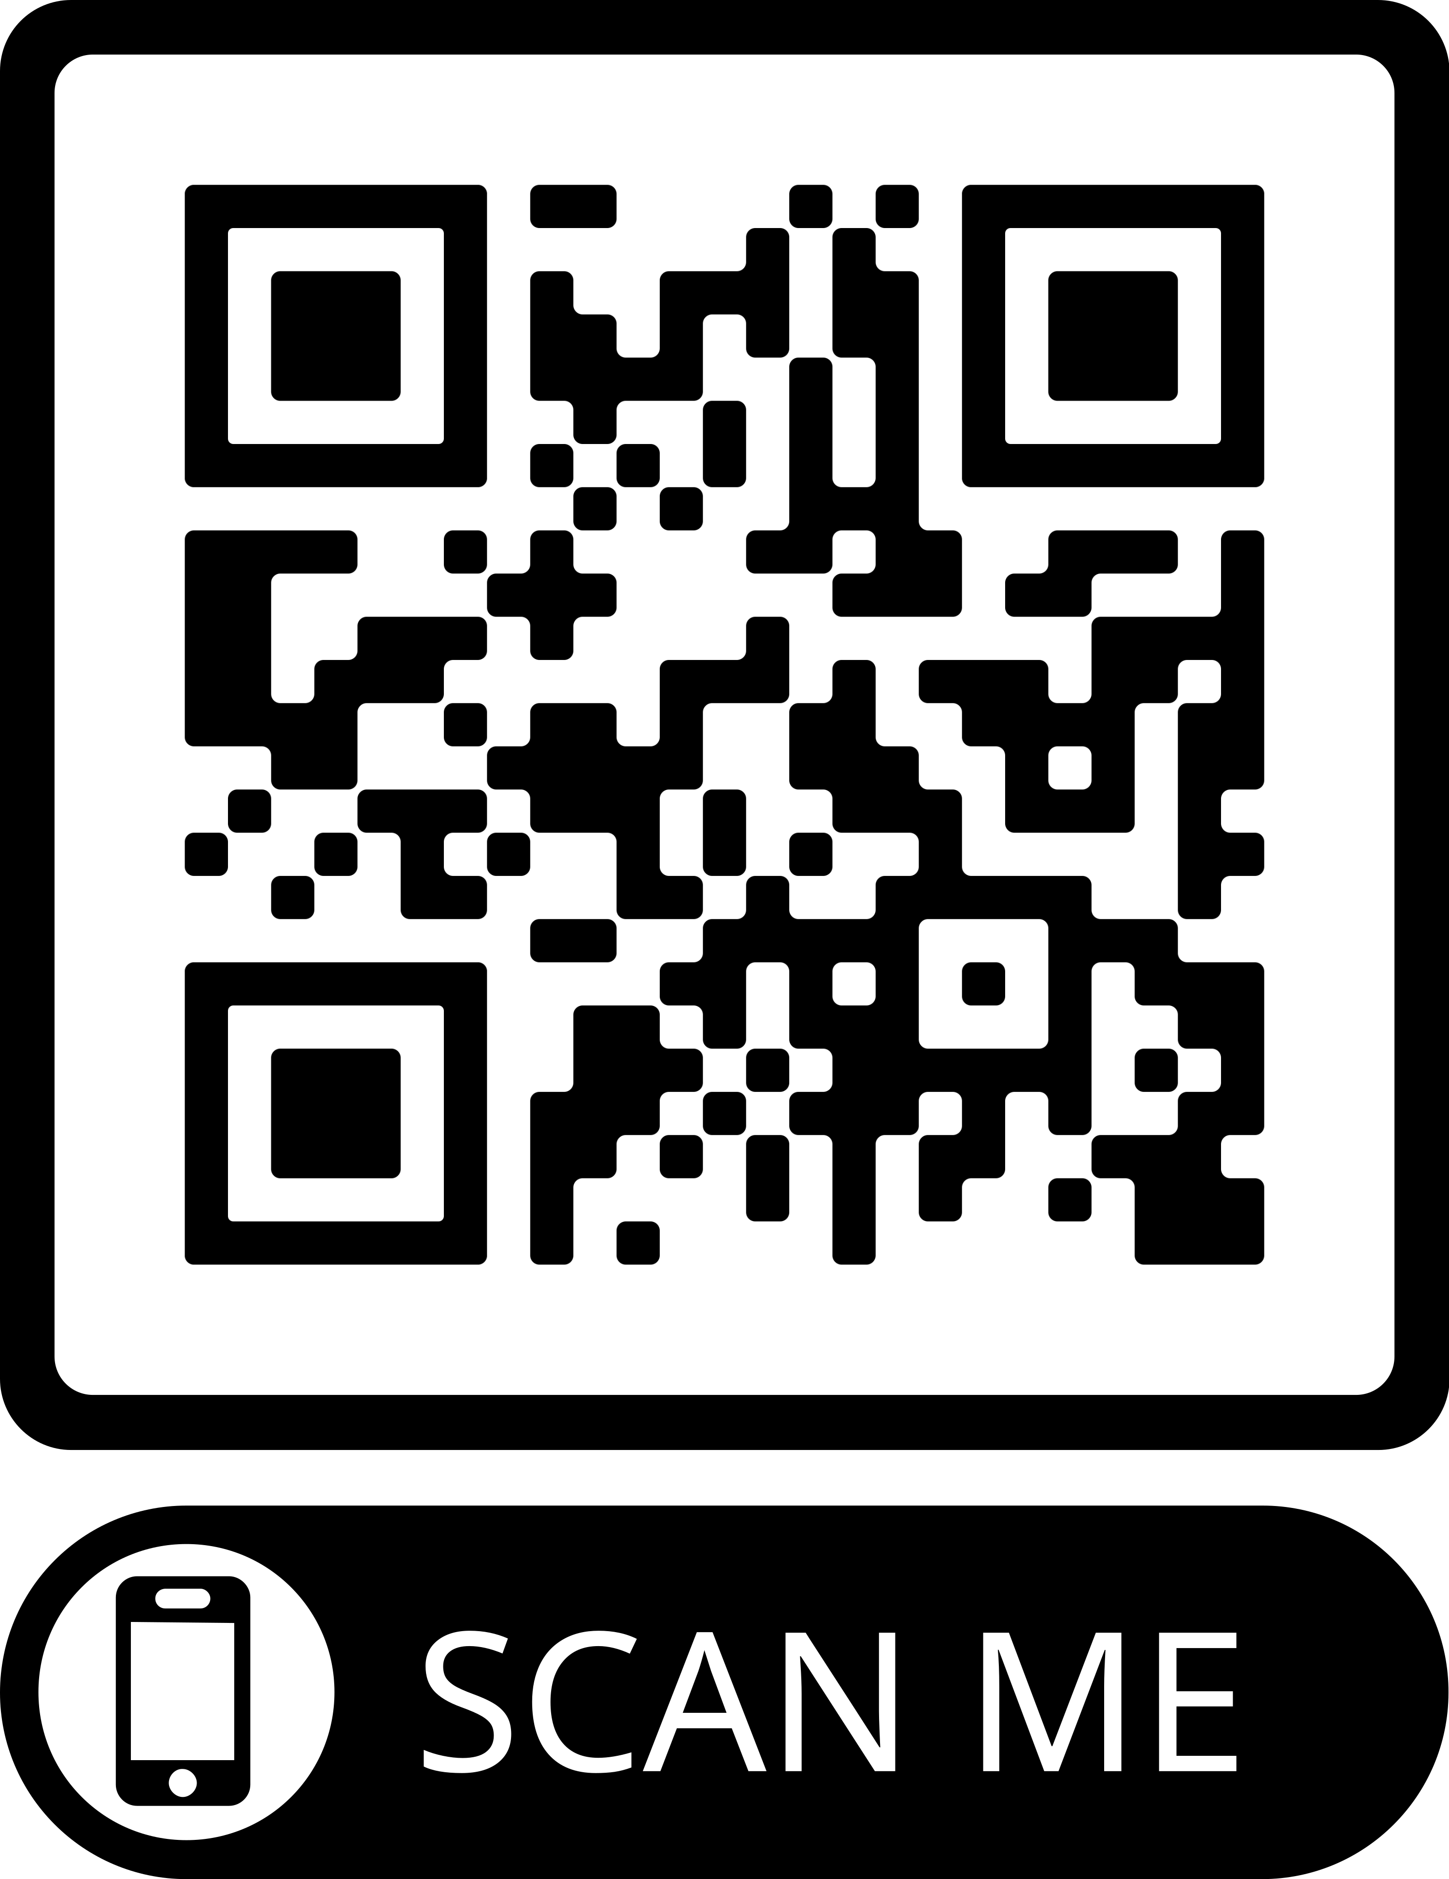
KSDE Dyslexia Initiatives
Dyslexia Handbook- revision in process once screening protocol is finalized.
Information for Kansas Initiatives- updates will be coming See: KSDE Dyslexia Page
Link to the
Early Literacy/ Dyslexia Link/ Newsletter
Notes:
Changes will be reflected here

Slide 13
Remain updated via
KSDE Weekly
Listservs (Early Literacy/ Dyslexia)
Stakeholder Meetings
KSDE Dyslexia Webpage
ELitDyslexia@ksde.org or lcurtis@ksde.org
Notes:
Ways to stay informed.

Slide 14
Laurie Curtis Early Literacy/ Dyslexia Program Manager CSAS (785) 296-2749 lcurtis@ksde.org

