Slide 1
Interstate Compact on Educational Opportunity for Military Children
  Monday, October 1, 2018
  Craig Neuenswander, Kansas Commissioner
  Kate Wren Gavlak, MIC3 Commission Past Chair and California Commissioner

Slide 2
OVERALL OBJECTIVES
Compact Overview
History and Background
Articles and Rules
Case Review
Assistance
Resources
Q&A

Slide 3
What’s an Interstate Compact?
  Pre-dates the Constitution
  Flexibility in form and use
  Scope: bi-state, regional, national
  Creation: negotiated
  Purpose: fixed agreements, advisory boards, regulatory entities
  Areas: transportation, environment, taxation, education, health, emergency management, corrections and public safety
Increasingly common, broader in scope, more frequent use for regulatory purposes.
Notes:
Interstate Compacts are contractual agreements between the states enacted through legislative means and adopted to resolve a dispute, study a problem or create an on-going administrative
mechanism for managing an interstate agreement.
It allows state governments to work collaboratively and jointly problem solve common concerns and issues without federal intervention regulation.
They are increasingly common and broader in scope.

Slide 4
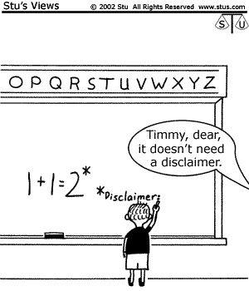
RULEMAKING POWER
Commission rules must be adopted in a manner that is substantially similar to the process of the Model State Administrative Procedures Act.
Once adopted, the rules have the force and effect of statutory law and supersede any inconsistent state laws.
Majority of state legislatures can reject a proposed rule.
Ref: "One of the axioms of modern government is the ability of a state legislature to delegate to an administrative body, including an interstate compact agency, the power to make rules and decide particular cases." West Virginia v. Sims, 341 U.S. 22, 33 (1951).

Slide 5
ENFORCEMENT POWER
The Commission has authority to enforce the Compact and its rules upon the states by:
  Requiring remedial training
  Requiring mediation/arbitration of dispute
  Imposing monetary fines on a state
  Seeking relief in federal court, most likely by obtaining an injunction to curtail state action or compel compliance
Notes:
Example: DCPS case and California on dues

Slide 6
Notes:
There are approximately 200 compacts formed since the founding of the US.
About 38 are inactive.
On average, each state is a member of 23 compacts.
Kansas is a member of 42 compacts ranging from 1921-2011:
1949 Arkansas River Compact of 1949:
2016 Medical Licensure Compact Interstate Insurance Product Regulation Compact: To promote and protect the interest of consumers of individual and group annuity, life insurance, disability income and long-term care insurance products, to develop uniform standards and review for insurance products covered under the Compact
Kansas was also the first state to pass legislation on joining the compact. ☺

Slide 7
COMPACT STATUTE
Each State has passed similar legislation becoming Signatories to the Interstate Compact.
Districts and schools should be familiar with the language of their State Statute/Code.
  Compact adopted in April 2008
  Sponsor: Representative Sydney Carlin
  Kansas Statutes, 72-8268

Slide 8
U.S. DEMOGRAPHICS
Source:: Defense Manpower Data Center on 9/7/16; DRS #103156
Notes:
Based on
1.4M active duty
1.4M national guard/reserves
10% dual military marriages
1.1M school aged children
630,000 military dependents
75% under 12
Where do they go to school?
Public schools 478,800 (76%)
Private 6,300 (10%)
DODEA 50,400 (8%)
Homeschool 37,800 (6%)
Data provided by the Military Child Education Coalition (MCEC)

Slide 9
Top Ten:
Virginia – 70,380
Texas – 62,368
California – 58,005
N.Carolina – 44,251
Florida – 38,696
Georgia – 31,384
Washington – 27,482
Hawaii – 19,992
Colorado – 19,179
Maryland – 18,850
Kansas – 10,935
21. Missouri – 7,815
Notes:
According to the US Defense Manpower Data Center, as of August 22, 2017 (provided to MIC3)
1.4M active duty
1.4M national guard/reserves
10% dual military marriages
1.1M school aged children
630,000 military dependents
75% under 12
Where do they go to school?
Public schools 76%
Private 10%
DODEA 8%
Homeschool 6%

Slide 10
Kansas Demographics
2015 Defense Spending by State
$3.3B spent (#29/nation)
2.3% GDP
0.8% of total U.S. spent $1,139/resident
41,152 personnel
$2.0B payroll
By service:
  Active Duty 56%
  Reserve/Natl Guard 27%
  Civilian 17%
Source: Office of Economic Adjustment, FY2015 Defense Spending by State

Slide 11
  Mission:
Through the Interstate Compact, MIC3 addresses key educational transition issues encountered by children of military families
Core Values:
  Doing the right thing for children
  Transparency in all we do
  Committed to making a difference
  Resolving issues fairly
  Respect for all
Notes:
Goal: to replace the widely varying policies affecting transitioning military students.

Slide 12
The Compact covers children of:
Active duty military, incl Guard and Reserves (Title 10)
Commissioned officers
  National Oceanic Atmospheric Administration (NOAA)
  US Public Health Service (USPHS)
Members or veterans who are medically discharged or retired (up to 1 year) (i.e. to their final home of record)
Members who perish on active duty (up to 1 year)
Notes:
In addition to the above, through an Memorandum of Understanding, the US DOD schools, both stateside and abroad, have agreed to follow the Compact.

Slide 13
The Compact:
Focuses on key educational transition issues
Seeks to inform schools of the unique educational challenges of transitional military children
Allows for uniform treatment of military students alongside their civilian peers
Covers students in grades Kindergarten thru 12th grade
Only applies to public and DODEA/DODDS schools
Notes:
The Compact is not all inclusive. Some stakeholders believe that the Compact covers every single education-related-transitional aspect for military students. It does not.
The Compact “levels the playing field” for military students and supports uniform treatment alongside their civilian peers.
The Compact tries to ensure that they are not hindered by different state or local educational regulations.
The Compact focuses on main transition concerns and allows schools to be more flexible military students

Slide 14
The Compact does not:
Advocate for preferential treatment for military students
Impact curriculum, nor state/local education authority on education
Apply to preschool or pre-kindergarten
Apply to private, parochial, homeschool, or international (abroad) schools
Notes:
The purpose of the Compact is to level the playing field for military students
The Compact does not affect local education agency authority
Why is it specific?
Again, the Compact was not created to resolve ALL transitional issues that families may encounter.
When the Compact was developed, the Department of Defense was focused on the main areas and issues of concern. They understood that states have autonomy in public schools and education.
So why is the Compact a good for students?
Schools all have student populations with unique challenges. The Compact highlights the uniqueness of military children and their challenges.

Slide 15
So why is the Compact Important?
Highlights the unique education challenges of military children
The Compact provides districts and schools flexibility to make accommodations within the Compact scope
Allows states, thorough their Commissioners, to converse and facilitate cases
Notes:
If it can’t resolve every issue parents have, why is the Compact good for military students?
Schools all have student populations with unique challenges. The Compact highlights the uniqueness of military children and their challenges.
It provides some flexibility for districts and schools to make accommodations.
However, everyone must “do” their part: i.e. students must obtain passing grades in their classes
Parents must research education options prior to their move and identify where they will reside
Also, contact your School Liaison Officer (if you have one)
Parents should be aware of a child’s interests (band, sports, academic programs)
The Compact allows member states to discuss cases and find resolutions so the child may continue their schooling or graduate on-time.
{Prior to the Compact, this opportunity was not an option)

Slide 16
HOW DID WE GET HERE?
July 2016 Mission, Vision, Strategic Plan
Aug 2014
Members
50 + 1
2010
First MIC3 Commission Meeting
Oct 2008
First Governing Meeting (CSG)
2006-07
Compact Development
  * Public and Department of Defense Education Activity (DODEA) schools
2006
DOD Contracts CSG
Developed by The Council of State Governments, with the assistance of The Department of Defense (DoD)
Input and assistance from national associations, federal and state officials, state departments of education and
school superintendents
Adopted by all 50 states and the District of Columbia as of August 2014
Initial meeting of the governing Commission was October 2008
9th Annual Commission meeting is October 2014 in Orlando, FL
Notes:
The mobile military lifestyle creates tough challenges for children, who attend on average 6 to 9 different school systems from kindergarten to 12th grade, and who often endure the anxiety of parental separation during deployments.
To help overcome these educational transition issues of children of military families, the Office of the Secretary of Defense, working through the Defense-State Liaison Office (DSLO).
The DOD contracted The Council of State Governments (CSG) to develop the Compact. A variety of federal, state and local officials as well as national stakeholder organizations representing education groups and military families were included in the creation of this interstate agreement.
The goal of the Compact is to replace the widely varying treatment of transitioning military students with a comprehensive uniform procedure and policy to be followed in every school district of every state that chooses to join.
In 2014, we attained our goal – and all 50 states, and the District of Columbia, signed onto the Compact
The Compact is specific in it’s rules and provisions apply only to students transferring intrastate, or between states.
Note: The Department of Defense Education Activity (DoDEA) has also agreed to follow the provisions of the Interstate Compact.

Slide 17
GOVERNANCE STRUCTURE
National Commission
Executive Committee
National Office
Finance
Rules
Communications and Outreach
Training
Compliance
Notes:
The Commission
Provides oversight of the administration and implementation of the Compact
Establish rules to effectively and efficiently achieve the purposes of the Compact
Monitor compliance and initiate interventions to address and correct noncompliance
Elect the Executive Committee and establish other committees as necessary
There are five standing committees

Slide 18





EX-OFFICIO MEMBERS
Notes:
MIC3 also has 5 ex-officio or non-voting members.

Slide 19
STATE COMMISSIONER
At the National Level:
Participate on Commission standing committees
Act as a liaison between the National Office, State Council and school districts
Coordinate with the Military Family Education Liaison (MFEL)
Ensure dues are paid within requirements set by Commission
Attend Commission meetings
Ensure appointment is in compliance with state statute
Notes:
DEANNA MCLAUGHLIN

Slide 20
STATE COMMISSIONER
At the State Level:
Promote the purpose and mission of the Commission
Coordinate rules implementation
Ensure state operations and council are in compliance
Document questions and cases that arise
Handle all cases in a timely manner
Develop a working relationship with stakeholders: Commissioners; school liaison officers; district and school personnel
Notes:
DEANNA MCLAUGHLIN

Slide 21
STATE COUNCILS
Is an advisory body
May be tasked with policy development regarding operations and procedures of the compact within that state
Assist the State Commissioner with their responsibilities
Archive meeting agendas/minutes with the National Office
Promote the Interstate Compact to stakeholders
Follow “Public Notice” requirements for your state
Note: State statute/code may vary
Notes:
DEANNA MCLAUGHLIN

Slide 22
STATE DUES
Calculation
Data from Defense Manpower and Data Center (DMDC)
K-12 (residing)
Active duty military
$1/military dependent
$2,000 - $60,000
Process
  Invoice distribution (April)
  Reminder notification at 30, 90 and 120 days
  Non-payment = referral to Compliance Committee
Ref: MIC3 Rule 2.102 (d)
Notes:
April/May – Distribution of dues invoices to the states beginning of each state’s fiscal year
Usually via email
Usually prior to a state’s fiscal year

Slide 23
COMPACT CONTENT
Article I – Purpose
Article II – Definitions
Article III – Applicability
Article IV – Enrollment
Article V – Placement and Attendance
Article VI – Eligibility
Article VII – Graduation
Article VIII – State Coordination
Article IX – Interstate Commission
Notes:
The Compact addresses key educational transition issues encountered by military families including enrollment, placement, attendance, eligibility and graduation.

Slide 24
ELIGIBILITY
Active duty members of the armed forces
National Guard and Reserve on Title 10
Uniformed members of the:
  National Oceanic Atmospheric Administration (NOAA)
  United States Public Health Service (USPHS)
Members or veterans who are medically discharged or retired for one year
Members who die on active duty, for a period of one year after death

Slide 25
ARTICLE IV - ENROLLMENT
Educational Records
Immunizations
Entrance Age (Kindergarten and First Grade)

Slide 26
ARTICLE IV - ENROLLMENT
“Educational Records”
Covered
Unofficial records may be requested by a parent
Used for enrollment/placement
Sending school must send official records within 10 business days from receipt of the receiving school request
Not Covered
Right to request a copy of every paper in the file
Receiving unofficial records free of charge

Slide 27
ARTICLE IV - ENROLLMENT
“Immunizations”
Covered
Child is given 30 days from enrollment to obtain required immunizations
A series of immunizations must be started w/i 30 days of enrollment.
Not Covered
TB testing: is a test rather than an immunization, therefore it may be required prior to enrollment

Slide 28
ARTICLE IV - ENROLLMENT
“Kindergarten and First Grade Entrance Age”
Covered
Continue in the same grade regardless of entry age, regardless if already enrolled and attended Kindergarten or 1st grade. May be promoted to next grade regardless of age requirements
Not Covered
Student was not enrolled in, nor attended Kindergarten (in the sending state) or 1st Grade, even though they are eligible
Kansas Kindergarten eligibility = age five by August 31st

Slide 29
ARTICLE V
PLACEMENT AND ATTENDANCE
Course and Program Placement
Special Education Services
Placement Flexibility
Absence Related to Deployment
“The toughest move I ever had was when I was in fifth grade. I switched schools in December and I was failing all my classes—and I’m an honor roll student. I don’t fail classes. My teachers thought I was being disrespectful—but I was just miserable.” - John

Slide 30
“Course and Educational Program Placement”
ARTICLE V
PLACEMENT AND ATTENDANCE
Not Covered
Guarantee of continued enrollment if not qualified
No requirement to create a course or additional space
Covered
Placement in courses and programs based on prior enrollment
Receiving state may subsequently perform an evaluation to ensure the appropriate placement and continued enrollment

Slide 31
ARTICLE V
PLACEMENT AND ATTENDANCE
“Special Education Services”
Covered
Receiving state will initially provide the same services identified in the students’ Individual Education Plan (IEP)
Receiving state may perform evaluations to ensure the appropriate placement.
Not Covered
A requirement to provide the exact programs as sending state
Anything above the requirements in the Individual with Disabilities Act (IDEA)

Slide 32
ARTICLE V
PLACEMENT AND ATTENDANCE
“Placement Flexibility”
Covered
Allowing flexibility to the Local Education Agency (LEA) to waive course or program prerequisites or other preconditions if similar course work has been completed in another LEA.
Not covered
Mandatory waivers of prerequisites or preconditions

Slide 33
ARTICLE V
PLACEMENT AND ATTENDANCE
“Absence Due to Deployments”
Covered
Flexibility for additional excused absences to visit parent or legal guardian due to deployment or posting to a combat zone.
Deployment window = 1 mo. prior to and 6 mo. after return.
Not Covered
Requiring more than “reasonable accommodation”
Provides discretion and flexibility to the LEA/school superintendent during testing periods or if additional absences will be detrimental

Slide 34
ARTICLE VI - ELIGIBILITY
Enrollment
Extracurricular Participation
“I like seeing how other people function differently. It gives me a different perspective and opens a door to a whole other world. My family is a big supporter and I put my energy and focus into excelling in soccer.” - Calvin

Slide 35
ARTICLE VI - ELIGIBILITY
“Eligibility for Enrollment”
Covered
A LEA cannot charge tuition to military children placed in care of a non-custodial parent or person serving “in loco parentis”
A student can continue to attend his or her current school even if living with a non-custodial parent or person serving “in loco parentis”
The power of attorney for guardianship is sufficient for enrollment and all other actions requiring parental participation or consent
Not Covered: Transportation to and from school

Slide 36
ARTICLE VI - ELIGIBILITY
“Eligibility for Extracurricular Participation”
Covered
State and local agencies shall facilitate the opportunity for inclusion in extracurricular activities regardless of deadlines as long as the child is otherwise qualified.
Not Covered
State student athletic associations, which are not affiliated with state or LEAs.
Although the receiving school must demonstrate reasonable accommodation, there is no requirement to hold open or create additional spaces.

Slide 37
ARTICLE VII - GRADUATION
From Receiving State
From Sending State
Exit Exams

Slide 38
ARTICLE VII - GRADUATION
Covered
Waiving courses required for graduation if similar course completed
Accepting sending state exit/end-of-course exams, national achievement tests, or alternative testing in lieu of testing requirements for graduation
Allow receipt of a sending school diploma as an alternative to accommodations for exit exams/graduation requirements that the student doesn’t have time to meet
Should a waiver not be granted to a student who would qualify to graduate from the sending school, the LEA shall provide an alternative means for acquiring course work so graduation may occur on time

Slide 39
ARTICLE VII - GRADUATION
Not covered
Mandatory waivers….although LEA must show good cause for a denial of waiver
Mandatory waiver of the exam or acceptance of alternative results
The right of parents to request a change of graduation requirements in the receiving LEA

Slide 40
Info for parents and schools
Compact Rules
Order brochures, guides, and rulebooks
Downloadable posters, one-pagers
State Commissioner information
WHO DO I ASK FOR HELP?
Notes:
Who do schools or parents ask for help if there is a possible transition case?
We encourage families to follow the chain of command and try to work with the school first.
We encourage parents to contact the military School Liaison Officer (if available in your areas) to assist.
If the case is not resolved, then we advise parents to contact the principal, then district superintendent.
The State Commissioner is also the point of contact on cases and inquiries on the Compact.
Schools should also follow the same process, and work internally. For clarification, we ask districts and schools to check with their State Commissioner first.
Should parents or schools contact the national office directly, they connect them with their sending and receiving State Commissioner who can work the case down the chain – and as appropriate.
The most successful implementations of the Compact are states where the Commissioner and the State Education Department work closely in tandem. In addition, these states often conduct training or provide regulatory guidance on the Compact directly to districts or schools.

Slide 41

http://bit.ly/mic3kansas
WEBSITE & RESOURCES
Contact Info
State Council Meeting Summaries
Resources
Statutes
General Information
Notes:
Downloadable guides, rule books, brochures, and other material are available on our website at www.mic3.net. You can also order material via the online order form.

Slide 42
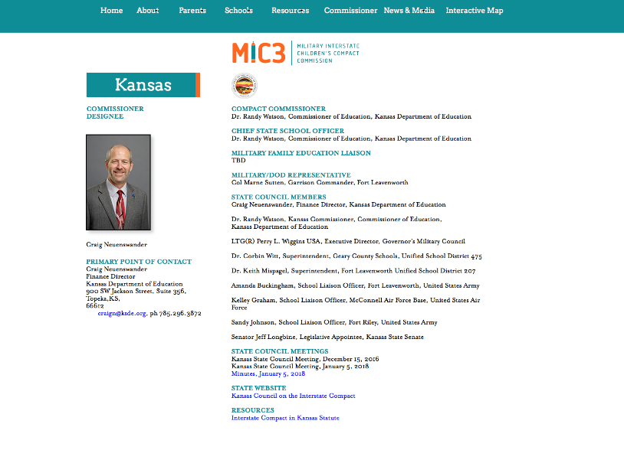
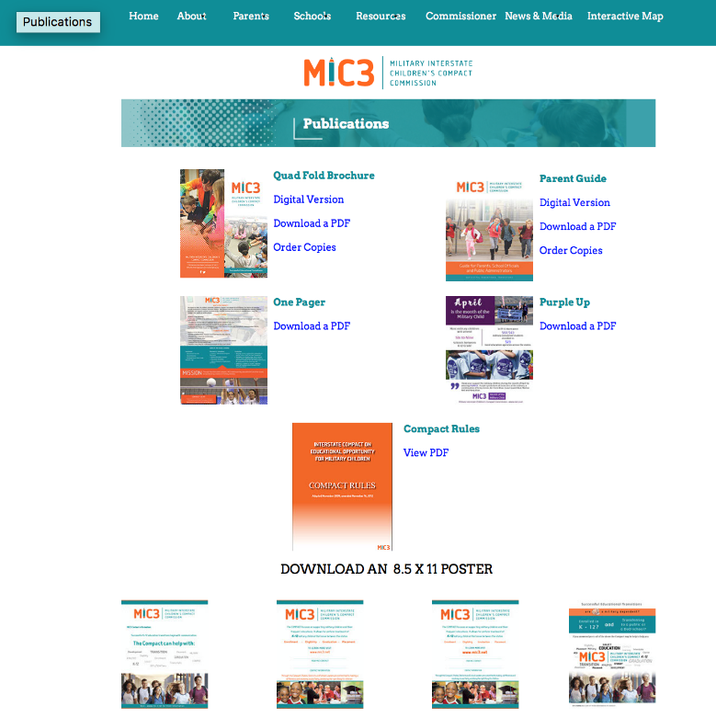
www.mic3.net
WEBSITE & RESOURCES
Info for parents and schools
Compact Rules
Order brochures, guides, and rulebooks
Downloadable posters, one-pagers
State Commissioner information
Notes:
Downloadable guides, rule books, brochures, and other material are available on our website at www.mic3.net. You can also order material via the online order form.

Slide 43
For more info or assistance:
Craig Neuenswander
Kansas State Commissioner
Bus: (785) 296-3872
Email: craign@ksde.org
or
National Office
Bus: 859-244-8000
Email: mic3info@csg.org
www.mic3.net

