Slide 1
Piece of the Puzzle
SPEDPro New User Introduction
By: Mason Vosburgh

Slide 2
Agenda
Item 1
Discussion Item One – Common Authentication
Log in, Access
Item 2
Discussion Item Two – Getting started Selecting the organization, Navigation pane, Calendar Set up, apply building settings, checking building minutes entering providers
Item 3
Discussion Item Three – Student Data Student Search, Keyboard Entry, Import / Upload batch files
Item 4
Discussion Item Four – Verifications
Item 5
Discussion Item Five – Exiting students
Item 6
Discussion Item Six – Reports
Item 7
Discussion Item Seven – Other Issues

Slide 3
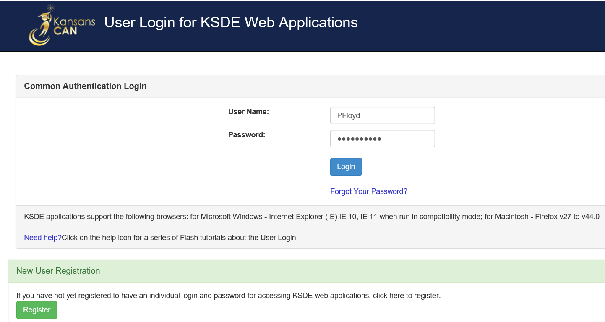
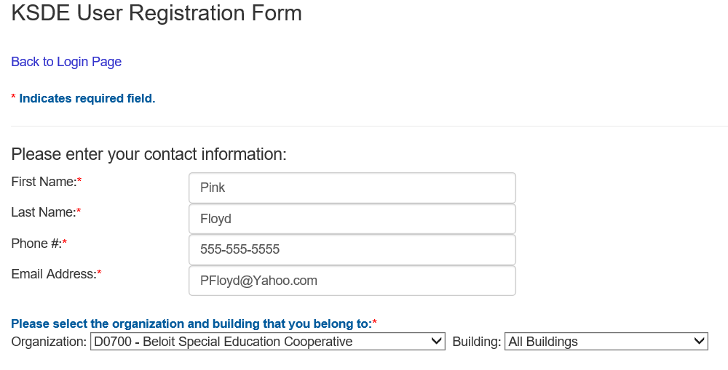
Common Authentication System
Log in
Go to KSDE Web Applications
Enter User name
Enter Password
Log In
If you have not registered, go here
Complete the registration form with your organization level and all buildings

Slide 4
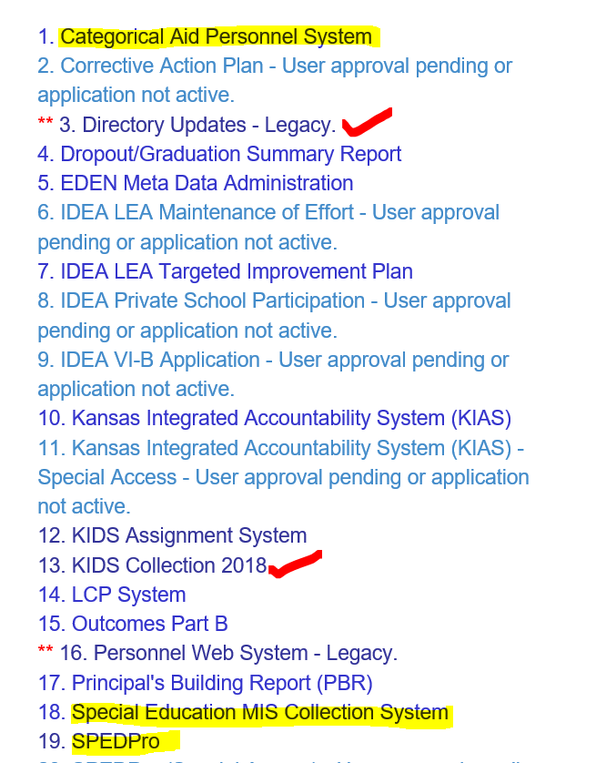
Authentication System
Once approved upon Log In, Select SPEDPro from the list of active applications. Manage My Account to request access to other Web applications
Choose SPEDPro for District Update permissions and submit request

Slide 5
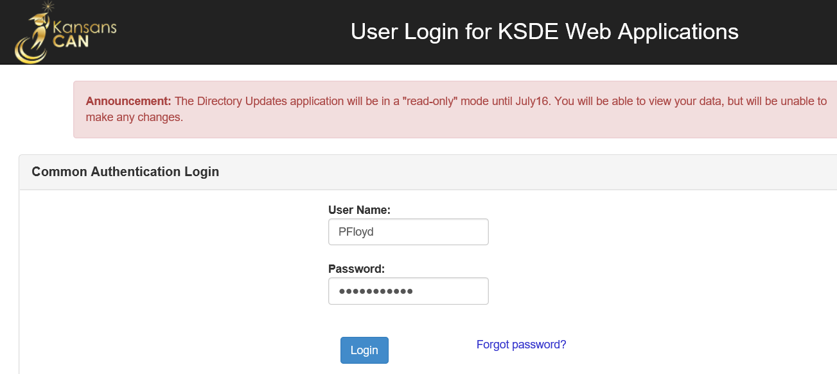
Common Authentication
RED Banner
The RED Banner is an alert that specific KSDE web applications will be unavailable for specific periods of time due to:
The application may be undergoing routine maintenance
Application upgrades
Bug fixes
Wait for the RED Banner to be removed before logging in. Note other web application not identified with a RED Banner are accessible.

Slide 6
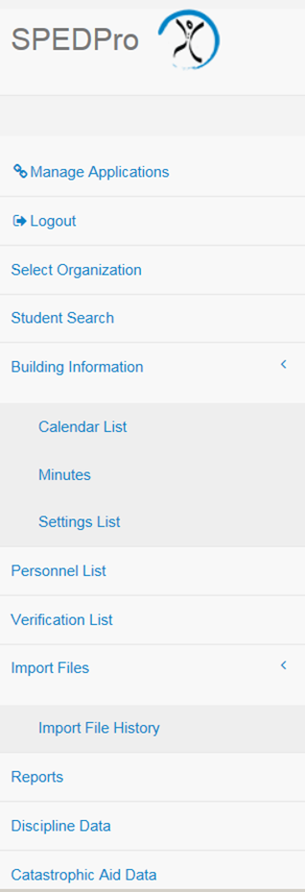
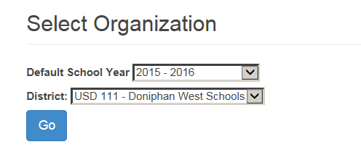
Getting Started
Select desired organization level – Click the “Go”
Navigation Pane
Select the destination in the application where the desired task is completed.
Students
Buildings, Calendars, settings
Personnel
Verifications
Upload / Import
Reports
Yearly Student roll over

Slide 7
Getting Started
Know your buildings
Neighborhood School – Where the Parent chooses to enroll their child for General Education.
Public school or Private / Parochial school
Elementary, middle or high school
Attendance building – Where special education services are provided
School, Program, home or off campus / community location
Calendars, settings, Directory sessions apply
Responsible school – Accountability or funding school
as reported in KIDS Collection records
Public elementary, middle or high school
State School

Slide 8
Getting Started
Calendars select from Navigation Pane
New calendar button
Select the target school year for which the calendar applies

Slide 9
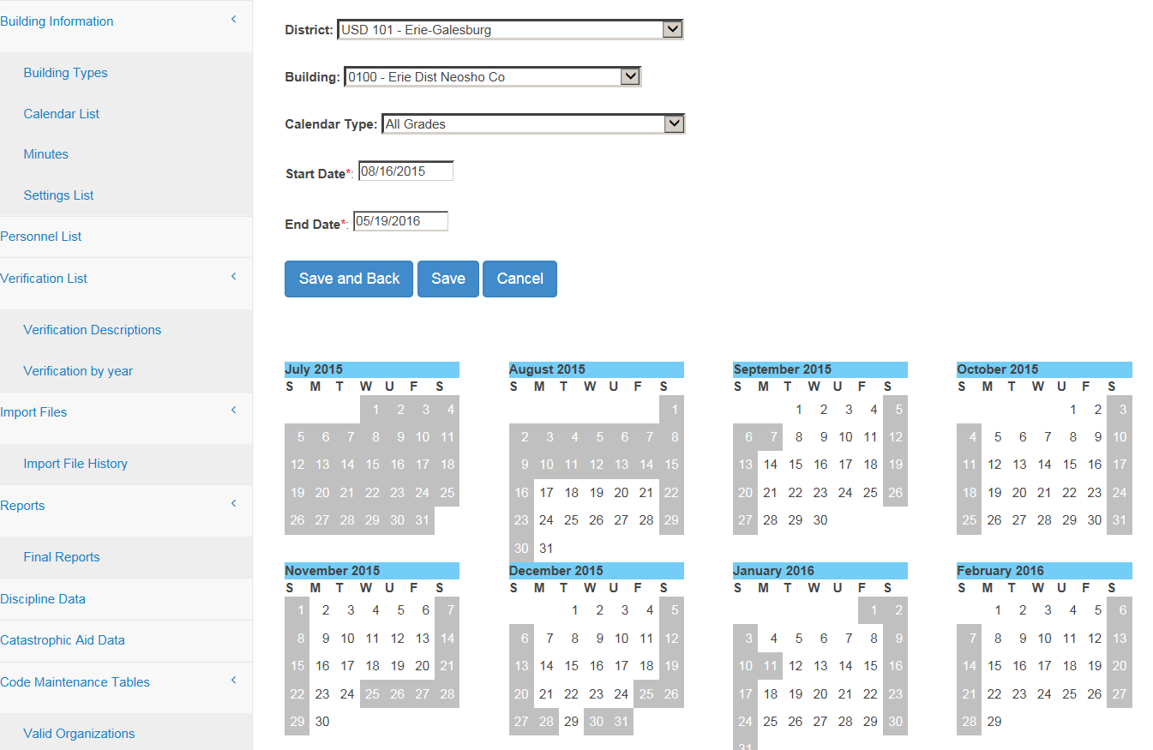
Getting Started
Calendars
Set default district level calendar for all grades, all buildings.
Enter first and last day of school.
Mark days not in session
Save
Create new calendar for any programs / buildings that does not follow the district calendar

Slide 10
Getting Started
Building Settings set up from Navigation Pane
July – August, Meet with administrators. Discover what programs are offered in each building for the current year
Use the Directory chart to document session times and program types.
Share Directory chart with board clerk to align programs and settings
For initial list of settings, Click the new button
Select each building and click search to bring up the settings list form

Slide 11
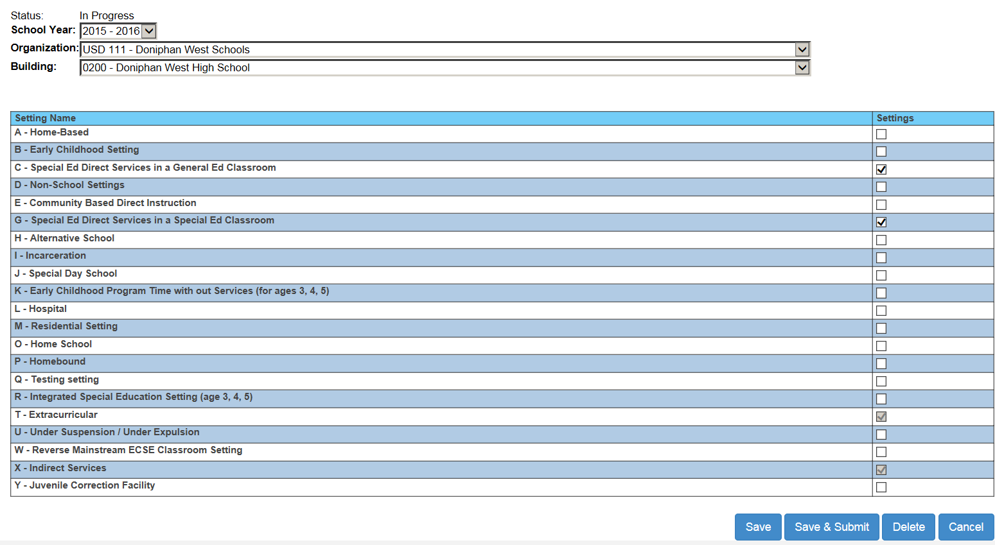
Getting Started Coding building and Program Settings
Mark (all that apply) the setting codes that represent the programs that are offered in the building
As you work on this, it is considered to be “In progress”. Save keeps the data in progress
The save and submit button is selected to send to KSDE for approval.
KSDE will deny invalid settings
If a error is made, you can un-submit or delete and start over and resubmit.

Slide 12
Getting Started Coding building and Program Settings
Tips
Note the difference between “School” building and “Program” buildings
Settings for special education programs are addressed in the Data Dictionary
Preschool session types in the Directory must align with preschool settings prior to approval
All settings are defined in the Data Dictionary with examples

Slide 13
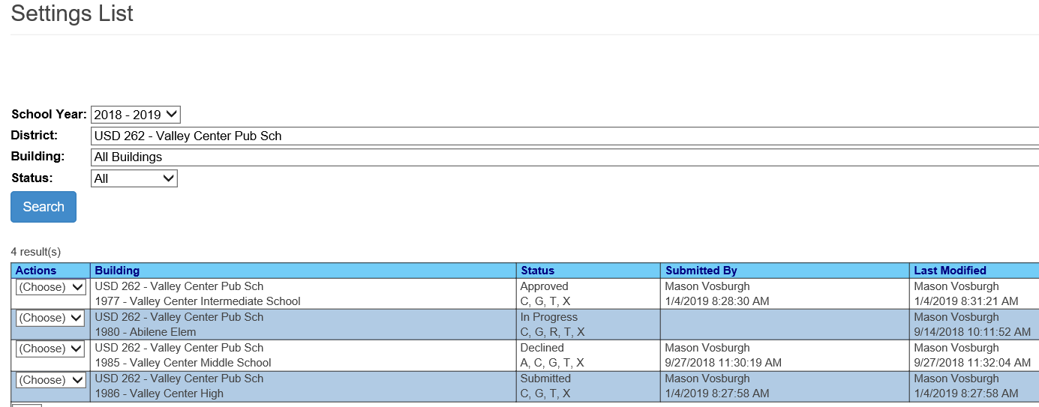
Getting Started Coding building and Program Settings
Settings list page shows the status of each building
In Progress – settings list is not completed. Additional work needed before submission
Submitted – Settings list is completed, submitted and awaiting approval
Approved – Settings align with the Directory and are available for selection on service lines
Declined – Settings do not exist in the building or do not align with Directory. Settings must be created anew and resubmitted for approval

Slide 14
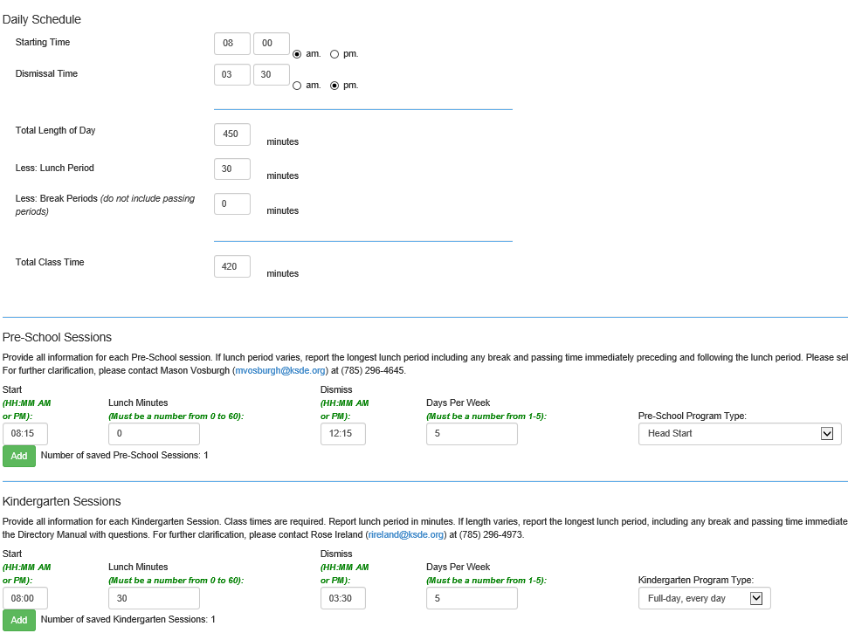
Getting Started
Directory is A KSDE Web application
Directory Updates
Directory navigation: Find Organization, then select buildings in organization
Section A, Daily Schedule = Grade 1- 12 Schedule
Section B, Preschool Sessions schedules only
Section C, Kindergarten sessions schedules only

Slide 15
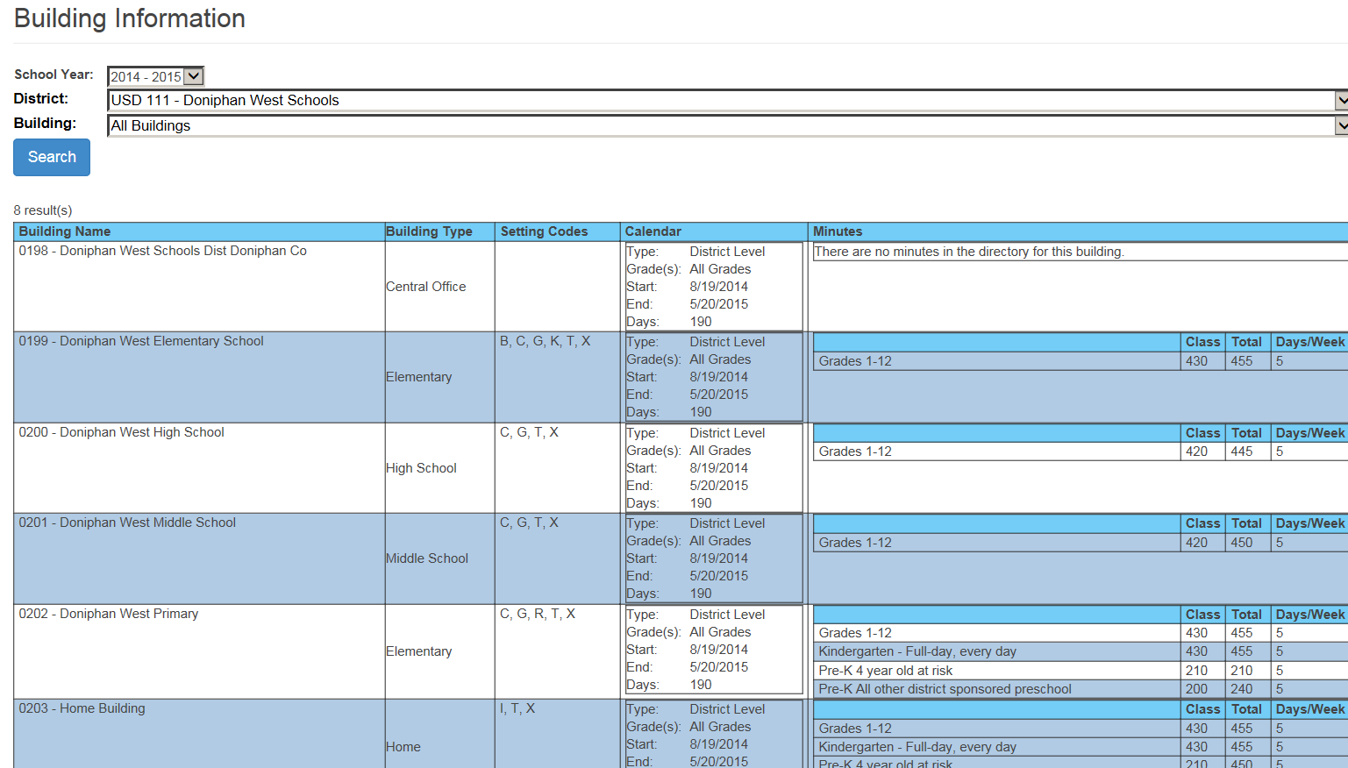
Getting Started
Building Information and Directory sessions
Minutes column pull from the State Directory
Note: Accuracy of session times and
Note: Preschool Program types reported
Corrections are made in the State Directory
Calendars and Settings are entered by the local MIS clerk

Slide 16
Getting Started
Begin Year Discovery Process
Before initial data is submitted to KSDE for the current year, a local Discovery process must be completed. The Discovery process has several parts
Calendars - Discover the district level calendars for all buildings
Providers – Discover inactive providers and remove them from the current school year provider list. Update provider service organizations to only assign a provider to the organization where they serve students.
Buildings – Discover what programs are offered in each building
Buildings – Discover current year session times and days per week in session
Directory – Provide current year building information with local Board clerk for Directory updates.
Crosscheck – Review Building Information Page for accuracy and alignment with Directory.
Students - Discover current year responsible / Accountability school reported in KIDS
Do not forgo the Discovery process and copy data from last school year into current school year !!

Slide 17
Getting Started
Building Discovery Process
Create a Chart of building session that can be shared with board clerk who completes the Directory Updates
Directory Chart templated can be found on the MIS and student data page at www.ksde.org

Slide 18
Getting Started
Building Discovery Process
Discover what programs are offered in what buildings
Know what each program is named
Program types and setting must match
Corrections to programs and minutes are made in the State Directory
Corrections to settings are made in SPEDPro

Slide 19
Getting Started
Program and setting matches
Program Type | Directory value | Setting Code |  | Program Type | Directory value | Setting Code
Headstart | 6 | B, K |  | SPED Reverse Mainstream Class | 9 | W
4 Year Old At-Risk | 7 | B, K |  | All other Reg / Gen Ed Preschool | 10 | B, K
Integrated SPED Class | 8 | R |  | Itinerant Services – All other | 10 | G

Slide 20
Getting Started
Current Year Providers
Keyboard Entry
Select Personnel List from Navigation Pane
Select the Target school year
Select the District / Organization
Click the New Button

Slide 21
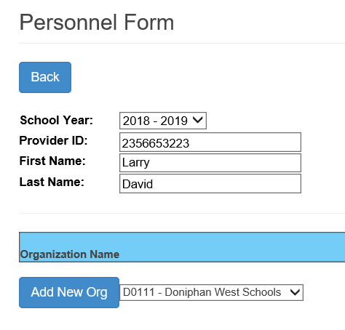
Getting Started
Personnel Entry Form
Enter the Provider (CAPS) ID number
Enter the Provider Name
Add the Organization where the provider delivers services

Slide 22
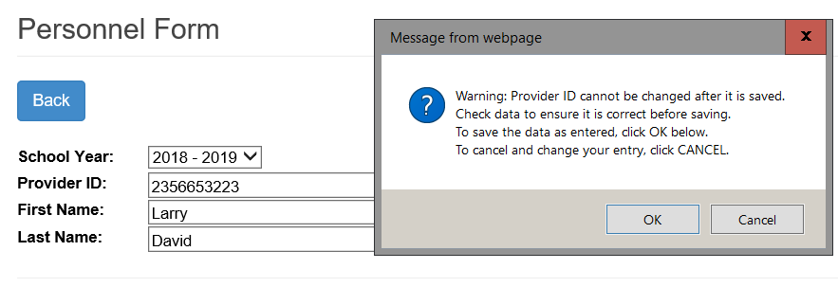
Getting Started
New Providers
ID Alert
Once an ID number is entered, it cannot be removed.
Incorrect ID numbers can be disassociated from an organization, removing them from service line selection

Slide 23
Getting Started
New Providers
Check Service Line Provider role
Only Required Role
Repeat for each organization the provider travels to.
Save

Slide 24
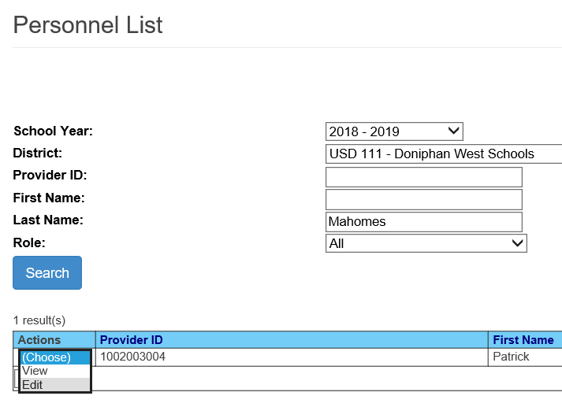
Getting Started
Provider Search
Enter Search Criteria
ID
Name
Role
Click Search
Selection Action

Slide 25
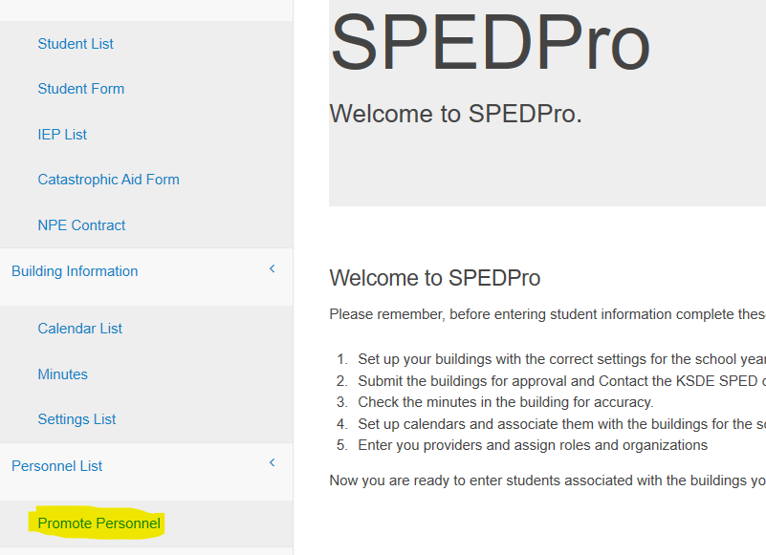
Getting Started
Current Year Providers
Promote Providers
Moving last year’s providers to this year
Navigate to the Promote Personnel page

Slide 26
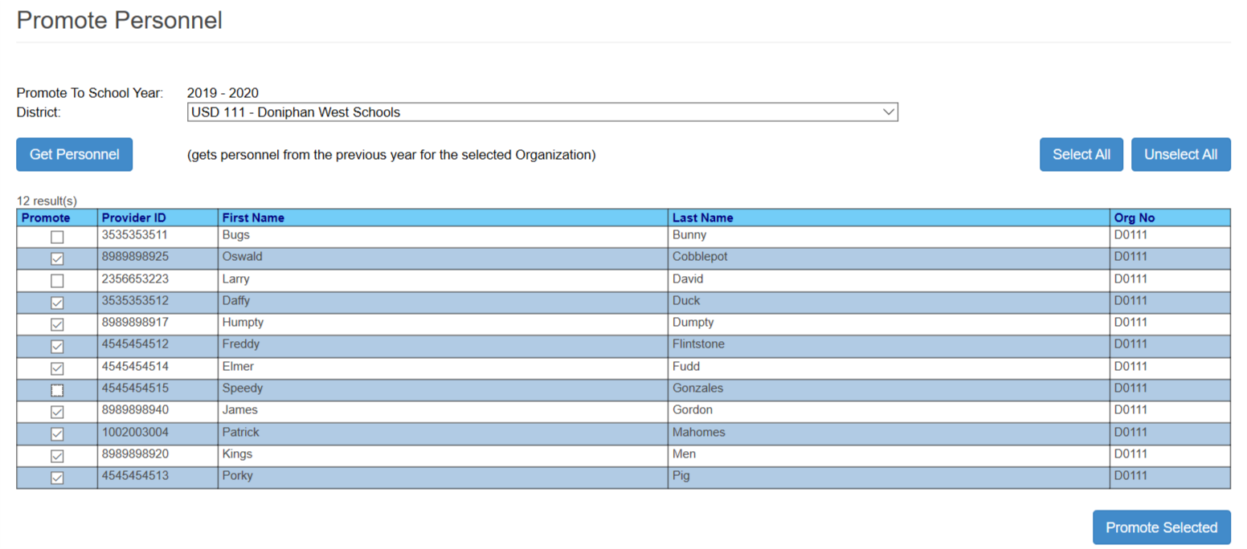
Getting Started
Promote Providers
Moving last year’s providers to this year
Get Personnel – pull from last year
Mark this years’ providers
Promote selected into current school year. Copies last data to this year

Slide 27
Getting Started
A batch file of Providers can be Imported following link on the Navigation Pane
Select Personnel as the file type
Browse computer to locate the file
Select the file
Click upload
Import Providers

Slide 28
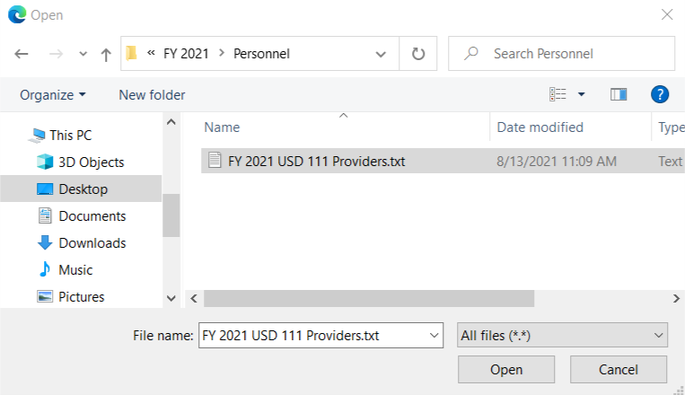
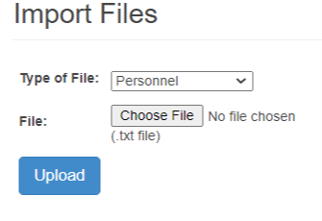
Student Data
Importing.
Go to Import Files
Select - Import type – Personnel
Select “Choose File” to find the record
Navigate to file location
Select / Highlight the file, click Open.
Upload to Import
2 methods for student data entry
Alert:
Always import complete data for school year. All IEPs and All Service for each import, original and subsequent. Subsequent imports erase all prior data for the student.
4
2
3
5
6
5

Slide 29
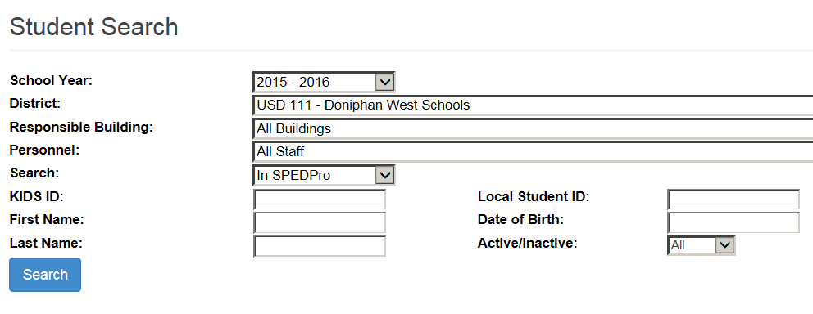
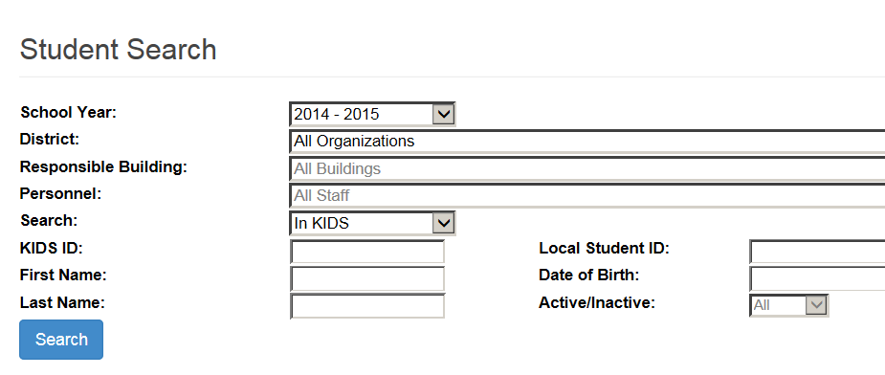
Student Data
Keyboard entry.
Student Search: Find a student in the application
Select status – where to find the student
In SPEDPro
KIDS Collection
Search
2 methods for student data entry

Slide 30
Student Data
2 methods for student data entry
Keyboard entry.
Create Student profile
Select the New button for new profile
Select the target school year for which the profile applies
Some data pulls from the KIDS record
Student Name
Birthday
Race / ethnicity
LEP

Slide 31
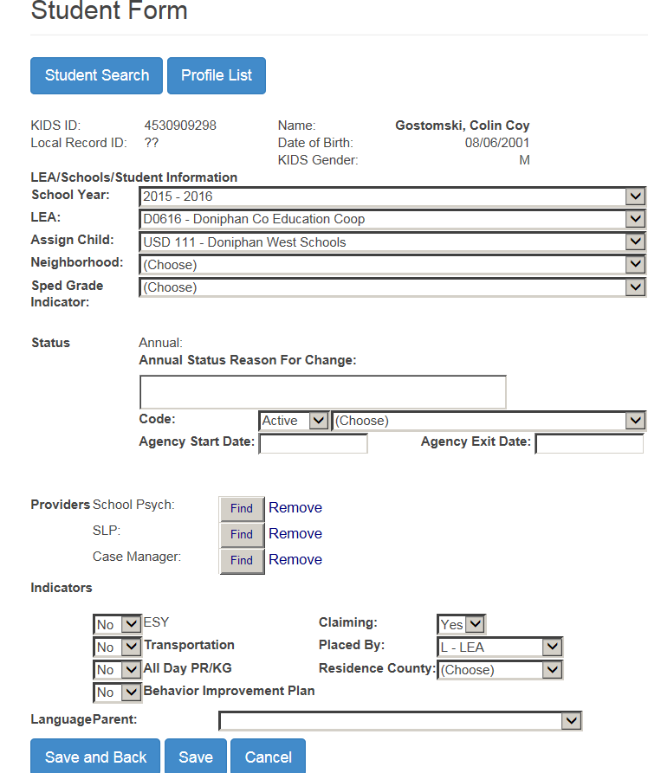
Student Data
2 methods for student data entry
Keyboard entry. Profile
Drop Down Menus for the selection of data elements
Optional fields are selected
Conditional fields are selected when applicable
Note: A student has 1 profile per school year. Multiple profiles for the same student will generate verification errors

Slide 32
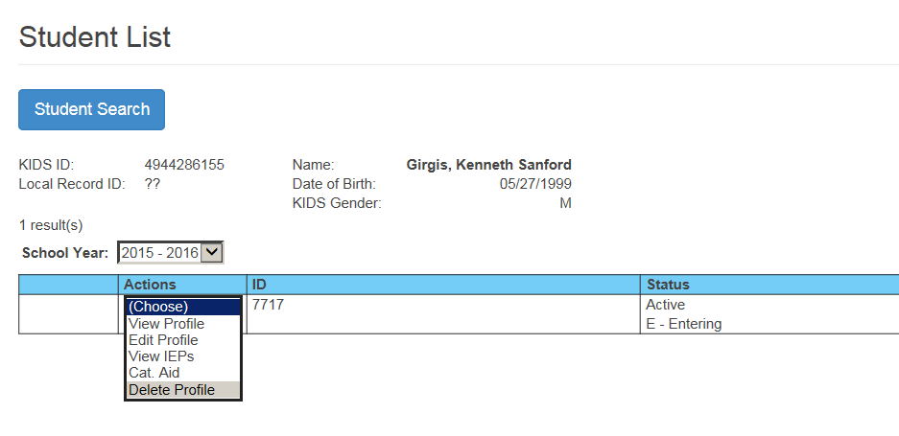
Student Data
2 methods for student data entry
Keyboard entry.
From the Actions Menu
Profiles can be edited, view only or deleted
Go to the IEP page
Go to catastrophic Aid page

Slide 33
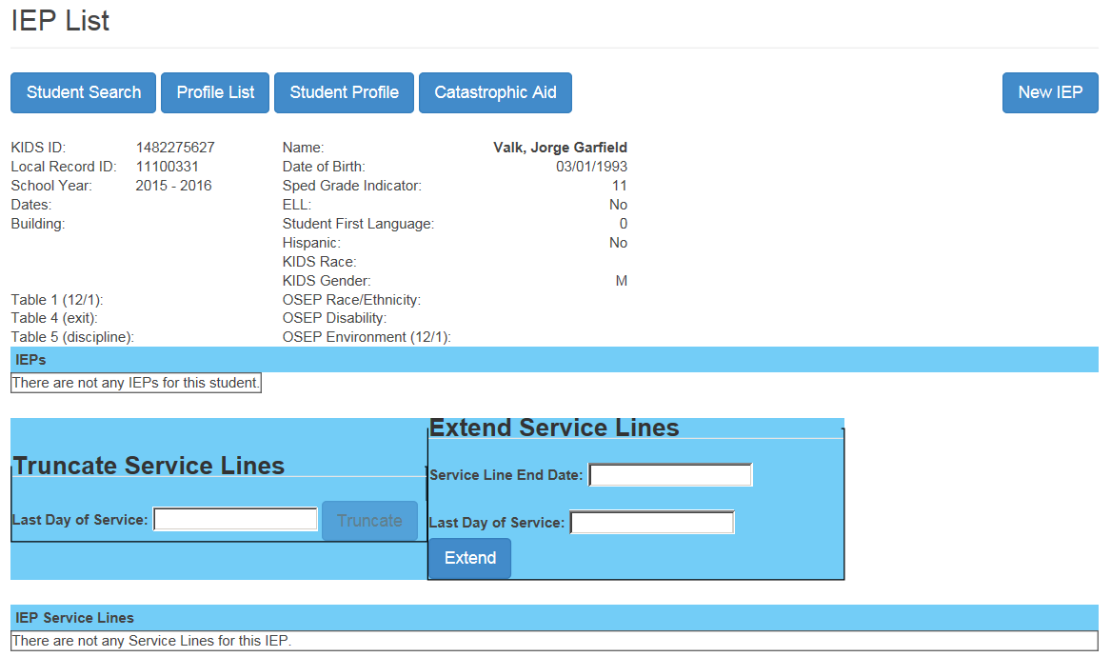
Student Data
Keyboard entry.
Student has no IEP entered
Because data entry is incomplete, OSEP data is not calculated
New IEP is selected
2 methods for student data entry

Slide 34
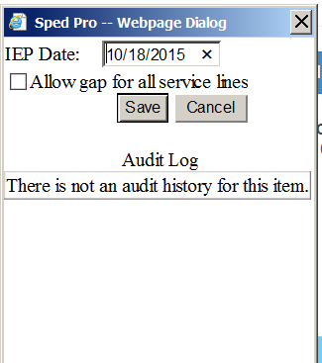
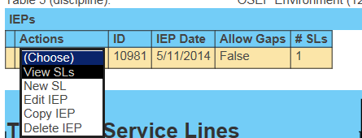
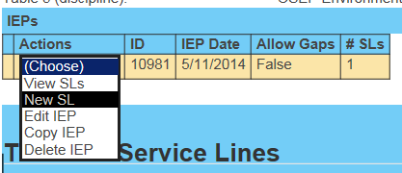
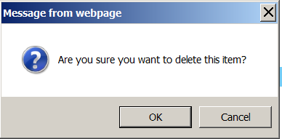
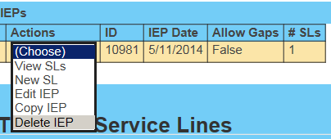
Student Data
Keyboard entry.
Enter IEP date
Do not tab
Save the Date
IEP is listed with alert of no service lines
Action – View Service line
Action – New Service line
Action – Delete Service line
Action – Copy Service line
Edit IEP to mark Allow Gap for students who move out and back in
2 methods for student data entry

Slide 35
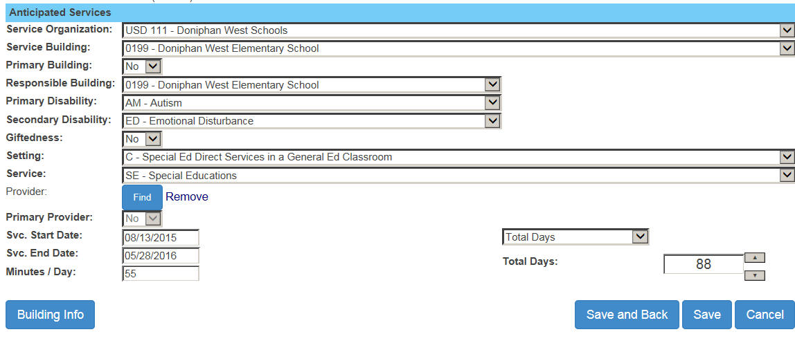
Student Data
Keyboard entry.
Select service line data for each of the service line fields
2 methods for student data entry
Service Organization
Attendance building
Responsible school
Disability and Gifted
Provider
Start and end dates, minutes
Frequency or total days

Slide 36
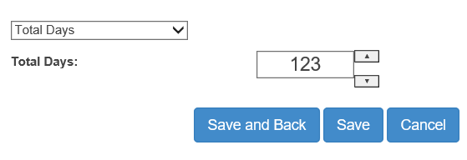
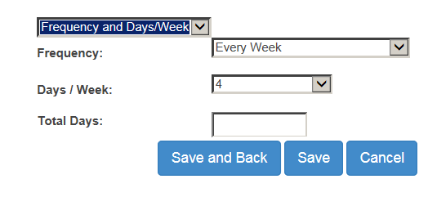
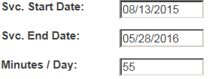
Student Data
2 methods for student data entry
Duration is determined by total days. There are 2
options, the user would select 1 option consistently
Total Days between Start and End dates
Days per week and frequency
123

Slide 37
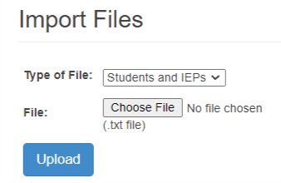
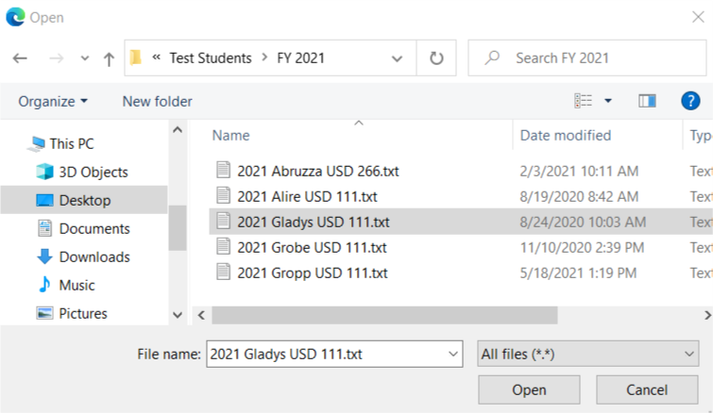
Student Data
Importing.
Go to Import Files
Select - Import type – student & IEP
Select “Choose File” to find the record
Navigate to file location
Select / Highlight the file, click Open.
Upload to Import
2 methods for student data entry
Alert:
Always import complete data for school year. All IEPs and All Service for each import, original and subsequent. Subsequent imports erase all prior data for the student.
4
2
3
5
6
5

Slide 38
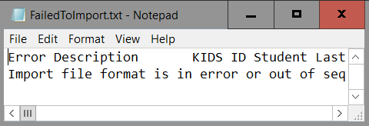
Student Data
Importing.
Import history
Check Import results
Note alerted records
Alert notes explain why import had discrepancies
2 methods for student data entry
Alert notes guidance; copy the text in the alert message and paste into Excel. Compare the header to the data. If the header has different data than the import. The wrong import type was selected.

Slide 39
Student Data
Use Import Template to find missing or invalid data in Import file
Missing Exit date
Alert message
Bad DOB
Invalid building

Slide 40
Student Data
Importing Alerts and failed to import
Import alerts
There is not a KIDS collection record present from the organization for which you are submitting, or the data does not match
No permissions.
Spelling of last name
Gender
Date of Birth
Responsible school
File format will prevent successful Imports
Invalid / Non-existing KIDS ID
The imported file does not meet the specifications. Too long or too short.
The format of the data is incorrect. For example a date field is 98/HQ/20!*, grade field is not numeric -P4, Name field is not alpha – Sm!t8

Slide 41
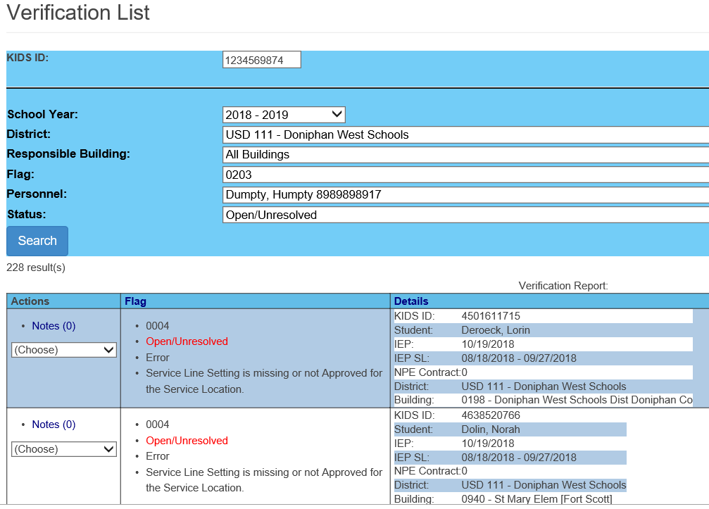
Verifications
Default to all students with verification
Verifications can be filtered by;
Agency / Building
Student or ID #
Flag / type
Open / unresolved
Search
Print verification report

Slide 42
Verification report
Report lists Profile ID, IEP ID, Service line ID or NPE ID
Use ID number as reference to find data triggering verification.

Slide 43
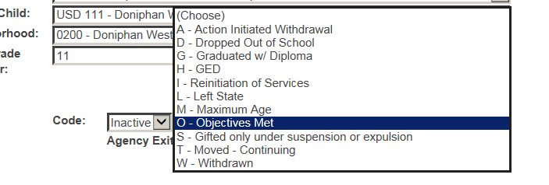
Exiting
Exit data is listed on the student profile.
Change to inactive status
Select Basis of exit
Enter Exit Date
Type
Select from calendar
Evidence box used when students move out
Note: Students who move within Coop / Interlocal member districts do not qualify as exits.
How to exit a student

Slide 44
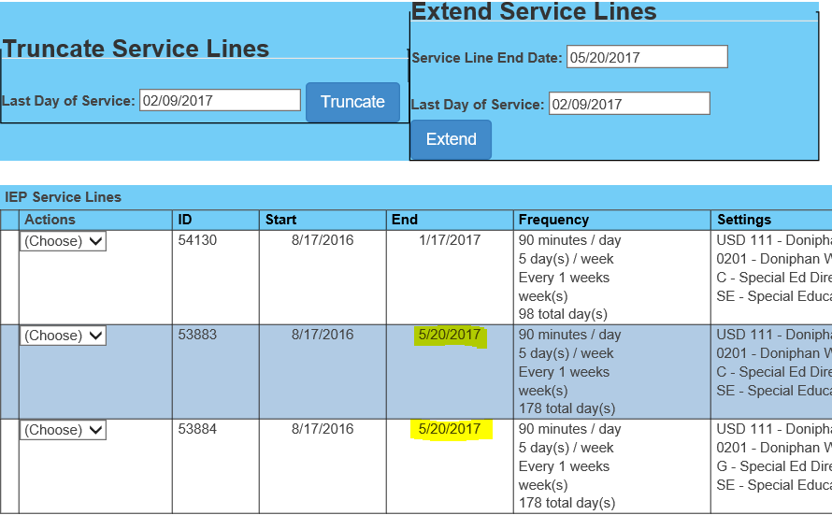
Exiting
Method 1 – Enter exit date on the student profile.
Use exit date field to end all service end dates to equal the exit date – save
Method 2 – use Truncate button to end individual services on a given date
Go to the IEP list
Select the current IEP
Enter the exit date as last day of services
Truncate service end date to = exit date
Save
Ending Services – How to Truncate end dates

Slide 45
Annual Status
Student’s First Status of the school year.
Students must be first reported as Active status to begin a school year.
Student status must be promoted to current year status before initial entry into the MIS each school year
All active status change to Continuing on July 1 of the current school year.
Children who turn 3 must be have an active status of New Referral (N) or C to B transition (B)
Failure to report an accurate initial active status may result in verification 0215. Changing the student’s Annual Status can only be done at the KSDE level

Slide 46
K Time
Portion of the day students participate in a qualified program with out IEP Support
Only B (regular early childhood) programs qualify as K time when no IEP support is provided
Settings “B” & “K” are companions and are always listed together

Slide 47
Catchment Area
The domain of your LEA / organization within its boundaries
Coops and Interlocals
All member districts inclusive
USD
All buildings and programs administered by the USD
Private / Parochial Schools
Calendars and building settings are updated in the MIS by the LEA for which the Private / Parochial Schools is in the catchment area
Exiting considerations
Students who move within the catchment do not qualify and are not considered exits

Slide 48
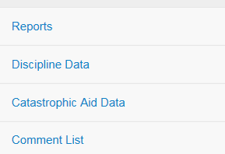
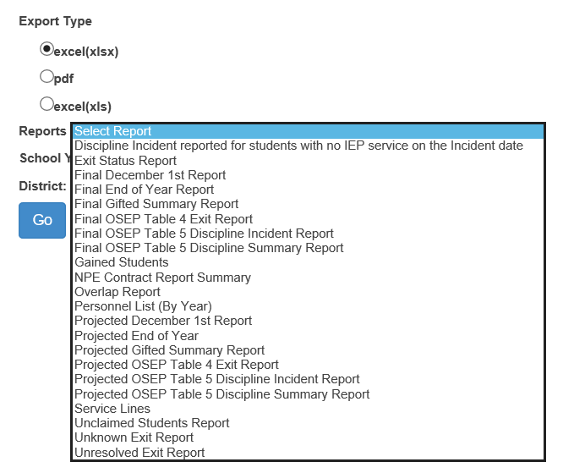
Reports
Reports from the
navigation pane
Select the target school
Select the Organization
Select the report format
Select the report
needed from the drop
down menu and file
type.
Click Go to generate the
report.

Slide 49
Reports
Projected Reports
Projected reports are used for quality checks before the Federal data is finalized and pulled
Projected Reports
Projected December 1 report
Projected Gifted Summery report
Projected End of Year
Projected Table 5 Discipline report
Projected Table 4 Exit report.
Review these reports in detail to assure all information is accurate

Slide 50
Reports
Verification Reports
Several reports are for quality analysis, comparing student level data state wide. These reports flag inaccuracies in the current data that may need to be corrected locally.
Verification Reports
Overlap Report
Unresolved Exit Report
Exit Status Report
Unknown Exit report
Discipline Incident Report
These reports provide evidence that current information needs to be corrected.

Slide 51
Reports
Overlap Report
2 Organization listed Overlap is in your data and a different agency. Service line dates overlap
1 Organization listed Overlap is in your data alone. Multiple profiles

Slide 52
Reports
Unclaimed Student Report
List of students that possibly should be included on the projected reports, but are excluded

Slide 53
Report Tools – Use to Verify Data
Projected reports can be used to verify data during the collection
Use the column filters to find missing or inaccurate information
Missing Neighborhood / responsible schools
Missing Demographics like race / ethnicity can mean no KIDS records
Exit dates and exit codes not aligning
Age and grade levels not representative.
Missing Grade levels
KG students with Preschool settings
Verify total number of students

Slide 54
Discipline Data
Go to: Projected Discipline Summery
Select:
target year
Review students, basis of removal, type of removal and days of removal
If discrepancies are found, alert your local KIAS administrator at the building or district level for corrections.
Revisit page for monthly updates to assure corrections have been made in KIAS.
54

Slide 55
Discipline Data
Discipline Incident Report – No Service
Discipline incidences do not align with service line data
Report is accessible in both KIAS and SPEDPro
Do service lines dates align with Disciplinary removal?
Was a non-disabled student marked as IDEA in KIAS?
If no, then contact building staff who enter KIAS data
55

Slide 56
Discipline Data
Cross check Incident date to total days of removal to find intersection with December 1 date for out of school suspension / expulsion
56

Slide 57
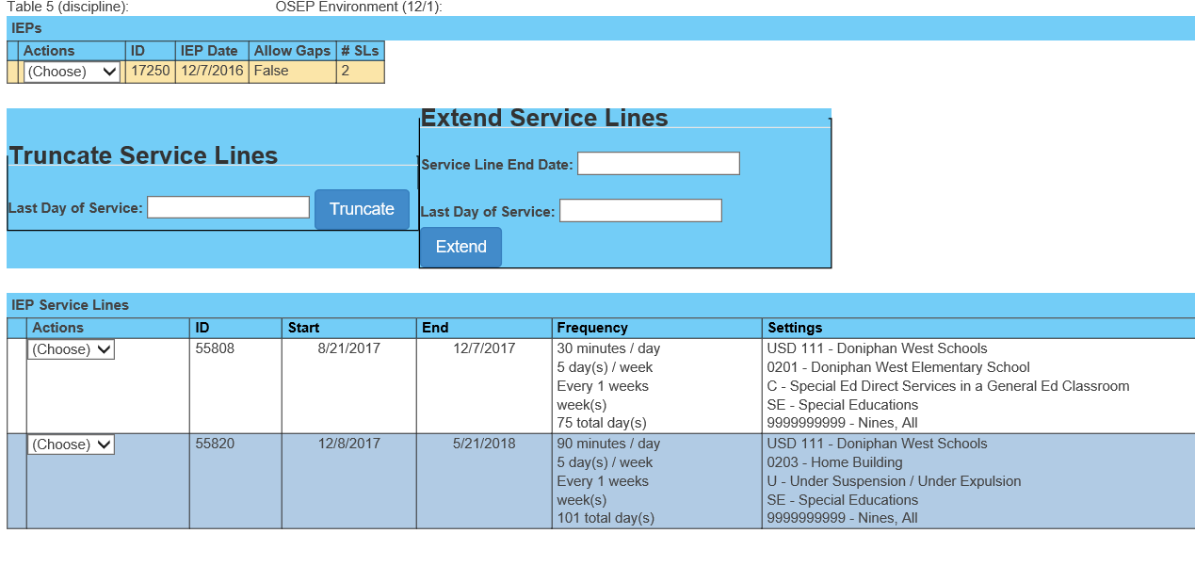
Student Data – Service line data
Do service lines align with Disciplinary removal?
If no, then contact building staff who enter KIAS data
If service location is in question, contact IEP case manager

Slide 58
OSEP Categories – Federally Reported Data
Each IDEA student is classified and counted under categorical subgroups for the December 1, Exiting and Discipline reports submitted to OSEP
OSEP data is submitted by state, district and building levels.
Each OSEP category is totaled by demographic subgroup
Reviewing these categories for accuracy is of high priority. Incorrect or changed values after the OSEP report is final can result in point loss for timely and Accurate reporting.
December 1 OSEP Category
OSEP Environment – where the student receives special education services.
Preschool Environments
Indicator 6
School age Environments
Indicator 5
OSEP Disability – the student’s area of disability on December 1

Slide 59
OSEP Categories – Federally Reported Data
End of Year Category
Exiting – Basis of exit (inactive code), reason services ceased.
Discipline – Incident date, when the removal occurred
Type of removal - in-school / out-of-school suspension, expulsion
Basis of removal – Drug, weapon, violation of school code of conduct
Duration of removal – number of days removed
OSEP Disability – the student’s area of disability
Demographics – from KIDS Collection
Age –December 1 age
Race / ethnicity
Gender
English language learner status
Responsible school

Slide 60
Timely and Accurate reporting
KSDE is subject to Timely and Accurate reporting at the Federal level
To assure Kansas is timely and accurate, each USD is subject to the same measurement.
What is being measured
Timelines are followed
Begin year set up is completed in September
December 1 data –
All qualified students are included
All non-qualified students are excluded
OSEP Indicators are accurate
Area of disability
Educational Environment
Responsible school

Slide 61
Timely and Accurate reporting
What is being measured
End of year data -
Complete data is reported for all students
Discipline incidences are accurate
Exiting data is accurate
Provider data in CAPS is accurate
Verifications flags are cleared
Data Quality reports are resolved
Exit status report
Unresolved Exits
Discipline Incident w/o Service report
Timely and Accurate is tracked by USD on a
score sheet. A score of 90% + is compliant

Slide 62
Support Documents
Support Documents are posted on the MIS and Student data page at www.KSDE.org
Data Dictionary
Reporting schedule, timelines and report specifications
Data elements collected, definitions, reporting rules and requirements
Index of MIS support documents – list of guidance by subject
Monthly FAQ – overview of monthly tasks
SPEDPro Training Material – User Guide, presentation workbooks
Other support documents for specific tasks

Slide 63
Security Tips
Do not attach or embed confidential student data to e-mails.
Upload your files to the MIS collection system which is a secure site.
User names identify you by your agency and level of access.
The same Password can be used with multiple user name log ins

Slide 64
Help Desk contacts
Crash – Let someone know
If the application crashes, there is some helpful information to remember when reporting a crash.
You may be asked a series of questions to trouble shoot.
Your log in access?
D0701
Your permissions?
District user
What you are going specifically?
selecting a frequency on a
service line
What student did this occur?
4587896541
SPEDPro Help – Mason, 785-296-4945, Mvosburgh@KSDE.Org
Directory Updates - Mason, 785-296-4945, Mvosburgh@KSDE.Org
State-wide Data Clerk contact info - Tim, http://ksdetasn.org/gstad
MIS Workshop Presentations - Tim, http://ksdetasn.org/gstad
Indicator 11 – Stacie Martin, Smartin@Ksde.org
Indicator 12 – Natalie McClane, NMcclane@KSDE.Org
KIAS System, navigation, data entry, or editing – Leader Services,(toll free) 877-456-8777
The SETS Help Desk by content area (file reviews, indicators, ESI, etc,) 785-296-3743
KSDE IT Help Desk, KIDS Data, Access to Authenticated applications - 785-296-7935

Slide 65
The End

