Slide 1
Using Preschool Environments
Data to Promote Inclusion in Kansas
Early Childhood (EC)
Least Restrictive Environments (LRE)
Notes:
Amanda

Slide 2
Participant Outcomes
As a result of our time together participants will …
Understand early childhood least restrictive environments (preschool environments) data collection and reporting requirements.
Understand common early childhood least restrictive environments (preschool environments) data collection and reporting mistakes.
Notes:
Amanda

Slide 3
Agenda
Participant
outcomes
Why and what of Indicator 6: EC LRE
National
data
Kansas
data
Efforts to improve
data quality
Kansas data resources
APR Reports
Decision Tree
Scenarios
Lessons learned,
next steps,
discussion
Contact
information
Notes:
Vera

Slide 4
What is Indicator 6?
Measures the percent of children with IEPs ages 3, 4, and 5 (not in kindergarten) who are enrolled in a preschool program attending a:
  Regular early childhood program and receiving the majority of special education and related services in the regular early childhood program;
  Separate special education class, separate school or residential facility; and
  Receiving special education and related services in the home.

Slide 5
What is Indicator 6? (continued)
Indicator 6 results are calculated from student level MIS/SPEDPro data submitted to KSDE from all special education local education agencies (LEAs). The Dec. 1 Child Count report contains the Indicator 6 population and each student’s environment category.
Verification is conducted as part of Special Education 618 data collection (SPEDPro). Collection procedures and requirements are documented in the MIS Data Dictionary posted at https://www.KSDE.org.

Slide 6

Why is Indicator 6 Important?
Identifies where children are receiving their special education services.

Slide 7
Why is Indicator 6 Important? (continued)
Ensures:
  States provide a continuum of services.
  Children with disabilities have the opportunity to attend and receive services with peers in regular early childhood programs.
  Data is available to analyze and inform practices.

Slide 8
Why is Indicator 6 Important? (continued)
The evidence base and recommended practices state that practitioners should provide services in inclusive environments during daily routines to promote the child’s access to and participation in learning experiences. However;
  Nearly 1/4 of children with disabilities are served in preschool special education receive services in separate classes.
  Only 1/3 of children with disabilities are served in inclusive early care and education classrooms at least 10 hours, as directed by federal policy.

Slide 9
Challenge in the Kansas
Preschool environments data: Part B State Performance Plan/Annual Performance Report (SPP/APR) Indicator 6A - Was historically low and stagnant.
Preschool environments data: Part B SPP/APR Indicator 6B - Was historically high and stagnant.

Slide 10
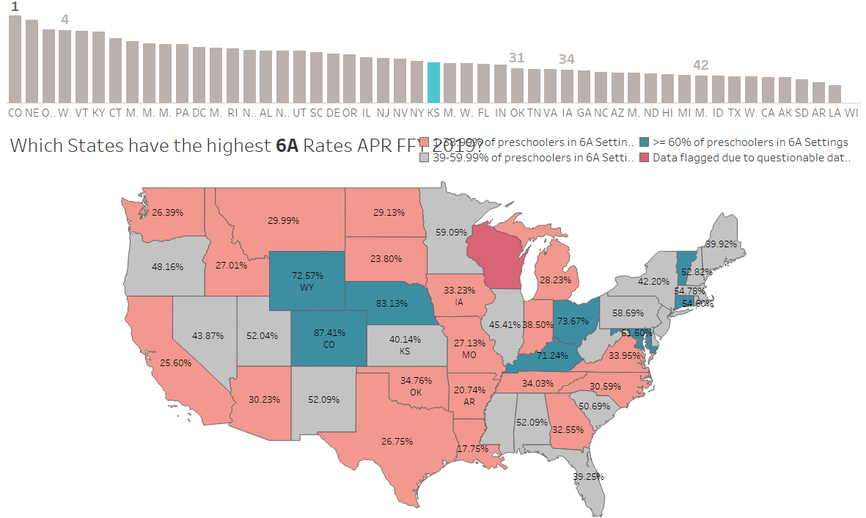
National Picture of Indicator 6 Data

Slide 11
Indicator 6A: Kansas EC LRE Target and Results Over Time

Slide 12
Indicator 6B: Kansas EC LRE Target and Results Over Time

Slide 13
Previous Efforts to Improve Data Quality and Results
Delivered yearly training on Indicator 6 at State Leadership Conference and Professional Early Childhood Conference.
Provided individual TA to LEAs if they had questions about their data.
Convened meetings initiated by special education cooperative (Co-op) to discuss issues related to supporting inclusive services.
Included Early Childhood Least Restrictive Environment (ECLRE) data in risk rubric for monitoring (for last 6 years).

Slide 14
Existing Efforts to Improve EC LRE Data
Look at IEPs alongside Indicator 6 data report during calls and correcting data in real time.
Yielded more efficient discussions.
Included special education director, assistant special education director/early childhood coordinator, data clerks and teachers/providers on part of discussions.
Discussed with LEAs how they will provide professional development (PD).
Work with the State ICC EC LRE subcommittee to collaborate with community-based partners.

Slide 15
KSDE goals for this project have been:
To increase understanding of how Kansas is helping LEAs promote more inclusive settings and practices for preschoolers with disabilities through examination of EC LRE data.
To gain a better understanding of Indicator 6 data in Kansas through the IEP process and the calculation of the measurement.

Slide 16
KSDE goals for this project have been:
To build strategies for how to go beyond public reporting requirements and effectively communicate data to multiple preschool stakeholders.
To help learn how to use preschool educational environments data in meaningful and useful ways for local programs and staff members.

Slide 17
KSDE goals for this project have been:
To ultimately increase Indicator 6A and decrease 6B - Increasing the number of 3-to 5-year-old preschool children who receive inclusive special education and related services in the least restrictive environment to the maximum extent appropriate.

Slide 18
            Kansas Data Resources
Kansas APR Reports
Decision Tree
Indicator 6 Measurement

Slide 19
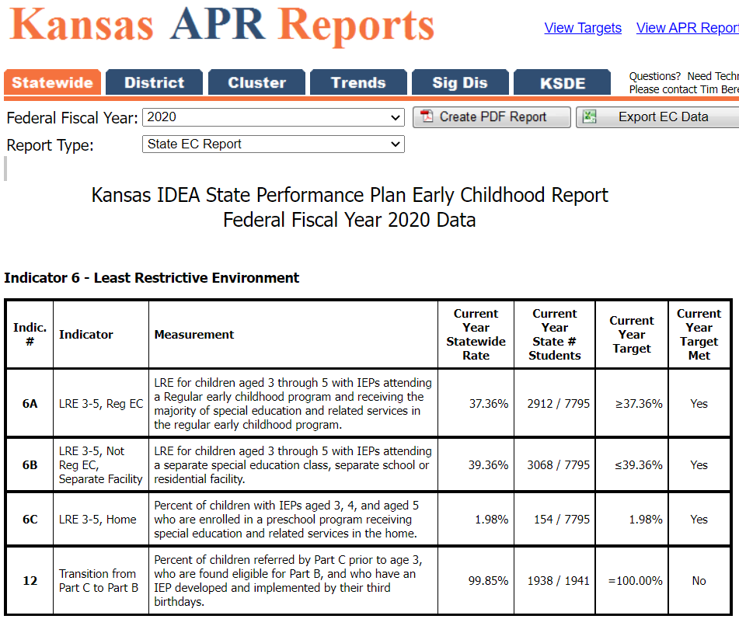
Kansas APR Reports

Slide 20
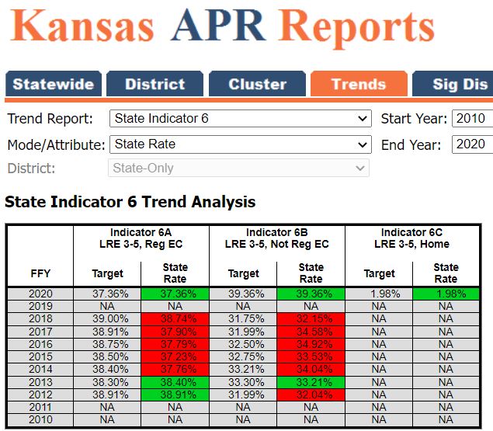
Kansas APR Reports

Slide 21
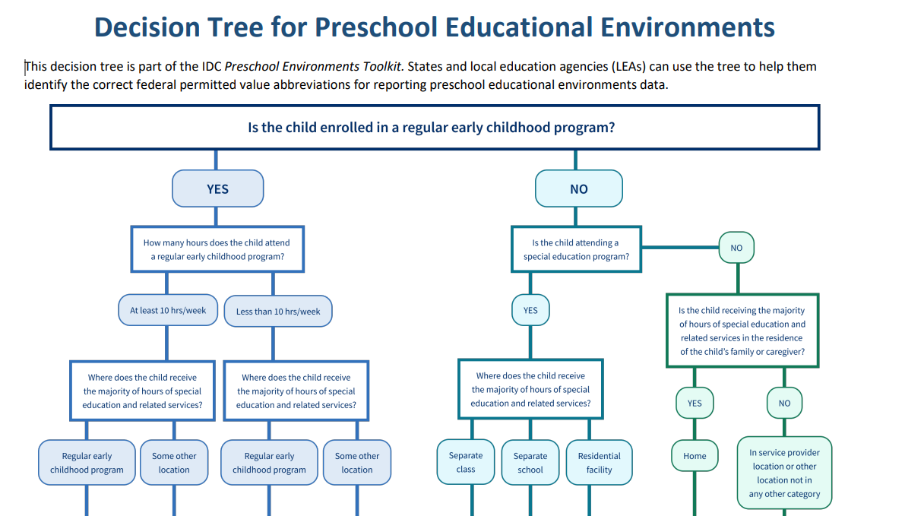
Decision Tree for Preschool Educational Environments
A1 A2 B1 B2 C1 C2 C3 D1 D2
Notes:
Modified from Preschool Environments Toolkit (ideadata.org)

Slide 22
Process to Determine Preschool Child’s Least Restrictive Environment
Child’s
IEP
From start …
SPEDPro:
Dec. 1 report
KSDE: Calculation to determine where the majority of special education services provided and time child is in regular education setting.
OSEP federal reporting categories: 6A, 6B, 6C

Slide 23
Scenario: Indicator 6A and 6B
Districts describing preschool classrooms with 50% or fewer students with disabilities but not meeting Indicator 6A.
Districts describing preschool classrooms with 0% to 49% students without disabilities and not meeting Indicator 6A.

Slide 24
Projected December 1 Report
ID | Gender | Grade | Age on 12/1 | Primary Disability | Current IEP | All Services | Kansas Setting Codes | Kansas Fed Code | Calculation Code
1 | M | 5-year-old preschooler | 5 | SL | 3/18/2020 | SS | G | SP | C1
2 | F | 4-year-old | 4 | SL | 8/29/2021 | KT, SS | K, G | TL | A2
3 | M | 4-year-old | 4 | SL | 5/21/2020 | SS | B, G | TM | A1
Service Codes
KT Participation in a special education program without SPED support.
OT Occupational therapy.
SE Special Education Services.
SS Speech, Language.
PT Physical therapy.
Kansas Setting codes
B Services in a regular early childhood classroom.
G Services outside a regular education setting (removed from regular education setting for services).
K Early childhood time without services.
B2 Children attending a regular early childhood program less than 10 hours per week - receiving the majority of hours of SPED in some other location. This child is not counted towards the numerator in 6A, but lowers the percentage because they do count in the denominator.

Slide 25
Projected December 1 Report
ID | Gender | Grade | Age on 12/1 | Primary Disability | Current IEP | All Services | Kansas Setting Codes | Kansas Fed Code | Calculation Code
1 | M | 4-year-old preschooler | 4 | DD | 12/1/2021 | SE, SS, OT | R | SP | C1
2 | F | 3-year-old preschooler | 3 | DD | 11/22/2020 | SE, SS, OT | R, G | TL | A2
3 | F | 3-year-old preschooler | 3 | DD | 11/22/2020 | SE, SS, OT | W, G | TM | A1
Service Codes
KT Participation in a special education program without SPED support.
OT Occupational therapy.
SE Special Education Services.
SS Speech, Language.
PT Physical therapy.
Kansas Setting codes
B Services in a regular early childhood classroom.
G Services outside a regular education setting (removed from regular education setting for services).
K Early childhood time without services.
B2 Children attending a regular early childhood program less than 10 hours per week - receiving the majority of hours of SPED in some other location. This child is not counted towards the numerator in 6A, but lowers the percentage because they do count in the denominator.

Slide 26
Lessons Learned From LEAs
Data manager and 619 coordinator should develop trainings together.
It’s important for LEAs to see their own data in a clear, concise way.
State must work directly with LEAs.
Funding misconceptions affect data quality.
Incentive of Kansas STAR recognition drives engagement with 619 coordinator.

Slide 27
Next Steps
Share lessons learned and challenges across LEAs.
Continue the work with the State ICC EC LRE subcommittee.
Make connections to Indicator 7: Early Childhood Outcomes.
Submit high-quality data for SPP/APR Indicator 6.

Slide 28
Discussion
In what ways have you examined the EC LRE data in your district?
What have you learned from analyzing this data?
What will you do differently as a result of this presentation?
What does your state team need to know about your data and your efforts to improve this data?

Slide 29
Indicator 6 Resources
Preschool LRE Reference Points and Discussion Prompts
Making Sound Preschool LRE Decisions
Kansas Special Education Process Handbook: Chapter 6-Least Restrictive Environment (LRE)
KSDE TASN Indicator 6- Research and Resources
For ECSE Administrators:
KSDE TASN

Slide 30
Contact us:
Amanda Petersen
Director
Early Childhood, KSDE
(785) 296-7929
apetersen@ksde.org

