Slide 1
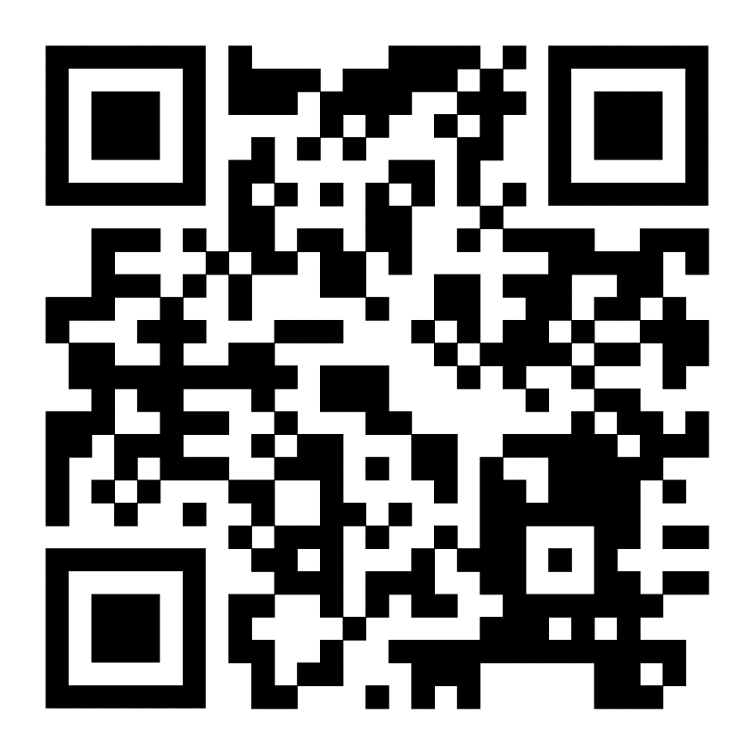
Indicator 14: Post School Outcomes
It’s Time to Move the Needle!

Slide 2
Special Education Leads the Way
Expect, Engage, Empower: Successful Transitions for All in Kansas

Slide 3
Transition History
1983 – Pilot transition services added to the Education for All Handicapped Children Act.
1990 – The Education for All Children Act renamed the Individuals with Disabilities Education Act.
IDEA now provides definitions and transition requirements.
2004 – IDEA updated
IDEA now requires accountability measures for transition: Indicator 13 compliance review annually, Indicator 14 Post School Outcomes measured one year after students leave high school. Students must exit with a Summary of Performance.
2014 – WIOA
Pre-ETS now provided to students with disabilities in 5 areas: Job Exploration & Counseling, Workplace Readiness Training, Work-based Learning, Self-Advocacy, Counseling in Post-secondary Education

Slide 4
Indicator 14 – Quick Summary
What’s Being Measured?
Indicator 14: Percent of youth who are no longer in secondary school, had IEPs in effect at the time they left school, and were:
Enrolled in higher education within one year of leaving high school. (Associate degree program or higher)
Enrolled in higher education or competitively employed within one year of leaving high school. (at least 20 hours per/week for 3 months, minimum wage or higher, with non-disabled peers)
Enrolled in higher education or in some other postsecondary education or other
training program; or competitively employed or in some other employment
within one year of leaving high school. (adds other training program – less than an associate’s
degree, adds other employment – less than 20hrs, less than 90 days, less than minimum wage
etc.)

Slide 5
How Did We Do?
Measure | Number of respondent youth | Number of respondent youth who are no longer in secondary school and had IEPs in effect at the time they left school | FFY 2021 Data | FFY 2022 Target | FFY 2022 Data | Status
A. Enrolled in higher education (1) | 238 | 1048 | 26.84% | 41.00% | 22.71% | N
B. Enrolled in higher education or competitively employed within one year of leaving high school (1 +2) | 589 | 1048 | 55.16% | 65.60% | 56.20% | N
C. Enrolled in higher education, or in some other postsecondary education or training program; or competitively employed or in some other employment (1+2+3) | 710 | 1048 | 69.62% | 79.09% | 67.75% | N

Slide 6
Kansas 2023 Census Results
Number of Students Eligible for 2023 Census – 4230
Number of Students with No Contact Info – 322 (7.6%)
Number of Students in the 2023 Census – 3908
Number of Students with disconnected, wrong, blocked, or business phone numbers – 487 (12.4%)
Number of Students with valid contact info - 3419
Number of Actual Respondents – 1048
Total Response Rate – 26.83%

Slide 7
Kansas 2023 Census Results
Response Rate for Opt-in Districts – 51 districts 1,111 Students in Census
Number of Respondents – 611
Total Response Rate – 55.00%
Response Rate for all other districts – 206 districts, 2795 Students in Census
Number of Respondents – 437
Total Response Rate – 15.63%

Slide 8
Kansas Leaders in Post School Outcomes
Anjanette Tolman Director USD #233
Dawn Gresham Director USD #260
Jessica Engelland Director USD #308
Sarah Sanders Director USD #321
Dedra Raines Director USD #345
Roger Christian Director USD #383
Scott Hoyt Director USD #389
Nichole Honeywell Director USD #409
Kristin O’Brien Director USD #450
Kevin Harrell Director USD #497
Jennifer Harrington Director USD #501
Kristi Houston Director ANW Interlocal #603
Meaghan Etheridge Director SCKSEC Interlocal #605
Trina Schmidt Director SKACD Interlocal #613
Dan Wray Director ECKSEC Interlocal #614
Khris Thexton Director Barton County Special Services Coop
Kay Hill Director Chautauqua and Elk County Coop
Nikki Heiman Director Marshall County Coop
Jon Harding Director KS School for the Blind

Slide 9
Kansas 2023 Census Results
Data for Districts choosing not to Opt-in
206 Districts
58 Districts with only 1 respondent
78 Districts with ZERO respondents

Slide 10
Opt-in or not? A tale of 2 districts…
District A District B
# of students in census = 5 9
# of completed interviews = 1 8
Measure A % = 0% 50%
Measure B % = 0% 75%
Measure C % = 0% 75%

Slide 11
Respondent Demographics
Total Number of Respondents = 1048 Number Percentterv,048
Former Student 270 25.76%
Parent 712 67.94%
Guardian 42 4.01%
Other 24 2.29%

Slide 12
Call Disposition
Call Disposition Data:
Total Interviews Attempted 3,906 100.00%rcent
Completed Interviews 1,048 26.83%
Blocked Call 7 0.18%
Business Number 25 0.64%
Disconnected 408 10.45%
Language Barrier 13 0.33%
Mid-Interview Termination 29 0.74%
No Answer 523 13.39%
Refused 137 3.51%
Respondent Not Available 58 1.48%
Take Me Off the List 46 1.18%
Voicemail 1,565 40.07%
Wrong Number 47 1.20%

Slide 13
How Do We Move the Needle?
A two-pronged approach…
#1 Better response rates produce better data. Better data leads to more effective interventions. Also, better APR reports for individual districts
#2 Let’s implement effective strategies/interventions that will enable students to access post-secondary education and/or training or competitive employment

Slide 14
Prong #1: Getting to Better Response Rates
#1 Communicate
Make sure that Parents and Students know they will be contacted in June of the year following graduation or exit from school. Disseminate this info at IEP meetings, SOP review, in newsletters, on social media etc. Communicate early. Communicate often

Slide 15
Getting to Better Response Rates
#2 Verify Contact Info Thoroughly
Make sure you have valid contact info for student and parents. Last year we had over 400 students in the census with no valid contact info. Over 200 students had no contact info at all. Verify contact info through 1) Post School Outcomes Web Application, 2) through your IEP system, 3) through your SIS.

Slide 16
Prong #1: How Do We Get Better Response Rates?
#3 Test your contact info!
Great opportunity to inform students/parents of upcoming interviews as you verify contact info is accurate.

Slide 17
Prong #1: How Do We Get Better Response Rates?
#4 Opt-in!
The results speak for themselves…

Slide 18
Prong 2: Getting to Better Outcomes…
#1 Effective Transition Plans in the IEP
Students who have effective transition goals and services are more likely to be successful

Slide 19
Getting to Better Outcomes…
#2 CTE is Key!
Students who are Concentrators or Completers are more likely to pursue post secondary education and/or be employed.
Common Barriers Include: Special Education Teachers/Transition Coordinators don’t know what pathways are available, Students denied access because they can’t pass the safety test, Students denied access because they can’t pass the certification test after completing the class, paraeducators are not available, pull-out time is scheduled during the time classes are available…
Perkins funding requires schools to make CTE classes available to special populations, have you reviewed your high schools CTE participation data?

Slide 20
Getting to Better Outcomes…
#3 FAFSA Completion
Common Barriers Include: Students don’t want to attend post-secondary training/education programs, Parents don’t want to provide tax info necessary to complete the FAFSA

Slide 21
Getting to Better Outcomes…
#4 Registration with local Workforce Center
Workforce Centers have federal mandates to provide services to special populations. They will work with schools to provide a variety of services designed to help students access employment after graduation.

Slide 22
Getting to Better Outcomes…
#5 Build Partnerships with Transition Service Providers
Partner with Pre-ETS, Families Together, Your local Transition Council, CIL, CDDO and other transition service providers.

Slide 23
Getting to Better Outcomes…
#6 Transition Tuesday Webinar
Connect with KSDE’s Transition Tuesday Webinar Monthly!

Slide 24
Who is Getting Better Results for Students?
SCKSEC Interlocal #605
Kaw Valley USD #321
Topeka USD #501

Slide 25
What’s Next?
Join us for the 2024 Special Education Leadership Conference
June 25-27

Slide 26
Connect with Successful Transitions
Expect, Engage, and Empower: Successful Transitions for All!
Expect, Engage, Empower Resource Database
Transition Tuesday Webinars
CTE Access for Special Pops Grant
Workforce Contact Info
Office of Registered Apprenticeship

Slide 27
Indicator 14 Contact
For Indicator 14 questions
aewing@ksde.org
785-296-3860

