Slide 1
College and Career Readiness—
A New Focus for 21st Century Learning and Employability in Today and Tomorrow’s Workforce
KEEN Conference
February 20, 2014
CTE & College and Career Readiness in the
Urban/Rural School District of Valley Center/USD 262

Slide 2
Thought for the Day, Month, and Year
THE FUTURE
is not something we enter.
THE FUTURE
is something we create.
Leonard Sweet

Slide 3
FACTS of Support for CCR at the Secondary Level in Kansas and USA
56% College Graduates require 6 years to obtain their College
Degree
Only 29% of High School Graduates have a College Degree
The Average Debt of College Degree with 4 + years---$40-60 K
65% of all jobs by 2020 will require technical training beyond high school
In Kansas we are preparing 41% of students for STEM related careers, when 60% is needed NOW!
KANSAS ‘ Senate Bill 155---- Jump starts high school students into College in specific career ready programs or skilled trade with potential Certification, Workplace Credential, and new focus on Post Secondary Opportunities.
Currently 3 Million Jobs are available in the US with no workforce to fill them and only 12% of those needs jobs require a 4 Year Baccalaureate Degreehttp://www.theblaze.com/stories/2013/10/23/mike-rowe-of-dirty-jobs-speaks-about-hard-work-how-many-are-following-the-worst-advice-in-the-history-of-the-world/

Slide 4
WHERE Do We START
Advisory Committees---Local Business and Industry Partners --Expansion and Updating Required
Budget Requirements---Growth/Expansion of Programs = Dedicated Funds
Determine What We Are DOING RIGHT--Make it Stronger
Decide What We Must DO BETTER---Make it a REALITY
TIME---The Key Ingredient: PLC, Professional Development, Continued Education, and Sacrifice
CTSO---Make Them a Priority—Funding and Supplemental
Grants---Go Get Them
Pathways are Just Opportunities for Student Learning--Today and Tomorrow
Support One Another--At All Costs/Team Approach

Slide 5
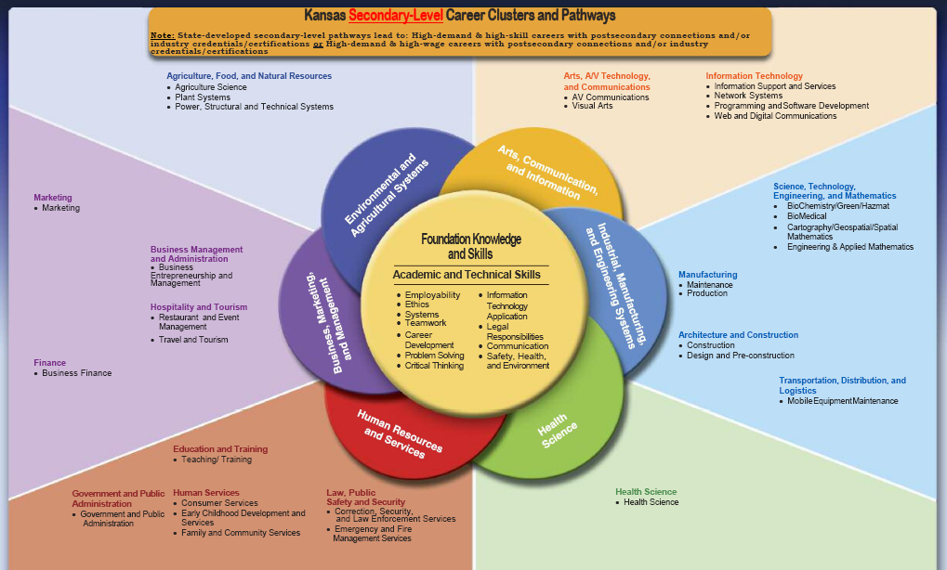

Slide 6
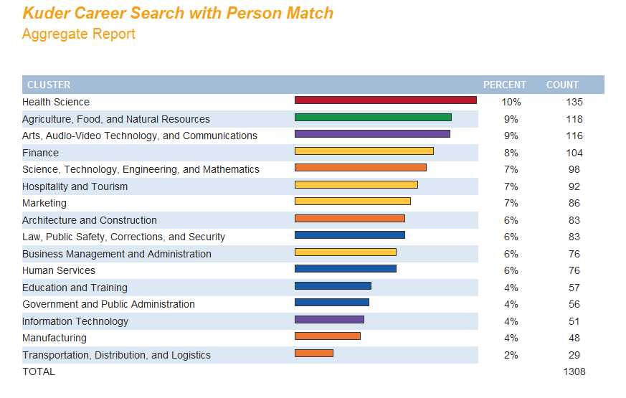
Valley Center Career Clusters & Pathways Beginning Year 2011-12 3 Clusters/5 Pathways

Slide 7
New Pathways to Learning
Valley Center High School
Business Mgt.
Business Entrepreneurship & Management Pathway
Law & Public Safety
Emergency & Fire Management Services Pathway
Corrections, Security, Law, & Law Enforcement Services**
Hospitality and Tourism**
Travel & Tourism Pathway***
** = Potential Pathway for 2014-15 or 2015-16
*** = Potential Pathway for 2015-16

Slide 8
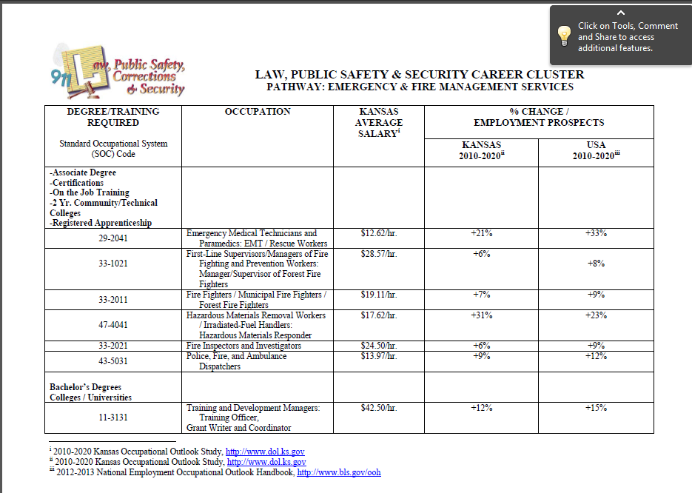

Slide 9
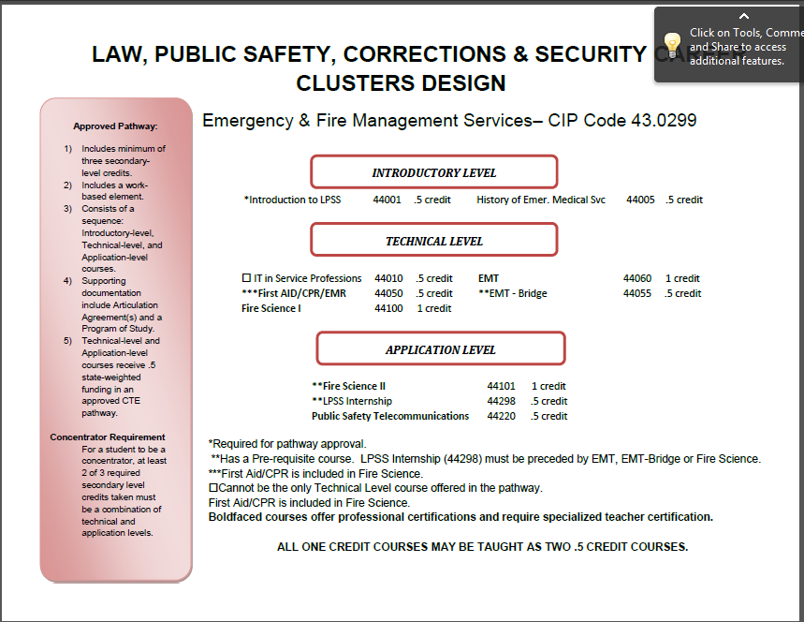

Slide 10
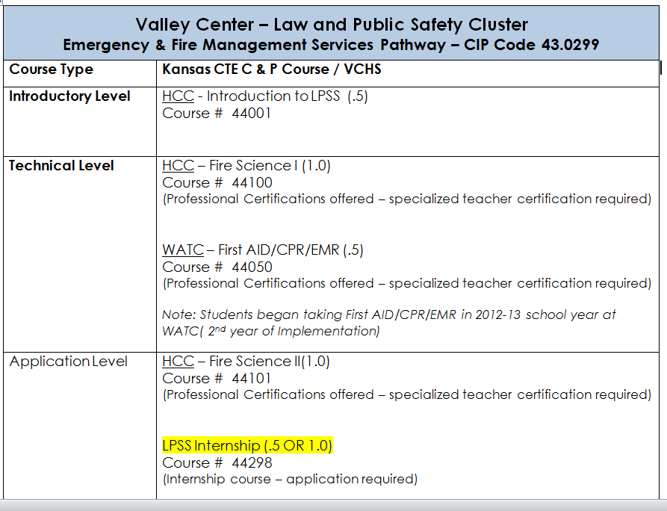

Slide 11
= Existing Pathway(s)
= 2014-15 Pathway(s)
2014-15 13 Clusters & 17 Pathway s
= Possible Future Pathway(s)

Slide 12

Pathway Maintenance and Application
Valley Center High School
Sub-Groups within CTE at Valley Center
Art (7-12)
AV Communications
Business (7-12)
FACS
Industrial Technology (7-12)
Physical Education (9-12)
Science (9-12)
These 7 groups will have 17 pathways for the 2014-15 school year:
15 Maintenance
2 New
HOW WILL WE BE ABLE TO GET ALL THIS WORK DONE?

Slide 13
Pathway Maintenance Process
MAINTENANCE CHECKLIST (see materials)
Assign responsible staff member to lead each pathway
For each section of the CPPSA, check off what they have been able to do, and list issues
  Advisory Committee verification
  Course verification
  Articulation Agreements – use of Statewide Agreements
  Year 13 course verification
Other materials needed (CTE Leaders):
Advisory Committee Meeting Minutes
Yearly Improvement Plans
KCCMS issues/fixes

Slide 14
CCR/CTE Opportunities for Learning
Project Lead the Way/STEM Education
PLTW /Gateway to Technology(GTT) – Middle School Program of Study
    Design and Modeling
    Automation and Robotics
    Magic of Electrons
    Energy and Environment
    Green Architecture
    Medical Detectives
    Science and Technology
PLTW Pathway to Engineering (PTE)- High School Program of Study
    Introduction to Engineering Design (IED)
    Principles of Engineering(POE)
    Robotics – Non-PLTW Course
    **Digital Electronics (DE)
    **Engineering Design and Development (EDD)
    ** Denotes Future Course offering

Slide 15
CCR/CTE Opportunities for Learning
Project Lead the Way/STEM Education
PLTW /Launch
K-6 Initiative—Will be implemented in All Elementary Schools 2014
(3) K-4 and (1) 5-6 Building

Slide 16
SENATE BILL 155—The Bottom Line
  Free/Paid College Tuition for Secondary Students in State Approved High Demand courses (Jr. & Sr.)
  Paid Transportation to Post-Secondary Institution
  Certificate 8 – 16 weeks, Technical Certification 16– 32 weeks, and/or Associates Degree 2 years
  Business & Industry Credential
    Students May Earn Industry Credential
    Assessment Paid by District
    When Student Passes Assessment – District Compensated $1,000 (Net Profit = $1000 - Cost of Assessment(s))

Slide 17
Partnerships: HCC and Valley Center
  NCCER Course Offering (National Center for Construction Research) Residential Carpentry I and II
  Receive between 4-16 college credit hours in credentialed certificate program ( 1 or 2 year programs)
  This course will meet for one or two consecutive periods daily
  Safety Orientation 1 Credit Hour
  Introductory Craft Skills 3 Credit Hours
  Basic Carpentry 4 Credit Hours
  Walls, Windows/Doors, Floors 8 Credit Hours
  Total Cr. Hrs. 16
  * College /Post Secondary Articulation from HCC Approved. Dual /Concurrent Credit will be an option to VC students enrolled for NCCER Residential Carpentry II.

Slide 18
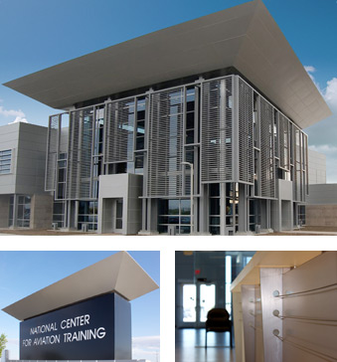
National Center for Aviation Training (NCAT) & Wichita Area Technical College (WATC)
After a century of leadership designing and manufacturing the world’s most advanced aircraft, Wichita now takes its rightful place as a global leader in aviation education. The National Center for Aviation Training built by Sedgwick County fuses Kansas’ aviation experience and expertise with cutting-edge instructional techniques and technology to forge a new educational standard.
WATC will provide opportunities for students in Aviation, Manufacturing and Engineering programs of study. Up to 26 college credit hours will be earned by students who successful complete the program.

Slide 19

Partnerships: WATC and Valley Center
College Core Schedule/Block
AVC 100-Aerospace Safety 1 Credit Hour
AVC 101-Blue Print Reading 2 Credit Hours
AVC 102-Precision Instrument 1 Credit Hour
AVC 103-Geometric Dimension & Tolerance 1 Credit Hour
AVC 104-Quality Control Concepts 1 Credit Hour
AVC 105-Aircraft Familiarization 1 Credit Hour
AVC 106-Aerospace Blueprint Reading 2 Credit Hours
AVC 107-Fundamentals for Aerospace Manufacturing 1 Credit Hour
AVC 108-Aircraft Systems & Components 4 Credit Hours
CPU 101-Computer Applications (Optional) 3 Credit Hours
___________
17 Credit Hours
*Semester students will attend class Monday-Friday from 7:30am-10:30 am OR Noon – 3:00.

Slide 20
WATC and Valley Center/SB 155: BLOCK
Allied Health College Core Schedule – Fall and Spring
Human Anatomy and Physiology (2 semesters) 2.5 Credit Hours
  Taught at Valley Center High School (50 Enrolled in Fall 2013)
Computer Applications 3 Credit Hour
Principles of Nutrition 3 Credit Hour
Medical Terminology 3 Credit Hour
First Aide and CPR 3 Credit Hour
Emergency Preparedness/Diseases, Disorders
and Diagnostic Procedures 3 Credit Hours
___________
17.5 Credit Hours
*Students will receive Dual/Concurrent Credit for these courses.

Slide 21
WATC and Valley Center/SB 155
Concurrent/Dual Credit
College Programs of Study – Fall and Spring: 9-15 credits
Automotive
Allied Health
Aerostructures
Electromechanical
Business
Aviation
HVAC
Mechanical Design
Medical Assistant
Machining
Welding
CNA
Composites
CAM
Other courses are available in various areas of study such as: Dental, IT Essentials, Robotics, etc.

Slide 22
Post Secondary and Workforce Career Readiness Opportunities
Manufacturing Production
Hutchinson Community College & NHS Brook’s Regional Center Valley Center High School
  Welding Technology (Receive college credit hours and/or credentialed certificate program). These courses will meet for three or four consecutive periods daily.
  Welding Technology 1 6 Credit Hours
  Welding Technology 2 6 Credit Hours
  Dual/concurrent credit will be awarded to VC students enrolled for Manufacturing/Production Courses.

Slide 23
CCR/CTE Report Card &
NEW Opportunities for Learning
VCHS Juniors/Seniors
2012-13/Post Secondary Education
2011-12 College and Technical Training Participation
  College Credit English 55 WSU
  College Study 10 Varied
  Technical Training 10 Newton/HCC
  Total Students Participation 75

Slide 24
CCR/CTE /Senate Bill 155 & Opportunities for Learning
VCHS /Soph.Juniors/Seniors 2013-14/Post Secondary Education
  2013 College and Career Readiness – First Semester
  College Credit English 1 VCHS/WSU
  College Credit English 39 VCHS/WATC
  College Speech 24 VCHS/WATC
  College Study 15 WATC/WSU
  Welding 1 Newton/HCC
  College HAP 51 WATC/VCHS
  Career Aviation/Manf./Design 2 WATC/VCHS
  Career Business Studies 2 WATC/VCHS
  Career Automotive Cert. 2 WATC/VCHS
  Career Health Sciences 6 WATC/VCHS
  Career Residential Carpentry 11 VCHS/HCC
  Transportation Gen Ser. II & III 31 VCHS/WATC
  Total Student Participation 185 (increase 110 students /2011-12)

Slide 25
CCR / Valley Center USD 262
Credit & Tuition BENEFIT-Fall 2013
Total College Credits and Tuition/Fee Cost Savings to Parents, Students, District, and Community as a result of Senate Bill 155 and WATC Reduced Tuition Fee
Total Tuition Hours Available to be Earned
695
Total Dollar Savings in Tuition and Fees
$139,000

Slide 26
CCR/CTE Report Card
  2014 College and Career Readiness – Spring/Second Semester Student Participation
  College Credit English 36 VCHS@WATC
  College Speech 43 VCHS@WATC
  College Algebra 15 VCHS@WATC
  College Pre-Calculus 57 VCHS@WATC
  College Study 5 Varies
  College Welding 1 @Newton/HCC
  College Business Education 3 @WATC\
  College Auto Service Technology 3 @WATC
  College Aviation Tech/ HVAC/Welding 3 @WATC
  College Human Anatomy & Phys. 51 WATC@VCHS
  College Computer Aided Manf. 10 WATC@VCHS
  College Allied Health C.N.A/CMA 3 @WATC
  Career Residential Carpentry 11 VCHS/HCC
  College Transportation/Auto Tech 30 WATC@VCHS
  C.N.A Hybird—16 weeks 19 WATC@VCHS
  Total Student Participation 290 (increase +105 over FS (2013-14)
  Most Courses OFFERED for CONCURRENT CREDIT 3 College Hrs = .5 HS Dual Credit

Slide 27
a CCR / Valley Center USD 262
Credit & Tuition BENEFIT-SPRING 2014
Total College Credits and Tuition/Fee Cost Savings to Parents, Students, District, and Community as a result of Senate Bill 155 and WATC Reduced Tuition Fee
Total Tuition Hours Available to be Earned
1000
Total Dollar Savings in Tuition and Fees
$205,000

Slide 28
Credentialing & SB 155 Reimbursement
CREDENTIALS Available For Students /Number Earned x $1K
AWS ---Welding
C.N.A.---Nurse Assistants and Orderlies
MSSC/CPT ---Manufacturing Skills Standards Council/Certified Production Tech.
ASE—Automotive Service Excellence – 4 Areas
HVAC/ICE/NCCER/NATE---Heating, Air Conditioning Technician
MTA—Microsoft Technology Associate
NCCER—National Center for Construction Education & Research Level 1
SB 155 Reimbursement from Post-Secondary Partners /Tuition $$$ x .75
Courses include: NCCER, Automotive Tech, CAM, Human Anatomy & Phys.

Slide 29
Why Internships?
Real-World Career Exploration
Mentors
Enhance Employability Skills
Community Involvement

Slide 30
Valley Center Internship Program
PURPOSE
METHOD
To allow students to explore a possible career field through real-world experience.
Observations at medical facilities
Fulfilling an actual job position at a company
Becoming an active participant in the business – no payment, but look and act like an entry-level employee

Slide 31
Implementation
2011-12 VCHS Interns at Showcase
Started with Gifted Education to create Pilot test cases:
Engineering
Health Science
Reviewed existing programs and best practices:
CAPS program at Blue Valley District
Newton Job Shadow Program
Junction City and Colby – looked at logistics and paperwork
2011-12:
1st Term: 7 students
2nd Term: 12 students
TOTAL: 12 students
2012-13:
1st Term: 20 students
2nd Term: 22 students
TOTAL: 27 students
2013-14:
1st Term: 20 students
2nd Term: 19 students
TOTAL: 20 students

Slide 32
Career Interests Explored
Nursing / Physician
Physician’s Assistant
Hospital Laboratory
Physical Therapy
Marketing Promotions
Law Enforcement
Fire Fighting
Veterinary Medicine
Elementary Education
Secondary Education
Engineering
Law
Golf Course Management
Art Education
Art Studio Management
General Management
Hotel Management
Social Work
Architecture
Animal Science (Zoo)
Landscaping / Botany
Pharmacy
Dentistry
Optometry
Information Technology
Music Education

Slide 33
CCR/CTE Looking Back at Progress
2011-12 A New Beginning for CTE In Valley Center
    Increase CTE Pathways from 5 to11
    Begin STEM Education Implementation Plan
    Prepare for Concurrent Credit Enrollment Expansion
    PERKINS Funding restored to full allocation—STAND ALONE
    Grants become a part of the New Program funding Model
    Build Partnerships with Post Secondary Institutions
    CCR Meetings for Parents and Students- Fall & Spring
    Freshman Orientation Includes CCR/Pathways
2012-13 Staying the Course w/CCR and CTE
    Pathways increased to 15
    PLTW /GTT and STEM Education starts@VCMS
    SB 155 Enters the Picture for CCR—FREE Tuition/Jr. & Sr.
    Concurrent Enrollment Grows Exponentially
    Health Sciences becomes a new focus for students
    CTE Numbers begin their climb and CTSO Clubs take off
    Industry Credentials Earned

Slide 34
CCR/CTE Opportunities for Learning
Looking Forward
2013-14 Continuing On---To a Strong Finish
    STEM Education Arrives at VCHS w/ Engineering/Bio-Med Programs
    BEST Robotics---Finds a HOME in CTE and STEM
    PLTW/GTT MS Program Expands and begins Year 2
    PLTW/K-6 Curriculum: Exploration Begins
    Health Science offers CPR/FIRST AID Cert. & Care of Athletes
    Concurrent Credit Offerings at VCHS Expands to CNC & Auto
    CTE Enrollment Reaches an All Time High
    PLTW & Cargill Grants continue support of STEM Education
    New Gen Ed. College Partnership Reaches 95% of Students
    SB 155 Multiplies Area of Study for FREE Tuition Courses
    PERKINS Allocation continues to increase with CTE enrollment
    Internships, Biology, & other courses crosswalk to CTE
    Potential New Grant Opportunities--- K-6 PLTW & YCG
    New Pathways (Business Management & Fire Science)

Slide 35
CCR/CTE Opportunities for Learning
Looking BEYOND
2014-15 Starting Another New Chapter
    PLTW LAUNCH –Elementary & Intermediate Schools
    PLTW/GTT MS– Begins 3rd Year w/ New Curriculum, PLTW/PTE HS—Begins 2nd Year w/POE
    Health Sciences Continues it Expansion to C.N.A. CPR/FIRST AID Certifications.
    Concurrent Credit Offerings in CTE@ VCHS Expands to CATIA and other CAD DESIGN Arenas
    CTE Enrollment Continue it CLIMB
    PLTW & Other Grants Continue the Opportunities and Support of CCR/CTE Education
    New College Ready Course – Available To Students
    SB 155 - Let’s Hope it’s Still Around
    PERKINS and Other Funds Sustain and Support CTE
    CTE Allocation Hits all Time High due to CTE Enrollment #s
    Economics crosswalks to CTE
    New Cluster & Pathways for 2015-16 (Hospitality &Tourism and ???)

Slide 36
Thank you for Your Participation Today
How Else Can We HELP YOU

Slide 37
Questions or Need Additional Information? Contact !
Mr. PJ Reilly
District Director of College and Career Readiness/ CTE ,and Adult Learning
Valley Center Schools/USD 262
316.755.7070 Ext. 7114 (Office)/316.214.3143 (Cell)
PJ.Reilly@usd262.net

