Slide 1
How an Individual Plan of Study for Each Secondary Student can Impact Your Teaching
Kansas leads the world in the success of each student.
Notes:
Objective stated in the title
Helping students plan for their futures through an IPS so they can make more informed decisions about their path to and after HS graduation
Mom says you don’t do anything!

Slide 2
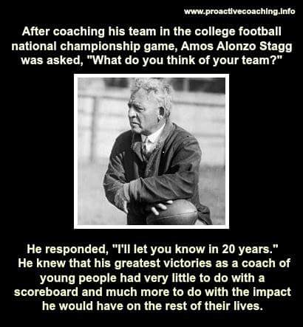
Notes:
Loved Coach Stagg’s response, very visionary
Aspirational goals, Vision
If we as educators can adopt that type of vision for each student, we’ll focus on the right aspects of learning and development.
Educators and Meteorologists

Slide 3
A NEW Vision for Kansas….
Kansas leads the world in the success of each student..
Notes:
Kansas’ version of an aspirational goal.
Predicting success based on what we heard from Kansans all across the state. IF we focus on academic/cognitive, technical, employability, civic engagement, THEN we can predict with greater certainty our students will be more successful.

Slide 4
To achieve a goal you have never achieved before, you must start doing things you’ve never done before.

Slide 5
Creating a Vision for Kansas
State Level Outcomes will drive our Vision!
Kindergarten Readiness
Individual Plans of Study
High School Graduation Rates
Post Secondary Success
Social/Emotional Growth Measured Locally

Slide 6
Lag vs. Lead Measures
Lag Measure
Lead Measure
Measures the Goal
(from X to Y by When)
Ex. High School Graduation
From 86% to Y by When
Ex. Postsecondary Success
From 40% to Y by When
Predictive
(Measures something that leads to the goal)
Influenceable
(Something we can influence)
Ex. Individual Plans of Study
Social/Emotional Growth

Slide 7
An Individual Plan of Study is a journey, not an event.

Slide 8
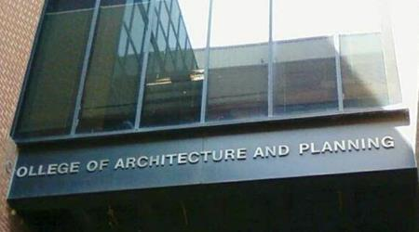
The Importance of Planning Ahead
Notes:
To navigate the minefield of postsecondary, it’s important to plan well while in K-12.

Slide 9
It’s more about
Career Exploration than it is about Career Selection

Slide 10
How do young people make career decisions?
Influences on Future Career Pathway
Own Interests/Experiences
Father
Mother
Teacher
Other Family
Coach
.........
Counselor
**Survey results from “Attracting the Next Generation Workforce”
Educational Research Center of America

Slide 11
Need Assistance?
Jay Scott Kathleen Mercer
785.296.4351 785.296.6765
jscott@ksde.org kmercer@ksde.org
@KSDE_CTE
KENT REED
785.296.8109
kreed@ksde.org

Slide 12
With quality career education and an individual plan for each student, Kansas students will be more successful post-high school
To learn more….
IPS webpage
CTE webpage
@KSDE_CTE

