Slide 1
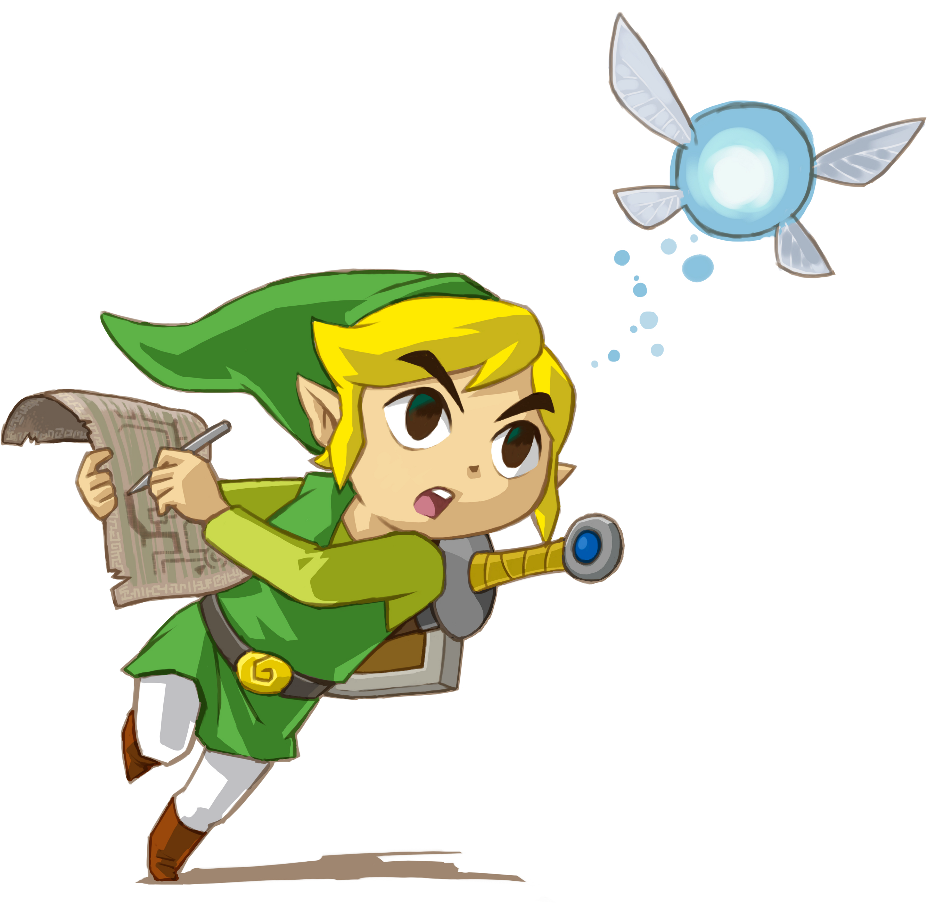
Gamifying the Classroom
A Psychological Examination of Using Video Games in Education

Slide 2
A Generation of Gamers
According to an APA study conducted in 2014, 91% of children ages 2 – 17 play video games.
99% of teenage boys
94% of teenage girls
This generation of students has grown up with videogames.
Source: Granic, Lobel. Engels

Slide 4
So What Even Are Videogames?
“An electronic game in which players control images on a television or computer screen”
Specifically video games are interactive!
Source: Merriam Webster’s Dictionary

Slide 5
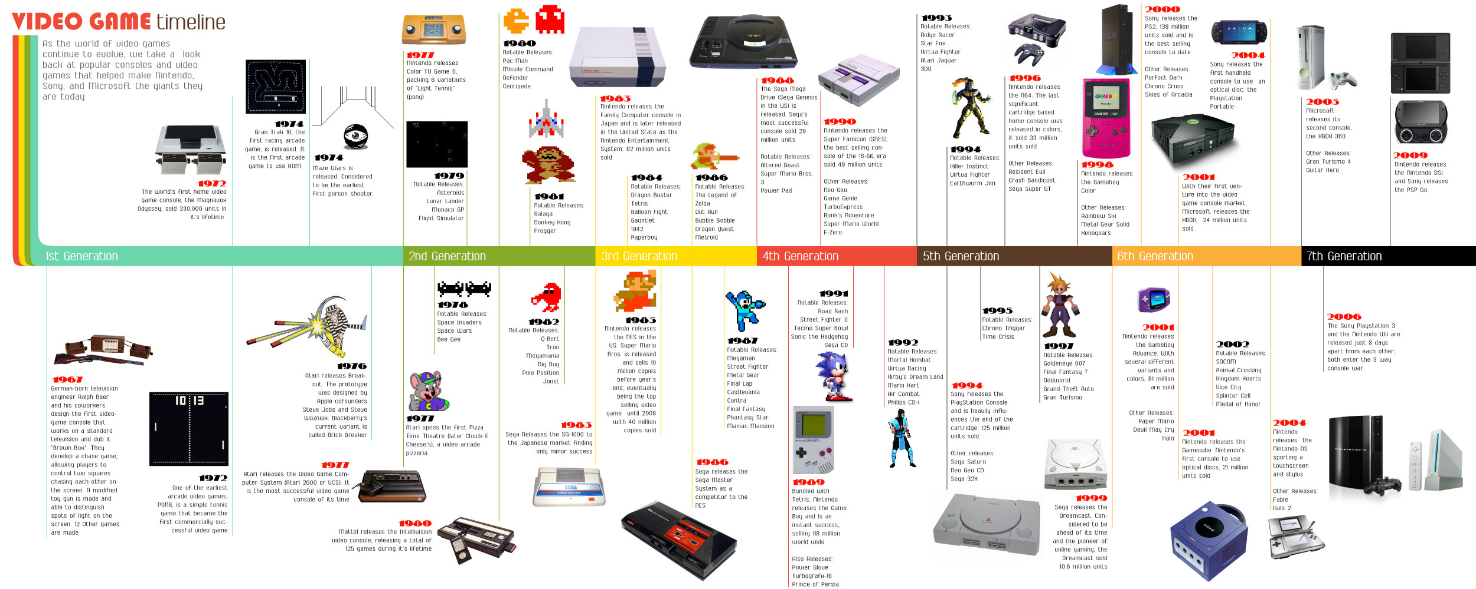

Slide 7
Then Versus Now
Videogames of the Past
Videogames Today
Isolationist
Simple
Targeted only for young kids
Little application to real life
Social
Complex
Aimed at various demographics
Realistic and applicable to life

Slide 8
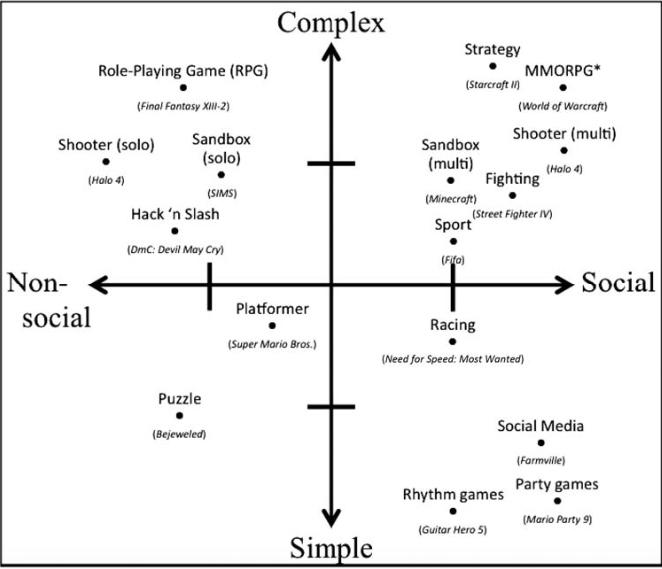

Slide 9
Play In Education
Benefits of “Play”.
“Allows children to experiment with social experiences and generate real world resolutions.” ¹
“Provides children opportunities to reproduce real-life conflicts, to work out ideal resolutions, and to ameliorate negative feelings.” ²
The goal of “Play” and education is almost nearly identical!
Source 1: Erickson 1977
Source 2: Piaget 1962

Slide 10
Benefits of Gaming
Enhanced visual-spatial and mental rotation abilities.¹
Improved problem solving skills.²
Enhanced creativity.³
Incremental beliefs about intelligence.⁴
Promote cooperation and positive group work ethics.⁵
Source 1: C.S. Green & Bavalier 2012
Source 2: Prensky 2012
Source 3: Jackson et al. 2012
Source 4: Dweck & Molden 2005
Source 5: Gentile et al. 2009

Slide 11
Games and the Classroom
This data is great but now what?
“You can’t wait for innovation, you have to go after it with a club.”
- Jack London

