Slide 1
Rural School Conference – March 2021
Dr. Randy Watson, Kansas Commissioner of Education

Slide 2
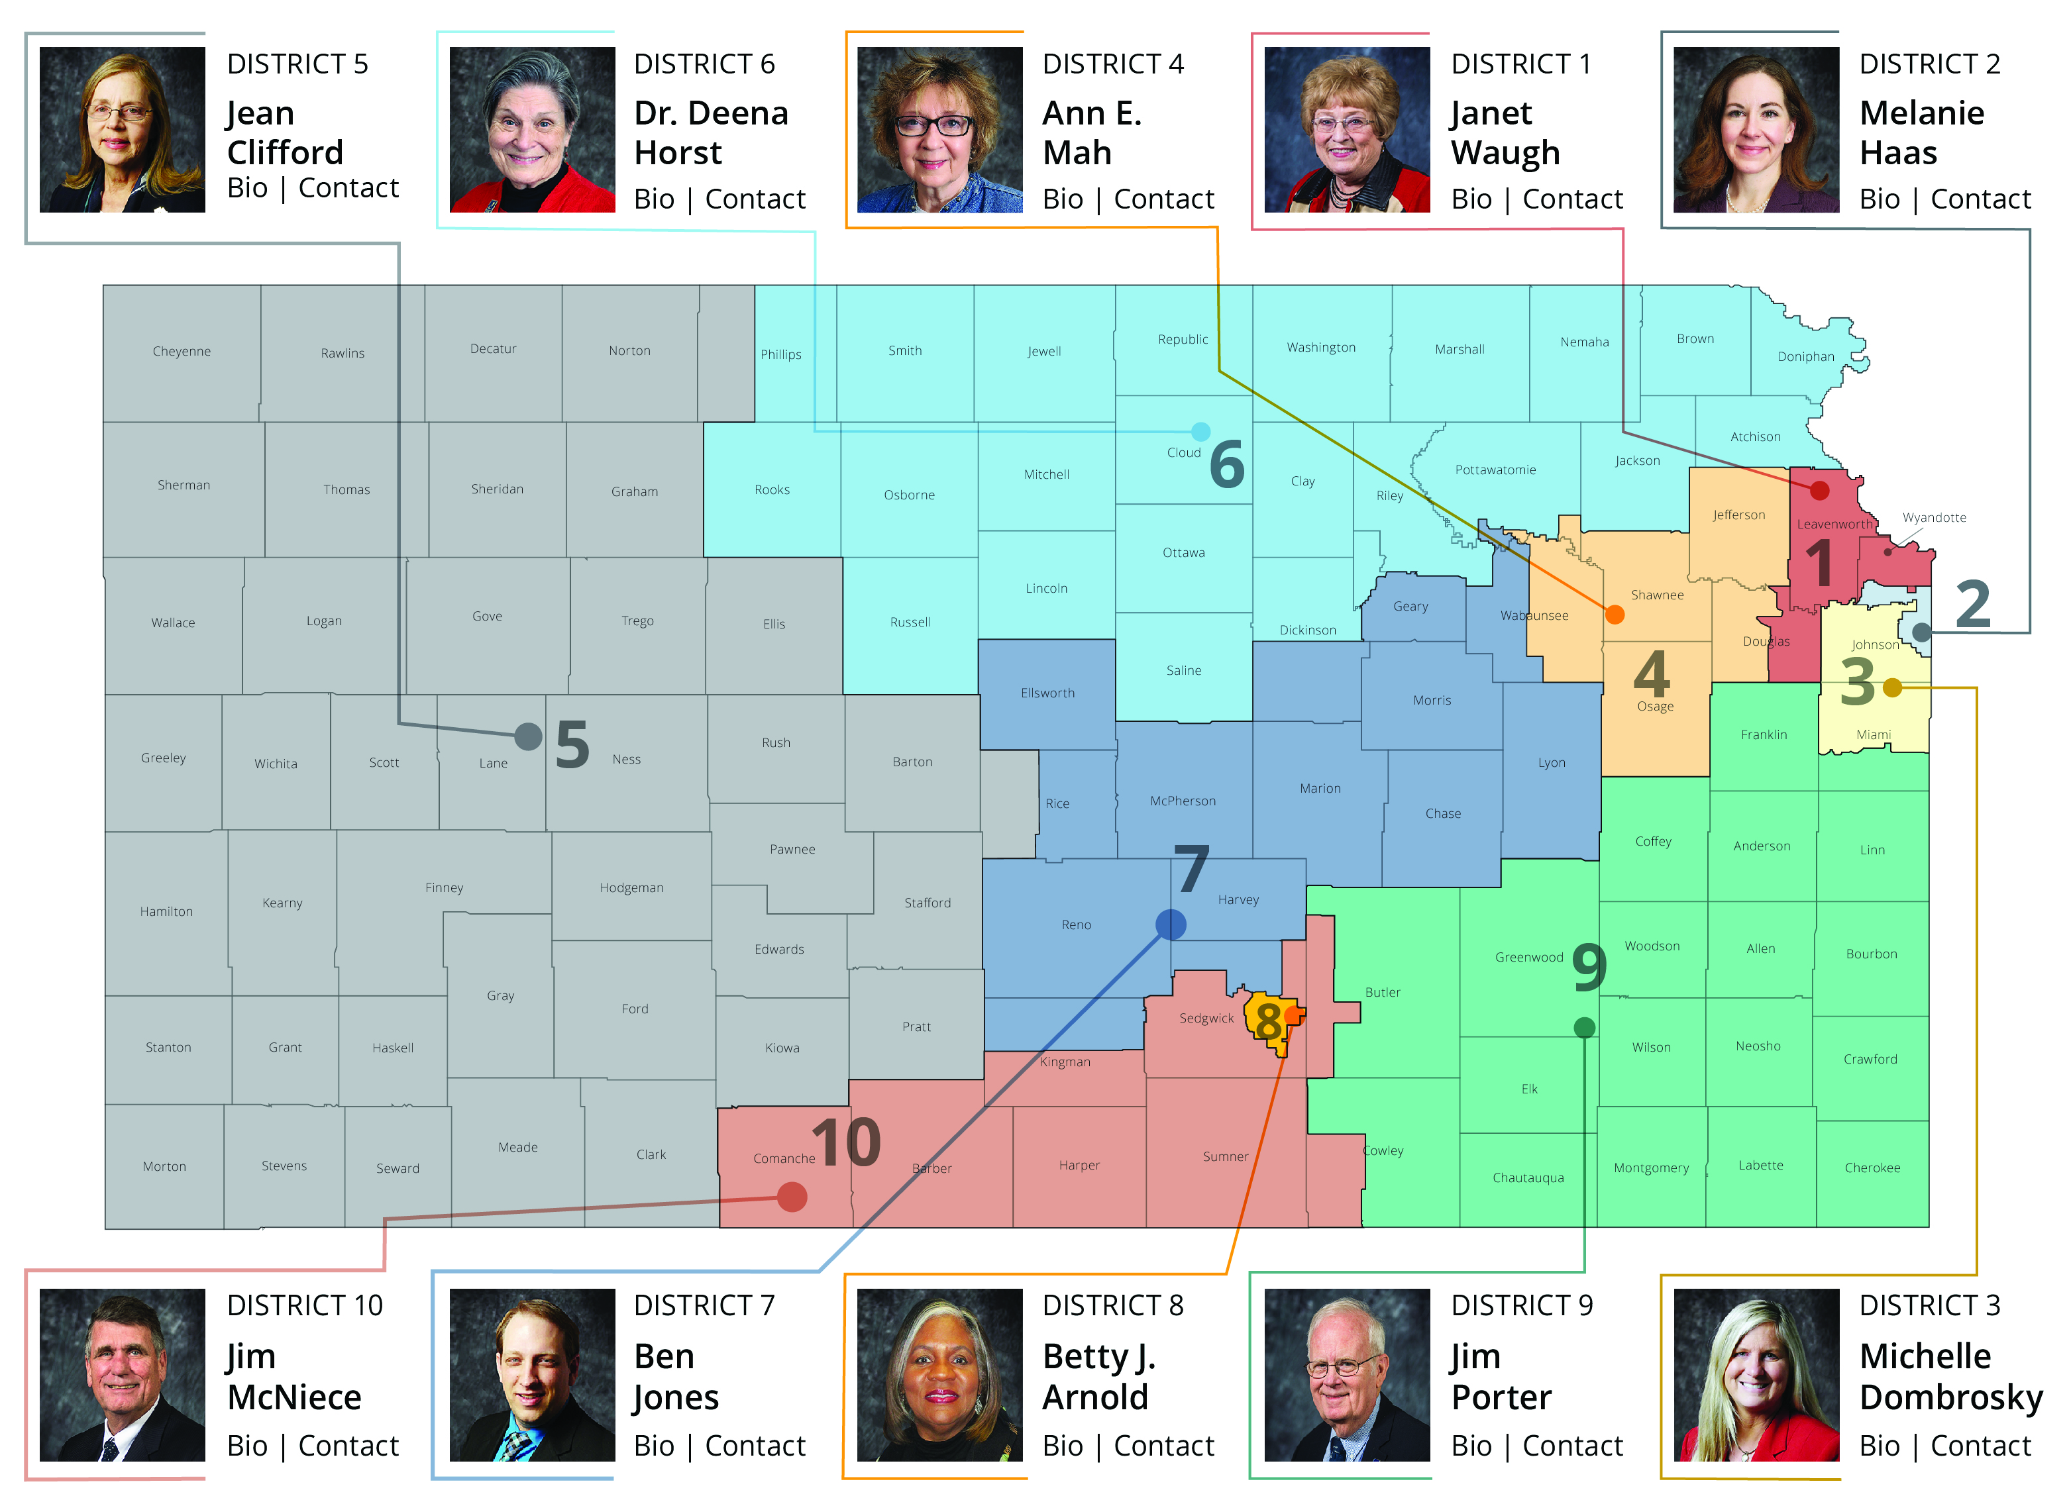

Slide 3
Our Vision for Kansas ...
Kansas leads the world in the success of each student

Slide 4
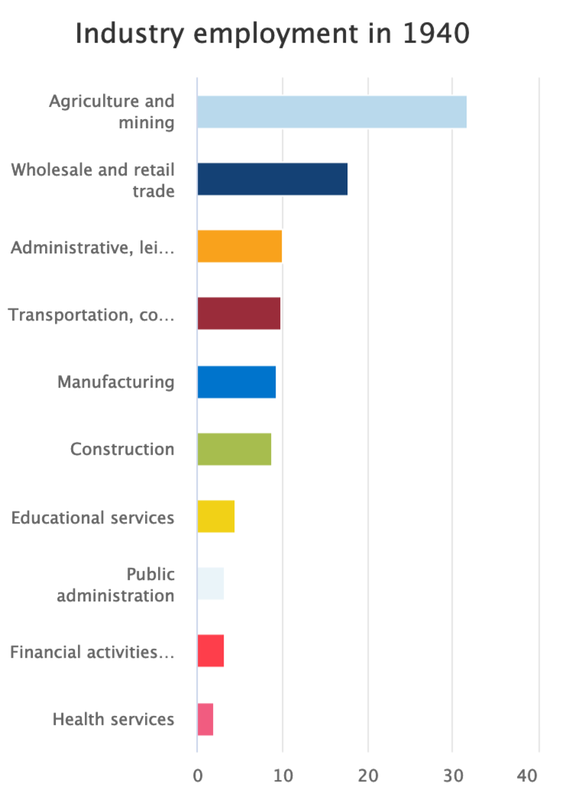
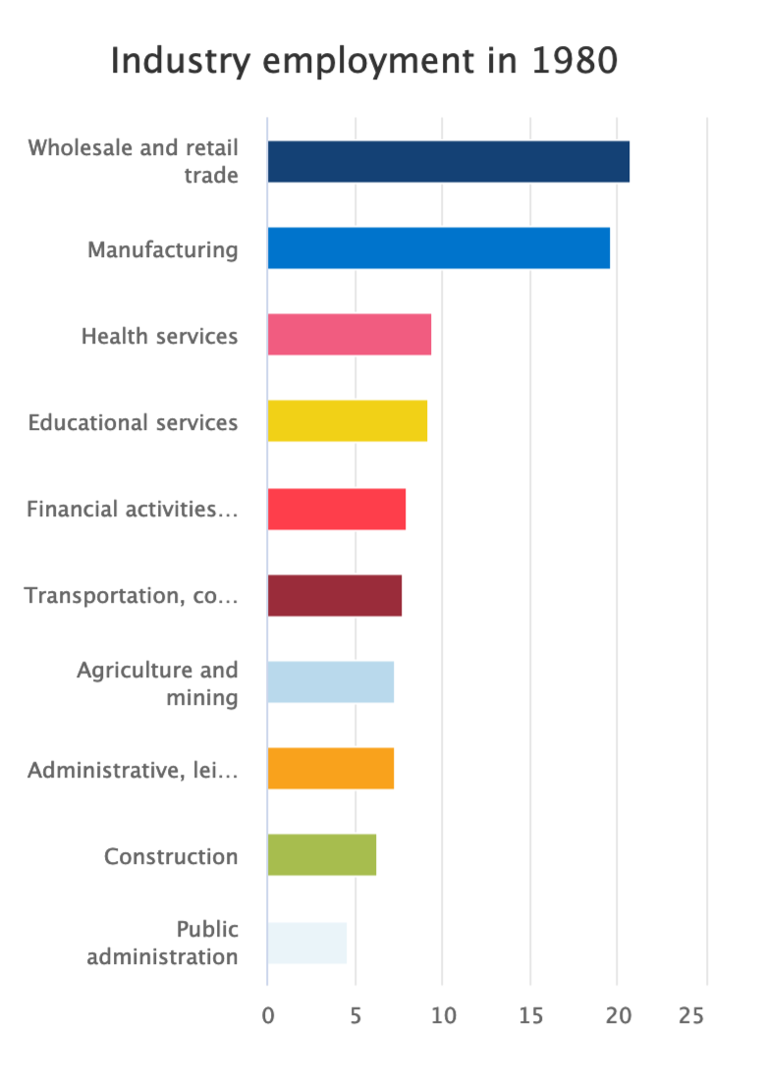
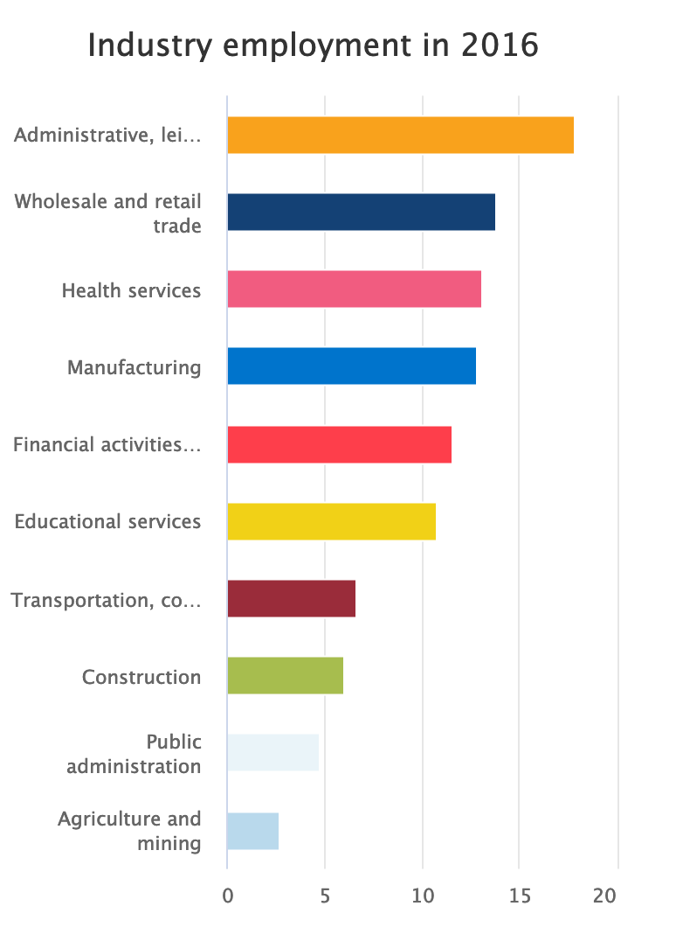
Changes in Kansas Workforce
31.7%
19.6%
9.5%
13.1%
9.2%
12.8%
9.3%
10.8%
4.4%
7.2%
1.9%
2.7%

Slide 5
Vacancy Assignment Top 5 – Fall 2019 | #1 | #2 | #3 | #4 | #5 | #6 | #7 | #8 | #9 | #10 | Total
Special Education | 27 | 12 | 12 | 13 | 61 | 5 | 10 | 30 | 8 | 8 | 186
Elementary | 3 | 2 | 2 | 8 | 55 | 4 | 12 | 19 | 4 | 6 | 115
English Language Arts | 2 | 1 | 1 | 2 | 31 | 5 | 4 | 1 | 3 | 3 | 53
Science | 2 | 0 | 0 | 2 | 32 | 7 | 0 | 9 | 2 | 4 | 58
Math | 11 | 0 | 1 | 1 | 18 | 4 | 4 | 2 | 4 | 2 | 47
TOTAL | 45 | 15 | 16 | 26 | 197 | 25 | 30 | 61 | 21 | 23 | 459
Board District

Slide 6
What does the LPR and licensure data from 2018-2019 tell us?
Entrance and exit data -
 | SY 2017-2018 |  | SY 2018-2019 |  | Definition
Stability | 88% |  | 87.5% |  | Percent of educators remained in same district.
Movement | 5% |  | 4.4% |  | Percent of educators who changed districts.
New grads | 4.27% |  | 4.39% |  | Percent of new graduates entering the field from in-state and out-of-state programs.
From other field | .85% |  | 1.21% |  | Teachers entering the field from business, industry or government.
Importing | 233 |  | 263 |  | Reported exited to out of state.
 |  |  |  |  | Reported entering from out of state
 | 568 |  | 559

Slide 7
Subject Area | Spring 2019 | Fall 2019 | Spring 2020 | Fall 2020 | Spring 2021
SPED/ESOL Teacher | 155 | 186 | 173 | 157 | 180
Elementary | 86 | 115 | 86 | 142 | 131
Life and Physical Sciences | 34 | 58 | 68 | 76 | 82
English Language and Literature | 37 | 53 | 45 | 51 | 66
Mathematics | 28 | 47 | 57 | 57 | 59

Slide 8
Retention – Third year of teaching
Ten-year retention rate for teachers in their third year of teaching.
Two year Mentoring Begins

Slide 9
Demographics
Experience:
Largest group of educators = One to four years of experience
Mean years of experience = 14
Age:
Average age of teachers = 42.9
Average age of educators = 44.3
Salary:
Average salary for first-year teacher = $39,744
Average salary for teachers = $56,530

Slide 10
Federal relief funds intended to further support LEAs and nonpublic schools in addressing these needs
Elementary & Secondary School Emergency Relief Fund (ESSER)
Emergency Assistance to Non-Public Schools (EANS)
Description
Awarded to SEAs based on Title I formula to provide emergency relief funds to LEAs to address the impact that COVID-19 has had, and continues to have, on elementary and secondary schools across the Nation
Awarded to Governors to provide services or assistance to eligible non-public schools
Intended Use
Used by LEAs for preventing, preparing for, and responding to COVID-19
Address the impact of COVID-19 on non-public school students & teachers
Focus of this Task Force
ESSER I
ESSER II
ESSER III
EANS I
EANS II
Bill
CARES Act (Mar '20)
CRRSA Act (Dec '20)
ARP Act (Mar ‘21)
CRRSA Act (Dec '20)
ARP Act (Mar ‘21)
KS Amount
$85M
$370M
TBD
$27M
TBD
Timeframe
Usable from Mar '20
Award within 60 days
Obligate by Sep '24
Award within 60 days
Obligate by Sep '24
Usable from Mar '20
Award by Jun '21
Obligate by Sep '22
Usable from Mar '20
Award by Jan '22
Obligate by Sep '23
Usable from Mar '20
Obligate by Aug '21
Services through Sep '23

Slide 11
ESSER II has multiple components; $370M in total allocated to Kansas
Multiple funding streams (where applicable) included in single consolidated application for each LEA (286 in total)
Federally mandated
Minimum LEA distribution
Allocated through Title I formula
$332.8M
3.1
0.0
LEA "True up"
Ensures all districts receive at least $300 per student
0.5
KSDE discretionary (9.5%)
$11.5M
ESSER II
$369.8M
Special Education
Additional set-aside for LEAs split across 2021-22 and 2022-23
$24M
Schools for the Deaf & Blind
Set-aside as schools do not receive funds through LEA distributions
$0.2M
KSDE Administration (0.5%)
SEA Administration
$1.8M

Slide 13
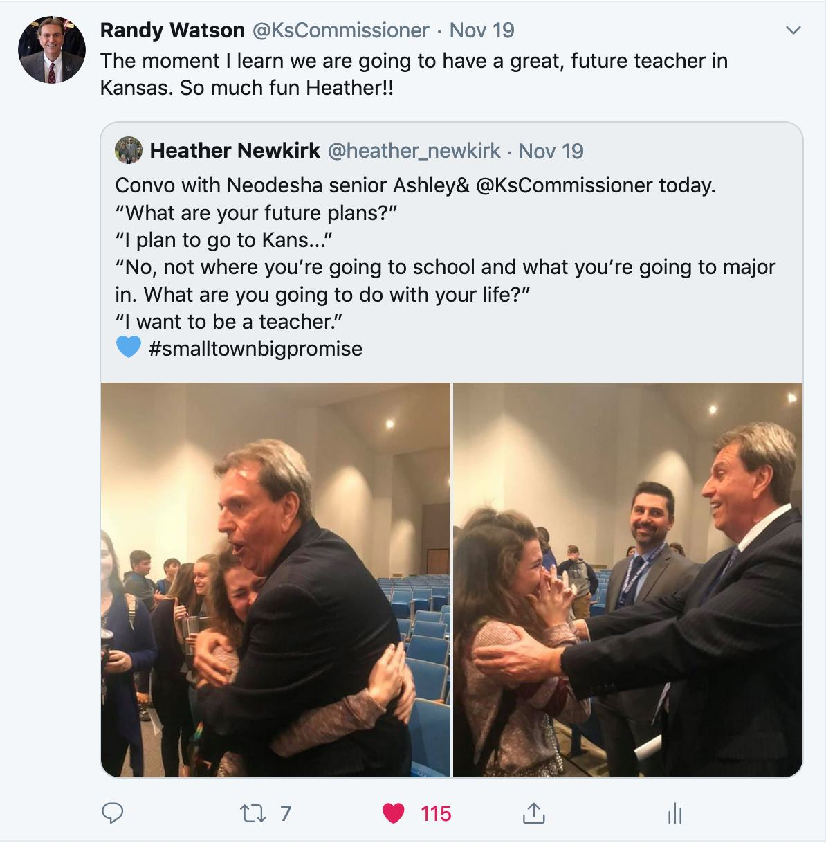

Slide 14
Notes:
Today’s students are the future workforce and future leaders of Kansas. Kansans Can achieve anything and, together, Kansans Can lead the world in the success of each student.

