Slide 1
Designing the
Rocket
Meeting 3

Slide 2
Agenda
12:00-12:30 Welcome and Overview of the Day
12:30-1:30 Goals, Measures, GAITs, and the Redesign Workbook
1:30-2:45 Plan Time/Coach Check In
2:45-3:00 Closing

Slide 3
Links
Slides -

Slide 4
Kansas Vision for Redesign
Kansas leads the world in the success of each student
It’s what Kansans said they wanted. It’s what the job trends and our current K-12 outcomes are telling us.

Slide 6
TURNKEY PROCESS
Regional Training Team will experience workshop + modify turnkey materials to train the School redesign Teams in their service centers
RTT
School Redesign Team receives training from RTT and makes key decisions to modify expectations for their district and school context
SRT
School teams receive training from their School redesign team and engage staff through participation in investigation teams
FULL SCHOOL
Notes:
Two Things:
While you are at these trainings, we are giving you content and walking you through activities to assist you in engaging in design thinking to plan your school redesign. As you participate, you should always be thinking about what you will take back to your staff and how you will deliver it.
To assist you with planning your ‘turnkey’, we have a communication log that you were asked to create in the beginning of our time together. You are not obligated to use this, but it is highly encouraged. Use this communication log to help you plan, to track your progress, and to implement a system of accountability.

Slide 7
WHAT
Determine what is the essential learning for all.
WHY
Establish a clear purpose for the learning.
Turnkey Considerations
HOW
Determine the best time, place, and delivery model for the learning.

Slide 8
Designing the Rocket

Slide 9
Goal Area Investigation Teams
Goals, Target Areas, & Measures
Redesign Workbook
Turnkey Planning & Closing

Slide 10
Objectives
01
Learn the Redesign Process
Experience Design Thinking
Empathize with your Students and Teachers
Create Goal Areas based on Data
02
Identify Strategies to Prototype (Principles)
Research and understand the 4 Redesign Principles (what, why, and how)
Compile list of possible Strategies
ID how many strategies to research for possible prototyping
03
Form Investigation Teams
Create Investigation teams based on Goal Areas
Establish Roles on Investigation Teams
04
Set Up School Visits
Goal Areas, Investigation Teams, and Capacity
In State, Out of State, and/or Virtual
Set up a Why and Goals before each visit
05
Communicate with Stakeholders
Why, Who, How, and When
Continue developing your plan
Over communicate

Slide 11
Designing the Rocket
FOCUS
LEVERAGE
ENGAGEMENT
ACCOUNTABILITY
Your Vision for Education
Learn the Redesign Process Research Goal Areas Engage Stakeholders & Communicate
-Design Thinking Challenge -Identify Goal Areas -Build a Purposeful
-Introduce 4DX -Develop Investigation Community
Teams -Mobilize Others -Research 4 Principles -Communication Plan
-Take Inventory -Business Plan
-Identify Strategies to Prototype
Notes:
Focus on the wildly important.
Act on lead measures.
Keep a compelling scoreboard.
Create a cadence of accountability.

Slide 12
Kansans Can School Redesign Principles
Student Success Skills | Family, Business, and Community Partnerships
There is an integrated approach to develop student social-emotional learning. | Partnerships are based on mutually beneficial relationships and collaboration.
Personalizing Learning | Real World Application
Personalized learning places the whole child at the center of instruction. It is informed by strong educator/student/family/community relationships to provide equity and choice in time, place, path, pace and demonstration of learning. | Project-based learning, internships, and civic engagement makes learning relevant.

Slide 13
BLENDING DESIGN THINKING & 4DX
EMPATHIZE
with our students and staff
TEST
models and strategies with students
DEFINE
their needs
Create a Cadence of Accountability
Iterations
PROTOTYPE
models and strategies
IDEATE
solutions to these needs
Focus on the Wildly Important (Goal Areas & Lag Measures)
Keep a Compelling Scoreboard
(Liang, Mitchell, & Scott, 2020)
Act on Lead Measures (Strategies)
Notes:
The HOW of Redesign - process
Blending of the two models - unique to school improvement
Start with Empathize and roll through
Design Thinking - student-focused solutions, lends itself to creativity and innovation (Navigating Next) Ex. Michelangelo
4DX - narrowing down to what’s most important for student, executing well with strategies that leverage student-centered goals Ex. Tom Osborne drawing up the split back veer play
Blending creativity & innovation with a focus on executing well = strong process to Redesign
Schools learn this process in the Plan Year and then continually replicate and cycle through in a perpetual loop

Slide 14
Conditions for a Learning Culture
Sh
Principals
Model Learning Leadership
Motivate Teachers
Support Inquiry, Innovation, and Exploration
Shared Leadership
Shared Leadership
-Shared Vision
-Psychological Safety
-Communication & Feedback
-Growth Mindset
Teachers
Collective Efficacy
Change Agents
Collegial Collaboration and Practices
Additional Stakeholders
Input in Goals and Strategies
Communicate about and Invest in the Work
Shared Leadership

Slide 15
Leadership Competencies

Slide 16
What is a school-based investigation team?
Investigation Team Overview

Slide 17
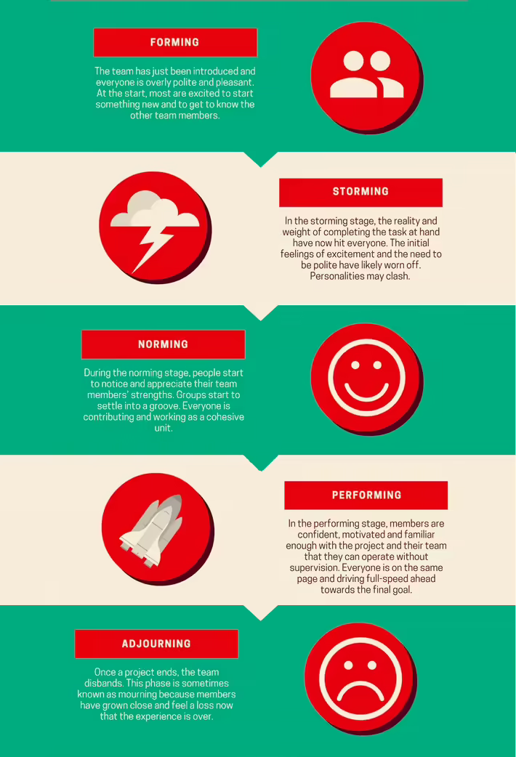
Team en
As you form up your Goal Area Investigation Teams, be aware of the 5 phases every team works through:
Forming
Storming
Norming
Performing
Adjourning
Utilize Chapter 6 of ‘Playbook for Redesigning Schools for the 21st Century’ to learn how to evaluate your team and how to grow from a group to a team.
Notes:
Tuckman’s 5 stages of team development.
https://toggl.com/track/stages-of-team-development/#:~:text=In%201965%2C%20a%20psychologist%20named,have%20a%20knack%20for%20rhyming.

Slide 18
3 Types of Research
Traditional Research
Google Site, Website, Etc.
Observational Research
Site Visits
Leading to...
Actn Research
Designing the Rocket
Building the Rocket

Slide 19
Site Visits & Connections
Research
Site Visits
KSDE Redesign Webpage- Videos Tab
Redesign Google Site- School Models Tab
EPIC Elementary
30 School Districts to Visit
Eminence, KY
Wilder, Idaho

Slide 20
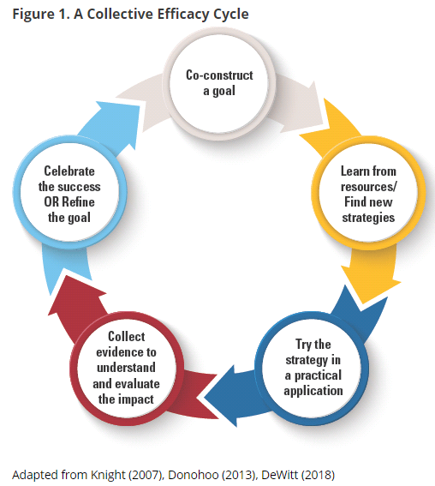
Grow Collective Efficacy
(Liang, Mitchell, & Scott, 2020)
Notes:
The graphic on the left walks through the steps necessary for growing collective efficacy in your organization. In order to grow and build collective efficacy, you must allow all staff an opportunity to co-construct the goal; learn from resources and investigate strategies; staff must have a chance to ‘try a strategy on’ while collecting evidence to understand impact; and lastly, staff must have a collective opportunity to celebrate and reflect.
If you compare that to the process used in Redesign of design thinking and the four disciplines of execution, you see that there is quite a significant alignment between them. In redesign, you use design thinking and 4dx to empathize with students and define your wildly important goals. You ideate and investigate strategies that become your lead measures. Your build prototypes the you test in small groups and while doing so, you create data scoreboards and you hold accountability meetings where ‘pivots’ or ‘adjustments’ are determined. And at the end of your test window, you reflect, celebrate and create a plan for scale or revise and begin again.
To put it simply, using the redesign process with fidelity and integrity will allow you to grow teacher collective efficacy. Let’s move on to learn a little bit more!
Donohoo, Jenni, and Steven Katz. “What Drives Collective Efficacy?” What Drives Collective Efficacy? - Educational Leadership, ASCD, July 2019, www.ascd.org/publications/educational-leadership/jul19/vol76/num09/What-Drives-Collective-Efficacy%C2%A2.aspx.
Liang, J. “Grace,” Mitchell, T., & Scott, J. (2020). Statewide School Redesign: Integrating Design Thinking and the Four Disciplines of Execution as a Continuous School Improvement Process. Journal of Case Studies in Educational Leadership, 1(13). Retrieved from https://journals.sagepub.com/doi/10.1177/1555458920975462

Slide 21
VISION: Kansas leads the world in the success of each student.
Kindergarten Readiness
Social Emotional Growth
Individual Plan of Study
Graduation Rate
Post Secondary Effective Rate
System VISION:
Note-
All of the work that happens in buildings is meant to move us closer toward achieving our state vision and reaching our state board outcomes. Additionally, the work of systems should also work to support buildings and reflect their priorities, while also moving us closer to our state vision and outcomes. These relationships should flow up and down.
System Values
KESA Goal Area:
KESA Goal Area:
Lag Measure(s):
Lag Measure(s):
School VISION:
Student Success Skills
Real World Applications
Personalized Learning
Family/Business/Community Engagement
Goal Area:
Goal Area:
Goal Area:
Lag Measure(s):
Lag Measure(s):
Lag Measure(s)
Strategies:
Strategies:
Strategies:
Notes:
The 4 Redesign Principles and the schools’ shared vision are foundational.
Schools, with the leadership of the SRT, will explore their student profiles, determine their HMW statements (or problems of practice). These could align with their KESA goal areas.
Schools do not need to have 4 goal areas, they could have fewer, depending on their student profiles.
The work of the investigation teams and the prototype results will inform the strategies that will be put in place. These strategies need to address the goal areas AND align to the 4 Redesign Principles.

Slide 22
VISION:
Foundations
Student Success Skills
Real World Applications
Personalized Learning
Family/Business/Community Engagement
How might we ...?
Goal Area:
Goal Area:
Goal Area:
Note-
It is recommended that you select 2-3 goal areas to intensely focus on in working to achieve your vision. Your goal areas should not be the Redesign Principles, but should connect back to the Principles through the execution of strategies. Also consider: what does your data tell you? What are your stakeholders telling you? What areas of need exist and need to be specifically addressed?
Lag Measure(s):
Lag Measure(s):
Lag Measure(s)
Strategies:
Strategies:
Strategies:
Goal Areas and Strategies
Notes:
The 4 Redesign Principles and the schools’ shared vision are foundational.
Schools, with the leadership of the SRT, will explore their student profiles, determine their HMW statements (or problems of practice). These could align with their KESA goal areas.
Schools do not need to have 4 goal areas, they could have fewer, depending on their student profiles.
The work of the investigation teams and the prototype results will inform the strategies that will be put in place. These strategies need to address the goal areas AND align to the 4 Redesign Principles.

Slide 23
VISION:
Foundations
Student Success Skills
Real World Applications
Personalized Learning
Family/Business/Community Engagement
How might we ...?
Goal Area:
Goal Area:
Goal Area:
Note-
For each Goal Area, it is important that you determine your Lag Measure. By addressing this goal area, what Lag Measure do you intend to impact? What is the ‘big rock’ that will be moved by executing on this wildly important goal?
Lag Measure(s):
(From x to y by when)
Lag Measure(s):
(From x to y by when)
Lag Measure(s):
(From x to y by when)
Strategies:
Strategies:
Strategies:
Goal Areas and Strategies
Notes:
NOTE- Building the Rocket with dive into lag and lead measures. This is introductory, it is not expected to be done!
The 4 Redesign Principles and the schools’ shared vision are foundational.
Schools, with the leadership of the SRT, will explore their student profiles, determine their HMW statements (or problems of practice). These could align with their KESA goal areas.
Schools do not need to have 4 goal areas, they could have fewer, depending on their student profiles.
The work of the investigation teams and the prototype results will inform the strategies that will be put in place. These strategies need to address the goal areas AND align to the 4 Redesign Principles.

Slide 24
Goal Area #1:
Note-
Once a Goal Area has been identified, narrow the Goal Area down into 1 to 3 Target Areas.
For each Target Area, determine a lag measure that will ultimately let you know once you reach the desired level in that particular Target Area.
Your Lag Measure should be a statement using the format ‘from x to y by when’. Your Lag Measure should in turn be a SMART Goal.
Target Area:
Target Area:
Target Area:
Goal Area, Target Areas, and Strategies
Lag Measure:
(From x to y by when)
Lag Measure:
Lag Measure:
Strategy:
Strategy:
Strategy:
Notes:
NOTE- Building the Rocket with dive into lag and lead measures. This is introductory, it is not expected to be done!
The 4 Redesign Principles and the schools’ shared vision are foundational.
Schools, with the leadership of the SRT, will explore their student profiles, determine their HMW statements (or problems of practice). These could align with their KESA goal areas.
Schools do not need to have 4 goal areas, they could have fewer, depending on their student profiles.
The work of the investigation teams and the prototype results will inform the strategies that will be put in place. These strategies need to address the goal areas AND align to the 4 Redesign Principles.

Slide 25
Goal Area #1:
Note-
The strategies you choose are your Lead Measures. They will lead you to success in your target area and goal area.
When writing your strategy, consider four things:
Verb: sets action orientation
Focus: states explicit outcome
Consistency: how often
Quality: criteria for success
Lead Measures should set you up to impact your Lag Measure.
Target Area:
Target Area:
Target Area:
Goal Area, Target Areas, and Strategies
Lag Measure:
(From x to y by when)
Lag Measure:
Lag Measure:
Strategy:
Implement soft starts according to blueprint five days a week beginning February 10, 2021.
Strategy:
Strategy:
Notes:
NOTE- Building the Rocket with dive into lag and lead measures. This is introductory, it is not expected to be done!

Slide 26
Quality Strategies
Safe enough to try (Research Based) vs Evidenced Based
In Redesign, we encourage you to test strategies that are ‘Safe enough to try’. That means you have done research, looked closely at your stakeholders, data, and resources, and determined that testing this strategy would be ‘safe’ and possibly highly impactful.
That does not mean you can try anything. It means you try things that have been researched formally, or informally by your Goal Area Investigation Team, and demonstrate a potential for impact in your setting.
Evidence Based means that the strategy has been validated to be effective through numerous studies. You can learn more about evidence based practices by exploring ‘Wise Ways’, ‘What Works Clearinghouse’ or other academic research bases.

Slide 27
Designing the Rocket
Sample Blueprint Slides

Slide 28
Goal Area Investigation Teams
Goals, Target Areas, & Measures
Redesign Workbook
Turnkey Planning & Closing

Slide 29
Leadership Focus- Principals
Ensure all actions are consistent with the school’s vision, mission, and values
Anticipate and address barriers and challenges
Begin using the Redesign Workbook to align your school’s vision, goals, and strategies with system expectations and State Board Outcomes.
Coach staff in prioritizing strategies that will leverage your goals and vision.
Serve as a conduit for communication between your teacher teams and your system leaders.
Evaluate resource implications for strategies so that implementation barriers can be addressed early.

Slide 30
Leadership Focus- Teachers
Psychological Safety- Relational Trust
Psychological Safety- Risk Taking
Benevolence- giving back to one another
Openness- sharing professional ideas
Honesty- telling the truth; refusing to spread untruths
Competence- collaborate to improve instructional practices
(Kaplan & Owings , 2013)
Utilize the mindset ‘safe enough to try’
Utilize the mindset of ‘failing forward’
Provide clarity around project ownership and responsibilities
Distribute authority to those closest to the decision
(Kim & Gonzalez-Black, 2016)

Slide 31
Turnkey & School Planning Time
Redesign Principles
Research & Investigation
Redesign Workbook
Goals
Lag Measures
Target Areas
System Alignment
Support for GAITs
Brainstorming
Research
Safe enough to try
Site-Visits
Feedback & Communication
Communication Plan
Business/Community Engagement Plan
WHY
WHAT
Turnkey Considerations
HOW

Slide 32
Share your commitments between now and the next Training.
Each school will share out loud.
Notes:
Note- This is like an ‘accountability meeting’. Reporting on last time’s commitments, giving a status update based on data (i.e. checklist), and talking about what’s next...that’s discipline 4 ‘create a cadence of accountability’!

Slide 33
SURVEY
Please take the survey at the end of each training. Your feedback is incredibly valuable.

Slide 34
Follow us on Twitter
@KSDEredesign
#kstothemoon

