Slide 1
Kansas Leads the World in the Success of Each Student.
Dr. Randy Watson, Kansas Commissioner of Education
Mr. Dale Dennis, Deputy Commissioner of Education

Slide 2
A NEW Vision for Kansas ...
Kansas leads the world in the success of each student
KANSAS STATE DEPARTMENT OF EDUCATION | www.ksde.org

Slide 3
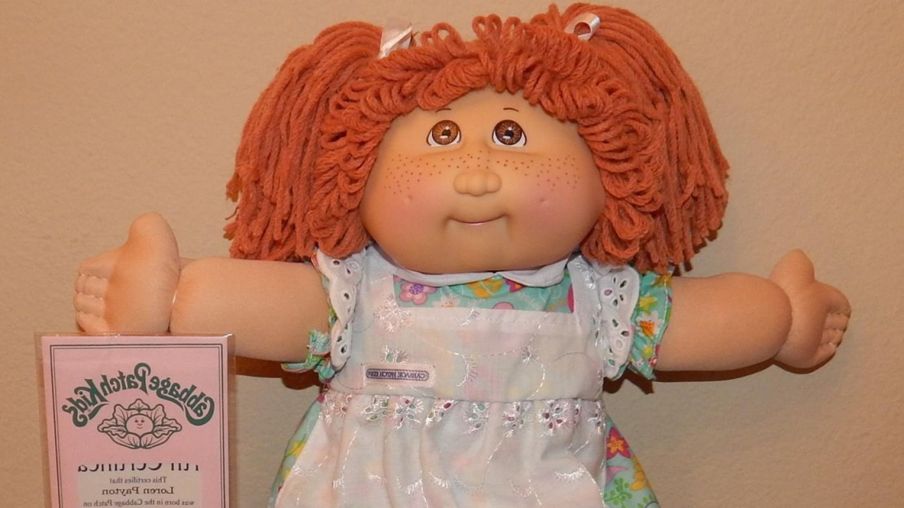
What creates demand?

Slide 4
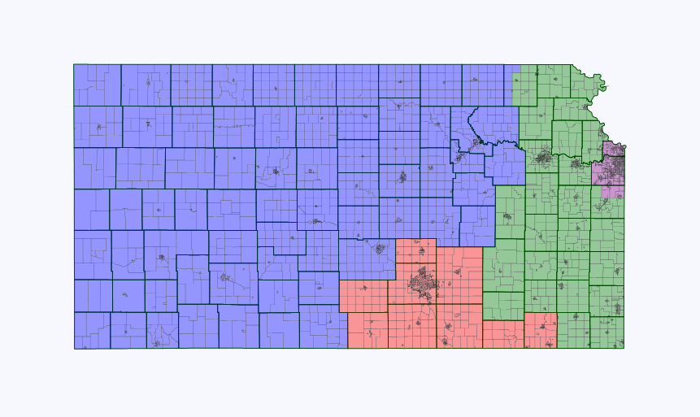
17%
91%
31%
28%
31%

Slide 5
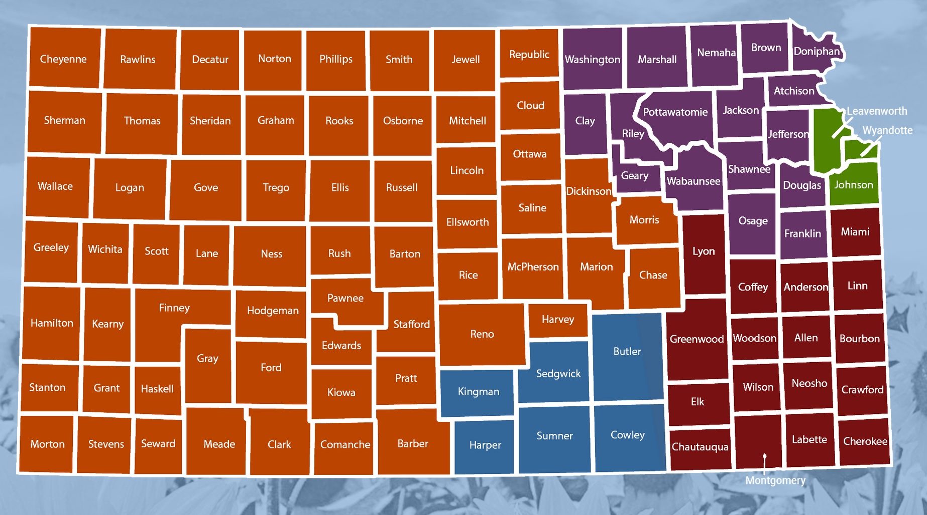
Health Care
Teaching
IT – Software developers
Business - Sales, managers, accountants
Energy - Lineman
Health Care
Teaching
IT – Software developers
Business - Sales, managers, accountants
Energy - Lineman
Health Care
Engineering
IT – Software developers
Business - Sales, managers, accountants
Truck Drivers
Health Care
Teaching
Ag
Business - Sales, managers, accountants
Machining
Health Care
Teaching
Ag
Business - Sales, managers, accountants
Energy - Lineman
Health Care
Teaching
Engineering
Business - Sales, managers, accountants
Aircraft machining
Health Care
Teaching
Engineering
Business - Sales, managers, accountants
Aircraft machining

Slide 6
Pathway Name | Count
Family, Community & Consumer Services | 236
Construction & Design | 230
Business Finance | 194
AV Communications | 187
Web & Digital Communications | 180
Comprehensive Agriculture Science Pathway | 170
Power, Structural, & Technical Systems | 170
Visual Arts Pathway | 133
Restaurant and Event Management | 131
Manufacturing | 116
Business Entrepreneurship and Management | 115
Marketing | 106
Health Science | 103
Teaching/Training | 103
Engineering & Applied Mathematics | 82
Early Childhood Development & Services | 77
Mobile Equipment Maintenance Pathway | 63
Programming & Software Development | 54
BioChemistry | 47
Plant Systems Pathway | 47
BioMedical | 46

Slide 7
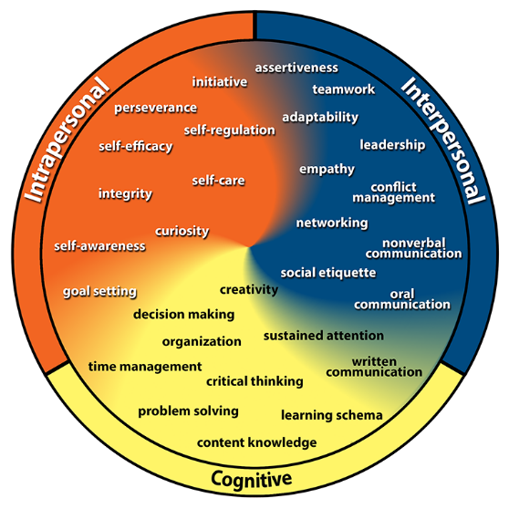
Kansans Can Competencies
Go to www.menti.com
Type 37 90 22

Slide 10
Teacher Shortage
Increase recognition of teachers
Increase pathways to be a teacher
Expand Redesign Schools - Apollo
Money

Slide 11
SCHOOL FINANCE
December 1, 2018

Slide 12
Base Aid for Student Excellence
School Year | BASE
1992-93 | 3,600
1993-94 | 3,600
1994-95 | 3,600
1995-96 | 3,626
1996-97 | 3,648
1997-98 | 3,670
1998-99 | 3,720
1999-00 | 3,770
2000-01 | 3,820
2001-02 | 3,870

Slide 13
Base Aid for Student Excellence
School Year | BASE
2002-03 | 3,863
2003-04 | 3,863
2004-05 | 3,863
2005-06 | 4,257*
2006-07 | 4,316
2007-08 | 4,374
2008-09 | 4,400
2009-10 | 4,012
2010-11 | 3,937
2011-12 | 3,780

Slide 14
Base Aid for Student Excellence
School Year | BASE
2012-13 | 3,838
2013-14 | 3,838
2014-15 | 3,852
2015-16 | 3,852
2016-17 | 3,852
2017-18 | 4,006
2018-19 | 4,165
Statutes provided for a BSAPP of $4,492 for 2009-10 and each school year thereafter--Repealed during 2014 legislative session.

Slide 15
Base Aid for Student Excellence—2017-18
*Approximately $244 of the increase was a result of raising the BASE and lowering the enrollment weighting which resulted in no increased spending authority.
$ 4,006 - $ 244 = $ 3,762

Slide 16
BASE/CPI-MU (Computed by Legislative Research Department)
School Year | BASE if CPI-MU Applied | CPI-MU Percent Change
2008-09 | 4,433
2009-10 | 4,497 | 1.440
2010-11 | 4,606 | 2.417
2011-12 | 4,728 | 2.660
2012-13 | 4,812 | 1.779
2013-14 | 4,875 | 1.312
2014-15 | 4,883 | 0.159
2015-16 | 4,895 | 0.236
2016-17 | 4,948 | 1.090

Slide 17
Kansas Supreme Court Opinion October 2, 2017
Ruled again that the Kansas School Finance law did not meet the adequacy test.

Slide 18
Kansas Supreme Court Opinion October 2, 2017
Page 25 of Opinion
“As a result, plaintiffs argue that more than the State’s proposed $522 million principal must be paid during that span. Plaintiffs make a valid point. And so adjustments need to be made to account for inflation during that time But the first year of payment—for upcoming SY 2018-19—need not be adjusted for the reasons.”

Slide 19
Kansas Supreme Court Opinion October 2, 2017
Page 25 of Opinion
“Toward that end, we observe that the average of all the years of inflation shown in the State’s chart from its April 23 memo (SY 2010-11 through SY 2016-17) is 1.44%. Inflation adjustments for SY 2017-18 and SY 2018-19 obviously enlarge the State’s principal figure of $522 million. That enlarged principal amount then needs to be adjusted again (for inflation) until the new principal is paid in full over time—as the State’s chosen remediation plan provides.”

Slide 20
Estimated State Aid Increases
Program | 2018-19 | 2019-20 | 2020-21 | 2021-22 | 2022-23
BASE | $ 4,165 | $ 4,302 | $ 4,439 | $ 4,576 | $ 4,713
General State Aid | 107,705,000 | 95,695,000 | 95,695,000 | 95,695,000 | 95,695,000
Special Education State Aid | 44,400,000 | 7,500,000 | 7,500,000 | 7,500,000 | 7,500,000
Four-Year-Old At-Risk | 2,000,000 | 2,000,000 | 2,000,000 | 2,000,000 | 0
Supplemental General State Aid | 35,000,000 | 7,300,000 | 7,300,000 | 8,600,000 | 13,000,000
Mental Health Pilot Program* | 7,500,000 | 0 | 0 | 0 | 0
ACT/WorkKeys | 2,800,000
Teacher Mentoring | 500,000
Adjustments** | (8,000,000) | (3,000,000)
TOTAL | 191,905,000 | 109,495,000 | 112,495,000 | 113,795,000 | 116,195,000
*The Committee also approved $2.5 million to establish a data system for the mental health pilot program.
**Adjustments—Reduction in new facilities weighting.

Slide 21
Supreme Court Decision—Gannon VI
INFLATION ADJUSTMENT
 | Prior Year | Inflation | Inflation Adjustment | Net
Year | Amount | Percent | Amount | Amount
2010-11 | $3,108,690,821 | 3.22 | $100,099,844 | $3,208,790,665
2011-12 | $3,208,790,665 | 2.03 | $ 65,138,451 | $3,273,929,116
2012-13 | $3,273,929,116 | 1.40 | $ 45,835,008 | $3,319,764,124
2013-14 | $3,319,764,124 | 1.47 | $ 48,800,533 | $3,368,564,656
2014-15 | $3,368,564,656 | (0.54) | ($18,190,249) | $3,350,374,407
2015-16 | $3,350,374,407 | 0.85 | $ 28,478,182 | $3,378,852,590
2016-17 | $3,378,852,590 | 1.66 | $ 56,088,953 | $3,434,941,542
2017-18 | $3,434,941,542 | 1.44 | $ 49,463,158 | $3,484,404,700
2018-19 | $3,484,404,700 | 1.44 | $ 50,175,428 | $3,534,580,128
2019-20 | $3,534,580,128 | 1.44 | $ 50,897,954 | $3,585,478,076
2020-21 | $3,585,478,076 | 1.44 | $ 51,630,884 | $3,637,108,960
2021-22 | $3,637,108,960 | 1.44 | $ 52,374,369 | $3,689,483,329
2022-23 | $3,689,483,329 | 1.44 | $ 53,128,559 | $3,742,611,889

Slide 22
Supreme Court Decision—Gannon VI
SUMMARY
Target Aid To Schools -- FY 2023 | $ 3,742,611,889
Less: Current Aid | ($2,817,090,821)
Less: Scheduled Increase in Aid -- FY 2019 | ($ 146,105,000)
Total Target Additional Aid | $ 779,416,068

Slide 23
Supreme Court Decision—Gannon VI
ANNUAL SUMMARY | 2019-20 | 2020-21 | 2021-22 | 2022-23 | TOTAL
Four-Year Average | $194,854,017 | $194,854,017 | $194,854,017 | $194,854,017 | $779,416,068
Five-Year Plan Amount | ($102,195,000) | ($105,195,000) | ($105,195,000) | ($103,195,000) | ($415,780,000)
Additional Required | $92,659,017 | $89,659,017 | $89,659,017 | $91,659,017 | $363,636,068

Slide 24
KSBE Recommended BASE
Sub SB 61 KSBE
2018-19 $4,165
2019-20 $4,302 $4,436
2020-21 $4,439 $4,569
2021-22 $4,576 $4,706
2022-23 $4,713 $4,846
2023-24 CPI
Notes:
Most recent.

Slide 25
Impact of 20-Mill Levy Tax Growth on State Board’s Recommendation to Fund Inflation
As part of the consensus revenue estimates, the general fund requirement for the last four years of the five-year school finance plan adopted by the 2018 Legislature will be reduced. The five-year amount was reduced by the growth in the 20-mill levy in all Division of the Budget (current law) recommendations.
The increase in the 20-mill levy is as follows.
FY 2020 - $33,596,000
FY 2021 - $26,782,000
FY 2022 - $25,611,600
FY 2023 - $24,621,600

Slide 26
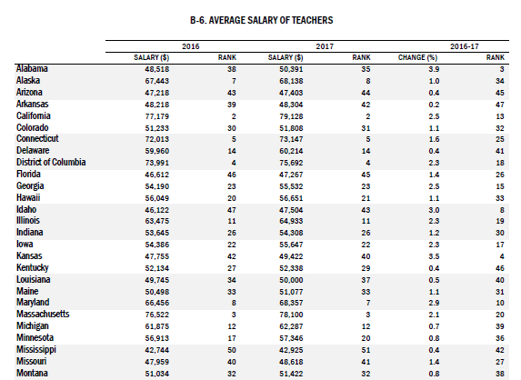

Slide 27
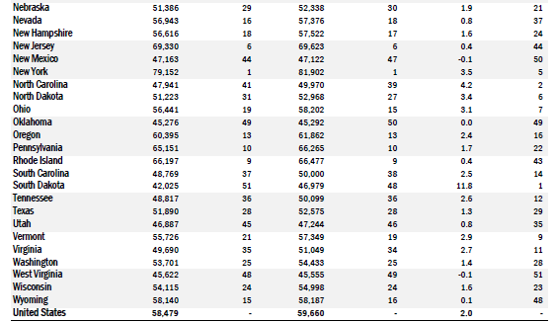

Slide 28
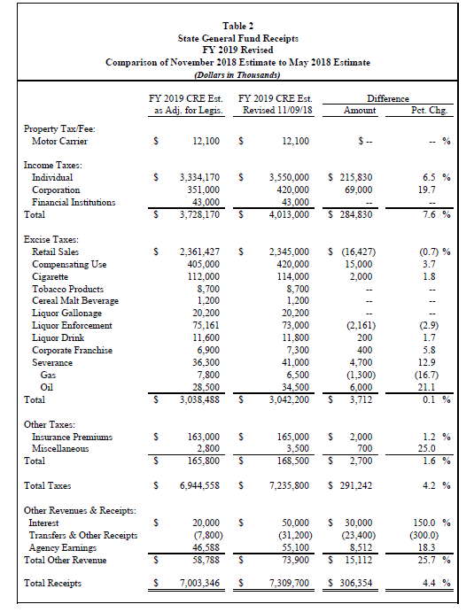

Slide 29
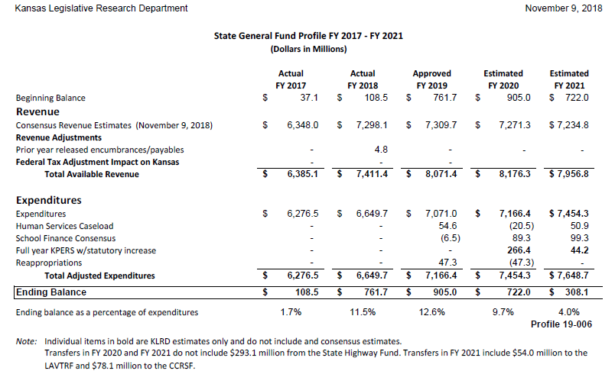

Slide 30
Notes:
Today’s students are the future workforce and future leaders of Kansas. Kansans Can achieve anything and, together, Kansans Can lead the world in the success of each student.

