Slide 1
2018 Safe Schools Conference
2018 Safe Schools Conference

Slide 2
Notes:
Today’s students are the future workforce and future leaders of Kansas. Kansans Can achieve anything and, together, Kansans Can lead the world in the success of each student.

Slide 4
Making Sure Every Child is Known
A middle school in Nevada uses a simple strategy to build deeper connections between teachers and students.

Slide 5
SOCIAL EMOTIONAL AND CHARACTER DEVELOPMENT MODEL STANDARDS
Adopted by the
Kansas State Board of Education
April 17, 2012
Revised July 2018
Notes:
The committee met three times as a committee of the whole and work groups met many times virtually.

Slide 6
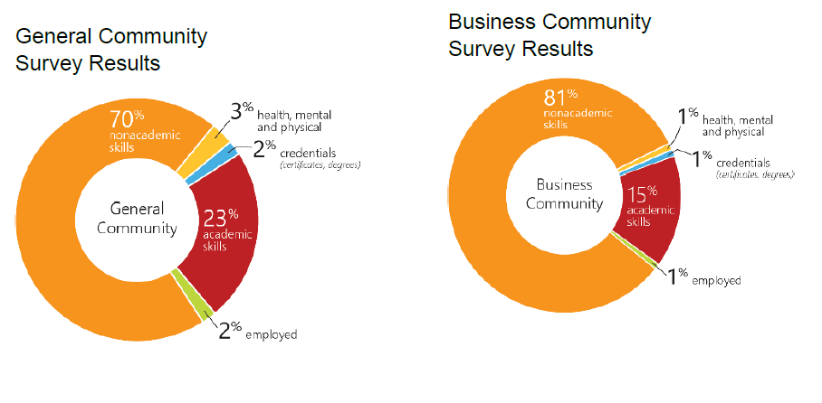
Community Conversations
Notes:
70% of the general community said non-academic skills; 81% of the business community said non-academic skills.

Slide 7
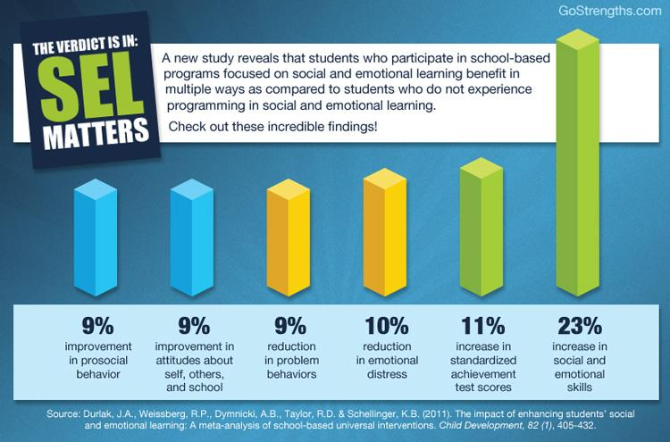
Notes:
Why SECD? Durlak et al. meta-analysis that further supports the need for social-emotional growth.

Slide 8
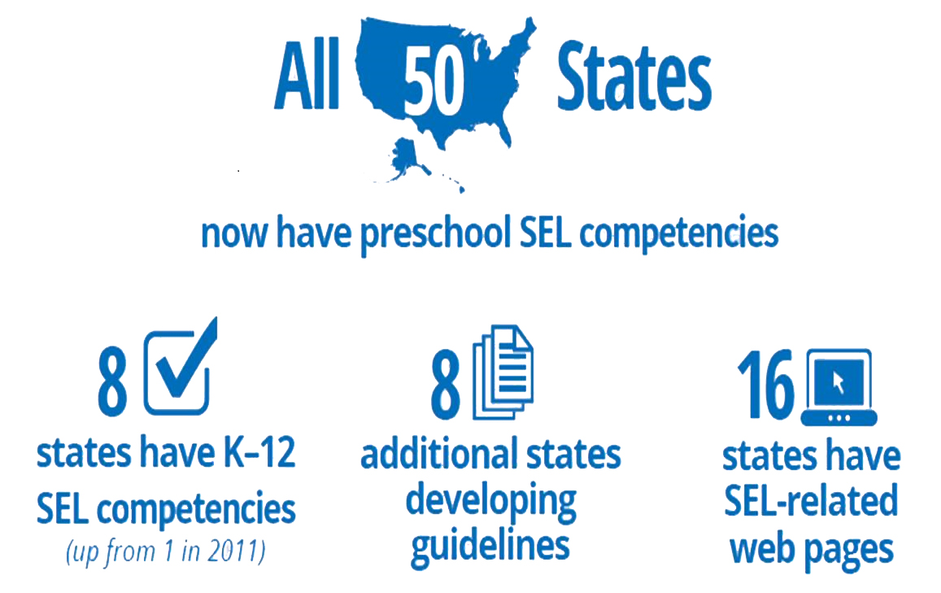
Source: 2017, Collaborating States Initiative, CASEL
Notes:
This slide reflects the national landscape for SEL/SECD; Kansas is a Collaborating State with CASEL and continues to be a national leader for SEL/SECD.

Slide 9
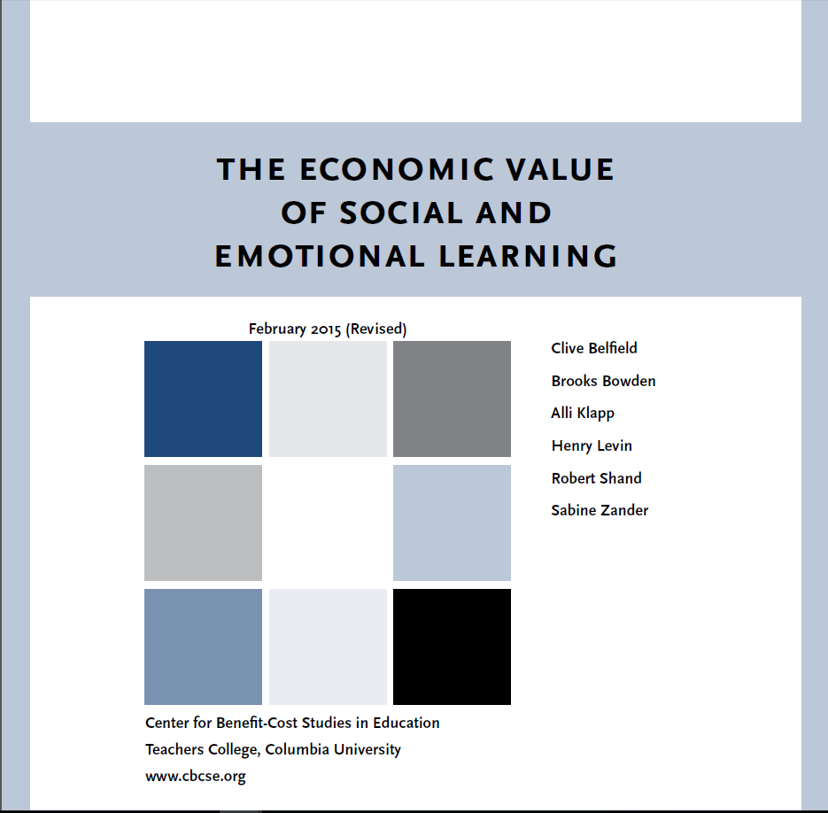
Notes:
The Economic Value of Social and Emotional Learning Clive Belfield, Brooks Bowden, Alli Klapp, Henry Levin, Robert Shand, and Sabine ZanderFebruary 2015 This report reveals, on average, that every dollar invested in SEL programming yields $11 in long-term benefits. These benefits include reduced juvenile crime, higher lifetime earnings, and better mental and physical health.

Slide 10
WHY FOCUS ON SOCIAL-EMOTIONAL GROWTH
Every $1 invested in Social Skills instruction = $___
in economic returns for the community.
$11
Source: Teachers College, Columbia University (2015)
Notes:
The economic value of SECD.

Slide 11
SECD STANDARDS
Kansas was the first state to adopt Social, Emotional and Character Development standards.
The standards were adopted in 2012.
2018 Revisions
Prevention statutes
Employability
School mental health
Civic engagement
First read for BOE will be in June
Notes:
Kansas was the first state to adopt Social, Emotional and Character Development standards. The standards were adopted in 2012 and have been a model for other states.
Research shows schools that incorporate social, emotional and character development have more student engagement, decreased suspensions and improved academic scores.

Slide 12
KANSAS SOCIAL, EMOTIONAL AND CHARACTER EDUCATION STANDARDS
Character Development
Core Principles
Responsible Decision Making and Problem Solving
Social Development
Social Awareness
Interpersonal Skills
Personal Development
Self -Awareness
Self-Management
Notes:
There are 3 standards 1) Character Development 2) Social Development and 3) Personal Development each with benchmarks and indicators. State statutes addressing SECD and mental health should be included in the Core Principles. The guidance includes encouraging schools to identify their own core principles based on their own needs.

Slide 13
STATE BOARD SOCIAL-EMOTIONAL GROWTH GOAL
Each student develops the social, emotional, and character competencies that promote learning and success in life.
Notes:
The State Board goal for social-emotional growth.

Slide 14
PURPOSE
Social, Emotional, and Character Development (SECD) Standards provide schools a framework for integrating social-emotional learning (SEL) with character development so that students will learn, practice and model essential personal life habits that contribute to academic, career, and personal success.
Notes:
The Purpose, Definition and Core Beliefs are examples of changes that the Revision Committee completed.

Slide 15
DEFINITION
SECD standards encompass practicing good citizenship as respectful, responsible, empathetic and ethical individuals, through making healthy decisions, practicing personal safety, understanding risk prevention, promoting a positive school culture, problem solving effectively, and valuing excellence.

Slide 16
CORE BELIEFS
SECD skills are teachable and measurable.
SECD skills are essential for academic achievement.
SECD skills are developed within a continuous growth process throughout life.
SECD skills are acquired by students through intentional, integrated efforts of the entire school, family and community.
SECD skills are best learned in a respectful, safe and civil school environment where adults are caring role models.

Slide 17
CHARACTER DEVELOPMENT
Definition:
Developing skills to help students identify, define and live in accordance with core principles that aid in effective problem solving and responsible decision making.
Rationale:
Our schools have the job of preparing students for citizenship in a global society. Success in school and life is built upon the ability to make responsible decisions, solve problems effectively, and to identify and demonstrate core principles.
Notes:
Each standard begins with an explanation of the definition and rationale.

Slide 18
SOCIAL, EMOTIONAL AND CHARACTER DEVELOPMENT STANDARDS
Notes:
Here is what the actual standard format looks like.

Slide 19
SUGGESTED EDITS/INCLUSION
Jason’s Law (youth suicide)
Erin’s Law (child sexual abuse)
KSA 72-8256 (bullying)
School Mental Health
Trauma-Informed/ACES
Self-Harm
Recovery and Resiliency
Growth Mindset
Civic Engagement
Ethical Use of Technology
Notes:
The Revision Committee considered these State Board initiatives as we proceeded with the revisions.

Slide 20
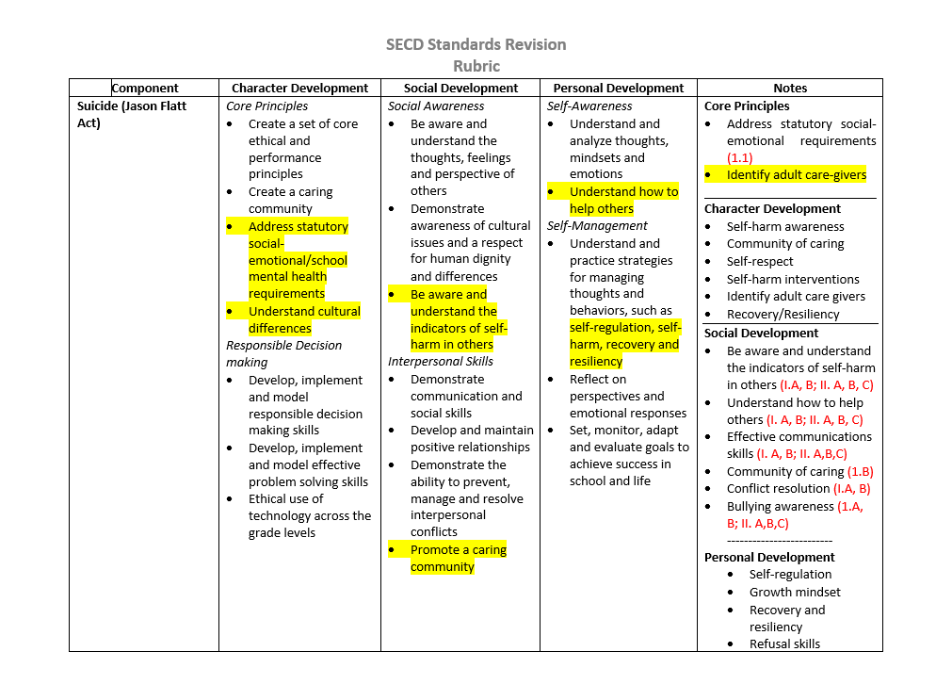
SECD STANDARDS REVIEW RUBRIC
Notes:
This is a crosswalk tool the committee used to ensure that the prevention statutes were addressed in the revisions.

Slide 21
CHARACTER DEVELOPMENT
Responsible Decision Making and Problem Solving
Develop, implement, and model responsible decision making skills.
Consider multiple factors in decision-making including ethical and safety factors, personal and community responsibilities, and short-term and long-term goals.
9-12 | Assess lessons learned from experiences and mistakes while demonstrating the ability to build resiliency. Implement responsible decision making skills when working towards a goal and assess how these skills lead to goal achievement. Utilize skills and habits of applying standards of behavior by asking questions about decisions that students or others make, are about to make, or have made. Evaluate situations that are safe or unsafe and how to avoid unsafe practices. Effectively analyze and evaluate evidence, arguments, claims, and beliefs. Students recognize consequences of sexual behavior, including sexual consent, pregnancy and the inability of minors to give consent.
Notes:
Example of changes in the Character Development strand. Changes were made to a., d., and f. was added.
Erin’s Legislation – Child Sexual Assault & Teen Dating Violence

Slide 22
STANDARDS USE
Framework for:
Needs assessment
Vetting for “best practices” curriculum and instruction
Evaluation
Verbiage for:
SIT Teams
IPS
IEP
Behavior plans
KESA
Notes:
Uses for the standards

Slide 23
PUBLIC COMMENTS
Feedback
KSDE conducted more than a dozen public comment sessions
Conferences (Kansans CAN, KCA etc.)
In-Services (i.e. USD 500, USD 233)
Superintendents Association
Webcasts
Service Center Workshops
Standards posted on-line and sent out over list serve
98% of more than 300 attendees Agreed or Strongly Agreed with the statements:
“The SECD Standards will be useful to me in my position”
“The SECD Standards will support positive change in the climate and culture (Conditions for Learning) of Kansas Schools.”
Notes:
Here is the data associated with feedback/public comments about the revisions.

Slide 24
PUBLIC COMMENTS
Most frequently stated concerns
“… help with implementing these standards.”
“… staff support.”

Slide 25
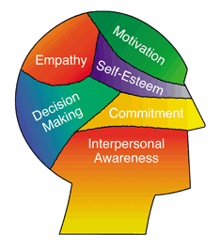
IMPLEMENTATION FOR SECD STANDARDS, CURRICULUM, INSTRUCTION AND EVALUATION
Notes:
Current practices for SECD.

Slide 26
SECD Classroom
Examples

Slide 27
I Wish My Teacher Knew by Kyle Schwartz
Teacher Writes Letter
Then Kids Write Letter
Think back to when were a kid the age that you teach what are the three things you would have liked them to know.
Identify the three things you wish your Principal/Superintendent or Fellow Teachers knew about you.

Slide 28
Curriculums Used In State
Second Step
Lion’s Quest
Capturing Kids Heart & Teen Leadership (Flippen Group)
Medal of Honor Character Development
Leader In Me
Ramped Up To Readiness
Jostens Renaissance
186 Days of Character

Slide 29
Brain Breaks
GoNoodle - https://www.gonoodle.com/
Brain Breaks – https://brain-breaks.com/
Brain Gym - http://braingym.org/
Conscious Discipline - https://consciousdiscipline.com/

Slide 30
INTEGRATION AND ALIGNMENT
FACS – Multiple Initiatives
ELA – Standards and Instruction
Math – Growth Mindset
Civic Engagement
Kansas Schools of Character Recognition Program
Anti-Bullying Awareness Week
Measuring Social-Emotional Growth Toolkit
CASEL’s Collaborative States Initiative
SECD Standards Revisions
Incorporated prevention statutes
Integration with content areas
ELA
Math and Growth Mindset
Employability (CTE)
Board Outcomes
IPS
Graduation
Post-Secondary
Career Development Cycle
Notes:
Here are the CSAS initiatives around social-emotional character development.

Slide 31
Notes:
What we learn early shapes our SECD development and crosses the life span; Seuss aligns with 1) personalized learning 2) Individual Plan of Study 3) Growth Mindset 4) self-regulation 5) self-awareness 6)

Slide 32
Career
Advising Model
KANSAS
Take Action
Make Choices
Know Yourself
Explore Options
Advisor Guide
Notes:
This is the guide that was developed for the “Building Hope Through the IPS” Roadshow. The SECD Standards and the Kansans Can! Competencies were integrated into the Career Advising Model. This initiative also aligned all three of the school counseling domains (Career, Academic, Social-Emotional) under one theme- career advising.

Slide 33
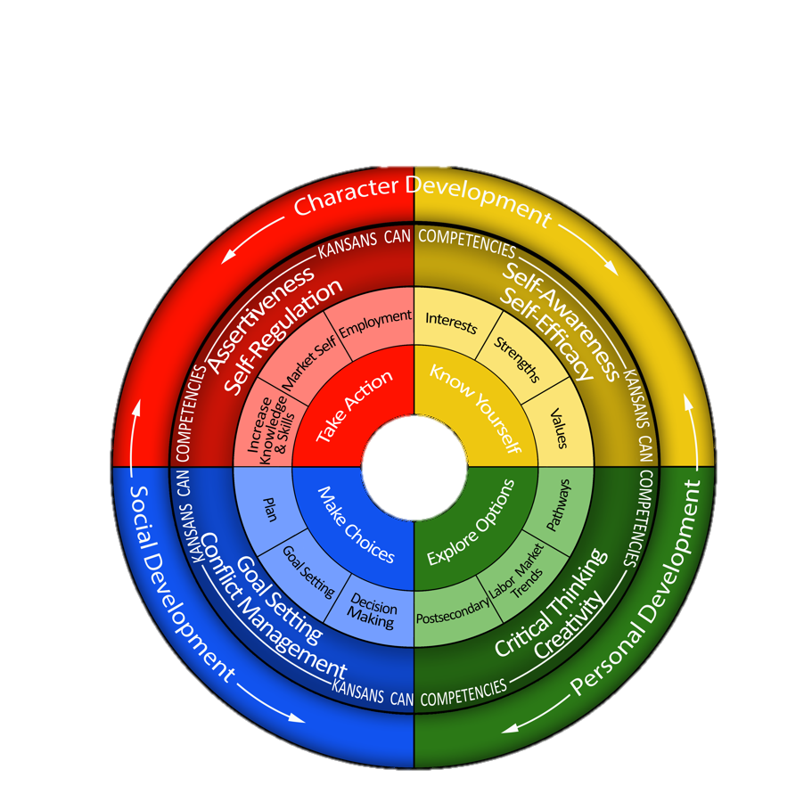
KANSAS CAREER DEVELOPMENT PROCESS
Notes:
This graphic reflects how SECD, the Kansans Can! Competencies and the Career Development Process align and intersect.
The IPS is both a process and a product that incorporates:
Career Development Cycle
Kansans Can Competencies
Social, Emotional and Character Development Standards
Employability Skills

Slide 34
Notes:
KH
The Kansans Can Competency Framework is another KSDE partnership that is producing strong results.
The Kansans Can Competency Framework is seamlessly aligned with KSDE efforts and integrates social-emotional growth into daily classroom instruction and throughout the school setting.
This is accomplished using our foundational SECD standards, structures currently supported through Kansas MTSS; tiered system of instruction/intervention, data-driven decision making, and effective collaboration.
And, the “why” in this graphic is aligned with each of the board outcomes.

Slide 35
Notes:
KU’s Research Collaboration Project Kansans Can Competency Framewrok).

Slide 36
Participating School Districts
Notes:
KH
This map illustrates where districts across the state are participating in the Kansans Can Competency Training.
The dark blue is school-wide implementation focus and the light blue is individual implementation focused.

Slide 37
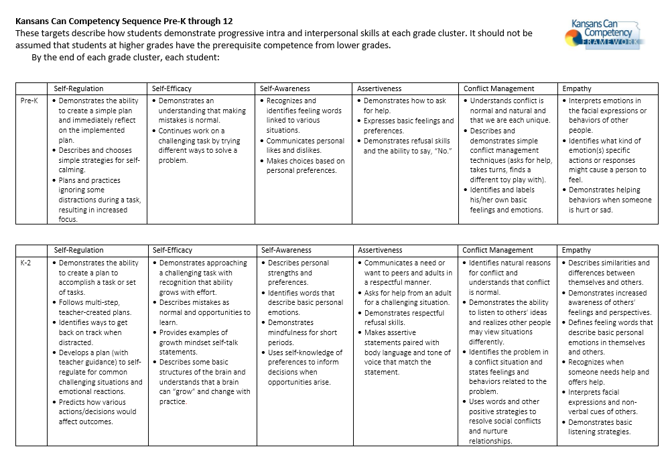

Slide 38
STATE WIDE SCHOOL MENTAL HEALTH INITIATIVES
Notes:
Current practices for SECD.

Slide 39
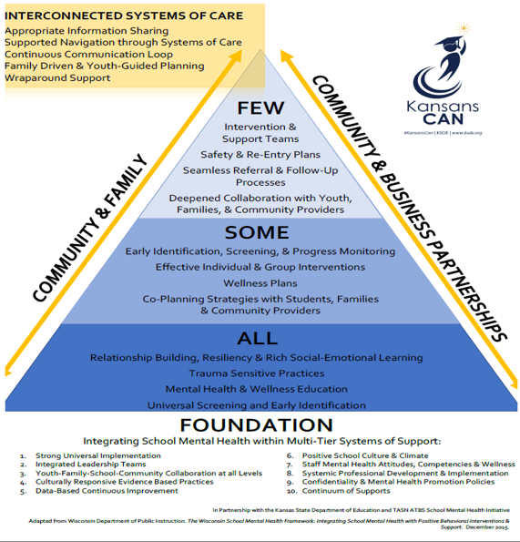
Notes:
School Mental Health Framework

Slide 40
Notes:
School Mental Health Advisory Council was formed July 2017, and began meeting in August 2017.
Purpose: The primary purpose of the school mental health advisory council is to advise the Kansas State Board of education on unmet needs in the area of school mental health and social-emotional character development
The Council coordinates with legislators and stakeholders to effectively address issues relevant to school mental health
And, the School Mental Health Advisory Council is to establish statewide partnerships with other child and family advocacy groups
Process: In terms of process, the school mental health advisory council meets monthly to review areas of need related to school mental health. Topics reviewed include:
- Legislation, statutes, and regulations
- State-level data
- District and school level practices
- State policy alignment
- Professional development/training
- Family support
Product: After assessing needs and considering options, the council makes coordinated recommendations to the State Board of Education regarding resources, training, and strategic/streamlined processes

Slide 41
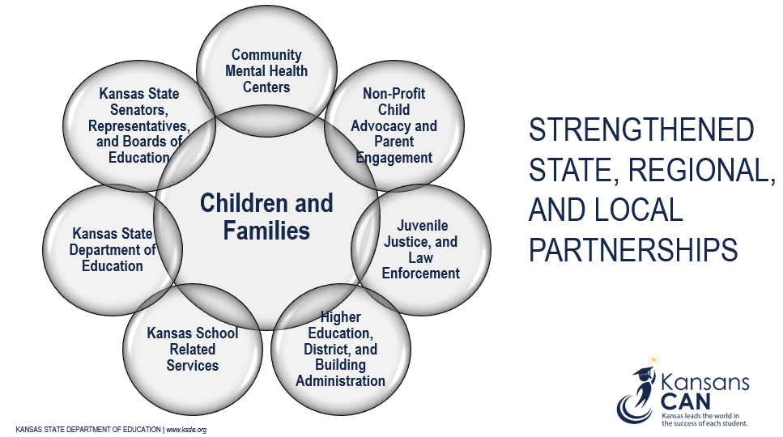
Notes:
It is clear that schools cannot address the mental health needs of students alone, and the need to forge State and Regional partnerships is essential.
Each of the groups depicted in this graphic has a seat at the table when the School Mental Health Advisory Council meets. The process is collaborative, everyone brings a unique perspective, and everyone has a voice.
And of course, at the heart of this collaborative process is the focus on supporting children and families.
School psychologists, counselors, social workers and nurses all have a seat at the table as well. Critical to the success of children and families is the collaboration and coordination of services between these three groups. These professionals have a unique role in understanding/connecting school system functioning, learning, mental health, and family systems.

Slide 42
Notes:
Another promising partnership on the horizon is the School Mental Health Professional Development and Coaching Initiative. This is a five-year process, and it is funded through a School Personnel Development Grant from the Department of Education. It aligns with goals of the School Mental Health Advisory Council, and will be coordinated with the Technical Assistance System Network.
KSDE-TASN will partner with approximately 15 districts from 5 communities (2 large and 3 small)
Focus will be on building school capacity to meet the SMH needs of students.
Developing and implementing evidenced-based mental health interventions in a tiered system of support.
Creating school/community cross systems of support to address school mental health needs.
Developing resources and systems that can be replicated across the State of Kansas.

Slide 43
Mental Health Intervention Treatment Program (MHIT)
Pilot program funded by the Kansas Legislature
Creates partnerships between targeted districts and Community Mental Health Centers (CMHC)
Participating Districts: Wichita #259, Topeka #501, Kansas City #500, Parsons #503, Abilene #435, and Garden City #457
GOAL: Provide treatment and track the behavioral health needs of two groups of youth
Children in Need of Care (CINC) and in state custody
Children who are not in state custody, but display a need for behavioral health treatment outside the normal school day

Slide 44
Child Sexual Abuse
Not In Room 204 – Shannon Riggs
No More Secrets For Me – Oralee Wachter
Mia’s Secret
Safer, Smarter Kids
Safer, Smarter Teens: Personal Power
Safer, Smarter Teens: Be the Change - https://safersmarterkids.org/teachers/curriculum/

Slide 46
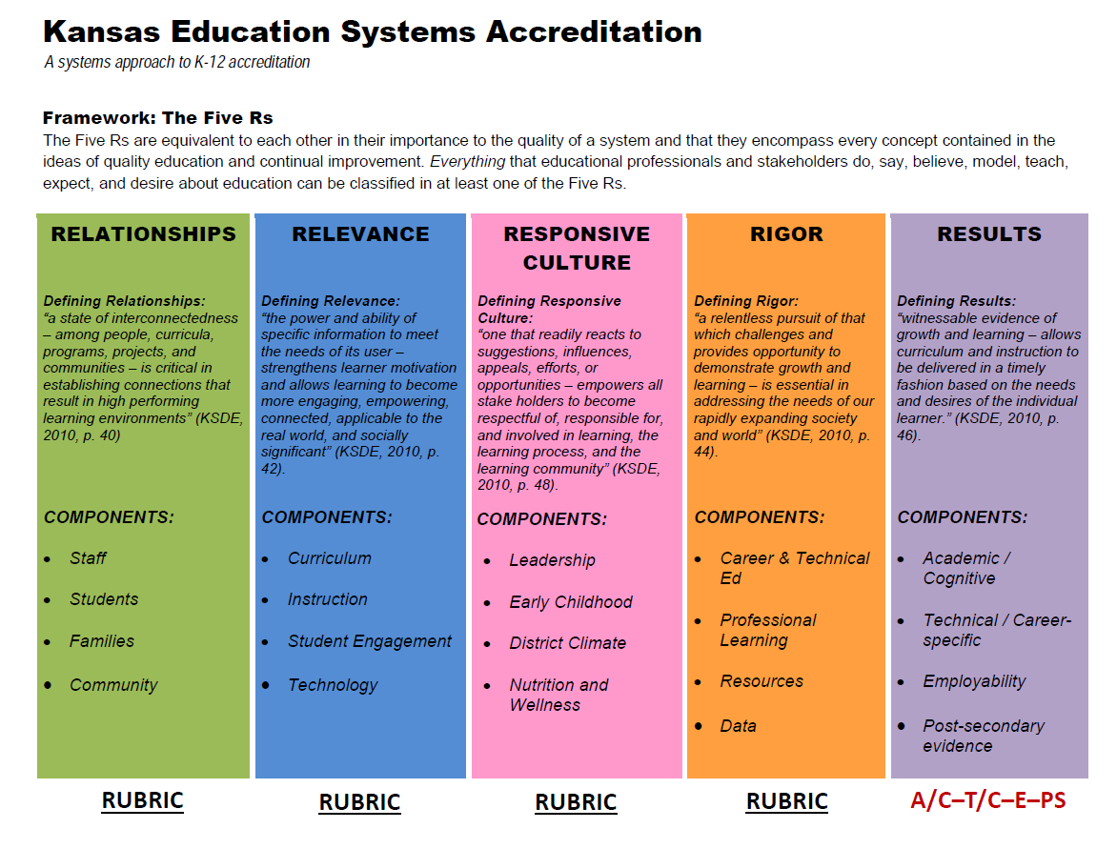
KESA
Notes:
Current practices for SECD.

Slide 47
KESA Social-Emotional Questions
9.1 There is evidence the system has collected and utilized data to determine resource and assessment needs.
9.2 There is evidence that social-emotional character development (SECD) standards are imbedded and aligned within K – 12 content area curriculum.
9.3 There is evidence that the system has adopted, or locally developed, an evidence-based program(s) for social-emotional growth at all grade levels.
9.4 There is evidence that social-emotional growth is being measured and is incorporated in the system’s overall assessment protocol.
9.5 There is evidence that local social-emotional growth data is analyzed and considered in the system/school improvement process.
Notes:
The 5 draft KESA social-emotional questions.

Slide 48
Indicators
Attitude and behavior (perception data; KAN-DIS)
School-based mental health (referral data)
Attendance and program completion (KIDS data)
Volunteerism/service learning (number of students involved)
Bullying prevention (bullying data collected)
Climate/student management (KAN-DIS)
Character development (perception data)
Prevention data (prevention curriculum outcome data)
Notes:
So how do you measure social, emotional growth?
First of all, the Kansas State Board of Education believes this is something to be measured locally.
There are several indicators already in play. Chancers are good you’re already addressing many of these indicators:
Attitude and behavior (perception data; KAN-DIS)
Attendance and program completion (KIDS data)
Bullying prevention (bullying data collected)
Character development (perception data)
School-based mental health (referral data)
Volunteerism/service learning (number of students involved)
Climate/student management (KAN-DIS)
Prevention data (prevention curriculum outcome data)
DISCUSSION
What questions do you have as a district that you need answered?
What would this look like in your school?
What ideas do you have for implementing?

Slide 49
Notes:
Refer later in presentation to SECD Formative Assessment.

Slide 50
Notes:
20 Minutes for Activity
Cover Letter & Interview
Handout – Sample Interview Questions - Made and in the Folder
Handout – Want Ad – Use Local Paper
Workshop Activity
Step 1 - Choose 10 Personal Competencies you think you possess. Then narrow the list to 5 that you think are your Strengths. Think of and list concrete examples of when you have demonstrated theses competencies for 3 of your 5 strongest. Write a paragraph about each of the 3 competencies, be specific in your description of what you did and how it demonstrated that competency.
Step 2 – Choose 5 Personal Competencies you think are areas of Weakness for you. Think of and list concrete examples for 2 of the 5 on how you are trying to improve those areas. Write a paragraph about each of the 2, be specific in your description of what you have done and how you have improved in that area.
Classroom Activity -
Step 1 - Choose 10 Personal Competencies you think you possess. Then narrow the list to 5 that you think are your Strengths. Think of and list concrete examples of when you have demonstrated theses competencies for 3 of your 5 strongest. Write a paragraph about each of the 3 competencies, be specific in your description of what you did and how it demonstrated that competency.
Step 2 – Choose 5 Personal Competencies you think are areas of Weakness for you. Think of and list concrete examples for 2 of the 5 on how you are trying to improve those areas. Write a paragraph about each of the 2, be specific in your description of what you have done and how you have improved in that area.
Step 3 – Based on a Want Add for a Job determine your Opportunities and Threats for success in that position. Determine if you should apply for the job based upon your analysis of Opportunities and Threats, as well as looking at your Strengths and Weaknesses and how they relate to the position.
Step 4 – If you decide to apply for the job, identify what Threats would keep you from getting the job. (For example – not preparing for the interview, not researching the company, not spell checking your resume or cover letter, not wearing appropriate attire.)
Step 5 – Write a cover letter for the position using the 3 Strengths paragraphs and the Opportunities you have identified.
Step 6 – Prepare for an interview for this job, reviewing 3 Strengths paragraphs, 2 Weaknesses paragraphs and the Opportunities and Threats identified.
Step 7 – Be interviewed.

Slide 51
ACT and WorkKeys Initiative
Both will be available, at no charge. Writing is optional.
USD’s will be responsible for administration.
TEST records will be required to participate.
Only students with TEST records will be allowed to participate on designated date.
KSDE will not fund student tests without a TEST record.
Accommodations and procedures must be ACT approved.

Slide 52
ACT and WorkKeys Initiative (cont’d.)
All state paid tests will be administered on same date
Mid-February (dates will be announced after contract is signed)
ACT- Day 1 morning
ACT writing- Day 1 afternoon
WorkKeys- Day 2
USD’s choose between paper/pencil or on/line computer.
ACT will provide all administrative training (i.e. Annual Conference).
USD’s will print their own WorkKeys National Career Readiness Certificates.

Slide 53
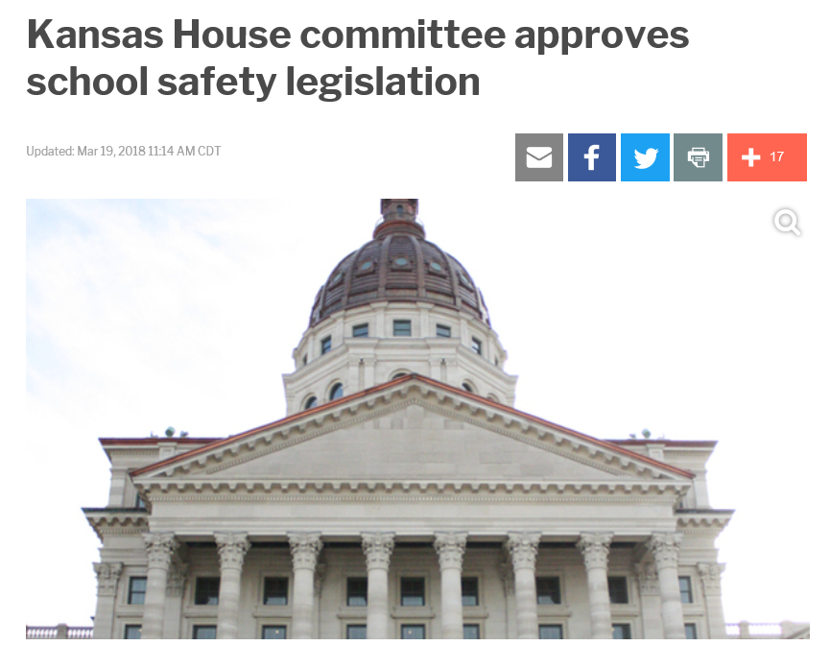
Notes:
HB 2773 (Ks. Safe and Secure Schools Act) would fund the Ks. Center for Safe and Prepared Schools, the Safe Schools Conference and provide $5 in aid to schools for school safety.

Slide 54
Kansas Safe and Secure Schools Act
Requires USD’s to adopt safety plans based on state standards (Emergency Operations Plans).
$5 million grant program for infrastructure and training
Provides for 2 KSDE “Safety Specialists” positions
The Safe Schools Conference will return.
Sept. 24-25
Hyatt in Wichita

Slide 56
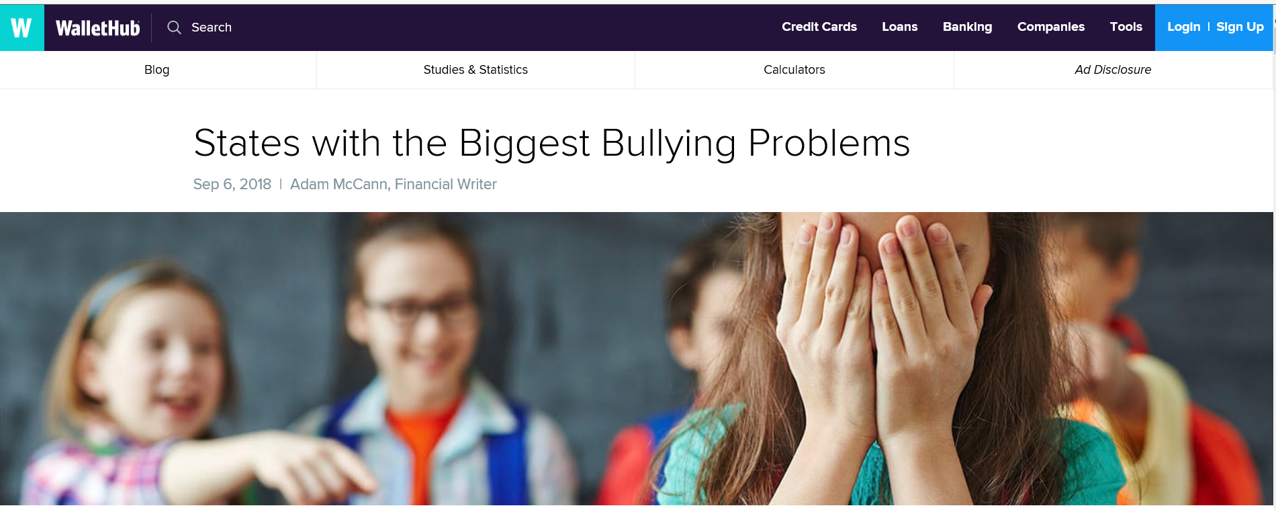

Slide 57
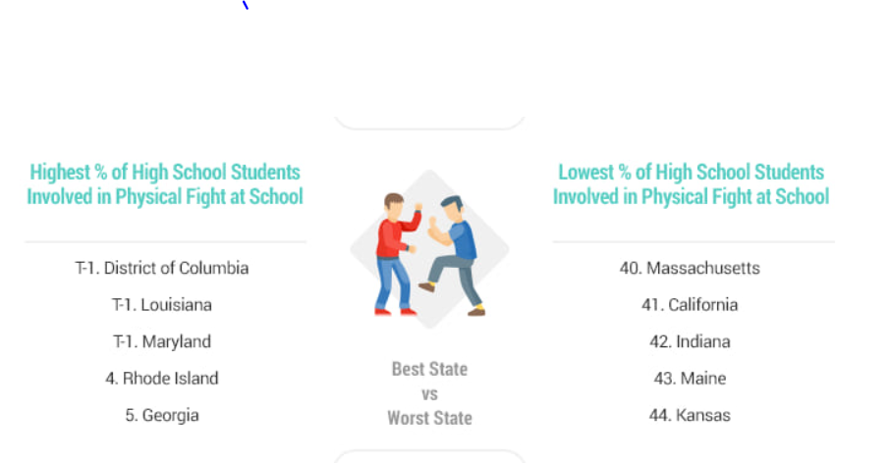

Slide 58
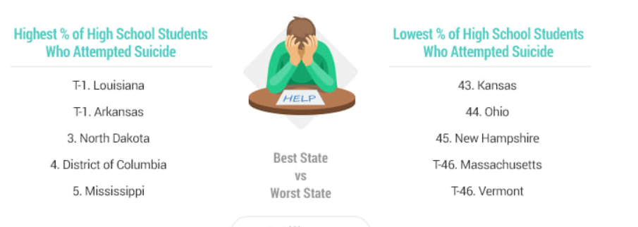

Slide 59
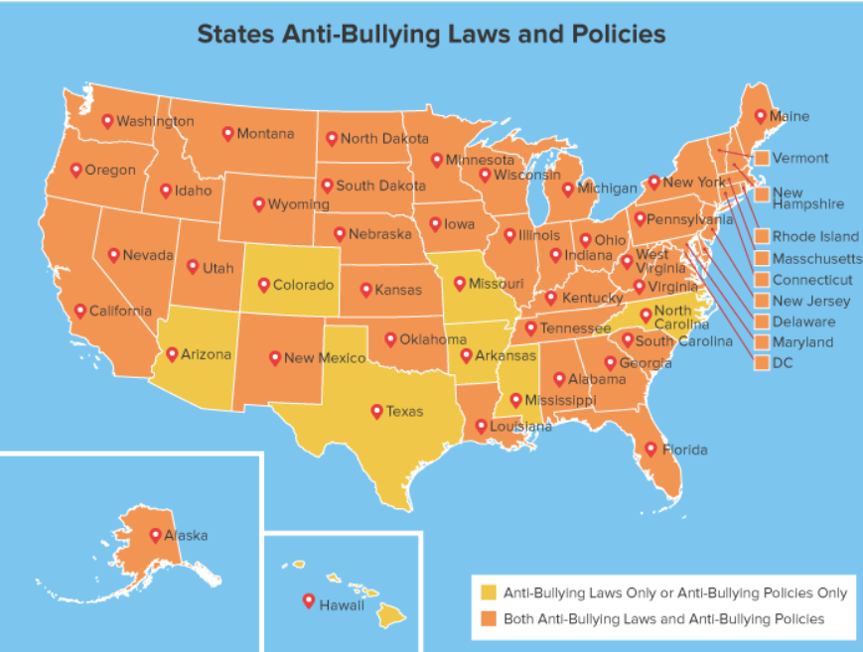

Slide 60
Notes:
The Hotline came about after Columbine, it is a direct link to the KHP State headquarters; calls are vetted and referred immediately to local Sheriff’s Offices. It has been credited for preventing possible gun violence situations at Kansas schools.

Slide 61
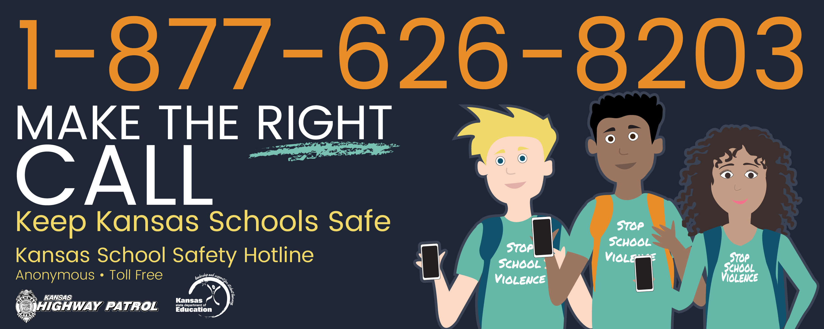

Slide 62
The Champion
Carrie Underwood
&
Ludacris
Notes:
Video – YouTube – 5 Keys To Social and Emotional Learning Success
https://www.youtube.com/watch?v=DqNn9qWoO1M

Slide 64
THANK YOU FOR YOUR LEADERSHIP AND SUPPORT
Kent Reed Noalee McDonald-Augustine KSDE SECD Committee Co-Chair
kreed@ksde.org Smoky Hill ESC
nmcdonald@smokyhill.org
Jodi Grover Susan Johnson
SECD Committee Member SECD Committee Member
ESSDACK ESC Greenbush ESC
jodigrover@essdack.org susanjohnsonconsulting@gmail.com
Notes:
Questions?

