Slide 1
Kansas Leads the World in the Success of Each Student.
Dr. Randy Watson, Kansas Commissioner of Education

Slide 2
A NEW Vision for Kansas ...
Kansas leads the world in the success of each student
KANSAS STATE DEPARTMENT OF EDUCATION | www.ksde.org

Slide 3
Time to Redesign Schools!
WHAT SKILLS DO BUSINESS & INDUSTRY SAY ARE LACKING IN HIGH SCHOOL, TWO-YEAR and FOUR-YEAR COLLEGE PROGRAM GRADUATES?

Slide 4
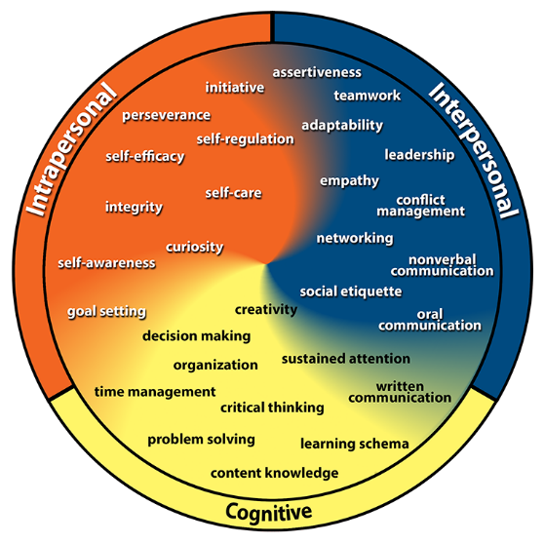
Gaumer Erickson, A.S., Soukup, J.H., & Noonan, P. (2013). College & Career Competency Wheel. Lawrence, KS: University of Kansas, Center for Research on Learning. Derived in part from Pellegrino, J.W., & Hilton, M.L. (Eds.). (2012). Education for Life and Work: Developing Transferable Knowledge and Skills in the 21st Century. Washington, DC: National Academies Press.

Slide 5
Time to Redesign Schools!
BUSINESSES NEED
STUDENTS NEED
SKILLED TALENT
Employability skills
executives:
SKILLED TRADE WORKERS:
89%
#1
of all first-time
hires who lose their job do so
because of a lack of employability skills
hardest jobs to fill

Slide 6
HIGH SCHOOL GRADUATES LACKING…
Professionalism/Work Ethic . . . . . . . . . 80.3%
Teamwork/Collaboration . . . . . . . . . . . 75.7%
Verbal Communication. . . . . . . . . . . . . 70.8%
Ethics/Social Responsibility. . . . . . . . . . 63.4%
Critical Thinking/Problem Solving. . . . . 57.5%
Information Technology Applications. 53.0%
Written Communication. . . . . . . . . . . . 52.7%
Diversity. . . . . . . . . . . . . . . . . . . . . . . . 52.1%
Lifelong Learning/Self-Direction. . . . … 42.5%
Creativity/Innovation. . . . . . . . . . . . . . . 36.3%
Consolidated Survey of Corporate America

Slide 7
TWO YEAR COLLEGE GRADUATES LACKING…
Professionalism/Work Ethic. . . . . . . . . . . 83.4%
Teamwork/Collaboration. . . . . . . . . . . . 82.7%
Verbal Communication. . . . . . . . . . . . . 82.0%
Critical Thinking/Problem Solving. . . . . . 72.2%
Written Communication. . . . . . . . . . . . . 71.5%
Ethics/Social Responsibility. . . . . . . . . . . 70.6%
Information Technology Applications. . 68.6%
Lifelong Learning/Self-Direction. . . . . . . 58.3%
Diversity. . . . . . . . . . . . . . . . . . . . . . . . . 56.9%
Creativity/Innovation. . . . . . . . . . . . . . . 45.5%
Consolidated Survey of Corporate America

Slide 8
FOUR YEAR COLLEGE GRADUATES LACKING…
Verbal Communication. . . . . . . . . . . . . 95.4%
Teamwork/Collaboration. . . . . . . . . . . . 94.4%
Professionalism/Work Ethic. . . . . . . . . . . 93.8%
Written Communication. . . . . . . . . . . . . 93.1%
Critical Thinking/Problem Solving. . . . . 92.1%
Ethics/Social Responsibility. . . . . . . . . . 85.6%
Leadership . . . . . . . . . . . . . . . . . . . . . . . 81.8%
Information Technology Applications. 81.0%
Creativity/Innovation. . . . . . . . . . . . . . . 81.0%
Lifelong Learning/Self-Direction. . . . . . 78.3%
Consolidated Survey of Corporate America

Slide 9
Time to Redesign Schools!
The most important skills are the hardest to teach -
until now.

Slide 12
Kansas School Redesign Principles
Student Success Skills | Family, Business, and Community Partnerships
There is an integrated approach to develop student social-emotional learning. | Partnerships are based on mutually beneficial relationships and collaboration.
Personalized Learning | Real World Application
Teachers support students to have choice over their time, place, pace and path. | Project-based learning, internships, and civic engagement makes learning relevant.

Slide 13
Do the best you can until you know better. Then when you know better, do better. – Maya Angelou

Slide 14
Notes:
Today’s students are the future workforce and future leaders of Kansas. Kansans Can achieve anything and, together, Kansans Can lead the world in the success of each student.

