Slide 1
What can School Boards do to Ensure Student Success?
Dr. Randy Watson, Kansas Commissioner of Education

Slide 2
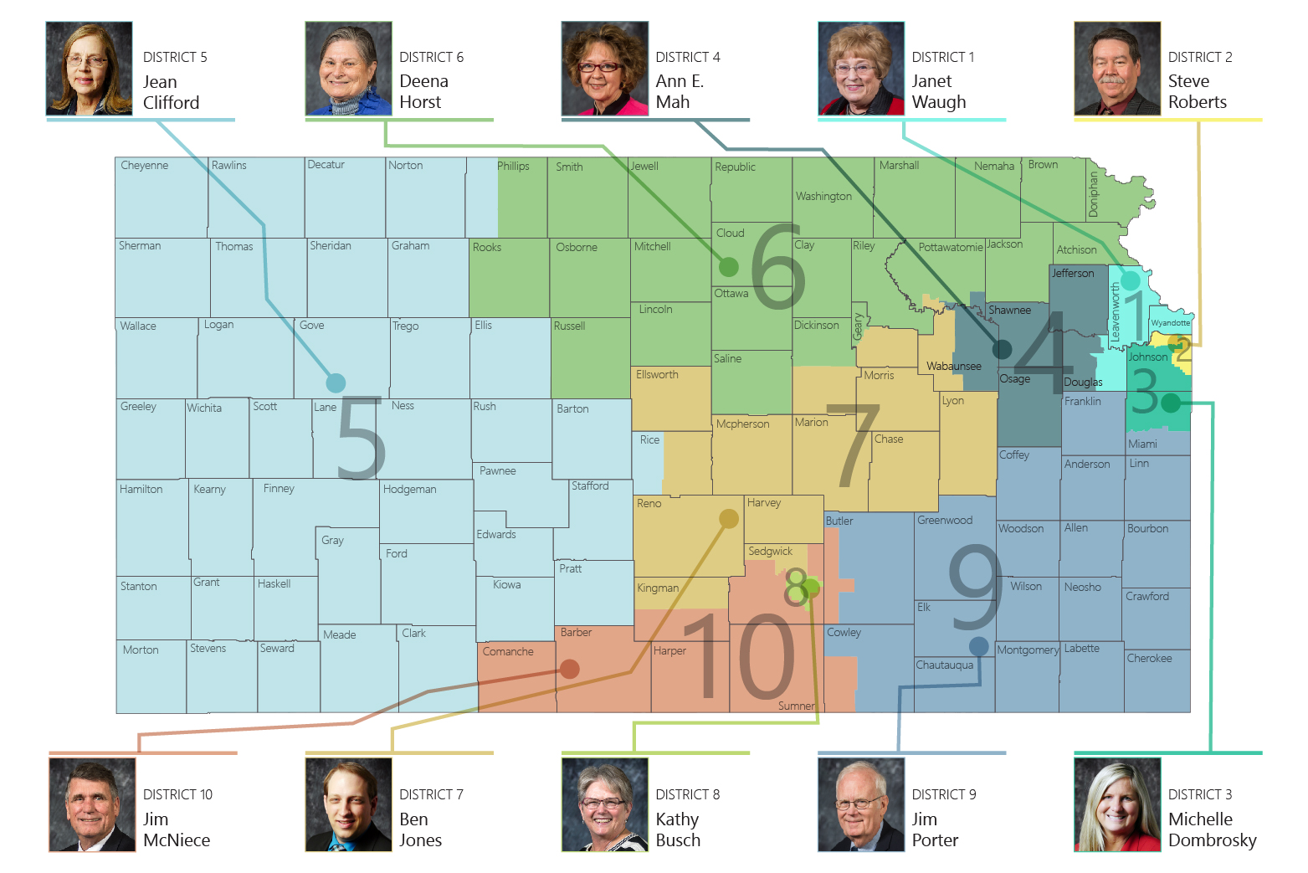

Slide 3
Our Vision for Kansas ...
Kansas leads the world in the success of each student
Notes:
Our business cards will stand out as innovative and memorable with a vertical or portrait orientation. Bonus it has a back side!
a portrait or vertical design. It’s also two-sided!
Another fundamental change you may notice (if not you will after I tell you) is that the main address for our agency has been simplified to the main desk in Suite 102. As all our mail is sorted in the print shop having everything labeled by a different team name and suite only made sense to us as we're used to it. It is less confusing and complex for those we serve.

Slide 4
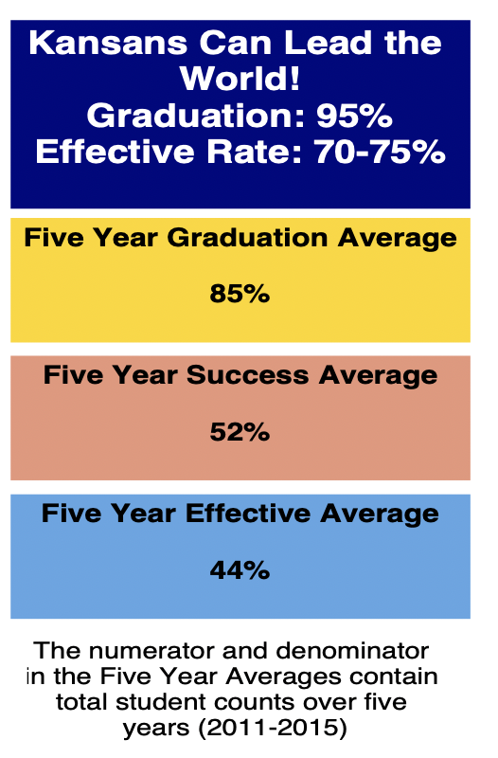
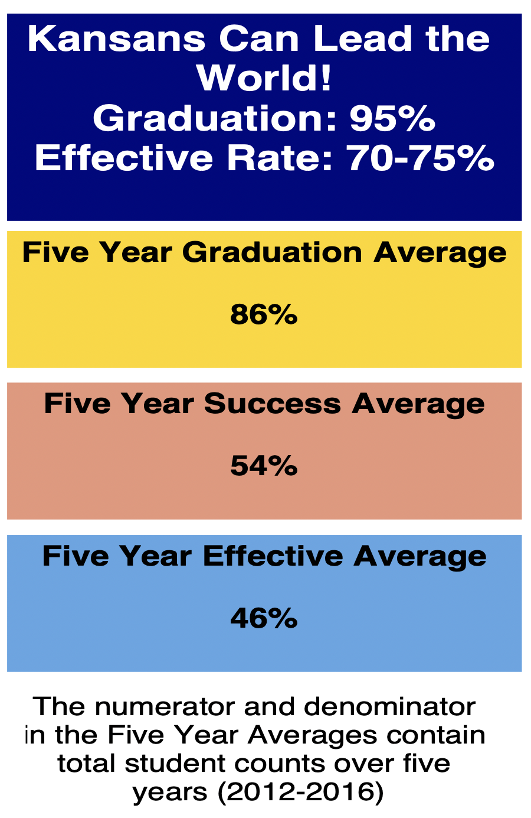
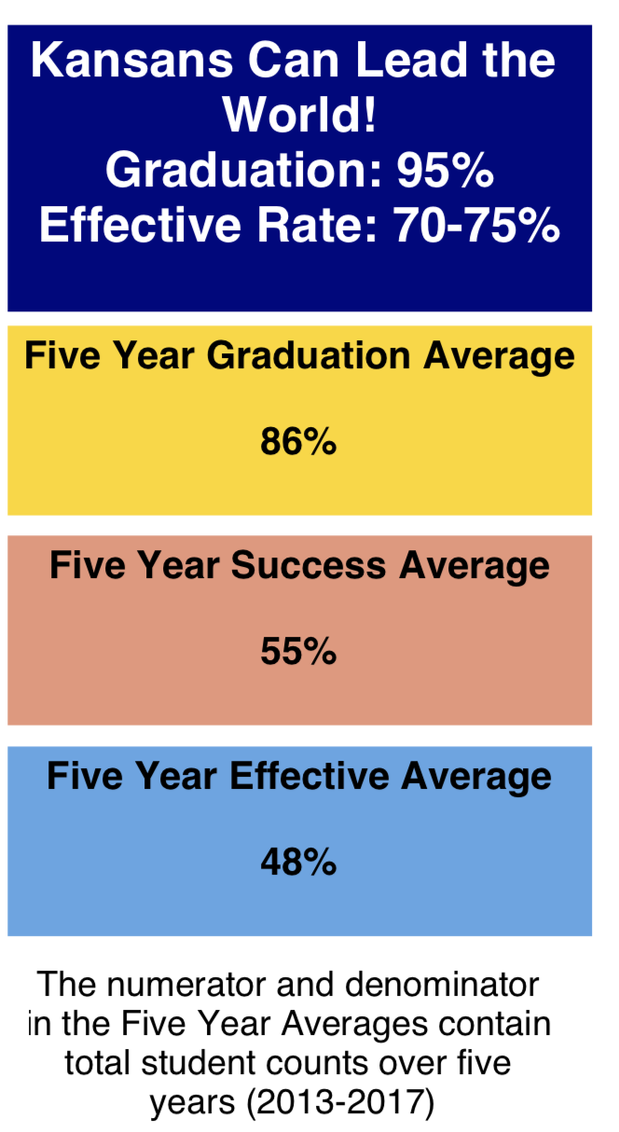
Notes:
Our business cards will stand out as innovative and memorable with a vertical or portrait orientation. Bonus it has a back side!
a portrait or vertical design. It’s also two-sided!
Another fundamental change you may notice (if not you will after I tell you) is that the main address for our agency has been simplified to the main desk in Suite 102. As all our mail is sorted in the print shop having everything labeled by a different team name and suite only made sense to us as we're used to it. It is less confusing and complex for those we serve.

Slide 5
From the first set of focus group responses, what characteristics of success were most frequently cited?
Notes:
This result is a little surprising since about 66% of the respondents were educators, education administrators, or former educators—people who mostly teach, or used to teach, academic skills. Nevertheless, the soft skills—social-emotional, personality skills, or 21st century skills—they have lots of names—were cited 70% of the time.

Slide 6
The business and industry focal groups cited non-academic skills with greater frequency than the community groups:
Notes:
Recall that the community groups cited non-academic skills 70% of the time and academic skills 23% of the time. These frequencies are remarkably similar to those expressed by the community groups. If volume can be equated with importance, the business and industry groups are saying that the non-academic characteristics are more important than academic skills, including applied skills, and that non-academic skills are at least as important to them as to the community groups, maybe more so.
One cited experience as a characteristic of the ideally prepared 24 year old (the tiny yellow line).

Slide 7
What themes made up the strategic activities?
human capital
Less frequently cited strategies:
Family engagement items complemented the career planning items, but the partnership between schools and families started early—birth through preK in some items. Some advocate joint planning for the child’s future, and others, opportunities for family participation and family education.
School climate activities were diverse and sometimes conflicting. Some advocate creating an environment of high expectations, while others recommend realistic expectations, or a positive supportive culture.
Career planning items called for individual goals and planning, of classes, pathways, further education, transitions, and careers. Some items included the family in the planning. When career planning should begin—middle school? 8th grade?--wasn’t clear.
teaching techniques
Project-based learning items emphasize the learning and demonstration of applied skills, sometimes in contrast to standardized curricula and assessments. Some suggest projects as part of community service, a qualification for graduation, or a better way to teach or measure personality skills.
Community collaboration items emphasized mutual obligations between students and the community and better social networking. Some advocate student community service, sometimes as a requirement; others, partnerships with local businesses and social agencies, especially early childhood agencies.
Individualized instruction and experience varied in intensity, from career interest diagnostics to universally required individual plans that the student must personally defend. The timing varied from beginning in Kindergarten, to middle school, to 8th grade.
Real-world instruction items advocate for concrete, real-life, relevant problems to solve, sometimes including their social dimensions. Some suggest integrating academics with applied skills, to improve motivation. Timing? As early as preK.
Early childhood strategies include strengthening the foundations of language and social skills at this sensitive stage, and the early establishment of parental collaboration.
accountability
extracurricular activities
college collaboration
funding
prevention
Notes:
About the less frequently cited strategies:
Teaching techniques as strategies included integrated, collaborative teaching; teacher as facilitator; engaging students; teaching teachers how to teach soft skills, among others.
Investments in human capital suggested increasing the number of counselors (which fits with the suggestion for more individual career planning), and more professional development for elementary math teachers.
The more striking suggestions in the accountability recommendations included more autonomy for teachers, aiming to meet the Rose Standards, linking drivers’ licenses to graduation, and allowing for greater individual differences in student development.
College collaboration and extracurricular activities were relatively few, which is surprising with the larger initiatives to prepare students to be college and career ready, and the ideal of teaching more social-emotional skills.

Slide 8
WHAT SKILLS DO BUSINESS & INDUSTRY SAY ARE LACKING IN HIGH SCHOOL, TWO-YEAR and FOUR-YEAR COLLEGE PROGRAM GRADUATES?
Notes:
Our business cards will stand out as innovative and memorable with a vertical or portrait orientation. Bonus it has a back side!
a portrait or vertical design. It’s also two-sided!
Another fundamental change you may notice (if not you will after I tell you) is that the main address for our agency has been simplified to the main desk in Suite 102. As all our mail is sorted in the print shop having everything labeled by a different team name and suite only made sense to us as we're used to it. It is less confusing and complex for those we serve.

Slide 9
HIGH SCHOOL GRADUATES LACKING
Professionalism/Work Ethic . . . . . . . . . 80.3%
Teamwork/Collaboration . . . . . . . . . . . 75.7%
Verbal Communication. . . . . . . . . . . . . 70.8%
Ethics/Social Responsibility. . . . . . . . . . 63.4%
Critical Thinking/Problem Solving. . . . . 57.5%
Information Technology Applications 53.0%
Written Communication. . . . . . . . . . . . 52.7%
Diversity. . . . . . . . . . . . . . . . . . . . . . . . 52.1%
Lifelong Learning/Self-Direction. . . . … 42.5%
Creativity/Innovation. . . . . . . . . . . . . . . 36.3%
Consolidated Survey of Corporate America
Notes:
Our business cards will stand out as innovative and memorable with a vertical or portrait orientation. Bonus it has a back side!
a portrait or vertical design. It’s also two-sided!
Another fundamental change you may notice (if not you will after I tell you) is that the main address for our agency has been simplified to the main desk in Suite 102. As all our mail is sorted in the print shop having everything labeled by a different team name and suite only made sense to us as we're used to it. It is less confusing and complex for those we serve.

Slide 10
TWO YEAR COLLEGE GRADUATES LACKING…
Professionalism/Work Ethic. . . . . . . . . . . 83.4%
Teamwork/Collaboration. . . . . . . . . . . . 82.7%
Verbal Communication. . . . . . . . . . . . . 82.0%
Critical Thinking/Problem Solving. . . . . . 72.2%
Written Communication. . . . . . . . . . . . . 71.5%
Ethics/Social Responsibility. . . . . . . . . . . 70.6%
Information Technology Applications. . 68.6%
Lifelong Learning/Self-Direction. . . . . . . 58.3%
Diversity. . . . . . . . . . . . . . . . . . . . . . . . . 56.9%
Creativity/Innovation. . . . . . . . . . . . . . . 45.5%
Consolidated Survey of Corporate America
Notes:
Our business cards will stand out as innovative and memorable with a vertical or portrait orientation. Bonus it has a back side!
a portrait or vertical design. It’s also two-sided!
Another fundamental change you may notice (if not you will after I tell you) is that the main address for our agency has been simplified to the main desk in Suite 102. As all our mail is sorted in the print shop having everything labeled by a different team name and suite only made sense to us as we're used to it. It is less confusing and complex for those we serve.

Slide 11
FOUR YEAR COLLEGE GRADUATES LACKING…
Verbal Communication. . . . . . . . . . . . . 95.4%
Teamwork/Collaboration. . . . . . . . . . . . 94.4%
Professionalism/Work Ethic. . . . . . . . . . . 93.8%
Written Communication. . . . . . . . . . . . . 93.1%
Critical Thinking/Problem Solving. . . . . 92.1%
Ethics/Social Responsibility. . . . . . . . . . 85.6%
Leadership . . . . . . . . . . . . . . . . . . . . . . . 81.8%
Information Technology Applications. 81.0%
Creativity/Innovation. . . . . . . . . . . . . . . 81.0%
Lifelong Learning/Self-Direction. . . . . . 78.3%
Consolidated Survey of Corporate America
Notes:
Our business cards will stand out as innovative and memorable with a vertical or portrait orientation. Bonus it has a back side!
a portrait or vertical design. It’s also two-sided!
Another fundamental change you may notice (if not you will after I tell you) is that the main address for our agency has been simplified to the main desk in Suite 102. As all our mail is sorted in the print shop having everything labeled by a different team name and suite only made sense to us as we're used to it. It is less confusing and complex for those we serve.

Slide 12
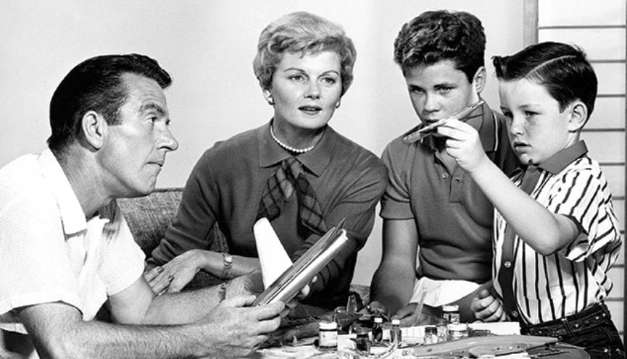
Notes:
Our business cards will stand out as innovative and memorable with a vertical or portrait orientation. Bonus it has a back side!
a portrait or vertical design. It’s also two-sided!
Another fundamental change you may notice (if not you will after I tell you) is that the main address for our agency has been simplified to the main desk in Suite 102. As all our mail is sorted in the print shop having everything labeled by a different team name and suite only made sense to us as we're used to it. It is less confusing and complex for those we serve.

Slide 13
Notes:
Our business cards will stand out as innovative and memorable with a vertical or portrait orientation. Bonus it has a back side!
a portrait or vertical design. It’s also two-sided!
Another fundamental change you may notice (if not you will after I tell you) is that the main address for our agency has been simplified to the main desk in Suite 102. As all our mail is sorted in the print shop having everything labeled by a different team name and suite only made sense to us as we're used to it. It is less confusing and complex for those we serve.

Slide 14
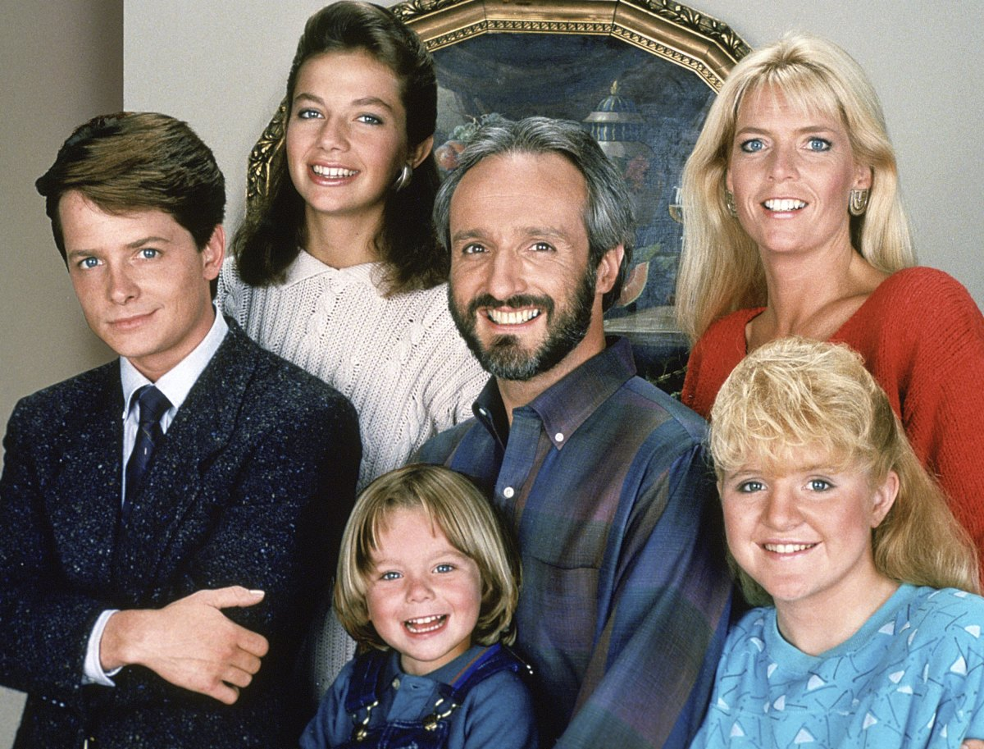
Notes:
Our business cards will stand out as innovative and memorable with a vertical or portrait orientation. Bonus it has a back side!
a portrait or vertical design. It’s also two-sided!
Another fundamental change you may notice (if not you will after I tell you) is that the main address for our agency has been simplified to the main desk in Suite 102. As all our mail is sorted in the print shop having everything labeled by a different team name and suite only made sense to us as we're used to it. It is less confusing and complex for those we serve.

Slide 15
Notes:
Our business cards will stand out as innovative and memorable with a vertical or portrait orientation. Bonus it has a back side!
a portrait or vertical design. It’s also two-sided!
Another fundamental change you may notice (if not you will after I tell you) is that the main address for our agency has been simplified to the main desk in Suite 102. As all our mail is sorted in the print shop having everything labeled by a different team name and suite only made sense to us as we're used to it. It is less confusing and complex for those we serve.

Slide 16
Notes:
Our business cards will stand out as innovative and memorable with a vertical or portrait orientation. Bonus it has a back side!
a portrait or vertical design. It’s also two-sided!
Another fundamental change you may notice (if not you will after I tell you) is that the main address for our agency has been simplified to the main desk in Suite 102. As all our mail is sorted in the print shop having everything labeled by a different team name and suite only made sense to us as we're used to it. It is less confusing and complex for those we serve.

Slide 17
Notes:
Our business cards will stand out as innovative and memorable with a vertical or portrait orientation. Bonus it has a back side!
a portrait or vertical design. It’s also two-sided!
Another fundamental change you may notice (if not you will after I tell you) is that the main address for our agency has been simplified to the main desk in Suite 102. As all our mail is sorted in the print shop having everything labeled by a different team name and suite only made sense to us as we're used to it. It is less confusing and complex for those we serve.

Slide 18
One of the biggest reasons most of us don't set out to achieve a huge goal is that we think we first need to develop a comprehensively detailed grand plan, one where every step is charted, every milestone identified—where success is pre-ordained.
But because we don't have that kind of plan—because creating that kind of plan is basically impossible—we hesitate. We need to see an end before we see a beginning.
And so we never start.
Notes:
Our business cards will stand out as innovative and memorable with a vertical or portrait orientation. Bonus it has a back side!
a portrait or vertical design. It’s also two-sided!
Another fundamental change you may notice (if not you will after I tell you) is that the main address for our agency has been simplified to the main desk in Suite 102. As all our mail is sorted in the print shop having everything labeled by a different team name and suite only made sense to us as we're used to it. It is less confusing and complex for those we serve.

Slide 19
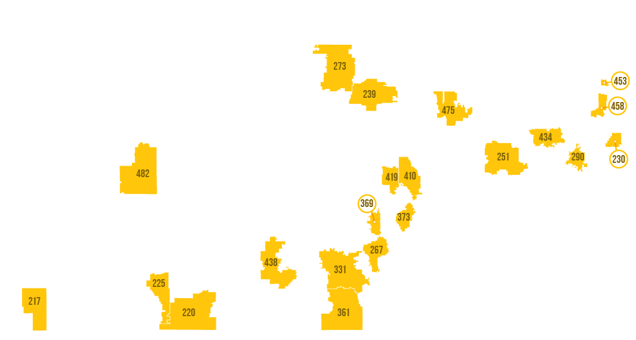
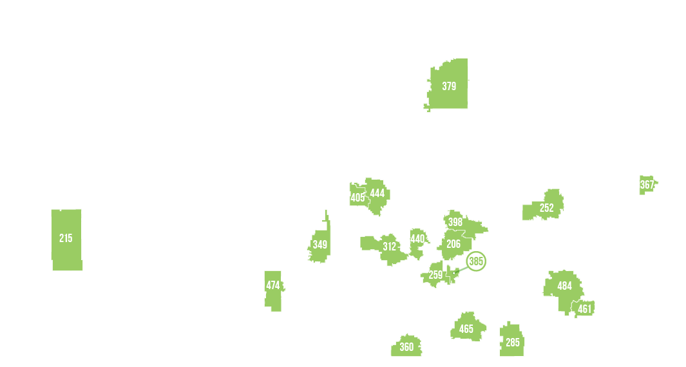
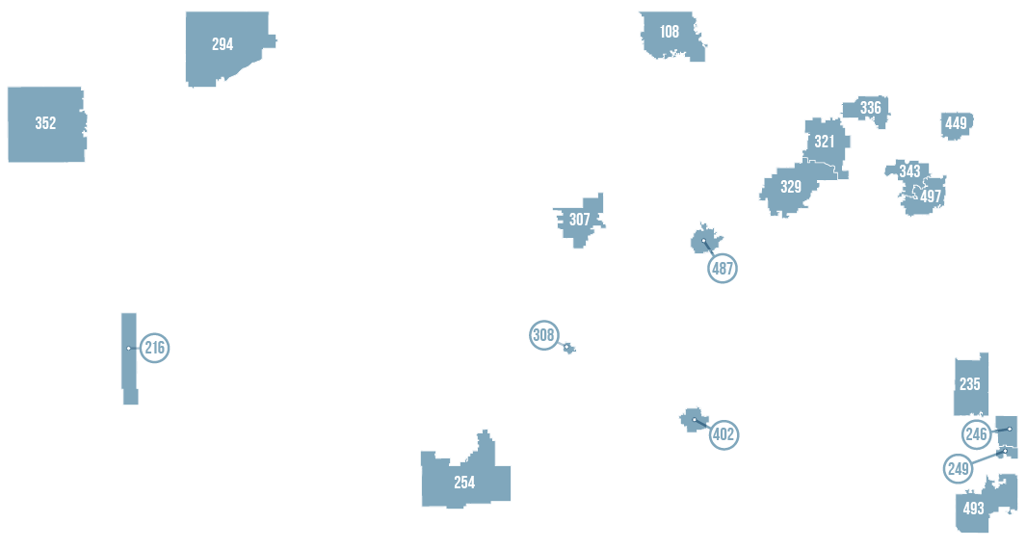
Notes:
Our business cards will stand out as innovative and memorable with a vertical or portrait orientation. Bonus it has a back side!
a portrait or vertical design. It’s also two-sided!
Another fundamental change you may notice (if not you will after I tell you) is that the main address for our agency has been simplified to the main desk in Suite 102. As all our mail is sorted in the print shop having everything labeled by a different team name and suite only made sense to us as we're used to it. It is less confusing and complex for those we serve.

Slide 20
Kansas School Redesign Principles
Student Success Skills | Family, Business, and Community Partnerships
There is an integrated approach to develop student social-emotional learning. | Partnerships are based on mutually beneficial relationships and collaboration.
Personalized Learning | Real World Application
Teachers support students to have choice over their time, place, pace and path. | Project-based learning, internships, and civic engagement makes learning relevant.
Notes:
Our business cards will stand out as innovative and memorable with a vertical or portrait orientation. Bonus it has a back side!
a portrait or vertical design. It’s also two-sided!
Another fundamental change you may notice (if not you will after I tell you) is that the main address for our agency has been simplified to the main desk in Suite 102. As all our mail is sorted in the print shop having everything labeled by a different team name and suite only made sense to us as we're used to it. It is less confusing and complex for those we serve.

Slide 21
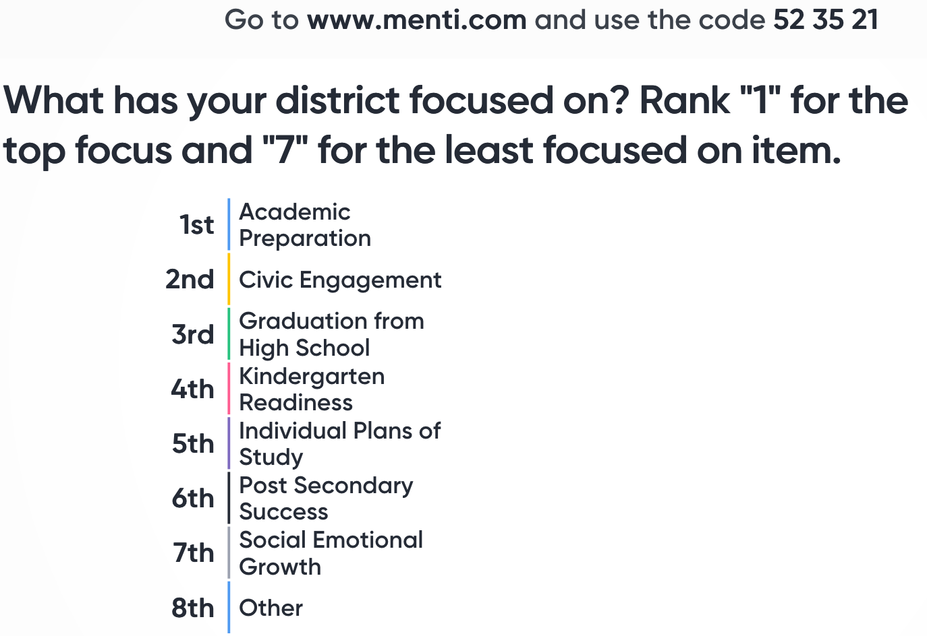
Notes:
Our business cards will stand out as innovative and memorable with a vertical or portrait orientation. Bonus it has a back side!
a portrait or vertical design. It’s also two-sided!
Another fundamental change you may notice (if not you will after I tell you) is that the main address for our agency has been simplified to the main desk in Suite 102. As all our mail is sorted in the print shop having everything labeled by a different team name and suite only made sense to us as we're used to it. It is less confusing and complex for those we serve.

Slide 22
Notes:
LiveSlide Site
https://www.mentimeter.com/s/79e604c86328a80d631c4b66d3757f37/68e184d1c738/edit

Slide 23
Highest Need Competencies Identified by Over 7,300 Kansas Students
Overall Rank by Highest Need | Males | Females | 6th Grade | 9th Grade | 12th Grade
Sustained Attention Self-Regulation | Sustained Attention Self-Regulation | Sustained Attention Self-Regulation | Sustained Attention Self-Regulation | Sustained Attention Self-Regulation | Sustained Attention Self-Regulation
Initiative | Initiative | Assertiveness | Initiative | Initiative | Assertiveness
Assertiveness | Conflict Management | Initiative | Conflict Management | Assertiveness | Communication Networking
Self-Efficacy Goal Setting | Communication | Conflict Management | Assertiveness | Communication | Conflict Management
Conflict Management | Assertiveness | Self-Efficacy | Goal Setting | Conflict Management | Self-Efficacy Goal Setting
Notes:
Our business cards will stand out as innovative and memorable with a vertical or portrait orientation. Bonus it has a back side!
a portrait or vertical design. It’s also two-sided!
Another fundamental change you may notice (if not you will after I tell you) is that the main address for our agency has been simplified to the main desk in Suite 102. As all our mail is sorted in the print shop having everything labeled by a different team name and suite only made sense to us as we're used to it. It is less confusing and complex for those we serve.

Slide 24
Current gauges of college and career readiness tend to focus on academic preparation and achievement, but a mounting body of evidence shows that success in college and the workplace is multidimensional.
Academics alone can’t prepare students for college. ACT The X Factor
Notes:
Our business cards will stand out as innovative and memorable with a vertical or portrait orientation. Bonus it has a back side!
a portrait or vertical design. It’s also two-sided!
Another fundamental change you may notice (if not you will after I tell you) is that the main address for our agency has been simplified to the main desk in Suite 102. As all our mail is sorted in the print shop having everything labeled by a different team name and suite only made sense to us as we're used to it. It is less confusing and complex for those we serve.

Slide 25
…the growing body of research suggests that other noncognitive characteristics can improve college success predictions beyond those based on academic measures alone. – ACT The X Factor
Notes:
Our business cards will stand out as innovative and memorable with a vertical or portrait orientation. Bonus it has a back side!
a portrait or vertical design. It’s also two-sided!
Another fundamental change you may notice (if not you will after I tell you) is that the main address for our agency has been simplified to the main desk in Suite 102. As all our mail is sorted in the print shop having everything labeled by a different team name and suite only made sense to us as we're used to it. It is less confusing and complex for those we serve.

Slide 26
Evidence Based Reading Practices
The Kansas State Board of Education should require each accredited school district to utilize structured literacy as the explicit and evidence-based approach to teaching literacy skills to all students and promote early intervention for students with characteristics of dyslexia. KSDE should create a checklist to guide selection and implementation of structured literacy practices for accreditation purposes. KSDE should ensure school districts are made aware of information concerning structured literacy training and information currently available from TASN.
Timeline August 2020 for checklist publication
August 2021 structured literacy practices implemented
Board Document Page 5 #1
Notes:
Our business cards will stand out as innovative and memorable with a vertical or portrait orientation. Bonus it has a back side!
a portrait or vertical design. It’s also two-sided!
Another fundamental change you may notice (if not you will after I tell you) is that the main address for our agency has been simplified to the main desk in Suite 102. As all our mail is sorted in the print shop having everything labeled by a different team name and suite only made sense to us as we're used to it. It is less confusing and complex for those we serve.

Slide 27
And yet a multitude of studies over many decades have shown that systematic, explicit phonics is the most effective method for teaching early readers.
The Most Popular Reading Programs Aren't Backed by Science
Notes:
Our business cards will stand out as innovative and memorable with a vertical or portrait orientation. Bonus it has a back side!
a portrait or vertical design. It’s also two-sided!
Another fundamental change you may notice (if not you will after I tell you) is that the main address for our agency has been simplified to the main desk in Suite 102. As all our mail is sorted in the print shop having everything labeled by a different team name and suite only made sense to us as we're used to it. It is less confusing and complex for those we serve.

Slide 28
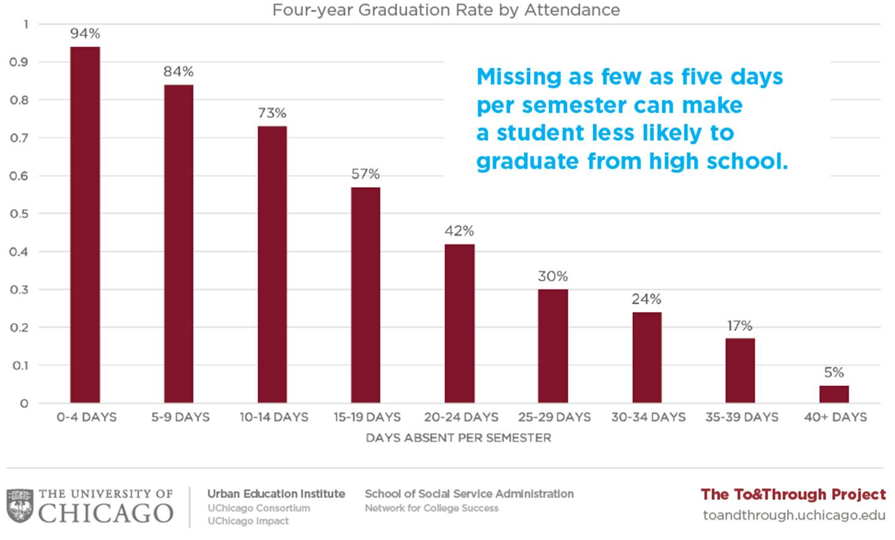
Notes:
Our business cards will stand out as innovative and memorable with a vertical or portrait orientation. Bonus it has a back side!
a portrait or vertical design. It’s also two-sided!
Another fundamental change you may notice (if not you will after I tell you) is that the main address for our agency has been simplified to the main desk in Suite 102. As all our mail is sorted in the print shop having everything labeled by a different team name and suite only made sense to us as we're used to it. It is less confusing and complex for those we serve.

Slide 29
Notes:
Today’s students are the future workforce and future leaders of Kansas. Kansans Can achieve anything and, together, Kansans Can lead the world in the success of each student.

