Slide 1
KASB Professor’s Meeting
November 10, 2012

Slide 2
Kansas by the Numbers
Number of students - 454,000 (FTE)
Number of school districts – 286
Number of schools – 1,380
Number of licensed educators – 41,000
Number of non-licensed personnel – 27,000
Numbers are rounded for presentation purposes

Slide 3
By the Numbers
Over 210,000 students transported to and from school each day
Over 92,000 breakfast meals served daily
Over 350,000 lunches served daily

Slide 4
Kansas Student Population Trends (Percent of K-12, September Unaudited Enrollment, Public Schools)

Slide 5
Kansas Assessments
Subject | Grades | Frequency | For AYP
Reading | 3-8, once in HS | Every year | Yes
Math | 3-8, once in HS | Every year | Yes
History/Govt. | 6, 8 once in HS | Every other year (next 2011-12) | No
Writing | 5, 8, 11 | Every other year (next 2012-13) | No
Science | 4, 7, once in HS | Every year | No

Slide 6
The Work Ahead in 2013
Closing the achievement gap
Students on paid lunch, reduced lunch, free lunch
White, Hispanic, African-American students
Implementing the Elementary & Secondary Education Act (ESEA) flexibility waiver
New accreditation system for Kansas schools
Continued transition to Common Core Standards in math and English language arts
Next generation of assessments
New science standards
Four new State Board of Education members (Beginning in January 2013)
New history/government standards
New evaluation system for teachers and leaders (Kansas Educator Evaluation Protocol)

Slide 7
New Terminology
Kansas College and Career Ready

Slide 8
State Board Strategic Agenda Through December 2012
Delivery system | Effective educators | Effective, visionary leaders | Collaboration
Multi-tier system of support | Barriers to teacher licensure & renewal | Review/revise leader preparation programs | Align PreK-20 systems of support
Accreditation of schools | Teacher recruitment, support & retention | Leader recruitment, support & retention | Communication
Graduation requirements, graduation rates, dropout rates | Educator evaluation & compensation | Leader evaluation & compensation | Strategic partnerships
Career & technical education | Review/revise teacher preparation programs
Growth model

Slide 9
Kansas Reading Gap: 2000 – 2012 (excludes ACT) (all grades, Report Card population)

Slide 10
Reading Gap by Ethnicity: 2000 – 2012 (excludes ACT) (all grades, Report Card population)
Notes:
JRD – re-embedded data chart, replaced and revised chart for both 2011 and 2012

Slide 11
Kansas Math Gap: 2000 – 2012 (excludes ACT) (all grades, Report Card population)
Notes:
JRD – 2011 and 2012 revised

Slide 12
Math Gap by Ethnicity: 2000 – 2012 (excludes ACT) (all grades, Report Card population)
Notes:
We are hoping that MTSS and adding Early Childhood to the accreditation system will help districts continue to narrow these gaps.

Slide 13
ESEA Flexibility 4 Required Principles
College- and Career-Ready Expectations for All Students
State-Developed Differentiated Recognition, Accountability, and Support
Supporting Effective Instruction and Leadership
Reducing Duplication and Unnecessary Burden

Slide 14
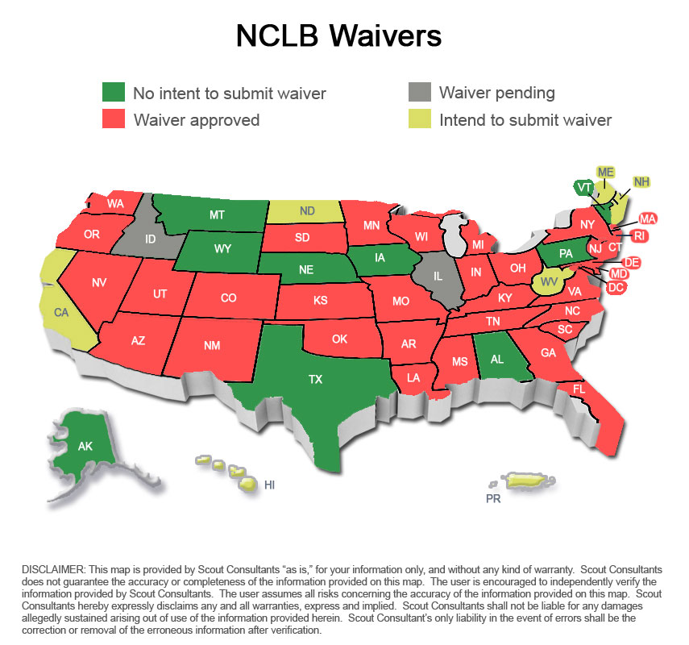

Slide 16
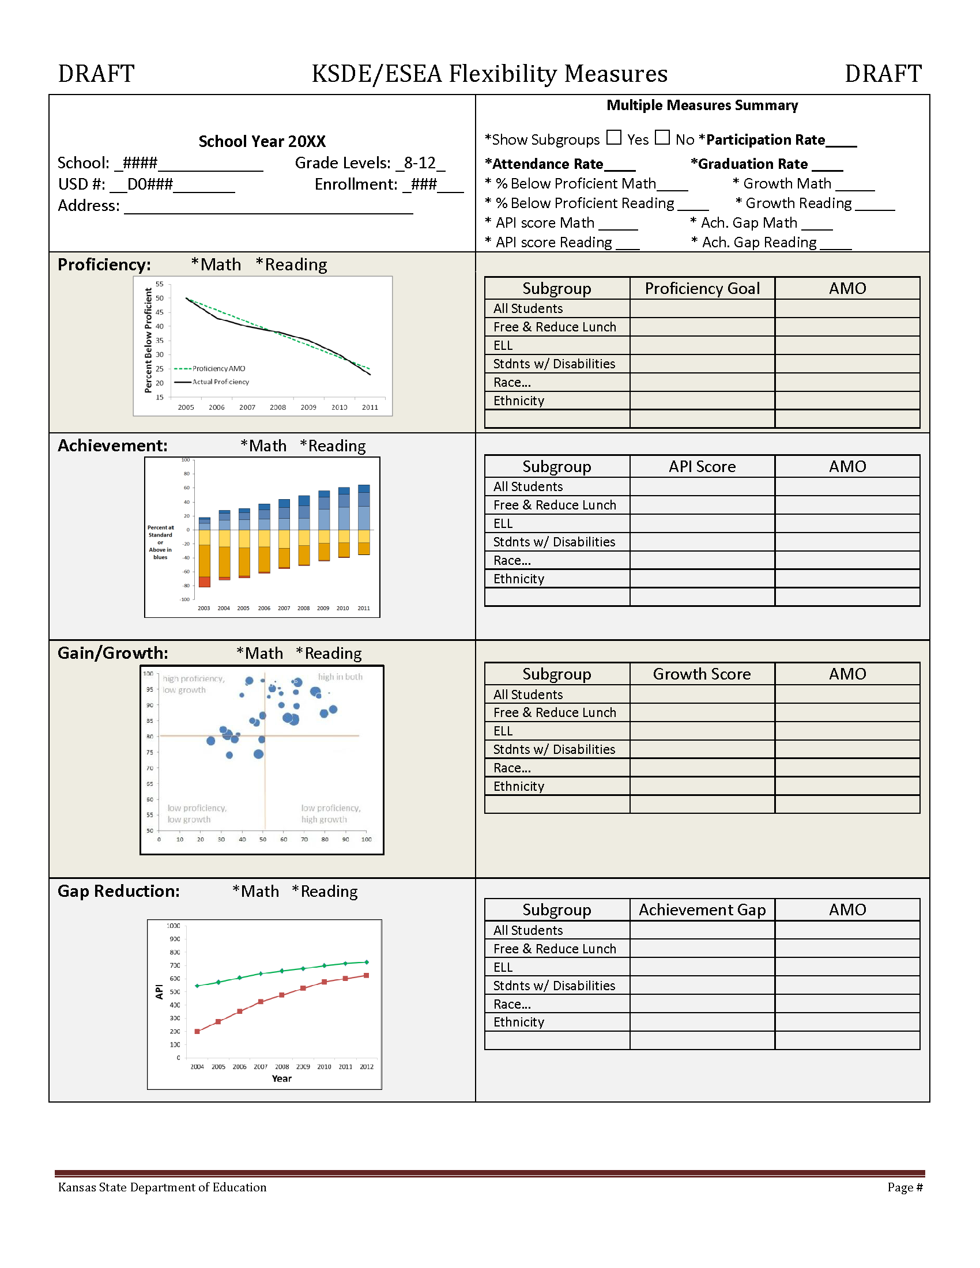

Slide 17
From QPA to 21st Century Accreditation
Moving from Quality Performance Accreditation of Q + P = A
To
21st Century Accreditation

Slide 18
21st Century Accreditation
Relationships
Relevance
Rigor
Results
Responsive
Culture

Slide 20
Questions, Discussion

