Slide 1
CPPSA Season
Tips from the Pathways Help Desk

Slide 2
July | August | September | October | November | December | January | February | March | April | May | June
 |  |  |  | November 15 - March 1 Pathways application open for new pathway applications or CPPSA maintenance for upcoming school year.
 |  | Sept. 1 - Oct. 31 Pathways System Updates. Note: May be subject to change. |  | November 15 - March 1 Career Pathway Program of Study Application (CPPSA) Submission and KSDE Processing |  |  |  | March 1 - June 15 KSDE Processing Window (after due date)
 |  |  |  | November 15 - June 15 Revisions to declined pathways made by districts (initially submitted by 3/1 but not yet approved by KSDE)
May 15 - Aug. 15 Assign & Update students after passing KCAN records are submitted in KIDS |  |  |  |  |  |  | February 1 - April 15 Concentrator Follow-up Data Entry for Concentrators Who Exited Last Year |  |  | May 15 - Aug. 15 Assign & Update students after passing KCAN records are submitted in KIDS
Pathways Help Desk available for assistance: PathwaysHelpdesk@ksde.org
Notes:
March 1st is the due date.

Slide 3
Preparing for CPPSA Entry/Maintenance
Gather and review these documents:
2024-2025 Kansas Career Cluster Guidance Handbook
Advisory Committee Handbook
Pathways (CPPSA) Checklist
Quality Pathway Rubric – Resource to “audit” your pathways
KSDE Secondary CTE Contact List
Check your Pathways Application Access
Check login information
Login Assistance: helpdesk@ksde.org or 785-296-7935
Verify access level
Must be either School Update or District/Org Update

Slide 4
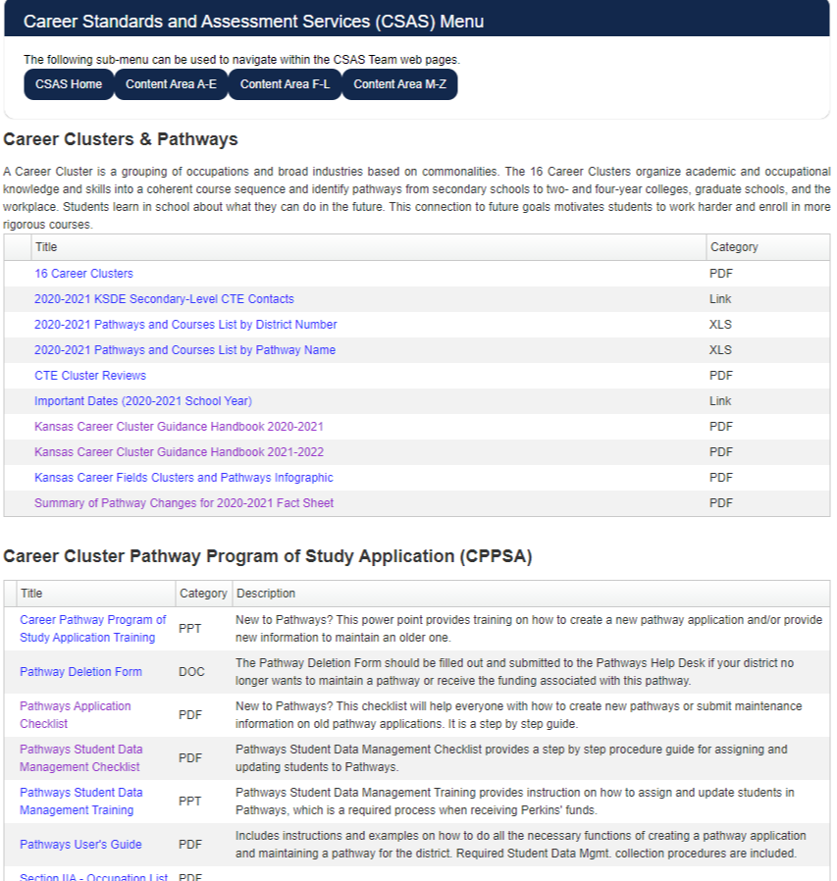
Resources: KSDE.org>Teaching & Learning>Career and Technical information>Career Clusters & Pathways (OR Click on the letter C in Letter Index)
Career Cluster Handbooks
CPPSA Training Guides

Slide 5
Preparing for CPPSA Entry/Maintenance
Review Pathway Content – View/Print document
Review Course Records within Pathway
Make friends with KCCMS & Data people in your district!
Each course selected in an approved pathway should be offered at least once every three years.
New KCCMS Course Records entered by Feb. 15th
Review Advisory Committee’s Improvement Plan & Assurances
Schedule Meetings if needed (Virtual or Email)
Keep documentation on file locally
Quality Pathway Rubric – Resource to “audit” your pathways
Notes:
Quality Pathway Rubric is especially helpful if there is new staff or advisory committee members.

Slide 6
Preparing for CPPSA Entry/Maintenance
Review Course Records within Pathway
New and updated KCCMS Course Records entered by Feb. 15th
Double check that all course records in KCCMS match your SIS
Pathways Courses report in KCCMS and Pathways
DO NOT upload all CTE courses each year.
Records are active until expiration date
Default setting is no expiration date
To update records in current pathways, use Update/Duplicate

Slide 7
Section I Tips
New CPPSA’s
Select the building, pathway, and responsible form completer.
Enter the Instructor and Years of Experience teaching the pathway course content.
List multiple instructors in “Notes” section.
Maintenance
Verify that the responsible form completer is correct.
Update the Instructor and Years of Experience teaching the pathway course content
Summary of CPPSA will reflect the sections that have been changed/NOT changed from year to year.

Slide 8
CPPSA Section IIA – Advisory Committee
Add, delete, or edit advisory committee members.
Advisory Committee membership must consist of at least 3 business and industry representatives of that pathway.
Student and Post-Secondary members are recommended.
Contact consultant or Advisory Committee Handbook for specifics on content area.
Spring (after March 1st) 2023 and Fall 2023/Winter 2024 for March 2024 pathway.
Can use same committee for pathways within the same cluster if members reflect both pathways appropriately
Notes:
The best practices for advisory committee meetings are to have a meeting in the Spring and Fall to cover all aspects needed for both years.

Slide 9
CPPSA Section IIB-Improvement Plan
Minimum of 3 years - New pathways need 1 year
See guidance in “Advisory Committee Handbook”
For 3 years, developed with input from the advisory committee
Please use specific dates (School Years) when composing goals
Four Areas
Partnerships
Physical Environment
Professional Development
Instructional Strategies
Quality Pathway Rubric document is available to use with your committee to “Audit” your pathway
Type goals in a Word Document first to avoid Pathways time-out!

Slide 10
Section IIb – Meeting Minutes should be kept locally.
Notes:
Assurance questions (Yellow) must be complete to save the section. Advisory Committee must meet a minimum of twice between March 2nd of last year and March 1st of the current year unless it is a new pathway this year. Use the first date box only for new pathways.

Slide 11
Sample Format:
Partnerships:
Goal: _________________________
2024-2025: Action Step
2025-2026: Action Step
2026-2027: Action Step

Slide 12
CPPSA Section III- Pathway Courses
Courses in this section must first be mapped in KCCMS.
If courses are not showing in section 3, please first check with local KCCMS person, then kccms@ksde.org
The course code that is used in Pathways must be tied to the course code at the local level (PowerSchool etc.) for auditing and KSDE system reports (KCAN). These must match exactly.
When a course is selected in pathways, you are agreeing to teach the state approved competencies for the course.
All .5 funding eligible courses in a KSDE approved Pathway must not also receive Excel in CTE funding.
Use Pathway Courses Report in Pathways & KCCMS to verify course numbers every Fall.

Slide 13
Section III Tips
Red box at the top of the section is more of a “To-Do” list than a list of errors.
Guide to what courses must be included in the pathway.
Three levels of courses:
Introductory
Technical
Application
An approved pathway must contain at least 3.0 credits.
2.0 credits must be a combination of Technical and Application level courses

Slide 14
CPPSA Section IV – Program of Study
Creates an Individual Program of Study document
Suggested academic, CTE, and post-secondary courses.
Share with students, parents, and/or school staff.
Grade 13 and 14
list all CTE courses the student must complete, at the articulated school, during their first two years.
Not the “free” course data from the Articulation Agreement.
Usually found on postsecondary institution’s website
Certifications must be listed and offered to students.
Assessments must be selected for end-of-pathway if there are any available.
Academic courses may be copied using the Copy Courses from Existing Program of Study function then any updates should be made if needed!
Notes:
If effort to coordinate with the IPS for each student, Grades 13 and 14 are required for the IPS, so they should also be in the pathway program of study.

Slide 15
Section IV Tips
If more than one articulation agreement is selected, you must include a program of study for each articulation agreement.
Students may utilize any Statewide articulation agreement, but only one selection is required on the CPPSA.
The long, red list of “errors” is, again, a “To-Do” list. It will disappear as courses are added to the Program of Study.
An existing Program of Study may be copied from another pathway, then edited to fit the pathway that you are working on.

Slide 16
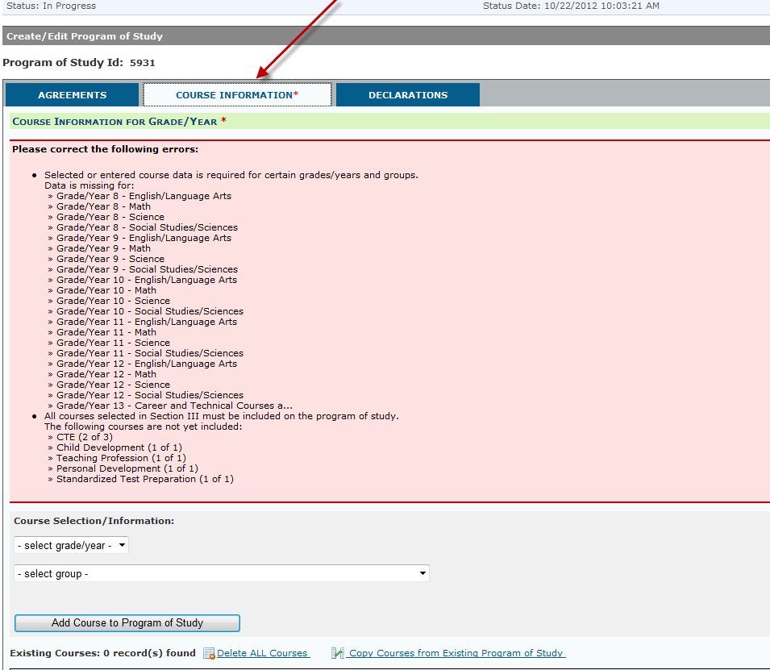
Second Tab in Section IV
Notes:
Section IV-Programs of Study
8. Click on the “Course Information tab at the top of the screen.
9. Select course information for each grade that appears in the Program of Study. This includes: English/Language Arts, Math, Science, and Social Studies/Sciences for grades 8-12. All Career and Technical Education (CTE) courses selected in Section III must also be included on the Program of Study. CTE courses for grade 13 and 14 (first 2 years at a post-secondary institution) are also required.
Courses must be mapped in the Kansas Course Code Management System (KCCMS) before they will appear for selection in the Career Pathway Program of Study Application (CPPSA). Check with the superintendent/district office to determine who in your district is responsible for mapping local courses in KCCMS.

Slide 17
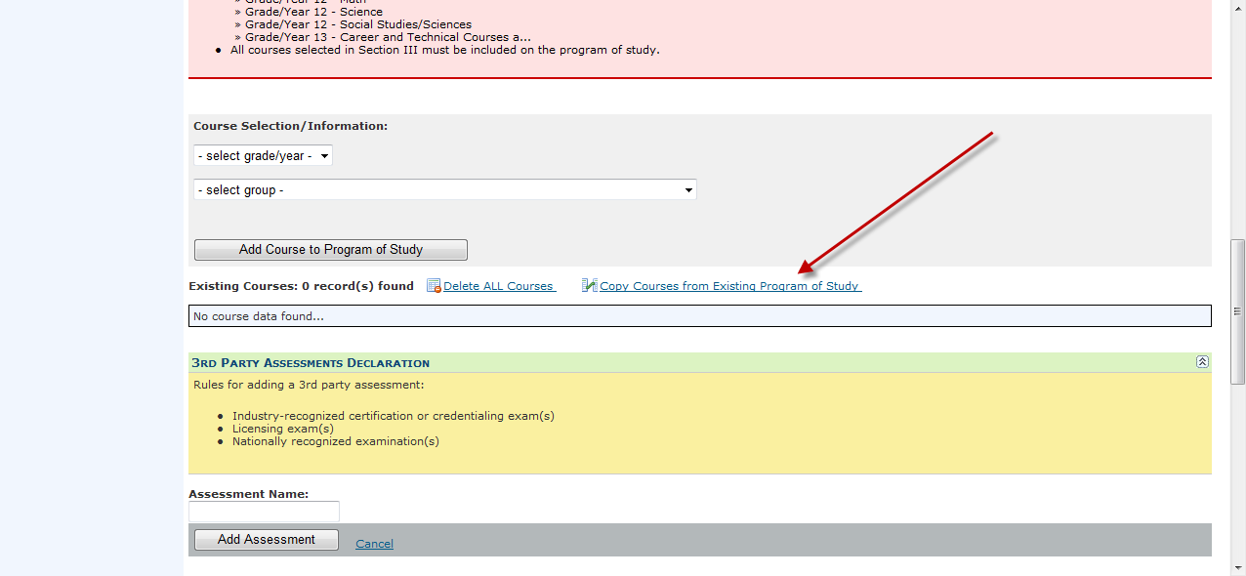
Short Cut May Be Available for the Academic Courses!
Notes:
Section IV-Programs of Study-Copying an existing program of study for your district. This will copy only academic courses.
Click on the “Copy Courses from Existing Program of Study” link
Choose the Program of Study you want by clicking on “Copy.”

Slide 18
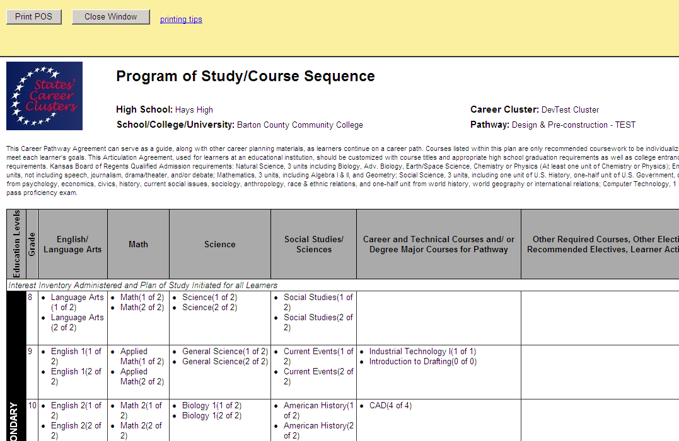
Notes:
Section IV-Programs of Study
16. Clicking on “View Program of Study” will open the Program of Study in a pop-up window.

Slide 19
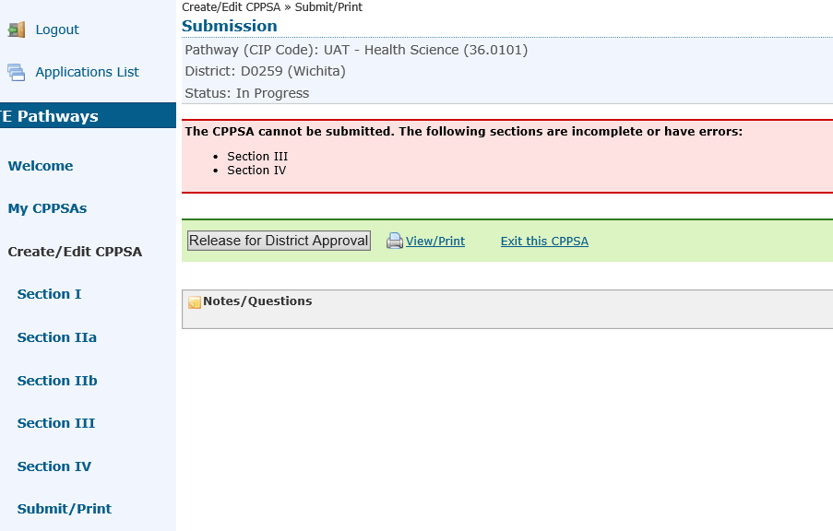
Final Step!
Error Check and Submission to District Super for Approval
Notes:
Submit/Print:
If all of the required information was completed in Sections I, IIa, III, and IV, the submissions page will state “The CPPSA has been validated and there are no errors that can be detected by the system.” Please note that this does not mean that your pathway has been approved. It simply means that the automated system was unable to detect any errors.
Click “Release for District Approval.” The CPPSA will then be delivered to the District/Org Approve’s CPPSA account.
Please note that the District/Org Approve (superintendent) will receive an email notification that a pathway is waiting for approval, if the District/Org Approve has an account in Pathways. It is recommended that you notify the District/Org Approve (generally the superintendent) to log into his/her Pathways account, click on “My CPPSAs” and review the pathway. The CPPSA will not be submitted to KSDE until it is approved and released by the District/Org Approve.

Slide 20
Examples of the Status of your Pathways
Status Column
Under My CPPSAs
Desired Status is Approved by KSDE

Slide 21
Status Column Definitions – In Progress
The pathway has either not been submitted or was submitted, declined, and has been viewed by someone in your district with editing access for the pathway application.
These applications should be carefully reviewed.
The View/Print option will allow you to view the history of the pathway by scrolling down to the “Approvals” section.
If there is a disapproval note, please review the notes and make necessary corrections.

Slide 22
Status Column Definitions – Released
The pathway is awaiting approval by your superintendent. They should have received an e-mail with instructions to do so. This is the final step to ensure that the pathway is in the proper status for review at KSDE.
If the status of the application has been in “Released” status for more than a few days, it is advisable to reach out to your superintendent to let them know that it is awaiting their approval

Slide 23
Status Column Definitions – Declined by District
Your superintendent has declined the pathway application.
Look for notes in the “Approvals” section of the View/Print Document.
Make the requested corrections and release again for district-level approval

Slide 24
Status Column Definitions – Declined by KSDE
A KSDE consultant has declined the pathway application and requested changes or corrections.
Look for notes in the “Approvals” section of the View/Print Document and in the notification e-mail that was generated when the application was declined.
Make the requested corrections and release again for district-level approval
Please make the requested changes within the two-week time frame as indicated in the notification e-mail.

Slide 25
Status Column Definitions – Approved by District
The pathway application is awaiting review by a KSDE consultant.
This is the correct status for review by KSDE, and no action is needed at this time.

Slide 26
Status Column Definitions – Approved by KSDE
Congratulations! This pathway has been approved by KSDE for the 2024-2025 school year.

Slide 27
Questions?
Pathway Applications are DUE March 1, 2024.
Email – PathwaysHelpDesk@ksde.org

