Slide 1
Kansas Leads the World in the Success of Each Student.
Dr. Randy Watson, Kansas Commissioner of Education

Slide 2
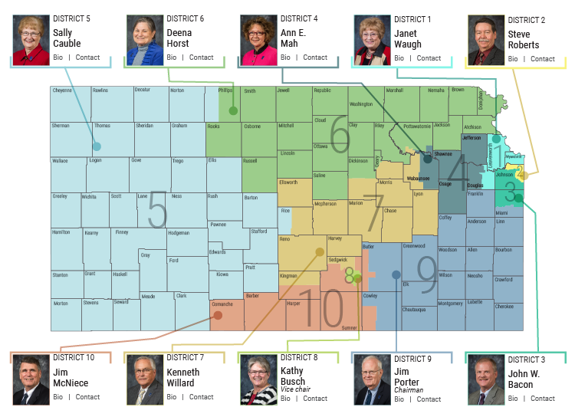

Slide 3
A NEW Vision for Kansas ...
Kansas leads the world in the success of each student
KANSAS STATE DEPARTMENT OF EDUCATION | www.ksde.org
Notes:
Jay - This is the vision for education in Kansas and the redesign initiative is all about aligning school systems to this vision.
“Each” – personalizing learning for each student.
What do you want success to mean for your students?

Slide 4
Creating a Vision for Kansas – State Outcomes
Social Emotional Growth
Kindergarten Readiness
Individual Plan of Study
High School Graduation Rates
Post Secondary Completion
Notes:
Among the outcomes being considered by the state board are:
High School Graduation Rates
Post Secondary Completion/Attendance
Remedial Rate of Students Attending Post-Secondary
Kindergarten Readiness
Individual Plan of Study Focused on Career Interest
Social/Emotional Growth Measured Locally
Education Commissioner Randy Watson and members of the State Board of Education will meet with business, education and state leaders to build agreement on how we will work together to achieve this vision for Kansas education.
Kansas schools are already doing tremendous work to address the needs of individual students, but in order to achieve this new vision we cannot expect schools to go it alone. This requires a unified effort with businesses, communities, parents, higher education, and elected officials working with educators to help provide the supports and experiences Kansas students need for their future success.

Slide 5
Blue Ribbon Task Force
Conclusions
99% of positions filled; vacancies cluster
Slight decline in teachers prepared; steeper decline in teacher education majors
Kansas is vulnerable to retaining early career teachers (less than five years experience)
Recruit teachers to rural communities, Wichita, and Kansas City, Kansas

Slide 6
Blue Ribbon Task Force
Make teaching as a career attractive to elementary, middle, and high school students and their parents.
Retain early-career teachers.
Change the Work After Retirement KPERS rules to encourage and enable retired personnel to teach without penalty.

Slide 7
New pathways to licensure in last five years

Slide 8
Paraprofessional Pathways To Teaching
Fort Hays State University
Paraprofessional Pathway allows the paraprofessional to maintain employment throughout the coursework. Credit is provided for experience toward observation courses and there is an option to either complete the student teaching experience over the traditional semester time frame or spread it over an entire year. Upon admission to Teacher Education, this program can be completed in a two-year time frame.

Slide 9
Paraprofessional Pathways To Teaching
Washburn University
The Parapros to Teachers Program (PTP) at Washburn University offers a pathway for paraprofessionals to complete teacher licensure. Credit for work experience is granted for introductory education courses. The program provides course work at times convenient for working paraprofessionals. The focus of the PTP program is on Special Education and STEM license areas.

Slide 10
Paraprofessional Pathways To Teaching
Wichita State University
Teacher Apprentice Program for ECU and Elementary Licensure allows the paraprofessional to maintain employment throughout the coursework. Credit for paraprofessional experience counts toward the field experience requirements throughout the degree program. Each Para Educator is provided a TAP Success Coach who provides mentoring and support throughout the program. The 4-year bachelor’s program offers a reduced tuition rate and a flexible transfer policy enabling most candidates to complete the program in two years. The program of study is characterized by an inverted curriculum emphasizing professional preparation early in the program facilitating candidates’ ability to transition from Para Educator to Teacher of Record on a Limited TAP license while completing the remainder of the degree.

Slide 11
Blue Ribbon Task Force On Teacher Vacancies and Supply
Challenges to Teacher Supply
Low salaries
Current and ongoing instability of education-related funding
New changes to KPERS

Slide 12
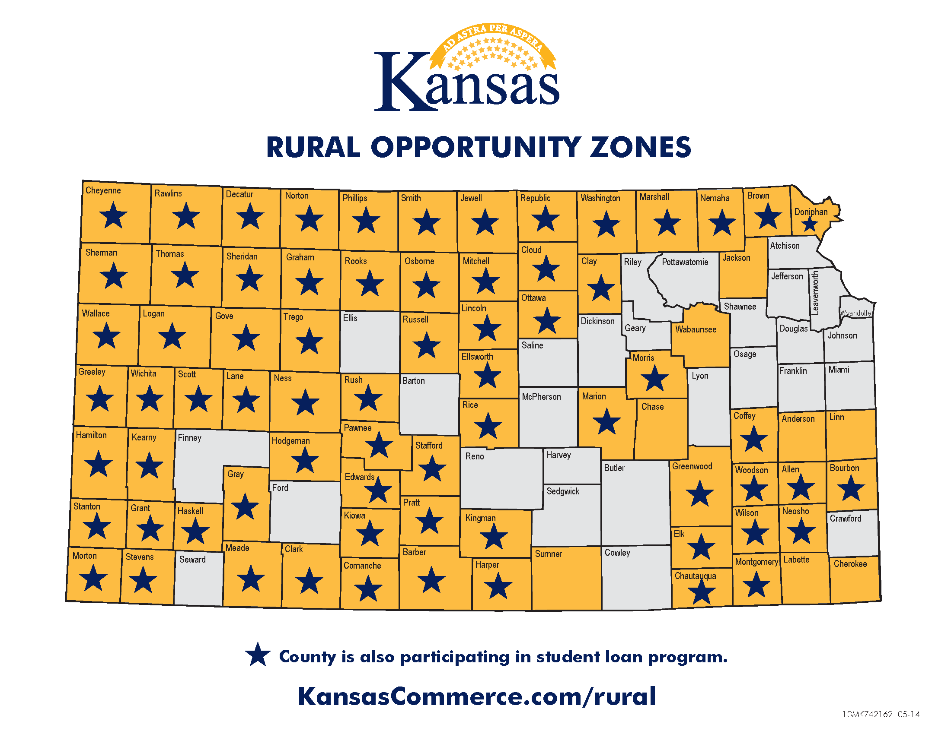

Slide 15
Redesign?
Personalized
Project Based
Longer time with teachers (hours and years)
Immersion with parents and the community

Slide 16
Blue Ribbon Task Force On Teacher Vacancies and Supply
Challenges to Teacher Supply
Low salaries
Low esteem for teaching as a profession
Current and ongoing instability of education-related funding
New changes to KPERS

Slide 17
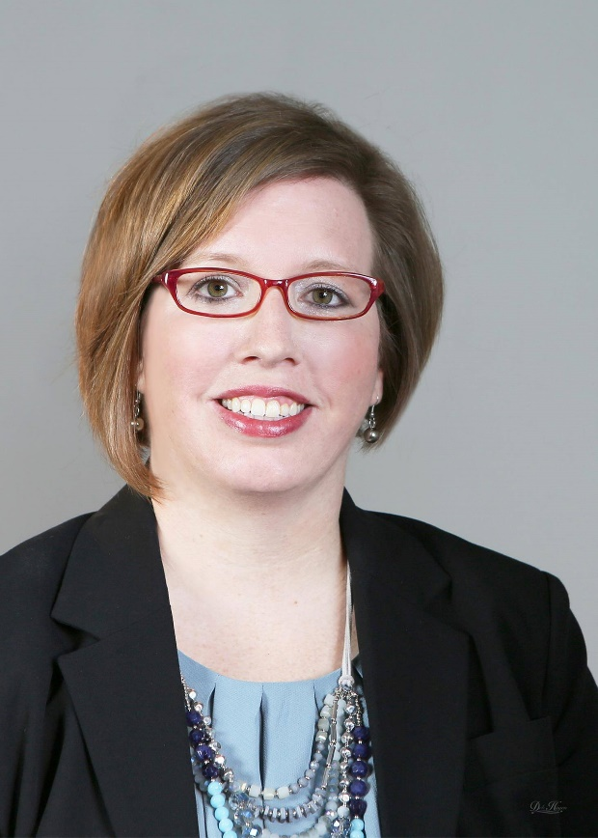
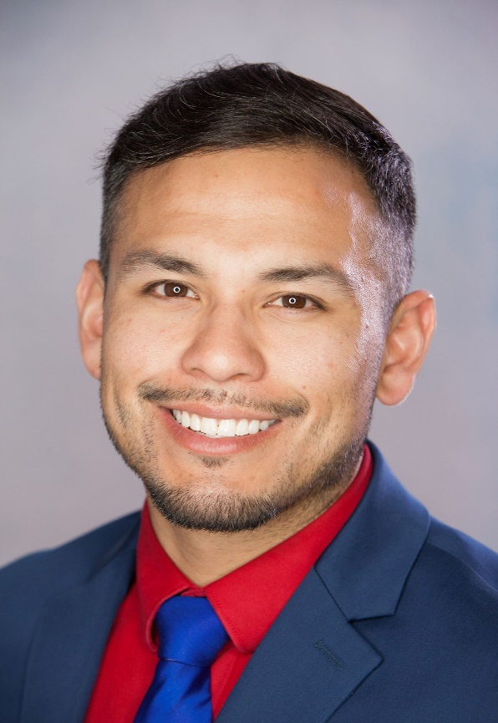
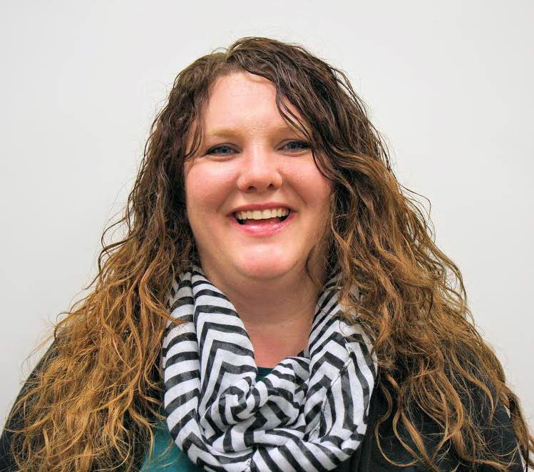
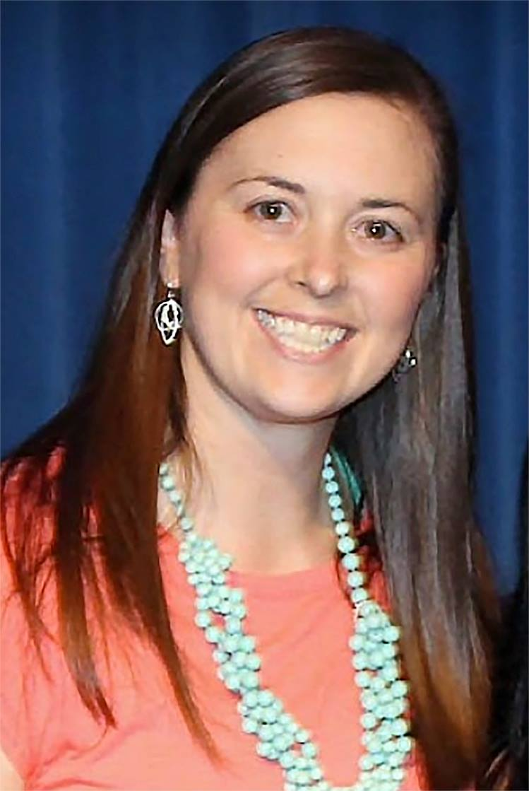
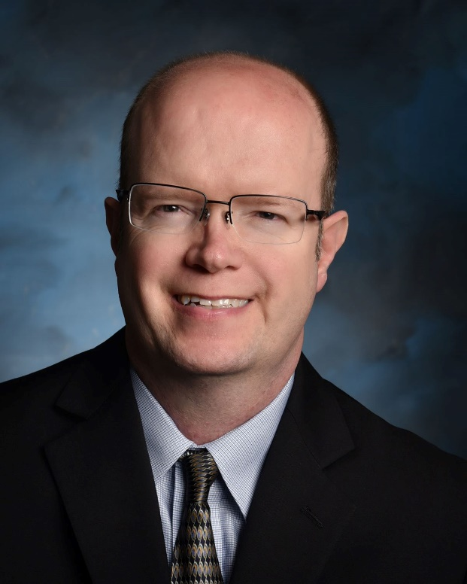
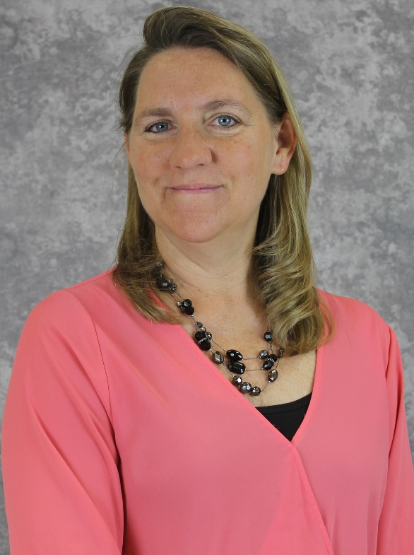
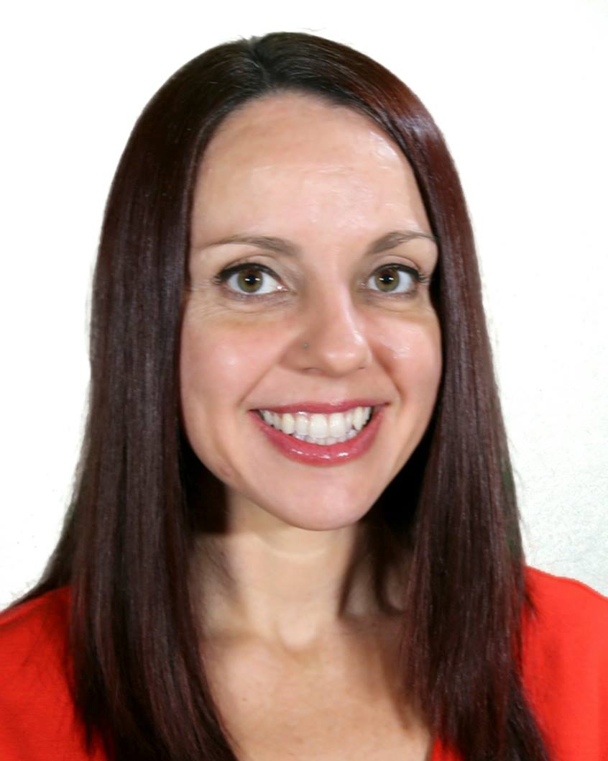
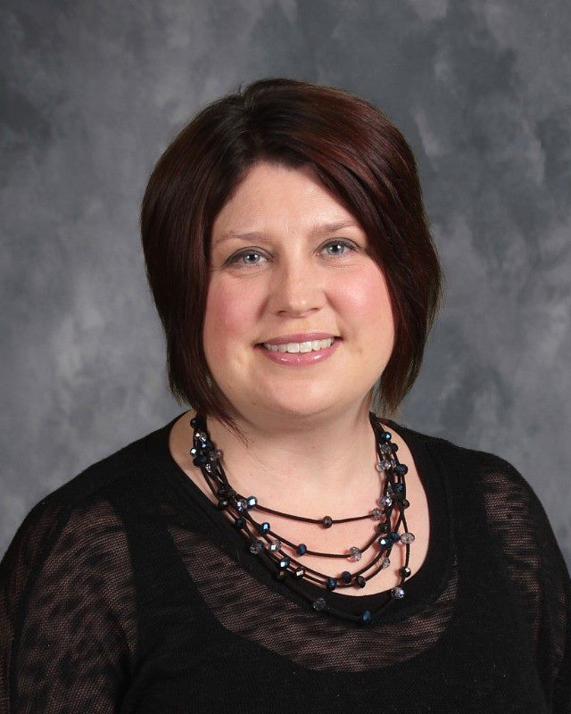
K
T
O
Y
2018

Slide 18
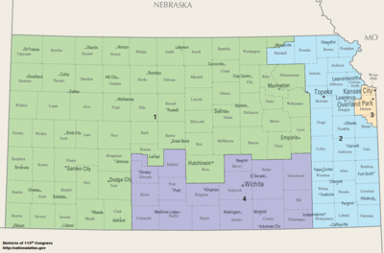
K
T
O
Y
2018

Slide 19
This is what educators every day…

Slide 20
Hope and Faith…

Slide 21
Notes:
Today’s students are the future workforce and future leaders of Kansas. Kansans Can achieve anything and, together, Kansans Can lead the world in the success of each student.

