Slide 1
State of Education
Vision 20/20 Committee
January 29, 2014

Slide 2
Year In Review - 2013
Introduced Annual Measurable Objectives (AMOs) to determine student, school, district and state achievement.
Approved the Emergency Safety Interventions guidelines.
Approved the creation of a transitional assessment by CETE for the spring 2014 state assessment in math and English Language Arts.
Approved the Kansas College and Career Ready Standards for History, Government and Social Studies.
Approved the Kansas College and Career Ready Science Standards.
Held a special session with members of the House and Senate Education Committees.
Moved KSDE to the Landon building.
Approved the Kansas Handwriting Curricular Standards.
Approved the Kansas College and Career Ready Standards for English Language Proficiency.
Redesigned KSDE website.
Acted on changes to K.S.A. 91-31-32 for Celebrate Freedom Week.
Approved CETE as the developer and vendor for the state summative assessments in math and English Language arts.

Slide 3
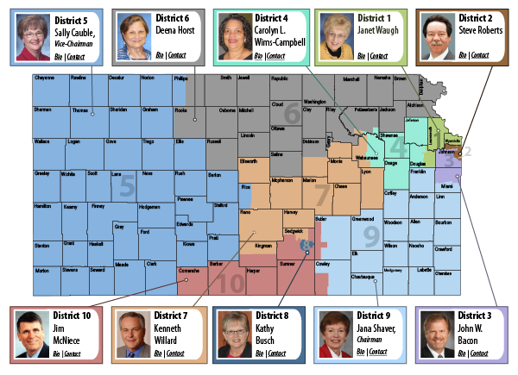

Slide 4
Kansas State Board of Education Supervision of K-12 Public Schools
Accrediting K-12 schools
Administering & distributing state & federal funds
Certifying teachers, administrators & school specialists
Developing, administering & monitoring state & federal plans
Approve standards
Evaluating & approving teacher education programs
Public hearings: state plans, rules & regulations, transfers of territory, due process appeals
Supervising KSSB & KSSD

Slide 5
State Board Goals 2013-14
Provide a flexible and efficient delivery system to meet our students’ varied and changing needs
Provide an effective educator in every classroom
Ensure effective, visionary leaders in every school
Promote and encourage best practices for early childhood programs
Develop active communication and partnerships with families, communities, business stakeholders, constituents and policy partners
Approved March 2013

Slide 6
School Characteristics
Students* - 485,147
School Districts – 286
Schools – 1,336
* Headcount enrollment

Slide 7
Student Characteristics

Slide 8
Kansas Population Trends

Slide 9
Kansas Education

Slide 10
College and Career Ready
College and Career Ready
means an individual has the
academic preparation,
cognitive preparation,
technical skills, and
employability skills
to be successful in postsecondary education, in the attainment of an industry recognized certification or in the workforce, without the need for remediation.

Slide 11
Putting Together the Puzzle
Kansas College & Career Ready Standards
Math
English Language Arts
History, Government and Social Studies
Science
English Language Proficiency
Handwriting
Theatre Arts
And more as they come up for review

Slide 12
More Pieces to the Puzzle
Career and technical education (CTE)
Senate Bill 155
Jobs for America’s Graduates (JAG)
Individual Plans of Study

Slide 13
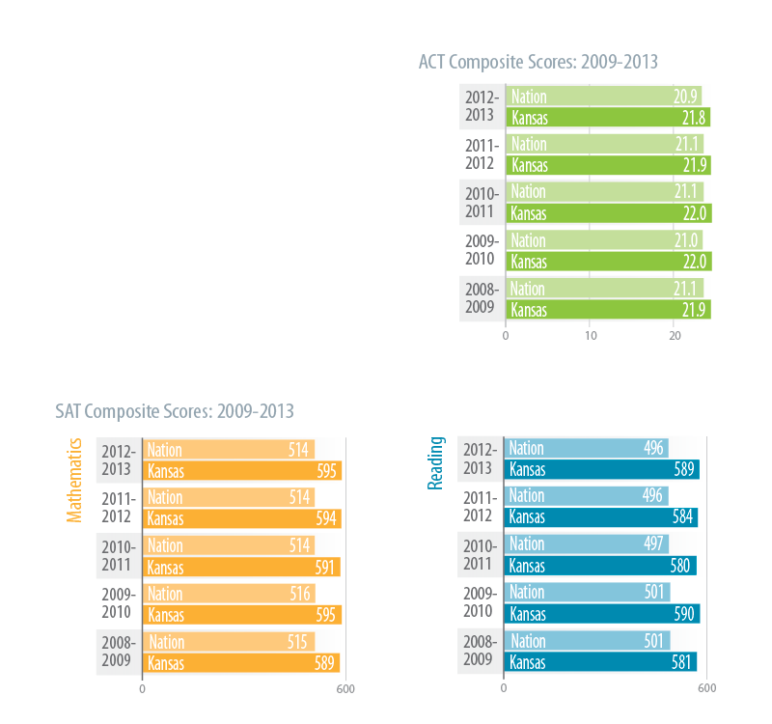
How Does Kansas Compare?
Above national average
on both ACT and SAT

Slide 15
Math Trends by Percent Proficient

Slide 16
Reading Trends by Percent Proficient

Slide 17
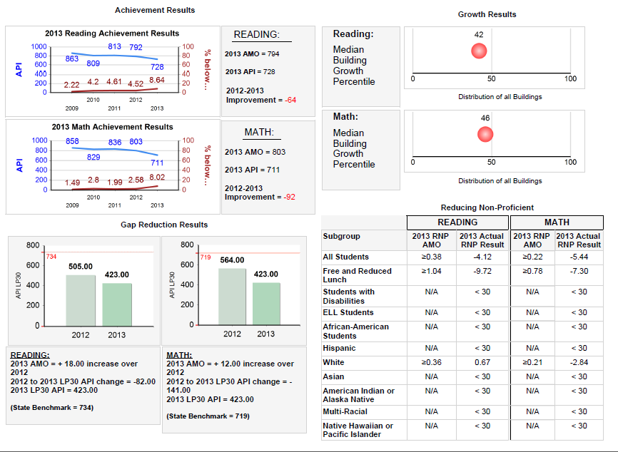

Slide 18
State Summative Assessments in Math and English Language Arts
Transitional assessment in 2013-2014
Based on the Kansas College and Career Ready Standards
Developed by CETE at KU
2014-2015 and Beyond
Developed and administered by CETE at KU
Features will include:
Constructed response
Technology enhanced
Adaptive at the section level (not item)
Multiple choice

Slide 19
*IPS = Individual Plan of Study

Slide 20
Moving from Proficient to College & Career Ready
Proficient
What % of Kansas students meet grade level proficiency, and ready to move to the next grade level?
Math 2012 = 85%
Reading 2012 = 87%
College & Career Ready
What % of Kansas Students perform at a CCR level on the new assessments?
?????
We don’t know, but we need to be prepared to communicate that standards and assessments have changed!

Slide 21
Old vs. New Performance
Old State Assessment 2002-2013
Exemplary
Exceeds
Meets
Approaching
Warning
New State Assessment 2014-2015
4
3
2
1

Slide 22
A New Start
2014-2015 and Beyond
2002-2013 Performance

Slide 23
What to Expect in 2014
21st Century Accreditation based on the relevance, relationships, rigor, responsive culture, and results
Full implementation of the Kansas College & Career Ready Standards in math and English language arts
Transitional assessment based on the KCCRS
Development of state summative assessment in math and English language arts
Application for renewal of the ESEA Flexibility Waiver
Continued work on teacher and principal evaluations with emphasis on student growth
Revisions of licensure in CTE
Revisions for out-of-state applicants
Revisions of licensure for special education teachers
Pilot of Individual Plans of Study

Slide 24
Magnitude of Change
Simple
First order
Technical
Bullets
Complex
Second order
Adaptive
Cannonballs

Slide 25
Ways to Keep in Touch
Follow Diane on Twitter @dianedebacker
“Like” KSDE on Facebook
Visit our website: www.ksde.org

Slide 26
Thank You!

