Slide 1
Crafting Your ‘Why’
& Shared Vision

Slide 2
Starting with Why
Simon Sinek & Personal and Team Why

Slide 3
“To embrace a vision, people have to clearly understand the vision and feel personally compelled to contribute to the vision.”
- Muhammad & Cruz, 2019
Notes:
Time for Change: 4 Essential Skills for Transformational School and District Leaders
In order to invest in the vision, every teacher must know his/her why. Moreover, the vision should be derived from the collective why of the staff, students, and community.

Slide 4
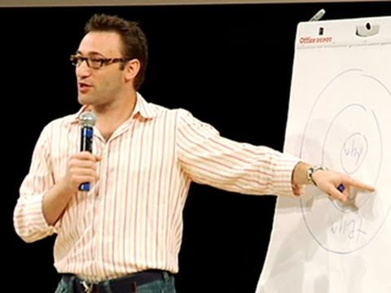
Notes:
https://fourminutebooks.com/start-with-why-summary/

Slide 5
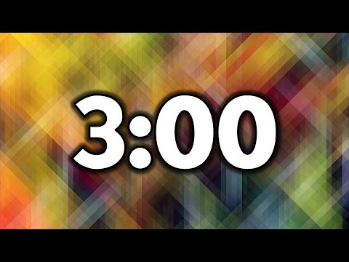
How to craft your personal why
Tip: Start by thinking about the following questions-
What is your purpose in being a teacher?
What do our students need?
Why does education matter?
Why does your school need to redesign?
To write your ‘why’, grab a post-it note and craft a statement that has fewer than 25 words.
Notes:
Personal Why

Slide 6
Mix, Pair, and Share
your ‘Why’ with 3-5 people.

Slide 7
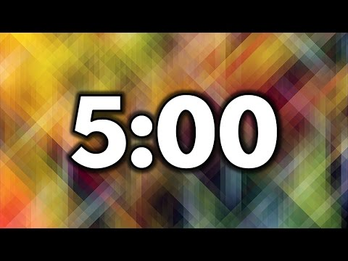
Revise your ‘Why’
Create a “Why Redesign” Statement for your team with 10 words or fewer
Why Statements + Trends + Values
WHY
10 words
Notes:
Team Why

Slide 8
Analyzing Values
Community Values Analysis

Slide 9
Analyzing Community Values
Step 1- Pick 5 cards that represent your school community: What do they believe/value? How do they act?
The pictures on the cards can mean whatever the team wants (open to group interpretation)
On a post-it, under the picture, write the value (word/phrase) that picture represents to your group
After each table picks their 5, go around and view the other teams’ choices.
Goal was to find similarities/differences.
All schools in the room were from the same district.
Discussion
Step 2- Choose 2 that you want to be most mindful of as you redesign.
What are the 2 your community values the most?
Step 3- Write a value statement about your community using the two words/phrases you isolated as being the most important.
This will be your community ‘why’.
What drives your community? What is the purpose of your patrons? What is their motivation?

Slide 10
Funnel It!
Values
Why
VAlues
Why
Notes:
Community Why

Slide 11
Analyzing Need
Defining Success

Slide 12
Define Success & Select Measurable Outcomes
Write down 5 success statements about students graduating from your district.
Review the measurable outcomes on the back.
Underneath each success statement, assign a measurable outcome.
Circle the statements you are currently able to measure accurately and with fidelity.
Star the areas in which you will need to intentionally begin monitoring.

Slide 13
Funnel It!
Success
Outcomes
VAlues
Why
Notes:
Create a Needs Statement

Slide 14
Shared Vision
Bringing It All Together
Notes:
Personal Why
Team Why
Community Why
Needs Statement

Slide 15
Vision
“Why”
This is our destination statement that we want every single one of our students to know and believe in!
Our purpose, cause or belief that inspires us to want to redesign!

Slide 16
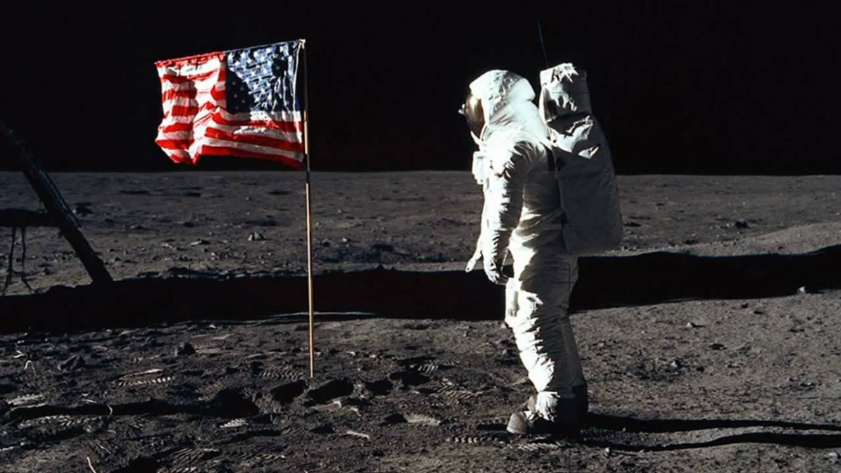
Kansas Vision for Redesign
Kansas leads the world in the success of each student
It’s what Kansans said they wanted. It’s what the job trends and our current K-12 outcomes are telling us.

Slide 17
Funnel It!
Success
Outcomes
VAlues
Why
Notes:
Personal Why + Team Why + Community Why + Needs Statement = Shared Vision

Slide 18
Shared Vision

Slide 19
Next Steps
Who else should you include in the creation of a vision?
How do you authentically engage stakeholders?
What do you do once you have a ‘why’?
Why
Who
How
Do
How will you bring your why/vision into the work you choose to do this semester?

Slide 20
Sarah Perryman Redesign Coordinator Division of Learning Services (785) 296-1074 sperryman@ksde.org
KSDE Redesign Team Division of Learning Services redesign@ksde.org

