Slide 1
Strategy Implementation & Analysis
Engaging in the Continuous Improvement Process

Slide 2
Strategy Selection

Slide 3
Strategy Selection - Where have we been? Where are we now?
What have you done/plan to do to ensure that your current strategies are having the intended effect?
Strategy Sort - Ease vs Impact
Defined High Impact Strategies via Effect Size Analysis
Strategy Evaluation Processes - Discussion prompts for systems to evaluate the degree to which impact and implementation can be monitored.

Slide 4
Kansans Can Design Principles
How do the strategies being implemented align with the Design Principles?
Notes:
How might they connect the work of the system to the work of classroom teachers?
We believe that the Design principles are where the ‘rubber meets the road’ as it relates to the work of the system getting down to the classroom level. If we want to engage teachers in the work of continuous improvement, then we have to ensure that classrooms are meeting the needs of the whole child. The design principles work to ensure just that. If systems want to move their work into classrooms, then the work must be simple, clear, and easily understood by teachers. Having 4 grounding principles is how we believe this work can enter the classroom.
1- Where did the Design Principles come from? (Booklet)
Kansas State Department of Education (KSDE) leaders, along with Kansas State Board of Education members, conducted more than 20 community conversations with teachers, parents, business leaders, and community members across the state before setting a new vision for education. Kansans said academic skills are important, but so are nonacademic skills, such as critical thinking, teamwork, perseverance, and civic engagement. Kansans also said we need to move away from a “one-size-fits-all” system that relies exclusively on state assessments to measure student success. The new, student-focused system will provide support and resources for individualized success.
KSDE, State Board of Education members, teachers, parents, business leaders, stakeholders, and community leaders are committed to the success of each student. This new system will be based on personalization and project-based learning. More focus will be on social and emotional development and immersion with parents and the community. And students and teachers will become more engaged in and out of the classroom, with mentoring playing a pivotal role in the student's educational experience.
2- How did Redesign schools use them?
As school teams worked to craft their ‘Redesign Plan’, they were asked to look at their plan holistically to ensure that each principle was evident and addressed through the scope of work. While schools did not need to employ a strategy under each principle, they learned that one high-impact strategy, when done well, could impact more than one Redesign Principle.
In order to ‘Launch’ their Redesign Plan, schools had to demonstrate that they were in fact addressing the 4 Redesign Principles.
3- How might they connect the work of the system to the work of classroom teachers?
We believe that the Design principles are where the ‘rubber meets the road’ as it relates to the work of the system getting down to the classroom level. If we want to engage teachers in the work of continuous improvement, then we have to ensure that classrooms are meeting the needs of the whole child. The design principles work to ensure just that. If systems want to move their work into classrooms, then the work must be simple, clear, and easily understood by teachers. Having 4 grounding principles is how we believe this work can enter the classroom.

Slide 5
Selecting the Right Lead Strategy
‘Good to do’
High Impact Strategy
Strategies that indirectly lead to growth in your goal area.
Positive in nature; will not cause harm.
Could be done at any time...not necessarily a result of your data analysis.
Strategies that can be directly connected to your goal area and its respective data.
Measurable connection
Require planning, prototyping, testing, and evaluation.

Slide 6
What’s meant by ‘safe enough to try’?
Clear purpose for the strategy
Direct connect to a ‘problem’ made evident through data analysis.
Supported by educational research
Benefits, possibilities, and downfalls have been identified
Clear prototype, or plan exists for the strategy
Data, expertise, resources or advice will be available to support the decision making process
It is measurable!
Notes:
Safe enough to try (Research Based) vs Evidenced Based
In Redesign, we encourage you to test strategies that are ‘Safe enough to try’. That means you have done research, looked closely at your stakeholders, data, and resources, and determined that testing this strategy would be ‘safe’ and possibly highly impactful.
That does not mean you can try anything. It means you try things that have been researched formally, or informally by your Goal Area Investigation Team, and demonstrate a potential for impact in your setting.
Evidence Based means that the strategy has been validated to be effective through numerous studies. You can learn more about evidence based practices by exploring ‘Wise Ways’, ‘What Works Clearinghouse’ or other academic research bases.
When you can use a promising practice, and collect your own action research on it.
Clear purpose for the strategy. What are the issues and who is being affected by the decision?
Does current educational research support this? If not, why not? Has the investigation team had time to thoroughly investigate the possibilities, benefits, and downfalls?
Clear prototype, or plan. What is being tried? How often? How long?
Exactly what data, expertise, resources or advice will be needed to make a decision?
How will you know that the strategy has the possibility of positively impacting student outcomes?

Slide 7
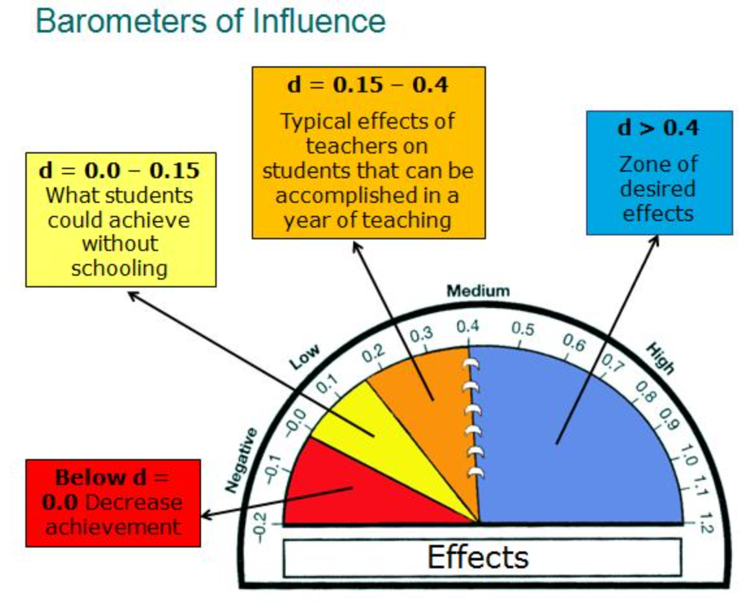
LEARNING BY CHANCE
LEARNING BY DESIGN
Notes:
The work of John Hattie and his research on influences that yield the highest degree of impact on student achievement focuses on the measurement that they have on student learning. As practitioners, we must identify what works best within instruction, in order to implement the most effective strategies with high levels of fidelity. Here is an illustration of Hattie’s effect sizes on the barometer of influence, moving from left to right, with explanation for each colored segment of the barometer: • Red: An effect size below zero represents strategies and actions that students may be exposed to that have reverse consequences on their learning. • Yellow: An effect size between zero and .15 indicates progress that a student can make without proper strategy instruction and guidance, where students are learning on their own through natural inquisitiveness and could achieve without schooling. • Orange: An effect size up to .40 represents a school year’s growth over the course of one school year. Schools that use effect sizes to measure student progress can maximize their impact on student outcomes. • Blue: An effect size of greater than .40 is the Zone of Desired Effects. Hattie’s research shows that there are many influences, when done with fidelity, will give students an opportunity to grow and have one, two and sometimes three years of progress. Schools that use effect sizes to measure student progress can maximize their impact on student outcomes.
Describe the barometer, focusing on a description of what the hinge point of 0.4 means. (one year of input resulting in a typical year of growth)
Provide examples of influences that fall in each of the sections of the barometer.
Retention = -0.32
Tracking/Streaming = 0.12
Homework = 0.28
Teacher Estimates of Achievement = 1.44

Slide 8
Strategy Quadrant Sort
High Effort
Rethink/Repurpose | Major Projects
Fill In Jobs | Quick Wins
Low Impact
High Impact
Low Effort

Slide 9
Strategy Implementation

Slide 10
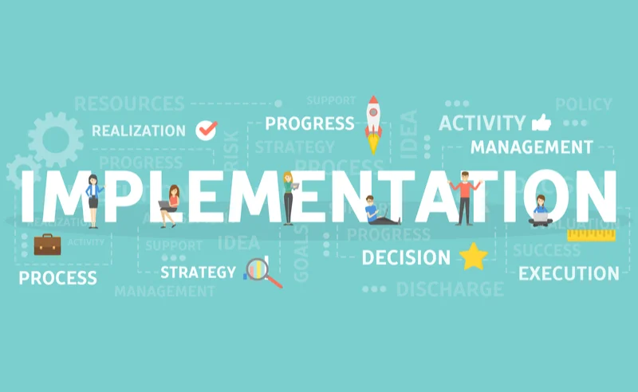
Strategy Implementation-
QFIC: Quality, Fidelity, Intensity, Consistency
Marginal Implementation
Alignment - Data/Goal/Strategy/Impact
Notes:
QFIC- For research-based classroom and school practices to improve achievement, they must be implemented with quality, fidelity, consistency, and intensity. Marginal, inconsistent, or unskillful implementation is not likely to produce desired results. This might be thought of as providing spark plugs to someone to install in a poorly running automobile without instructions for installing them. Providing the right parts and tools for improving performance without the knowledge to use them correctly will not produce needed improvements.
Focus on improving school and classroom practices that are already well developed and implemented.
Focus on school and classroom practices that are implemented marginally.
Focus on practices that lack evidence for improving student achievement.
Alignment -
Alignment means that your data, goal, strategy, and measures are aligned. Your data analysis informed and influenced your goal, your goal influenced your strategies, your strategies are research-based and connected to your goal, and you have a mechanism for measuring each strategy and its impact on your goal and data.
Reflect: How will you measure and monitor your strategies and impact?
Reflect: How will you ensure that your strategy is right for your students?
Action Plan - How are you ensuring QFIC for your current work? How will you ensure everyone is involved in this process?
Quality - with a high degree of skill, excellence, or effectiveness
Fidelity - in accordance with the core components; based on findings and/or guidance
Intensity - time; focus and commitment to providing recommended exposure
Consistency - in the same way over time, maintain standards for quality, fidelity, and intensity
Page 37 - https://files.eric.ed.gov/fulltext/ED544245.pdf
https://slideplayer.com/slide/17559269/

Slide 11
Example -
Strategy = Instructional teams meet regularly (twice month or more for 45 minutes each meeting) to review implementation of effective practice and student progress.
Quality - meetings will be normed and structured; discussion protocols will be taught, modeled, practiced, and evaluated for feedback
Fidelity - PLC training will be provided; coaches/leaders will monitor meetings to coach for fidelity and quality
Intensity - we will build in PLC time and protocols
Consistency - check in quarterly to ensure QFI
Notes:
Wise Ways - https://ncstar.weebly.com/uploads/5/2/4/4/52444991/a2_-_01_new.pdf

Slide 12
Strategy Analysis

Slide 13
FOCUS
LEVERAGE
ENGAGEMENT
ACCOUNTABILITY
4 Disciplines of Execution
Focus on the wildly important.
Act on lead measures (strategies).
Keep a compelling scoreboard.
Create a cadence of accountability.

Slide 14
FOCUS
LEVERAGE
ENGAGEMENT
ACCOUNTABILITY
FOCUS
Focus on the Wildly Important
Identifies starting line, finish line, and deadline.
Narrows the gap
Think WHAT not HOW
Creates behavior change
Tests:
Aligned
Measureable
Ownership
Performance based
Notes:
FOCUS
Example - Kansas Vision for education
WIG statement - From X (current) to Y (desired) by When
Ex. From 48% PS Effectiveness to 70% PS Effectiveness by 2030
WIG creates a breakthrough and leverages the Vision
Natural tendency is to think of how to accomplish as goals are established…...not conducive to setting stretch or breakthrough goals, set How aside until the WIG is set
To achieve a WIG, it generally requires a behavior change, which is why the focus must be narrow….most people have limited capacity available to change their behavior (80% of your capacity to the Whirlwind, 20% of your capacity to the WIG)
WIG must be aligned with larger organizational goals
Must be measurable (lag measures as they will take place after the work is done, not influenceable by staff)
Co-create with staff so there is ownership
Student-centered performance WIGS

Slide 15
FOCUS
LEVERAGE
ENGAGEMENT
ACCOUNTABILITY
LEVERAGE
Act on the Lead Measures (Strategies)
Moves the needle toward the wildly important goal
High impact ideas
Influenceable by the team
Tests:
Predictive
Measurable
Ownership
Ongoing
Team Game
Notes:
LEVERAGE
Called Lead measures because they are drivers that actually lead to achieving the WIG
High impact ideas that leverage the WIG
Lead measures are influenceable by the team...instead of biting our nails waiting for the lag measure to be posted, teams can take action through the lead measures
A lag measure shows you if you’ve achieved a goal…..a lead measure tells you if you are LIKELY to achieve the goal….it is predictable
Conceptually most difficult aspect of lead measures…...they must be measurable too! Lead measures (strategies) must be consistently evaluated for their effectiveness, so there must be a “measured” side of each strategy.
Ex. Redesign is a lever towards our Vision…..it is THE lever
It’s a player’s game and it’s ongoing

Slide 16
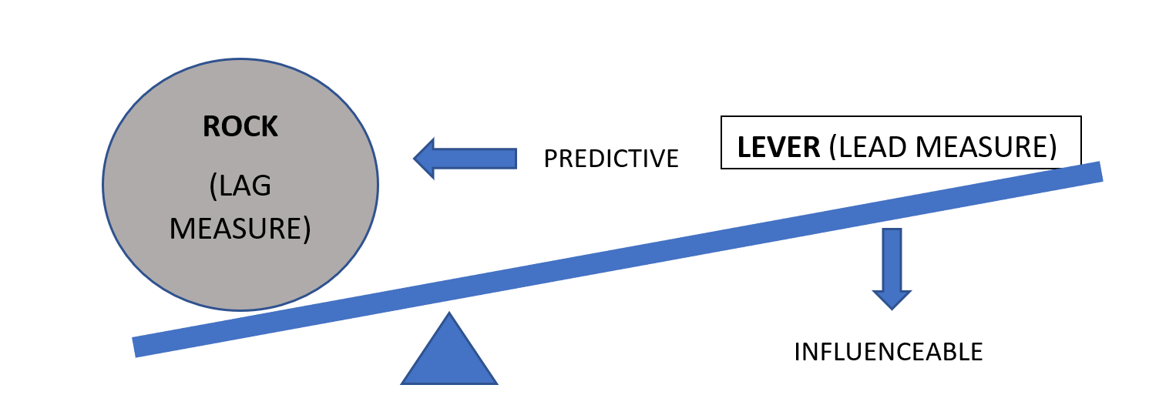
The 2nd Discipline of Execution
Act on Lead Measures (Strategies)
From The 4 Disciplines of Execution, McChesney, Covey, Huling 2012
Notes:
Ex. Rock - Astronauts can survive 7 days in space, including walking on the moon (LAG)
Lever - Incrementally, increase length of time in simulated weightless environment (LEAD)

Slide 17
Definitions
Lead Strategy = leads you to the result, outcome; leading measure/indicator of success; ‘formative’
Tied to implementation data or impact data
Lag Measure = end result, outcome; they lag behind the work; ‘summative’
Tied to outcome data (impact)
IF
THEN

Slide 18
Definitions
Implementation -
Are you doing the thing you said you would do?
Impact -
Is your data the same along the way? (i.e. reading scores)
Is the data a measure of growth? Performance? Results?

Slide 19
FOCUS
LEVERAGE
ENGAGEMENT
ACCOUNTABILITY
ENGAGEMENT
Keep a Compelling Scoreboard
Stakeholders remain emotionally engaged by knowing the score
Designed by and for the players
Tests:
Visible
Simple
Shows lead and lag measures
Shows if we are winning or losing
Notes:
ENGAGEMENT
Players will lose interest if they have to wait until the lag measure comes out to justify their work.
Its a players scoreboard (staff engaged in the strategy)
High degree of visibility to leverage engagement and accountability (maybe a bit of competition)
Easy to understand - one look and anyone can know what it means and can see if they are winning or losing
Includes both the lead measure (strategy) and the lag measure (WIG)
Ex. map of all redesign districts in Kansas or monthly touchpoints or satisfaction survey scores

Slide 20
The 3rd Discipline of Execution
Keep a Compelling (and Public) Scoreboard
(TEST)
-People play differently when keeping score
-Create a Player’s scoreboard, not a Coach’s
Is it simple?
Can I see it easily?
Does it show both lead and lag measures?
Can I tell at a glance if I’m winning?
Notes:
Ex. Track the length of time astronauts can function in a simulated weightless environment

Slide 21
Tips for determining what to measure
For Lag, ask...
For Lead, ask...
What outcome data do I ultimately want to move?
What is the greatest need my data is highlighting?
What high impact strategy will lead me to the impact I am seeking?
How do you know?
For measurement, start by asking:
What is the simplest piece of data I could collect?
If we used that in discussion, what other questions would I have?
What data steps could I take to answer the questions?

Slide 22
Example (More Examples)
*Reading scores (lag) --> Systematic Instruction (strategy)
--> Training (lead)
Implementation - Are staff receiving training? Tally
--> Classroom Practice (lead)
Implementation - Are teachers using the practice? Tally
Impact - Are teachers using the practice effectively? Walk Through Feedback/ Rubric
Impact - Are students achieving? Data Chart
Notes:
Moving from assurance --> qfic --> outcome (student learning)

Slide 23
Lead and Lag within a System
Implementation & Impact
Lead- Teachers using the advisory time lessons
Lag- Student completion of IPS
Lead- Student completion of IPS
Lag- Star Recognition for IPS
Lag- Post-Secondary Success Rate is 5% above predicted
SCHOOL
SYSTEM

Slide 24
High School Example
In this example, we have two lead/lag examples.
In the first, they measure completion of weekly BRAGG Conferences.
This leads to IPS Benchmark Completion (lag).
In the next example, they measure scheduling conferences.
This leads to attendance (lag).

Slide 25
Lead & Lag within a System
Impact Only
Lead = student scores on formative assessments (Lexia)
Lag = student performance on interim assessments
Lead = student performance on interim assessments
Lag = student performance on summative assessments (KAP)
SCHOOL
SYSTEM

Slide 26
Elementary Example
In this school, they are tracking three things:
Social Emotional Learning-
Did teachers complete the lessons? (lead)
Are students staying ‘green’ throughout the day? (lag)
Reading-
Are students advancing along: Mobymax & AR? (lead)
Are kids meeting benchmarks? (lag)
Math-
For each grade, how well are students scoring on the introductory & end of chapter exams? (pre/post)

Slide 27
Why start this habit?
“Execution doesn’t like complexity. The two best friends of execution are simplicity and transparency.” ~ Chris McChesney
The lag and lead measures won’t have much meaning to the team unless they can see the progress in real time.
Bowling through a curtain is not that much fun.
Discipline 3 is the discipline of engagement.
People perform best when they are emotionally engaged, and the highest level of engagement comes when people know the score: whether they are winning or losing the game. It’s that simple.
https://www.franklincovey.com/the-4-disciplines/discipline-3-scoreboard/

Slide 28
FOCUS
LEVERAGE
ENGAGEMENT
ACCOUNTABILITY
ACCOUNTABILITY
Create a Cadence of Accountability
Weekly commitments made by team
WIG meetings held weekly to report and commit
3 part agenda for a WIG session
Account. Report on last week’s commitments
Review scoreboard.
Plan. Make new commitments
Notes:
ACCOUNTABILITY
This ensures that QFIC is determined and held onto throughout implementation.
Discipline 1, 2, and 3, set up the game but until you apply Discipline 4, your team isn’t in the game.
Analyzing the scoreboard and making a personal commitment to move the score forward for next time.
Rules to a WIG meeting:
Same day, same time each week
Whirlwind is never allowed into the meeting
Keep WIG meetings to 20 to 30 minutes
Agenda
Ex. Monday morning Project Team meetings - survey results from PLC’s, Account. Review. Plan.

Slide 29
Creating a Cadence of Accountability
Purpose - Keeping your team focused on what’s important despite the daily whirlwind
Through these consistent touchpoints, team members can:
Learn from each other about how to improve the strategy being tested
Give each other the support needed to keep commitments
Adapt on the fly
Celebrate progress and get re-engaged

Slide 30
Discipline 4- Staying Accountable
Keep these separate from teacher collaboration time!
Short, ~20 minutes, 3 questions: what did you do (Account), what was the result (Review), what will you do by next time (Plan)?
If issues are identified, then you flag that issue for discussion in a sit-down meeting.
Consider:
When and where will each team meet?
What roadblocks need to be removed to ensure these meetings happen?
Where will teams report their commitments?

Slide 31
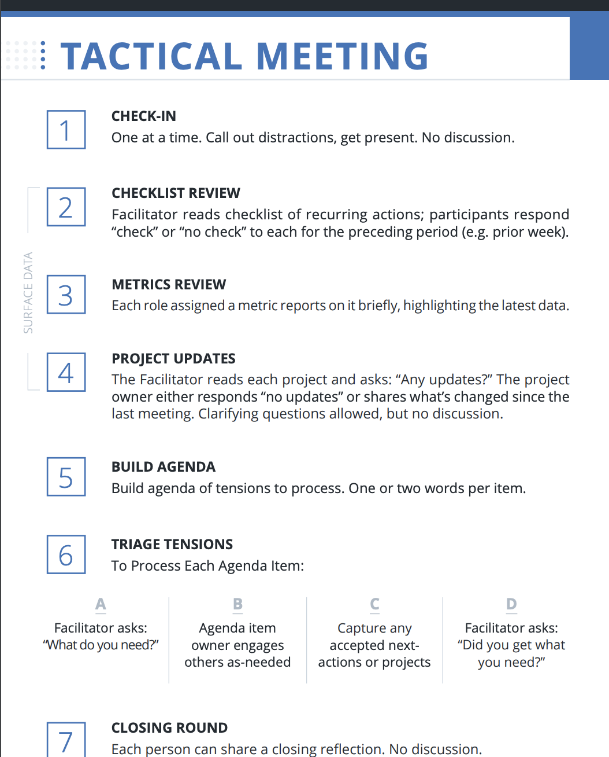
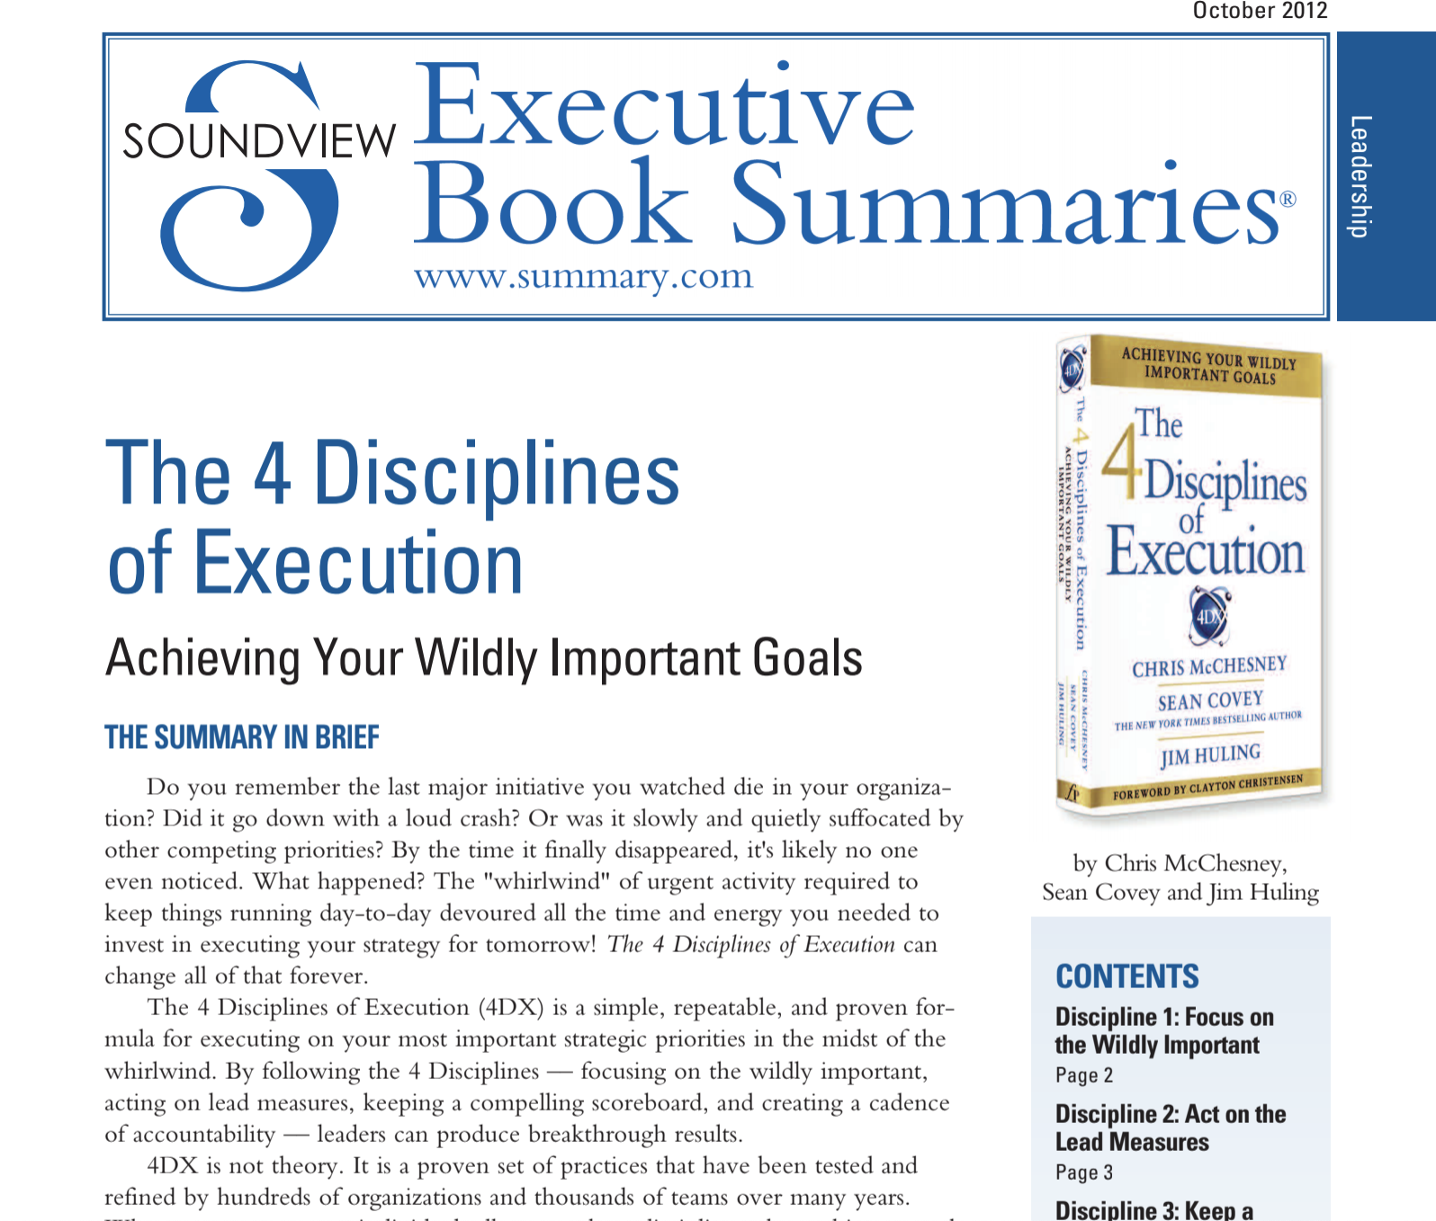
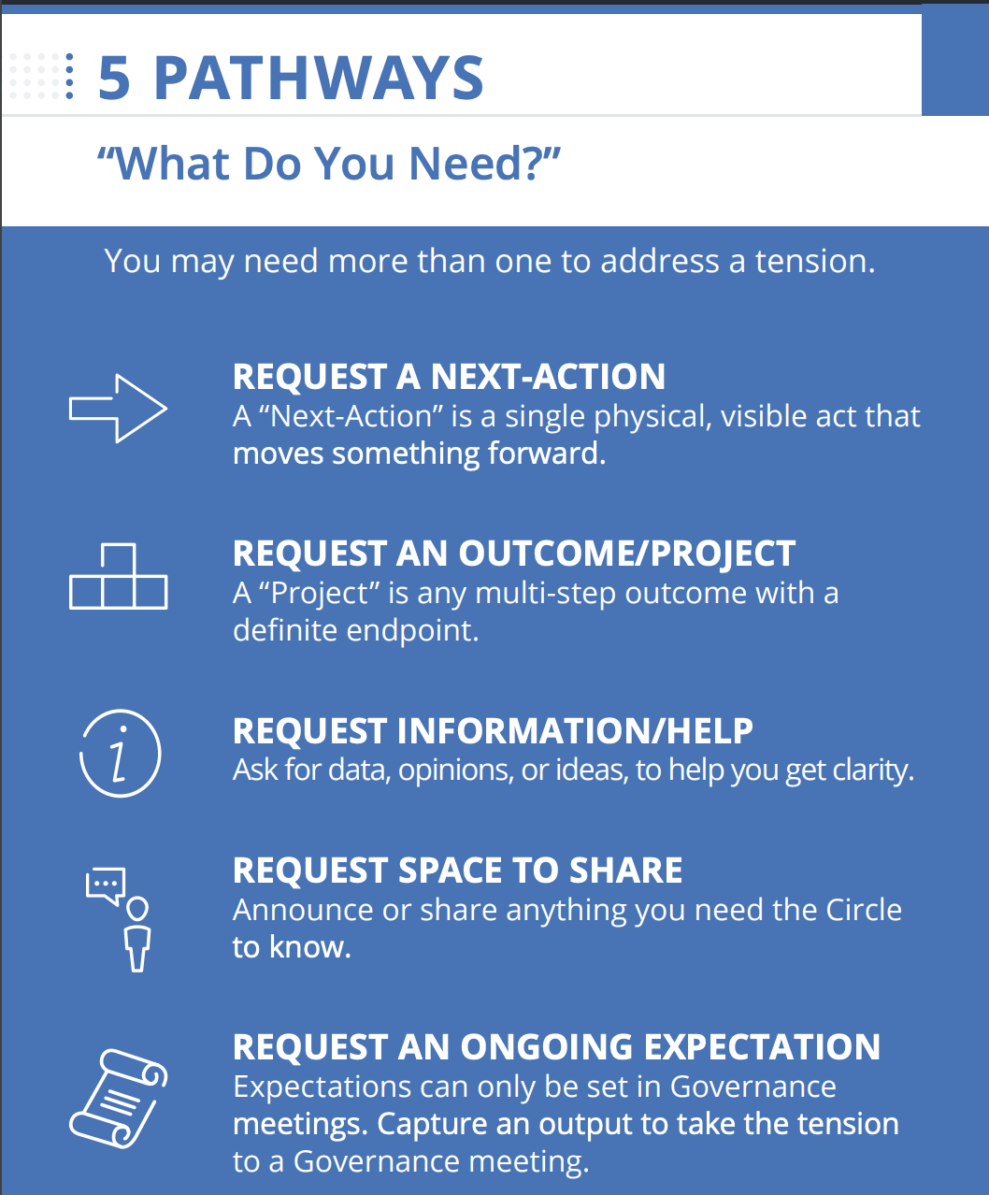
Resources for Exploration
Holacracy
4 Disciplines of Execution
The New School Rules
Notes:
Myron
Holacracy Tactical Meeting
Meeting card- https://static1.squarespace.com/static/5d1239a79c02150001db74d4/t/5d262f366c03c80001ad40ec/1562783542971/Tactical-Card_02-25-19.pdf
KSDE Accountability Talks
New School Rules (Rule 6- Learning Organizations)

Slide 32
Meeting Option 1: Create a Strategy Progress Document
Look back at your Strategy Action Plan.
List which project milestones were met.
List which project milestones were not met.
Identify what challenges existed during implementation and testing.
List out next steps for each strategy.

Slide 33
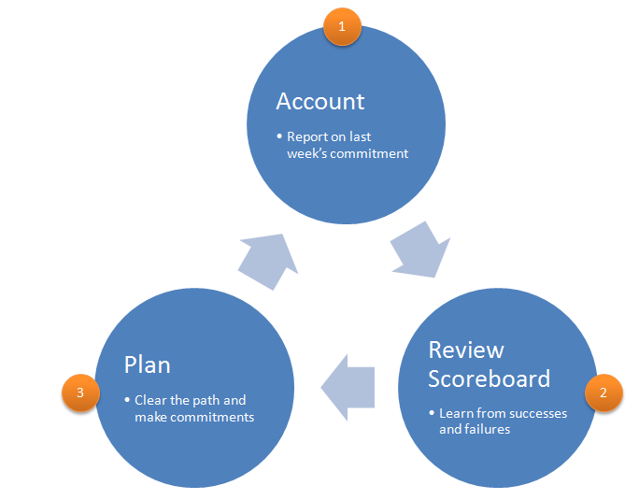
Meeting Option 2: 4DX Model
Meetings should last 20-30 minutes
Step 1 & 3- Commitments:
What did you bring? What will you do?
Tied to a deliverable
Act on lead measure
Timely
Notes:
https://www.franklincovey.com.au/discipline-4-create-a-cadence-of-accountability/
https://www.slideshare.net/BradMease/4-disciplines-of-execution-presentation

Slide 34
Meeting Option 3: 15 Minute Data-Dive
Easy to use 5 step process that can be adapted for any data set.
Allows for conversation about what has been done, how it’s going, and what needs to occur moving forward.

Slide 35
Accountability Meetings- Recommendations
Standards for Meeting Structures
Principles of (Meeting) Design
Groups should address only one topic at a time.
Groups should only use one process at a time.
Meetings should be interactive and engage in balanced participation.
Decision-making meetings should encourage cognitive conflict.
All parties should understand and agree on meeting roles.
Allocentrism- plan with the group in mind
Relevance- connect to the members and unit goals
Information- ensure that groups have the information they need to do their task
Interaction- keep minds and voices active
Congruence with organizational values and beliefs
Notes:
From “Adaptive Schools” (Garmston & Wellman)
CLEAR OBJECTIVES & AGENDAS

Slide 36
Strategy Report
Optional tool for evaluating tested strategies for scaling across your launch and ascent years.

Slide 37
Leadership Considerations

Slide 38
Leadership Focus- Administrators
Coach those you lead: Give Constructive Feedback
Maintain Accountability Meetings
Focus on the needs of the receiver
Be specific with descriptive facts
Tough on the performance (data)
Focus on the future and suggest positive alternatives
(McBride, 2019)
Ensure staff have time to hold weekly accountability meetings within their Goal Area Investigation Teams.
Provide technical support to teams when called upon.
Assist in facilitating tough conversations.
Notes:
KLC Guidebook, by Julia Fabris McBride, Kansas Leadership Center, 2020
Criticism:
A way of unloading anger or disappointment
Focused on the needs of the giver
Angry, dismissive, emotional
Ignore positive
Tough on the person
Vague, generalized, evaluative
Attributes opinions to others
Looks backward; laments missed opportunities
One-way pronouncements

Slide 39
Leadership Focus- Teachers
Giving and Receiving Constructive Feedback
Analyzing Data in Objective Conversations
Focus on the needs of the receiver
Be specific with descriptive facts
Tough on the performance (data)
Focus on the future and suggest positive alternatives
(McBride, 2019)
Focus on the facts and not the feelings
Establish and stick to conversation outcomes
Ex- Strategies are evaluated to determine if they should be continued, revised, or stopped.
Notes:
KLC Guidebook, by Julia Fabris McBride, Kansas Leadership Center, 2020
Criticism:
A way of unloading anger or disappointment
Focused on the needs of the giver
Angry, dismissive, emotional
Ignore positive
Tough on the person
Vague, generalized, evaluative
Attributes opinions to others
Looks backward; laments missed opportunities
One-way pronouncements

Slide 40
FAQ

Slide 41
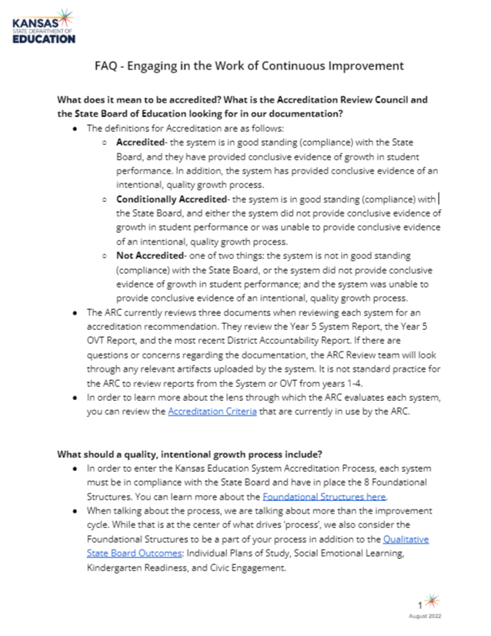
Supporting the Work -
FAQ

