Slide 1
Kansans Can Success Tour Data Discussion with SBOE - February 2022
Dr. Randy Watson, Kansas Commissioner of Education

Slide 2
Our Vision for Kansas ...
Kansas leads the world in the success of each student

Slide 3
KANSAS CHILDREN KANSAS’ FUTURE Tour

Slide 4
From the first set of focus group responses, what characteristics of success were most frequently cited?

Slide 5
The business and industry focal groups cited non-academic skills with greater frequency than the community groups:

Slide 6
What Kansans want from their schools
Changes need to be made to address school culture
New dynamic roles for counselor and social workers
Collaboration between schools and businesses
Reorganize schools around students, not the system
Community service needs to play a bigger role
Kansas children need quality preschool including all day kindergarten
Notes:
We also learned that Kansans believe
Every child needs access to quality preschool education
School culture needs to be addressed – we must value the student going to a two-year or certification program as much as a student attending a four-year institution.
Counselors need to be able to help students identify and explore career interests
Must be collaboration between schools and businesses to prepare students for postsecondary pursuits
Schools must be reorganized around the student, not the system to meet unique needs
Community service is an important part of preparing students for life after high school.

Slide 9
Examining the 2021 Success Tour Data R12 Comprehensive Center - McRel Kansas State University Kansas State Department of Education

Slide 10
Success Tour Data 2021
Statewide participation
Who attended the sessions?
How do they feel about the skills needed and strategies to produce successful adults?
Deep dive into qualitative findings
What supports do schools need?
Five common themes
Notes:
Table of contents to be revised as needed

Slide 11
Statewide glance
How many people responded to the survey questions?
3,455 respondents
3,213 online Menti respondents
242 paper question cards completed
50 in-person sessions across the state and 1 online session
Notes:
General information about session attendees.
3,455 total survey respondents. 3,213 responded to the online Menti during the session and an additional 242 individuals completed the question cards or paper survey.
**It should be noted that the Menti items and the paper Question Cards did phrase the scale items in different ways. The Menti asked them to rate on a scale of 1 – 5 with 1 being the lowest and 5 being the highest. The Question card however, asked respondents to select from strongly agree to strongly disagree. The data has been interpreted with the strongly agree to strongly disagree scale.

Slide 12
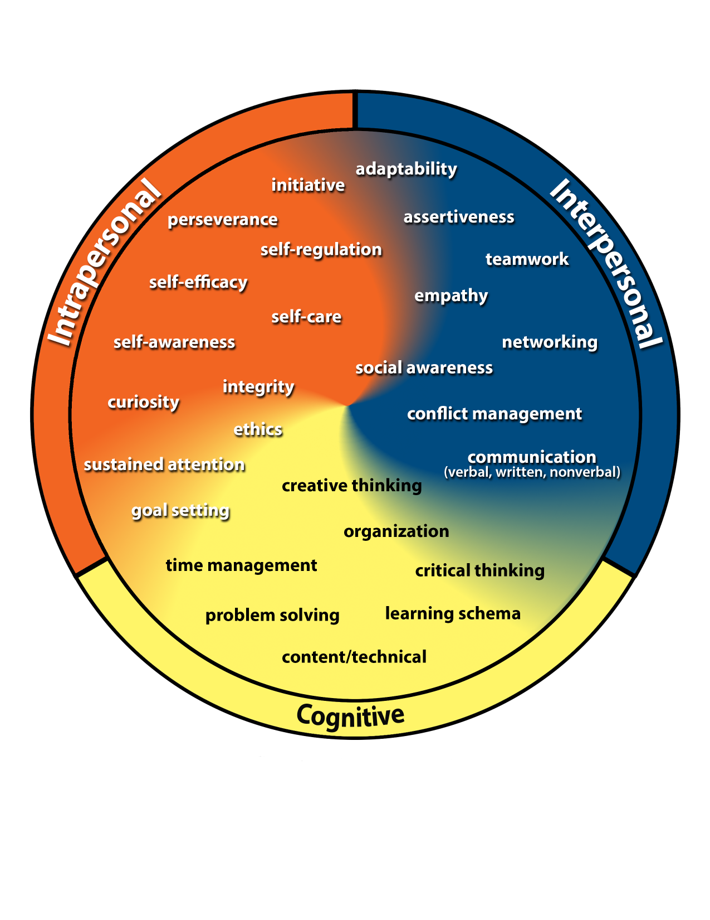
Kansans Can
Competencies
Notes:
Added the Kansans Can Competency Wheel here as a reminder of the skills included prior to viewing the responses to the following survey item.

Slide 13
From the first set of focus group responses, what characteristics of success were most frequently cited?

Slide 14
The business and industry focal groups cited non-academic skills with greater frequency than the community groups:

Slide 15
Kansans Can
Competencies
Notes:
Added the Kansans Can Competency Wheel here as a reminder of the skills included prior to viewing the responses to the following survey item.

Slide 16
The skills represented on the Kansans Can Competency Wheel are the skills students need to be successful as an adult.
5%
2% Disagree or Strongly Disagree
Neutral
Notes:
This provides the same data as the previous slide. Here we have combined the top and bottom two categories into a single grouping.
**We are also interpreting the ratings of 1 – 5 as strongly disagree to strongly agree.**
93% of individuals agree or strongly agree that the KCCW skills are needed for students to be successful adults. Whereas 2% of respondents reported disagreement or strong disagreement with the statement. 5% of respondents selected 3, which could be interpreted as a neutral response.

Slide 17
These strategies Kansans expressed are still a priority to accomplish the goal of producing successful high school students.
8%
3% Disagree or Strongly Disagree
Neutral
Notes:
This provides the same data as the previous slide. Here we have combined the top and bottom two categories into a single grouping.
**We are also interpreting the ratings of 1 – 5 as strongly disagree to strongly agree.**
89% of respondents agree or strongly agree that the strategies expressed are still a priority to accomplish the goal of producing successful high school students. Whereas 3% of respondents reported disagreement or strong disagreement with the statement. 8 % of respondents selected 3, which could be interpreted as a neutral response.

Slide 18
What Kansans want from their schools
Changes need to be made to address school culture
New dynamic roles for counselor and social workers
Collaboration between schools and businesses
Reorganize schools around students, not the system
Community service needs to play a bigger role
Kansas children need quality preschool including all day kindergarten
Notes:
We also learned that Kansans believe
Every child needs access to quality preschool education
School culture needs to be addressed – we must value the student going to a two-year or certification program as much as a student attending a four-year institution.
Counselors need to be able to help students identify and explore career interests
Must be collaboration between schools and businesses to prepare students for postsecondary pursuits
Schools must be reorganized around the student, not the system to meet unique needs
Community service is an important part of preparing students for life after high school.

Slide 19
Across the state, Kansans overwhelming agree that we are prioritizing the right skills and strategies to produce successful high school students and adults.
Notes:
Most survey respondents rated the statements high which can be interpreted as agreement with the Kansans Can Competency Wheel skills (93%) and the strategies (89%) used to accomplish the goal of producing successful adults.
…but there is more work to be done to support schools in achieving these goals…

Slide 20
What support do schools need in order to accomplish the system change desired by Kansans?
Notes:
A total of 2,867 open-ended responses to this item.
Analyzed by KSDE with Qualtrics TextiQ and manually. Also examined by the R12 Comprehensive Center and K-State. These groups were able to use NVivo.
Purpose of analysis is to identify common responses and categorize these into larger themes representing the entirety of responses.

Slide 21
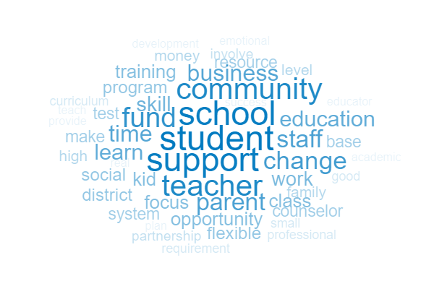
2,867 open-ended responses
Data was examined by:
KSDE
R12 Comprehensive Center
Kansas State University
Consensus among these three groups on the five overarching themes
Notes:
Each group that examined the data found many common themes emerging from the data. They may have been labeled in different ways and structured in categories or topics differently but there was some consensus on the overarching themes found in the data.
R12CC examined the data by looking at board region as well as four locale categories.
KSU examined the data by looking at 12 locale types as well as district size.
All found overall consistency across the state in the supports reported. These comparisons are not presented here due to the coding structures varying among the groups, but are available upon request.

Slide 22
Notes:
Each group examined the data in unique ways and developed their own set of themes and codes. Through a collaborative process, these five core themes were developed to synthesize the work of KSDE, R12CC and KSU and to illustrate the needs expressed by respondents.
Other info to note:
Respondents reported a wide variety of detail in their responses from simply “more funding” to a paragraph describing specific funding needs and other detailed supports.
Many individuals reported supports in multiple areas across themes
We chose not to report the frequency of responses aligning with each theme due to the variation in coding structure among KSDE/KSU/R12
Each theme was prominent in the data across all regions/locations and all contribute to the Kansans Can vision
Some unique and specific needs were reported, particularly in rural tour locations, that may not be represented in the data due to lower frequency/small session size
Tour location specific analyses can be conducted if districts are interested in what was said by attendees of their session though we cannot confirm that attendees of the session belong to their district or even region

Slide 23
Community Relations and Engagement
Providing for opportunities for community engagement and support of schools to enhance opportunities for students through:
Communication with families
Partnerships with businesses
Collaboration across districts
Involvement from the community
Notes:
Four subthemes are listed with descriptions and examples for each.
Communication: educate and communicate with families and broader community about changes
Engagement: support and involvement from community groups including higher education institutes, professional organizations (e.g., school board association, teacher unions), business leaders and families to meet the needs of schools and students
Partnership: build and sustain partnerships with business, industry, and private-sectors to expand opportunities for hands-on learning, real-world experiences
Collaboration: increase collaboration and networking within and among school districts

Slide 24
Educator-Centered Supports
Prepare, train, trust and support educators by:
Updating and enhancing teacher preparation programs
Encouraging autonomy in the classroom
Hiring and retaining qualified staff and offering better pay
Providing continued relevant professional development
Increasing educator time for instruction, implementation, communication
Notes:
Five subthemes and descriptions.
Professional development: provide continued meaningful professional development, technical assistance and training
High quality staff: attract, recruit and retain quality staff; offer better pay and support for staff
Autonomy: trust teachers and allow for autonomy and decision-making in the classroom
Time: Increase time for educators to collaborate, work with community partners, communicate with families, implement changes etc.
Teacher preparation: enhance and update teacher preparation programs; develop strong partnerships to increase teacher pipeline

Slide 25
System-wide Needs
Work to address system-wide needs in order to support students and staff by:
Increasing funding to enhance programs and instruction, offer PreK and increase salaries
Hiring qualified teachers, paras, counselors, social workers and allowing for reduced class size
Prioritizing the mental health and social-emotional needs of staff and students
Notes:
Three subthemes under system-wide needs.
Funding: increase funding to increase educator salaries, allow for differentiation of instruction, provide PreK and enhance early childhood programs etc.
Meet staffing needs: hire and retain high quality educators and support staff including paraprofessionals, counselors, social workers as well as change implementers and researchers; allow for reduced class sizes
Social-emotional support: prioritize mental health and social-emotional needs of staff and students; provide access to counselors and social workers in all schools

Slide 26
Leadership and Policy
Leadership and policies that support educators and enable system change through:
Clear guidance and communication
Flexibility in instruction, assessment and curriculum requirements
Adapting policies including those related to accreditation, licensure, graduation, and how credits are awarded
Notes:
Leadership here not only refers to building or district leadership but also state-level leadership at KSDE, State Board of Education and Legislature.
Policy changes: adapt policies to support schools and students including changes to licensure requirements and accreditation process, graduation requirements and how credits are awarded
Stable leadership: clear guidance and effective communication; support and trust educators
Flexibility: allow for flexibility in instruction, assessment and curriculum requirements and support local autonomy

Slide 27
Enhance Student Learning and Success
Enhancing and increasing opportunities for diverse student learning and assessment through:
Opportunities for internships, job shadow, work-based learning etc.
Diversifying ways in which learning is assessed
Reducing emphasis on traditional testing
Adapting school structures like class size, schedules, and grading
Supporting educators in implementing changes
Opportunities for individualized learning
Notes:
Real world experience: provide more opportunities for internships, mentorships, work study, job shadow, work-based learning; support Career and Technical Education and Pathways
Diversify measures: diversify the ways student learning and competency can be assessed; use real-life applications as a way of assessing learning and competency
Testing: reduce the emphasis on traditional testing and assessments
Adapt school structures: adapt and adjust class size, school schedules, grading and credit structures to support student learning; balance academic knowledge and social-emotional learning
Guidance and supports: support educators in implementing changes with professional development, resources, guidance and time
Personalized learning: allow for more personalized learning and individualized instruction, project-based learning

Slide 28
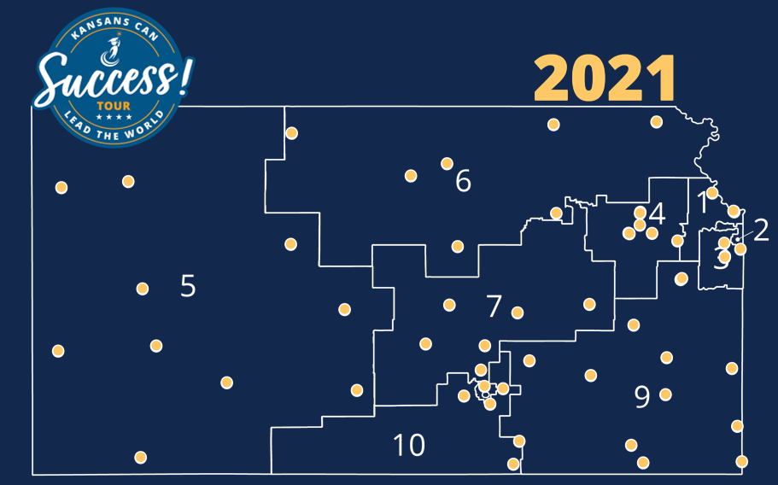
Though there were some unique needs shared, overall Kansans reported clear and consistent needs for supporting schools regardless of geographic location, board region and district size.
Notes:
Final Summary points:
Validation of the current work of the agency
Consistency in needs across the state regardless of location, board region, district size
There were specific needs identified unique to certain locations (particularly rural session locations)
Regional and district comparison data can be provided if requested (however, the data was analyzed with themes and codes unique to KSDE/KSU/R12CC)
Many of these supports intersect the five core themes
Funding touches student learning, system wide needs, educator centered supports and is impacted by leadership and policy
Some supports may lead to action whereas others are out of the control of the districts/KSDE

Slide 29
Notes:
Today’s students are the future workforce and future leaders of Kansas. Kansans Can achieve anything and, together, Kansans Can lead the world in the success of each student.

