Slide 1
Kansas Leads the World in the Success of Each Student.
Dr. Randy Watson, Commissioner of Education
Dr. Brad Neuenswander, Deputy Commissioner

Slide 2
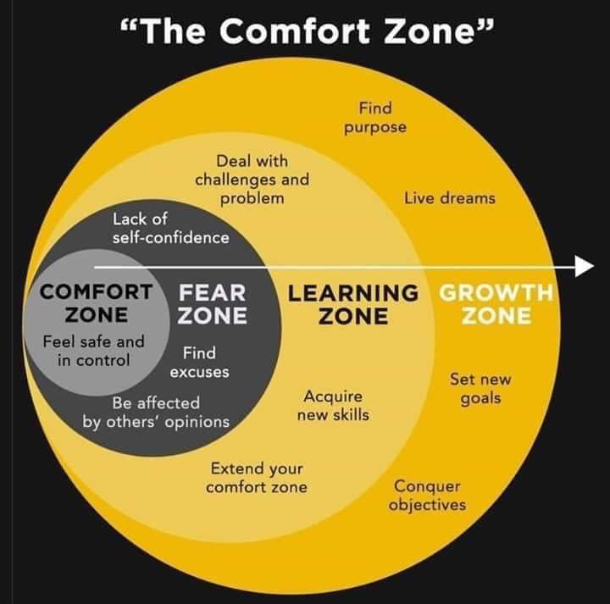
The Challenge of Change

Slide 3
Our Big Rocks…Our Overall Goal
100% of Students Graduate High School
100% of Students execute a Post Secondary Plan
45% attend a four year college
45% attend a two year college and/or have multiple certificates
5% are in apprentice programs
4% enlist in the military
1% attend 18-21 year old program

Slide 4
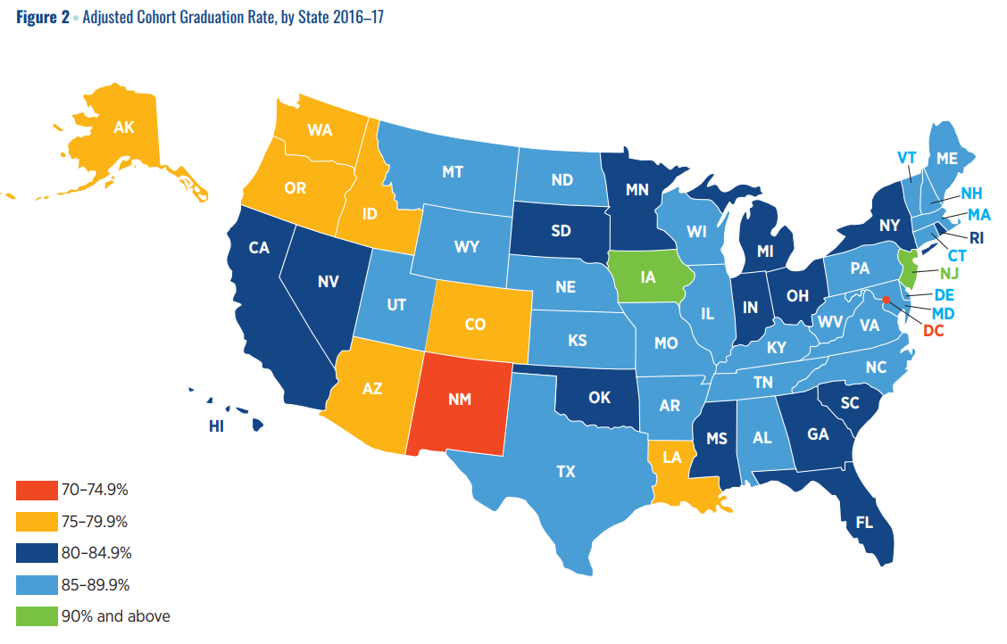

Slide 5
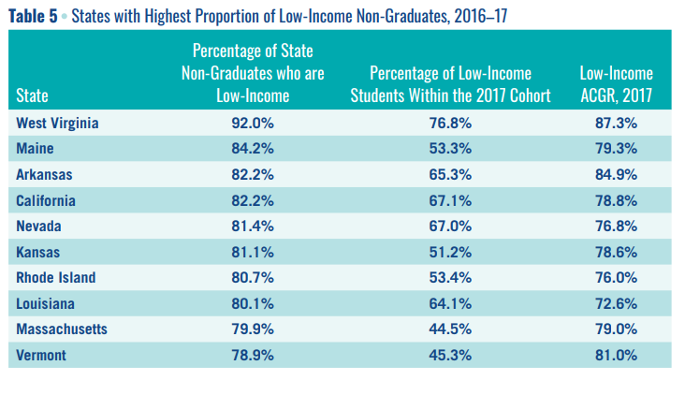

Slide 8
Stages of Development – What we look for
Birth – Age 4
Ages 5 - 9
Ages 10-16
Ages 17-20

Slide 10
Notes:
Today’s students are the future workforce and future leaders of Kansas. Kansans Can achieve anything and, together, Kansans Can lead the world in the success of each student.

