Slide 1
Kansas Leads the World in the Success of Each Student.
Dr. Randy Watson, Kansas Commissioner of Education

Slide 2
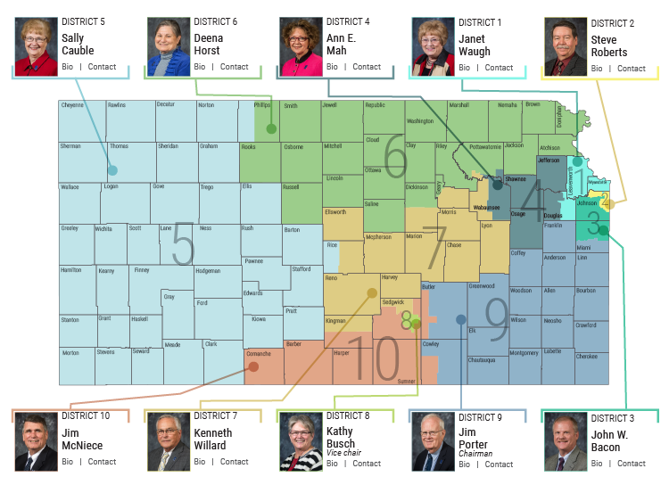

Slide 3
A NEW Vision for Kansas ...
Kansas leads the world in the success of each student
KANSAS STATE DEPARTMENT OF EDUCATION | www.ksde.org
Notes:
Jay - This is the vision for education in Kansas and the redesign initiative is all about aligning school systems to this vision.
“Each” – personalizing learning for each student.
What do you want success to mean for your students?

Slide 4
How Does an IPS flow into Post Secondary Success?

Slide 5
From the first set of focus group responses, what characteristics of success were most frequently cited?
Notes:
This result is a little surprising since about 66% of the respondents were educators, education administrators, or former educators—people who mostly teach, or used to teach, academic skills. Nevertheless, the soft skills—social-emotional, personality skills, or 21st century skills—they have lots of names—were cited 70% of the time.

Slide 6
The business and industry focal groups cited non-academic skills with greater frequency than the community groups:
Notes:
Recall that the community groups cited non-academic skills 70% of the time and academic skills 23% of the time. These frequencies are remarkably similar to those expressed by the community groups. If volume can be equated with importance, the business and industry groups are saying that the non-academic characteristics are more important than academic skills, including applied skills, and that non-academic skills are at least as important to them as to the community groups, maybe more so.
One cited experience as a characteristic of the ideally prepared 24 year old (the tiny yellow line).

Slide 7
What employers want

Slide 8
Creating a Vision for Kansas – State Outcomes
Social Emotional Growth
Kindergarten Readiness
Individual Plan of Study
High School Graduation Rates
Post Secondary Completion
Notes:
Among the outcomes being considered by the state board are:
High School Graduation Rates
Post Secondary Completion/Attendance
Remedial Rate of Students Attending Post-Secondary
Kindergarten Readiness
Individual Plan of Study Focused on Career Interest
Social/Emotional Growth Measured Locally
Education Commissioner Randy Watson and members of the State Board of Education will meet with business, education and state leaders to build agreement on how we will work together to achieve this vision for Kansas education.
Kansas schools are already doing tremendous work to address the needs of individual students, but in order to achieve this new vision we cannot expect schools to go it alone. This requires a unified effort with businesses, communities, parents, higher education, and elected officials working with educators to help provide the supports and experiences Kansas students need for their future success.

Slide 11
Redesign?
Personalized
Project Based
Longer time with teachers (hours and years)
Immersion with parents and the community

Slide 12
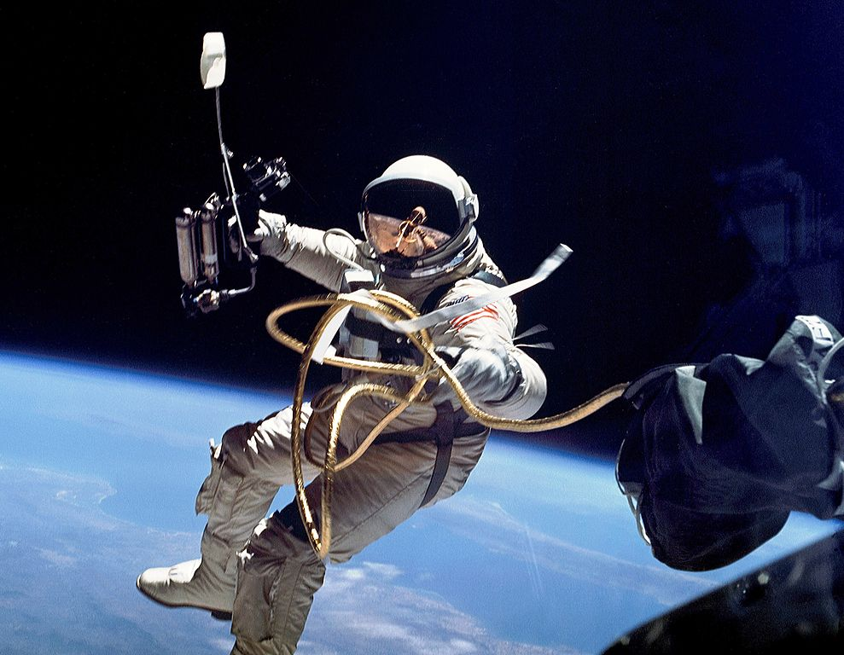
Announcing...Gemini II – The Space Walk Begins

Slide 13
Gemini II Application Process
Agree to redesign one elementary and one secondary school.
Each district and school must provide evidence and have approval by school board with vote; faculty with a vote of 80 percent; and local Kansas-National Education Association or other professional organization support.
Be able and willing to completely redesign one elementary and one secondary school around the vision, outcomes and definition of a successful high school graduate.
Be able and willing to launch a new school design in the 2019-2020 school year.

Slide 14
Gemini II Application Process
Window for application starts on February 5, 2018
Deadline for applications is April 2, 2018
Gemini II districts will be announced at the SBOE meeting on April 17, 2018

Slide 15
Gemini II Application Process
Kansas is in the process of developing a Kansas Redesign Flight Manual that will help guide Gemini II schools in the redesign process.
Individualized regional support will be provided to Gemini II schools and districts beginning the Fall of 2018.

Slide 16
Governor Brownback’s Education Proposal
Graduation Rate of 95%
Post Secondary Effective Rate of 75%
150 Counselors, Social Workers, School Psychologists
More Redesign Schools (50)
ACT and ACT WorkKeys
First 15
Lead in teacher salaries

Slide 17
Notes:
Today’s students are the future workforce and future leaders of Kansas. Kansans Can achieve anything and, together, Kansans Can lead the world in the success of each student.

