Slide 1
Personalized Learning: Deep Dive
Training Activity

Slide 2
Day 1
First Look

Slide 3
Activity-
Review definition
Define the 5 ‘Flexibilities’
Review Definition, Research, and Nav Change to come up with similarity statements for PL and CBL
How do these 3 connect?
Next Time- Deep Dive into Equity and Choice and Flexibility Considerations

Slide 4
Kansas Definition-
Personalized Learning: It’s what students deserve.
Notes:
https://www.ksde.org/Portals/0/Communications/KC_School_Redesign/Personalized%20Learning%20Fact%20Sheet.pdf?ver=2020-09-30-124429-557

Slide 5
Personalized Learning- Student Benefits
Promotes student ownership
Creates lifelong learners
Increases student engagement
Students deserve equitable opportunities and supports when learning. Students deserve to bring their whole selves to the learning experience. With personalized learning, students get what they deserve, leading to success in school and beyond.

Slide 6
Definition of Personalization
Personalizing learning places the whole child at the center of instruction. It is informed by strong educator/student/ family relationships to provide equity and choice in time, place, path, pace, and demonstration of learning.

Slide 7
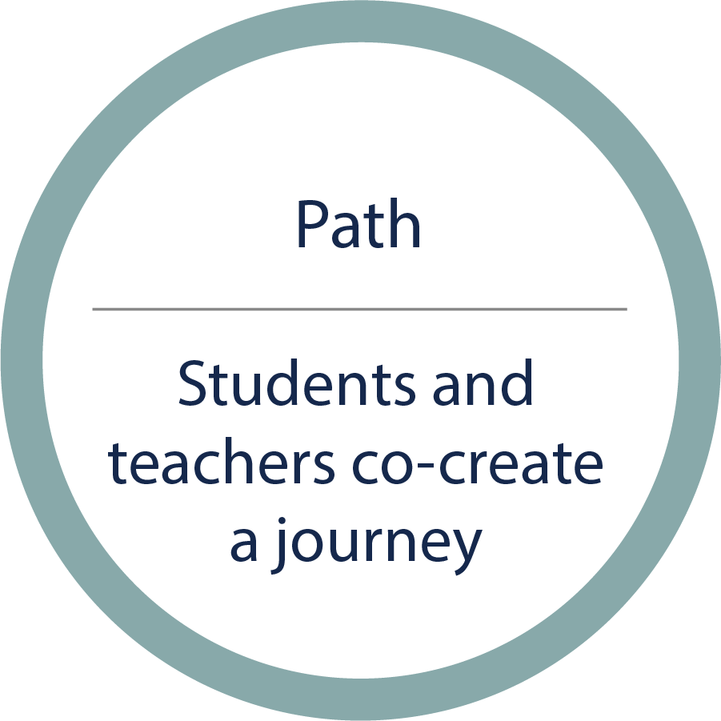
Path
A student, family and teacher get to know each other,¹ and make a plan to learn based in part on a student’s experiences.² The journey both develops interests and shows new possibilities.³
¹ Gehlbach, H., Brinkworth, M., King, A., Hsu, L., McIntyre, J., & Rogers, T. (2016). Creating birds of similar feathers: leveraging similarity to improve teacher-student relationships and academic achievement. Journal of Educational Psychology, 108(3), 342–352.
O’Neil, M., Volmert, A., & Gerstein Pineau, M. (2019). From caring to conditions: Strategies for effectively communicating about family, school , and community engagement (A FrameWorks Brief). FrameWorks Institute. Retrieved from https://www.frameworksinstitute.org/publication/from-caring-to-conditions-a-frameworks-framing-brief/
² Herrera, S. (2016). Biography-driven culturally responsive teaching (2nd ed.). Teachers College Press.
Connor, C. M., Dombek, J., Crowe, E. C., Spencer, M., Tighe, E. L., Coffinger, S., Zargar, E., Wood, T., & Petscher, Y. (2017). Acquiring science and social studies knowledge in kindergarten through fourth grade: Conceptualization, design, implementation, and efficacy testing of content area literacy instruction (CALI). Journal of Educational Psychology, 109, 301–320.
³ Levine, E. & Patrick, S. (2019). What is competency-based education? An updated definition. Aurora Institute. https://aurora-institute.org/resource/what-is-competency-based-education-an-updated-definition/

Slide 8
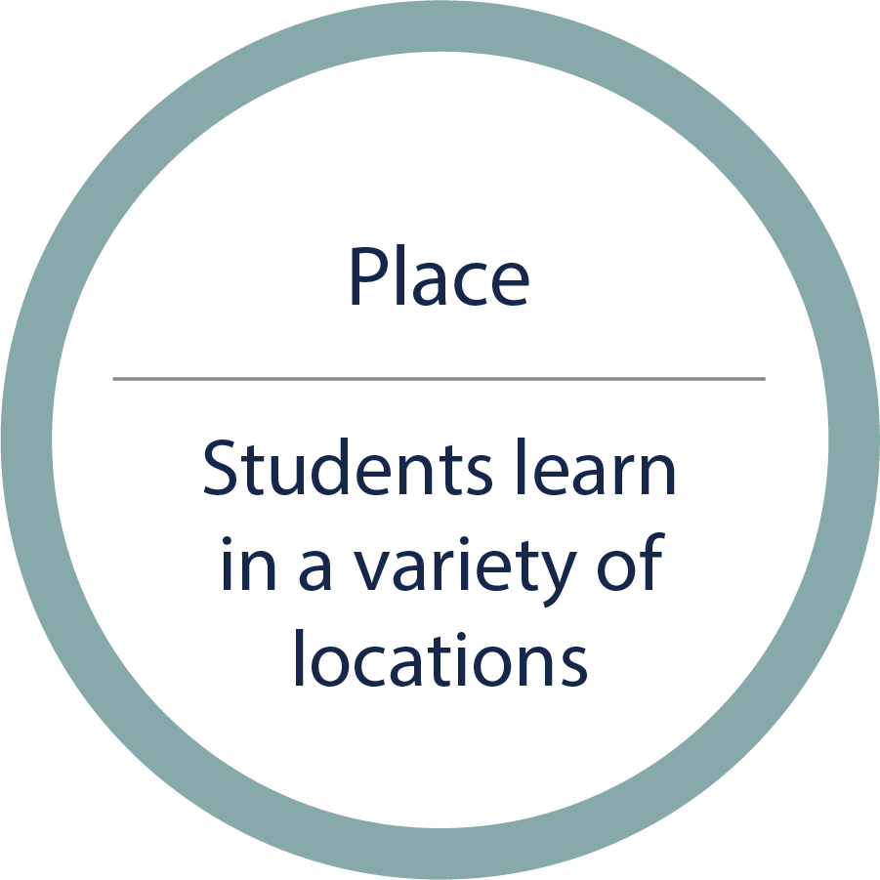
Place
Learning happens anywhere. Students make use of their surroundings to learn, and activities help students build competencies in the places most important to their lives.⁴
⁴ Van Noy, M., James, H. & Bedley, C. (2016). Reconceptualizing learning: A review of the literature on informal learning. Education and Employment Research Center. Retrieved from https://equityinlearning.act.org/wp-content/uploads/2017/07/Informal-Learning-Lit-Review-Final-April-2016-1.pdf
Hurst, M., Polinsky, N., Haden, C., Levine, S., & Uttal, D. (2019). Leveraging research on informal learning to inform policy on promoting early STEM. Social Policy Report, 32(3). Retrieved from https://srcd.onlinelibrary.wiley.com/doi/full/10.1002/sop2.5
Herrenkohl, L., & Bevan, B. (2017). What science and for whom?: An introduction to our focus on equity and out-of-school learning. Science Education, 101(4), 517–519.

Slide 9
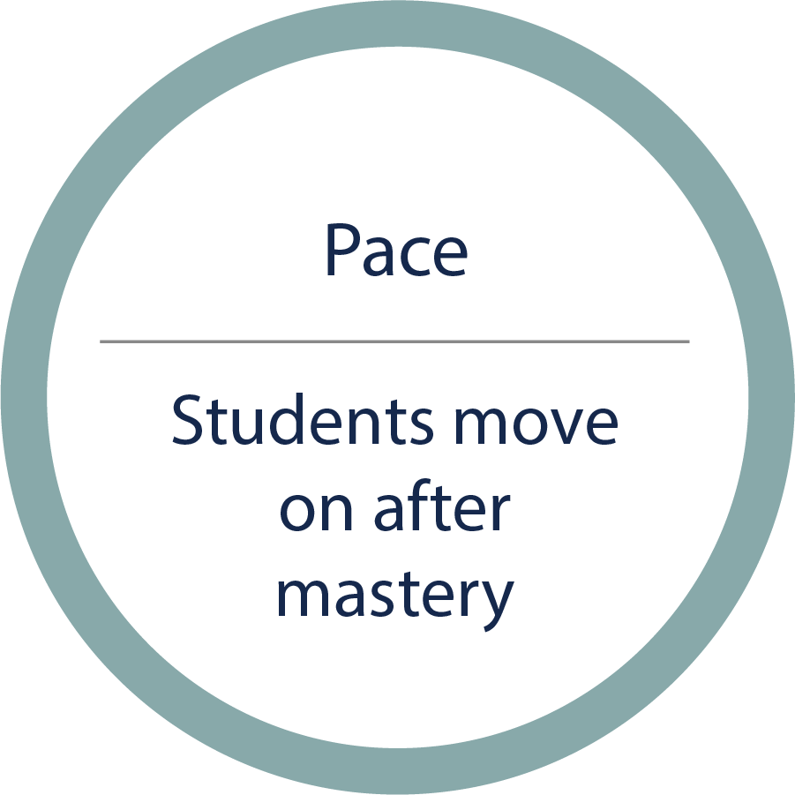
Pace
Students work at the speed it takes for them to learn.⁵
⁵ Levine, E. & Patrick, S. (2019). What is competency-based education? An updated definition. Aurora Institute. https://aurora-institute.org/resource/what-is-competency-based-education-an-updated-definition/
Loyd, E., Prante, M., & Messinger, L. (2017). Evaluation of Charlotte‐Mecklenburg schools personalized learning initiative—year 2. Charlotte‐Mecklenburg Schools. Retrieved from http://pl.cmslearns.org/wp-content/uploads/2014/04/PL-Evaluation-Year-2_FINAL_7.6.17.pdf
Bill & Melinda Gates Foundation. (2014). Early progress: Interim research on personalized learning. Retrieved from http://k12education.gatesfoundation.org/resource/early-progress-interim-research-on-personalized-learning/

Slide 10
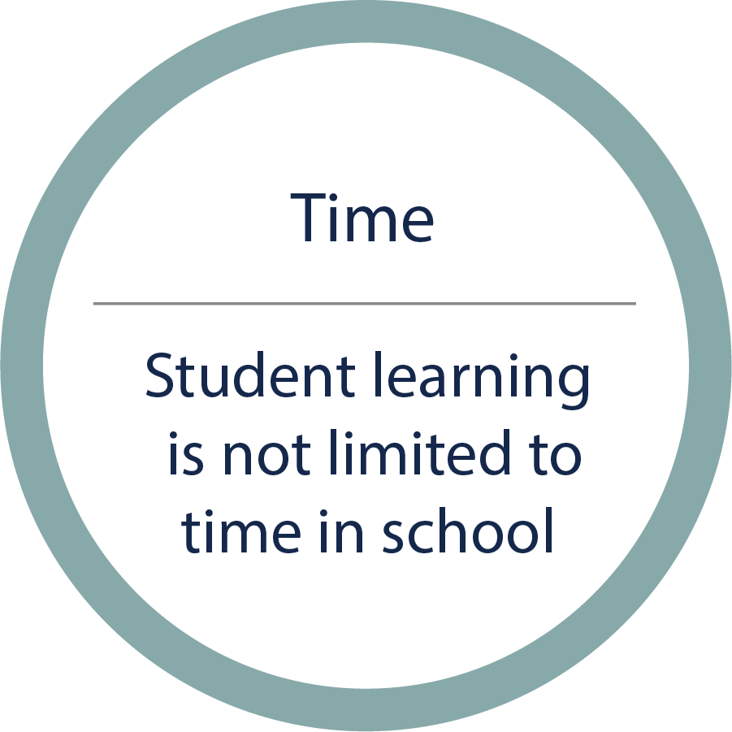
Time
Students learn at any time of day.⁶ Students need to rest, eat, exercise, socialize, and learn in formal and informal ways.⁷
⁶ Pane, J., Steiner, E., Baird, M., & Hamilton, L. (2015). Continued progress: Promising evidence on personalized learning. RAND Corporation. Retrieved from https://www.rand.org/pubs/research_reports/RR1365.html
⁷ U.S. Bureau of Labor Statistics. (2018). 2017 American Time Use Survey [Data set]. Retrieved from https://www.bls.gov/tus/#tables

Slide 11
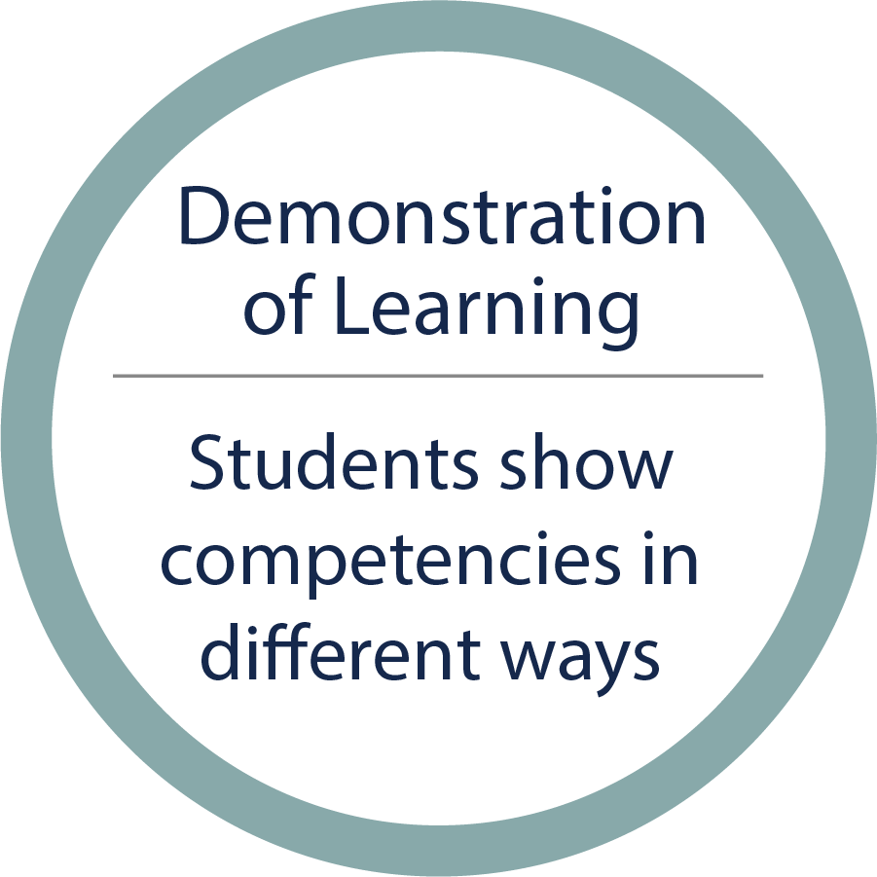
Demonstration of Learning
Students have a variety of ways to show mastery.⁸ Common expectations and rubrics can help students know what they have learned.⁹
⁸ Levine, E. & Patrick, S. (2019). What is competency-based education? An updated definition. Aurora Institute. https://aurora-institute.org/resource/what-is-competency-based-education-an-updated-definition/
⁹ Kansas State Department of Education. (2020). Navigating change: Kansas’ guide to learning and school safety operations. Retrieved from https://www.ksde.org/Teaching-Learning/Resources/Navigating-Change-Kansas-Guide-to-Learning-and-School-Safety-Operations

Slide 12
Activity-
Review the definition (PL and Flexibilities), review the 5 trends from PL Research, and review ‘Competencies’ as laid out in Navigating Change.
Think:
How do these three items align?
What differences exist?
What are small steps you can take now?
What areas need more exploration?

Slide 13
Definition of Personalization
Personalizing learning places the whole child at the center of instruction. It is informed by strong educator/student/ family relationships to provide equity and choice in time, place, path, pace, and demonstration of learning.

Slide 14
Five Commonalities from Research on Personalized Learning
Student agency, which can include student voice, setting goals, and some degree of choice
Progression based on mastery of competencies rather than duration of study
Knowledge of both content and students, derived from relationships, informing teacher decisions
Flexibility in the learning environment
Integration of social, emotional, and academic development
(Basham et al., 2016; Bill & Melinda Gates Foundation, 2014; Connor et al., 2017; Loyd et al., 2017; Pane et al., 2015)
Notes:
Put together by our Comprehensive Center for Technical Support.
Research Brief- https://www.ksde.org/Portals/0/Communications/KC_School_Redesign/KansansCan%20Cadre%20Training.PersonalizedLearningReferences.2020.08.06%20(1).pdf?ver=2021-02-23-082813-900

Slide 15
Navigating Change- Competencies
Meaningful learning (for example, see Grade Band 9–12, Competencies, Overview page)
Broadly stated (for example, see Grade Band P-K–2, Competencies, Overview page)
Something that may cross content boundaries (for example, see Grade Band 3–5, Implementation, Overview [Competency Codes Narrative] page)
Something a student can describe getting better at (for example, see Grade Band 3–5, Assessment, Science, Extended: Chemical Reactions)
Sometimes designed with the end in mind (for example, see Grade Band 6–8, Assessment, EL Mathematics, Overview page)
Built from standards (for example, see Grade Band 3–5, Competencies, Overview page)
A fixed goal with flexible entry paths and ways to demonstrate (for example, see Grade Band 6–8, Competencies, Overview page)

Slide 16
Day 2
Deeper Dive

Slide 17
Activity-
Given the prominence of “equity” and “choice” in the definition of personalization, create analyses of particular decisions in light of their likelihood to advance those values.
Face-to-Face: Use a single chart for placing post-it notes along the axes after table discussions on the challenges.
Interactive Slides/Menti:
Use the item that enables participants to move items along two axes. Use “ameliorates disadvantage” and “exacerbates inequality” on one axis labeled “equity” and use “inflexible” and “custom” on the axis labeled “choice.”
Generate sample decisions and challenges to consider.
For greater value, prepare the decisions in advance with relevant equity data, and use actual challenges rather than samples.

Slide 18
Sample Decisions: Path
When a student chooses an essay topic.
When a teacher finds a student a book like the last one they enjoyed.
When a school organizes the science department by module rather than course.

Slide 19
Sample Decisions: Place
When a student watches the teacher modeling from home (comfortable chair and headphones, watching at 2x speed).
A teacher prompting for student experiences regarding a science topic, giving credit for prior knowledge, customizing remaining coursework accordingly.
When a school partners with local organizations to provide free internet to families.

Slide 20
Sample Decisions: Pace
When a student submits a second marketing plan (assignment was to complete one) because they had two ideas they liked.
When a teacher holds check-in meetings with students regarding progress on student-set goals.
When a school teams teachers across a grade band for flexible student groups.

Slide 21
Sample Decisions: Time
When a student waits until the end of the semester to do all assignments.
When a teacher holds a morning circle in which students can share what is on their mind.
When a school has a few teachers report late and stay late so that students who work evenings can report/login to school at a different time.

Slide 22
Sample Decisions: Demonstration of Learning
When a student asks if presenting at parent night can count for the grade.
When a teacher presents a menu of written work product options, asking students to choose two.
When a school provides support for rubric building during teacher collaborative time.

Slide 23
Activity-
Select one challenge/question identified.
Brainstorm several possible responses to the question.
Then complete the analysis of the equity and choice potential for each response as one consideration for deciding which to prototype.

Slide 24
Brainstorming Rules
One conversation at a time
Go for quantity
Headline!
Build on the ideas of others
Encourage wild ideas
Be visual
Stay on topic
Defer judgment (no blocking)

Slide 25
Considerations: Path
How do we account for students taking different paths, compared to progressing altogether by grade for a content area?
How to manage multiple students at different points in their learning?
How best to gather and ameliorate the condition when a student does not have access to experience-based learning?
How to engage and build students' skills to own their own learning?
Teachers want students to be co-creators, but they have become comfortable with others bringing the information to them. How do we teach students to be owners of their learning?
How do teachers determine the starting points of students?
How can flexibility be demonstrated when trying to take courses (e.g., subbing CTE for required courses)?
How do we focus on learners’ individual strengths and areas of natural giftedness?

Slide 26
Considerations: Place
How would a teacher simultaneously engage and manage both in-class and remote students?
How best to build student relationships when they are in a remote learning setting?
How do we address social-emotional concerns remotely?
Real-world application through internships and sample projects – How can students build something the community needs (and have the community respond to its use)?
Let’s work more with our communities to build capacity (e.g., senior centers, community centers, churches) so students have other places to learn.
How best to ensure the quality of online student work is equal to work products produced when in school?
How do we work with families to discover hidden talents/mentors for specific interests?

Slide 27
Considerations: Pace
How best to help teachers discern when and how much students need their help and support, when to press, and when to let them work on their own?
If a student is to move on, how do we define mastery and know they are ready to move on?
How long should students work on assignments before moving them to the next lesson?

Slide 28
Considerations: Time
How do teachers address Individual Education Plans (IEP) time constraints when the student is remote?
What options are there to meet the six-hour daily mandate for students in a remote setting?
What requirements for time spent on learning should we place if any? (e.g., one district requiring 8A–4P)

Slide 29
Considerations: Demonstration of Learning
How to measure student learning when it is a performance assessment (e.g., music, PE, CTE)?
How to address group-learning, activities (e.g., music, PE) when students are remote?
How do you resource project-based learning from low income households?
What is an appropriate remote demonstration of learning?
What does it mean to meet mastery—individually versus as a group?
How to ensure each student has opportunities given their own circumstances?
How to help teachers understand and know how to model competency-based learning?

