Slide 1
Council of Superintendents September 2021
Dr. Randy Watson, Kansas Commissioner of Education

Slide 2
Our Vision for Kansas ...
Kansas leads the world in the success of each student

Slide 4
Kindergarten Readiness
To advance kindergarten readiness, all accredited Kansas elementary schools are required to partner with families to administer both the Ages & Stages Questionnaires®, Third Edition (ASQ-3) and Ages & Stages Questionnaires®: Social-Emotional, Second Edition (ASQ:SE-2) to kindergarten students by September 20, 2021.
All data (including pending Family Access screenings) must be submitted in ASQ Online by October 11, 2021. Schools do not need to send additional data to the state once they have entered it into ASQ Online.
Support is available, at agesandstages.com/ks/ and by emailing Jordan Christian, jchristian@ksde.org.

Slide 5
Dental Screenings
The Bureau of Oral Health has implemented a statewide oral health screening program to satisfy The Kansas State Statute for Annual Dental Inspection (K.S.A.72-5201).
email KBOH@ks.gov or call our Outreach Dental Hygienist at (785) 368-8264 for more information.

Slide 6
Preventive measures | 3 tools to keep schools safely open
Vaccination
Testing
Masking
Reduces risk of infection among eligible youth; reduces risk of exposure for ineligible or otherwise unvaccinated youth
Coupled with contact tracing, helps schools stay open through early identification of cases and mitigation of potential outbreaks
Reduces chance of transmission among vaccinated and unvaccinated students, mitigating risk of outbreaks
Note: The FDA has granted emergency use authorization for the Pfizer-BioNTech vaccine for those 12-15 years of age. The Pfizer vaccine has full FDA approval for those 16 years of age and older.

Slide 7
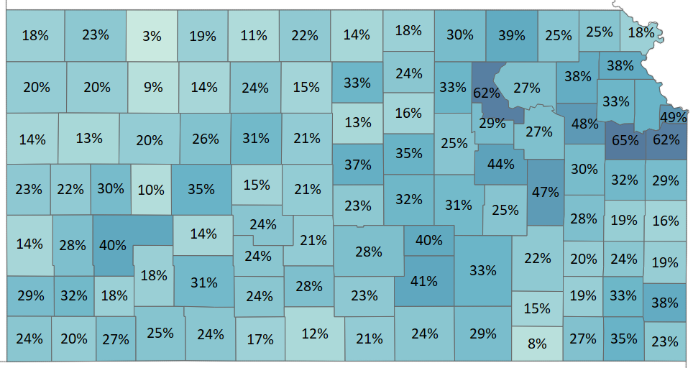
Vaccination | Youth vaccination rates by County
1+ dose vaccination rate among eligible youth population, by County¹
As of 9/17
Population of 12-to-17-year-olds unevenly distributed across Kansas; wide disparity in vaccination rates
Johnson, Douglas and Riley Counties exceed national youth Vx rate
Johnson County has highest gross eligible youth population and second-highest vaccination rate at 62%
Sedgwick County has similar gross youth population, but only 41% vaccination rate among youths
1. 1st dose only among 12-to-17-year-olds, who are eligible only for Pfizer vaccine, 2. Based on 2020 Census data, 3. May exclude Vx administered by federally-enrolled pharmacies
Source: U.S. Census (2020); KDHE Epidemiology data as of 9/8

Slide 8
Testing | Rate of application for funding and ongoing testing
+X
+Xpp
= WoW gross increase
= WoW percentage point increase
School Districts seeking testing funding
As of 9/16, both Public and Private schools
Children affected in each group
As of 9/16 (000s of children, %)¹, Public schoolkids only
Takeaways
307
491
Since last week, additional 7 School Districts submitted budgets for testing
Responses were fielded from additional 2 School Districts
Like last week a total of 19% of students across KS attend School Districts that have not responded (11%) or are not interested (8%)
35 (11%)
37 (8%)
38 (12%)
53 (11%)
184 (60%)
50 (16%)
359 (73%)
42 (8%)
359 (73%)
Drafted, submitted, or approved
Interested
No response
No interest
Total
Drafted, submitted, or approved
Interested
No response
No interest
Total
+7
+2pp
-4
-2pp
-2
-1pp
-1
-1pp
+2K
+0pp
-1K
-1pp
-1K
+0pp
-1K
+0pp
1. Total child numbers only include Public School children (286 schools), excluding ~26K children attending private schools; Note: Change in responses metrics may not sum to 0 due to rounding.

Slide 9
Testing | School Districts' reporting on testing metrics
Tests conducted last week
As of 9/16
Key takeaways
Only 100 School Districts reporting testing numbers; remainder are either not testing or failing to report to KDHE
Nearly all School Districts reporting tests are using antigen tests
~800 total cases reported across 74 districts
PCR
Antigen
Total
Positives
5.6K
28 districts
8.6K
96 districts
14.2K
100 districts
0.8K
74 districts

Slide 10
Masking | Mask mandates by School District and % of total KS youth pop.
+X
+Xpp
= WoW gross increase
= WoW percentage point increase
Mask policy metrics
As of 9/20
School Districts¹
Schoolkid population (K)²
Encouraged but not required
76 (25%)
+3
+1pp
82 (17%)
+6
+2pp
Required for all students
39 (13%)
+2
+1pp
179 (37%)
+4
+1pp
Required for most, but not all students
10 (3%)
+1
+0pp
30 (6%)
+1
+0pp
No mask policy
24 (8%)
+2
+1pp
18 (4%)
+1
+1pp
No response or unknown
158 (51%)
-8
-3pp
183 (37%)
-12
-3pp
Total
491
1. Includes results submitted by 10 individual schools outside of Public School system (e.g. Catholic schools, other private schools), 2. Numbers only include Public School children (286 schools), excluding ~26K children total; those private-school children also excluded from total bar Question text: What is your district's mask policy for students? Answers, top to bottom: Masks are encouraged but not required for students; Masks are required for all students; Masks are required for most, but not all students; No mask policy at this time

Slide 11
Backup | Detail on outbreaks
What are outbreaks?
How are they identified & reported?
What gets published?
Definition: Two or more cases where the transmission happened while in school
When a school has students/teachers/staff etc. out of school in isolation due to COVID-19, it’s not necessarily an outbreak
If transmission occurred in school, only then is it considered an outbreak
Outbreak is considered over when two incubation periods (i.e. 28 days) have passed with no additional infections
Local health departments and schools report outbreaks to KDHE and communication between these entities is crucial
When there is a case being investigated, the investigator tries to trace where exposure could have occurred in the last 14 days.
If a case does not state that they were potentially exposed at school, then there’s no outbreak report is submitted
When news reports about classrooms isolating or closing arise, KDHE reaches out to LHDs to find out if there are any possible outbreaks that they have not been notified
Names of locations that have five or more COVID-19 cases with symptoms onset in the last 14 days.
It is removed once a location no longer has five or more COVID-19 cases with symptoms

Slide 12
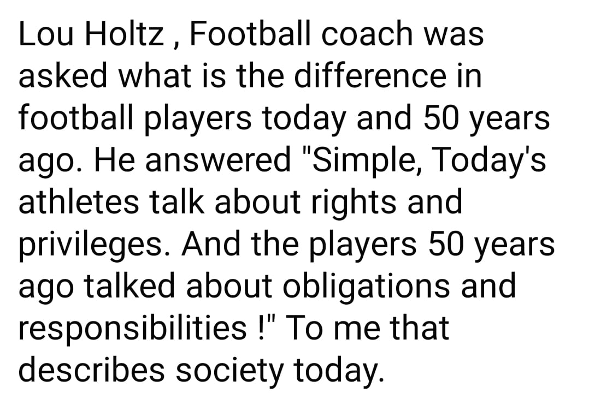

Slide 13
Notes:
Today’s students are the future workforce and future leaders of Kansas. Kansans Can achieve anything and, together, Kansans Can lead the world in the success of each student.

