Slide 1
How much could Kansas save if we invested in high-quality early childhood education?
Brad Neuenswander & Tony Moss September 2014
Government Efficiency Committee

Slide 2
The brain is sculpted by experience, especially in the first 5 years. This foundational architecture shapes some capacities for life.

Slide 3
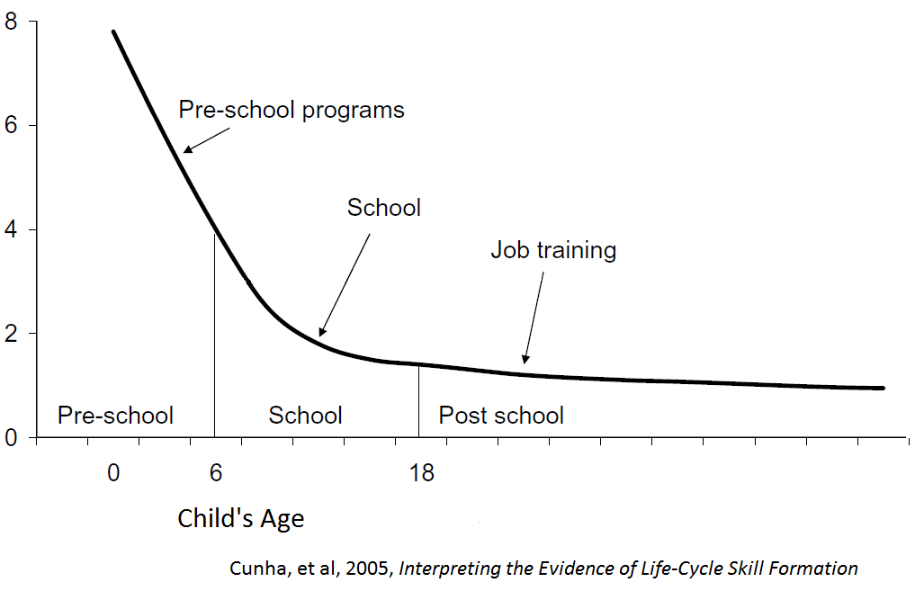
Because experience shapes the brain and other systems in this early, formative period, early childhood is the most cost-effective period for improving long-term health and educational achievement. High-quality early childhood returns 3 times as much as school investments, and 8 times as much as adult remediation programs.
return
per $1
invested
Notes:
In practical terms, the sensitivity and plasticity of early childhood makes it the most cost-effective period in which to invest. In as much as development can be optimized, we can prevent the loss of potentials, and many bad, and expensive outcomes.

Slide 4
An Example of Long-Term Savings from the Perry Preschool Project
Notes:
Criminal Justice and Social Service policymakers should be natural allies in advocating for high-quality, well-placed early childhood education and care.

Slide 5
But current American investments miss this opportunity:
Notes:
But, compared to many of our economic competitors, U.S. educational spending is missing this opportunity. We spend one-and-a-half times the average of other wealthy countries on school-age children—about $12,000 per pupil per year nationally--but almost nothing on very young children, though that is where we would get the most benefit from our investments. (See “Choose your parents wisely,” in The Economist, July 26th, 2014, 21-25.)
We miss another opportunity in that our school curricula do not teach young people the basics of child development, good parenting, and healthy family life. Some of this blindness to practicality is ideological: conservatives know that parents and families matter, but want all the responsibility for whatever goes wrong to be blamed on the parent, and to avoid any public spending obligations. Liberals tend to be in favor of public investments in early childhood, but want to avoid holding parents responsible for the investments made in their children or the lack of them.
Sources:
Heckman, James, “Lessons from the Technology of Skill Formation,” University of Chicago (Jan. 2005)
America’s Promise, “Every Child, Every Promise”
Heckman, J. and Cunha, F., “Investing in Our Young People,” University of Chicago, University College Dublin, The American Bar Association (Nov. 2006)

Slide 6
Re-allocation toward prevention rather than remediation would make government more much more efficient.

Slide 7
Because of the long time-horizon, the Return-on-Investment grows larger as participants become adults.
Notes:
Sources: Karoly, L.A., et al, Investing in our children: What we know and don't know about the costs and benefits of early childhood interventions (Rand Corporation, 1998); and Bruner, C., et al, Seven Things Policy Makers Need to Know about School Readiness (Child and Family Policy Center, 2005); and Reynolds, A.J., et al, Age-26 cost benefit analysis of the Child-Parent Center Early Education Program, Child Development, 2011, 82 (1).

Slide 8
Chicago Child-Parent Centers (CPC) are the most realistic model for states.
One of the largest, publically-funded (Title I) early childhood interventions.
4 decades of operation.
20 CPCs in lowest income neighborhoods of Chicago.
Depending on the methods used, and the age of the participants, the per-dollar return on investments have run from $7 at age 19 to $22 at age 26.
Even larger returns might be realized by experiments in the design, e.g. coupling with a visiting nurse program; adding a Thirty-Million-Words curriculum; starting at age 1 or 2 through age 3 or 4.

Slide 9
Factors in Benefit / Cost Analysis:
Targeting: e.g. larger benefits generally accrue to the most disadvantaged; targeting both mother and child may be more effective.
Time-horizon: recovery of costs, e.g., lower crime, is realized years after the intervention. Following participants longer, into adulthood, is more likely to show larger benefits.
Including the benefits to the mother, e.g. employment earnings, educational levels, savings, lower-crime, should be included in the benefit ratio.
Quality of program personnel, developmental timing of the intervention, and duration, e.g. earlier language interventions, ages 1 through 4, may have larger effects than later interventions, ages 4 through 5.

Slide 10
Example: Carolina Abecedarian Project
111 infants born between 1972 & 1977
Random assignment, treatment group in preschool for 5 years, 6 to 8 hrs. / day, 5 days per week
Game-based activities that cultivated social, emotional, and cognitive development, especially language
Control group got nutritional supplements, social services and health care

Slide 11
Abecedarian Results at age 21:
Half-year more education
42% vs. 20% continuing their education
36% vs. 14% attending college
47% vs. 27% in skilled jobs
26% vs. 45% teen parents
Mothers of participants, esp. those who were teen moms, achieved higher education and employment status

Slide 12
While benefits / costs are greater than $4 to $1, and are still accumulating, they weren’t as large as the Chicago Child-Parent Centers.
Program ran from infancy through age 5 (more expensive).
University personnel so much higher personnel costs ($73 K per child)

